Slide 1
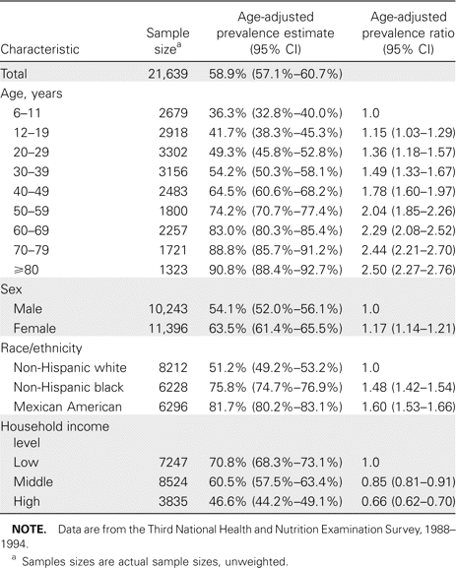
Table 1 Age-adjusted cytomegalovirus (CMV) seroprevalence in the noninstitutionalized, civilian population of the ...
Notes:
Table 1 Age-adjusted cytomegalovirus (CMV) seroprevalence in the noninstitutionalized, civilian population of the United States, aged ⩾6 years.
Unless provided in the caption above, the following copyright applies to the content of this slide: © 2006 Infectious Diseases Society of America

Slide 2
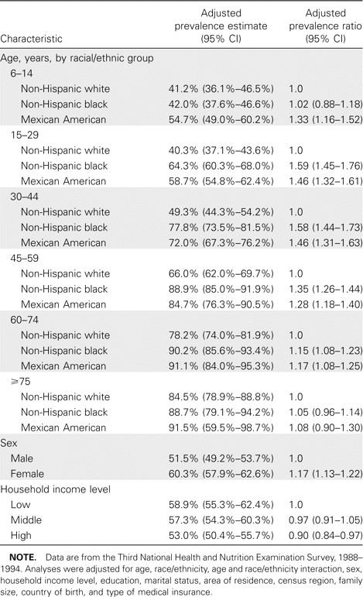
Table 2 Multivariate analysis of cytomegalovirus (CMV) seroprevalence in the noninstitutionalized, civilian ...
Notes:
Table 2 Multivariate analysis of cytomegalovirus (CMV) seroprevalence in the noninstitutionalized, civilian population of the United States, aged ⩾6 years (n = 21,639).
Unless provided in the caption above, the following copyright applies to the content of this slide: © 2006 Infectious Diseases Society of America

Slide 3
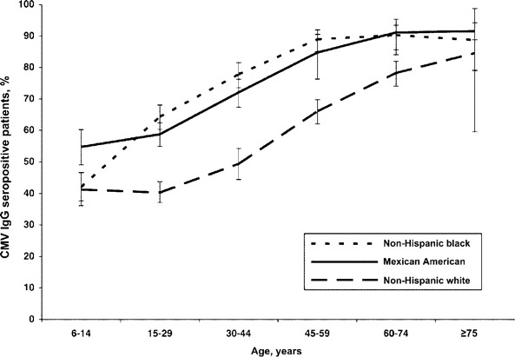
Figure 1 Data from the Third National Health and Nutrition Examination Survey, 1988–1994, showing results of testing ...
Notes:
Figure 1 Data from the Third National Health and Nutrition Examination Survey, 1988–1994, showing results of testing for seroprevalence of cytomegalovirus (CMV), by age and race. Data were adjusted for sex, household income level, education, marital status, area of residence, census region, family size, country of birth, and type of medical insurance.
Unless provided in the caption above, the following copyright applies to the content of this slide: © 2006 Infectious Diseases Society of America

Slide 4
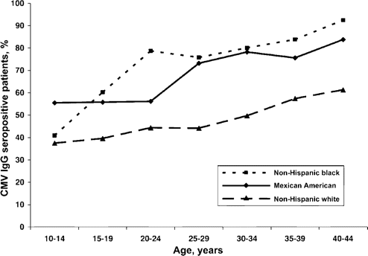
Figure 2 Data from the Third National Health and Nutrition Examination Survey, 1988–1994, showing results of testing ...
Notes:
Figure 2 Data from the Third National Health and Nutrition Examination Survey, 1988–1994, showing results of testing for seroprevalence of cytomegalovirus (CMV) in women of childbearing age, by age and race. Data were adjusted for household income level, education, marital status, area of residence, census region, family size, country of birth, and type of medical insurance.
Unless provided in the caption above, the following copyright applies to the content of this slide: © 2006 Infectious Diseases Society of America

Slide 5
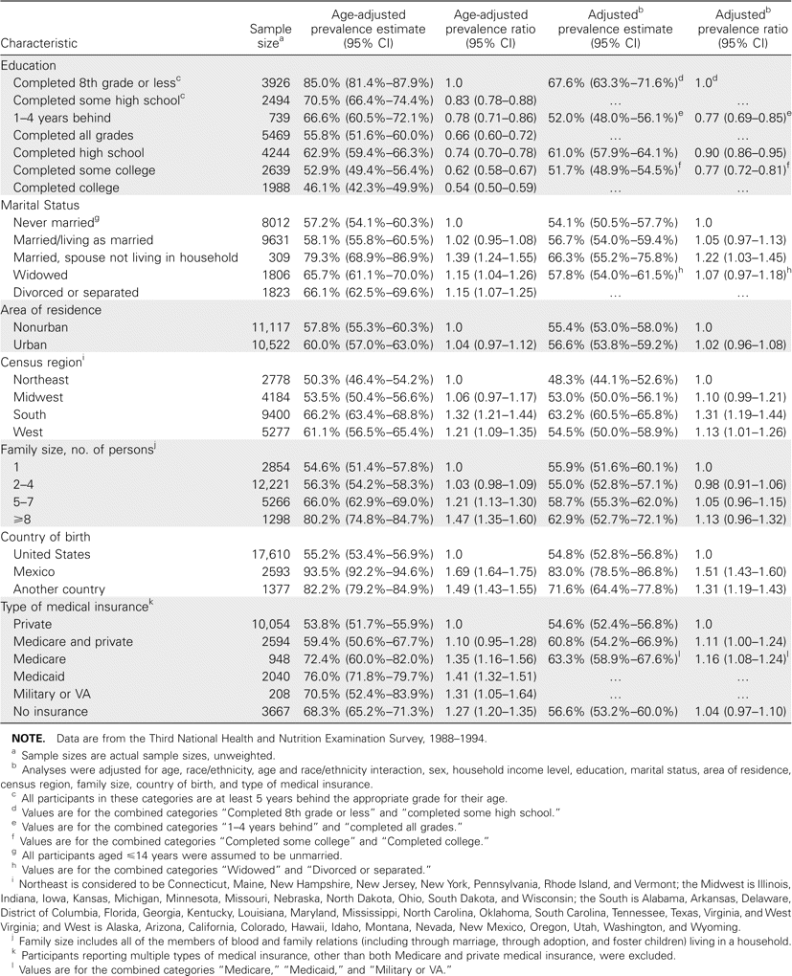
Table 3 Other demographic risk factors and cytomegalovirus (CMV) seroprevalence in the noninstitutionalized, civilian ...
Notes:
Table 3 Other demographic risk factors and cytomegalovirus (CMV) seroprevalence in the noninstitutionalized, civilian population of the United States, aged ⩾6 years (n = 21,639).
Unless provided in the caption above, the following copyright applies to the content of this slide: © 2006 Infectious Diseases Society of America

