Slide 1
Box 1 Database: Ovid MEDLINE, 1950 to Week 2, August 2010
Notes:
Box 1 Database: Ovid MEDLINE, 1950 to Week 2, August 2010
Unless provided in the caption above, the following copyright applies to the content of this slide: © Royal Society of Tropical Medicine and Hygiene 2010

Slide 2
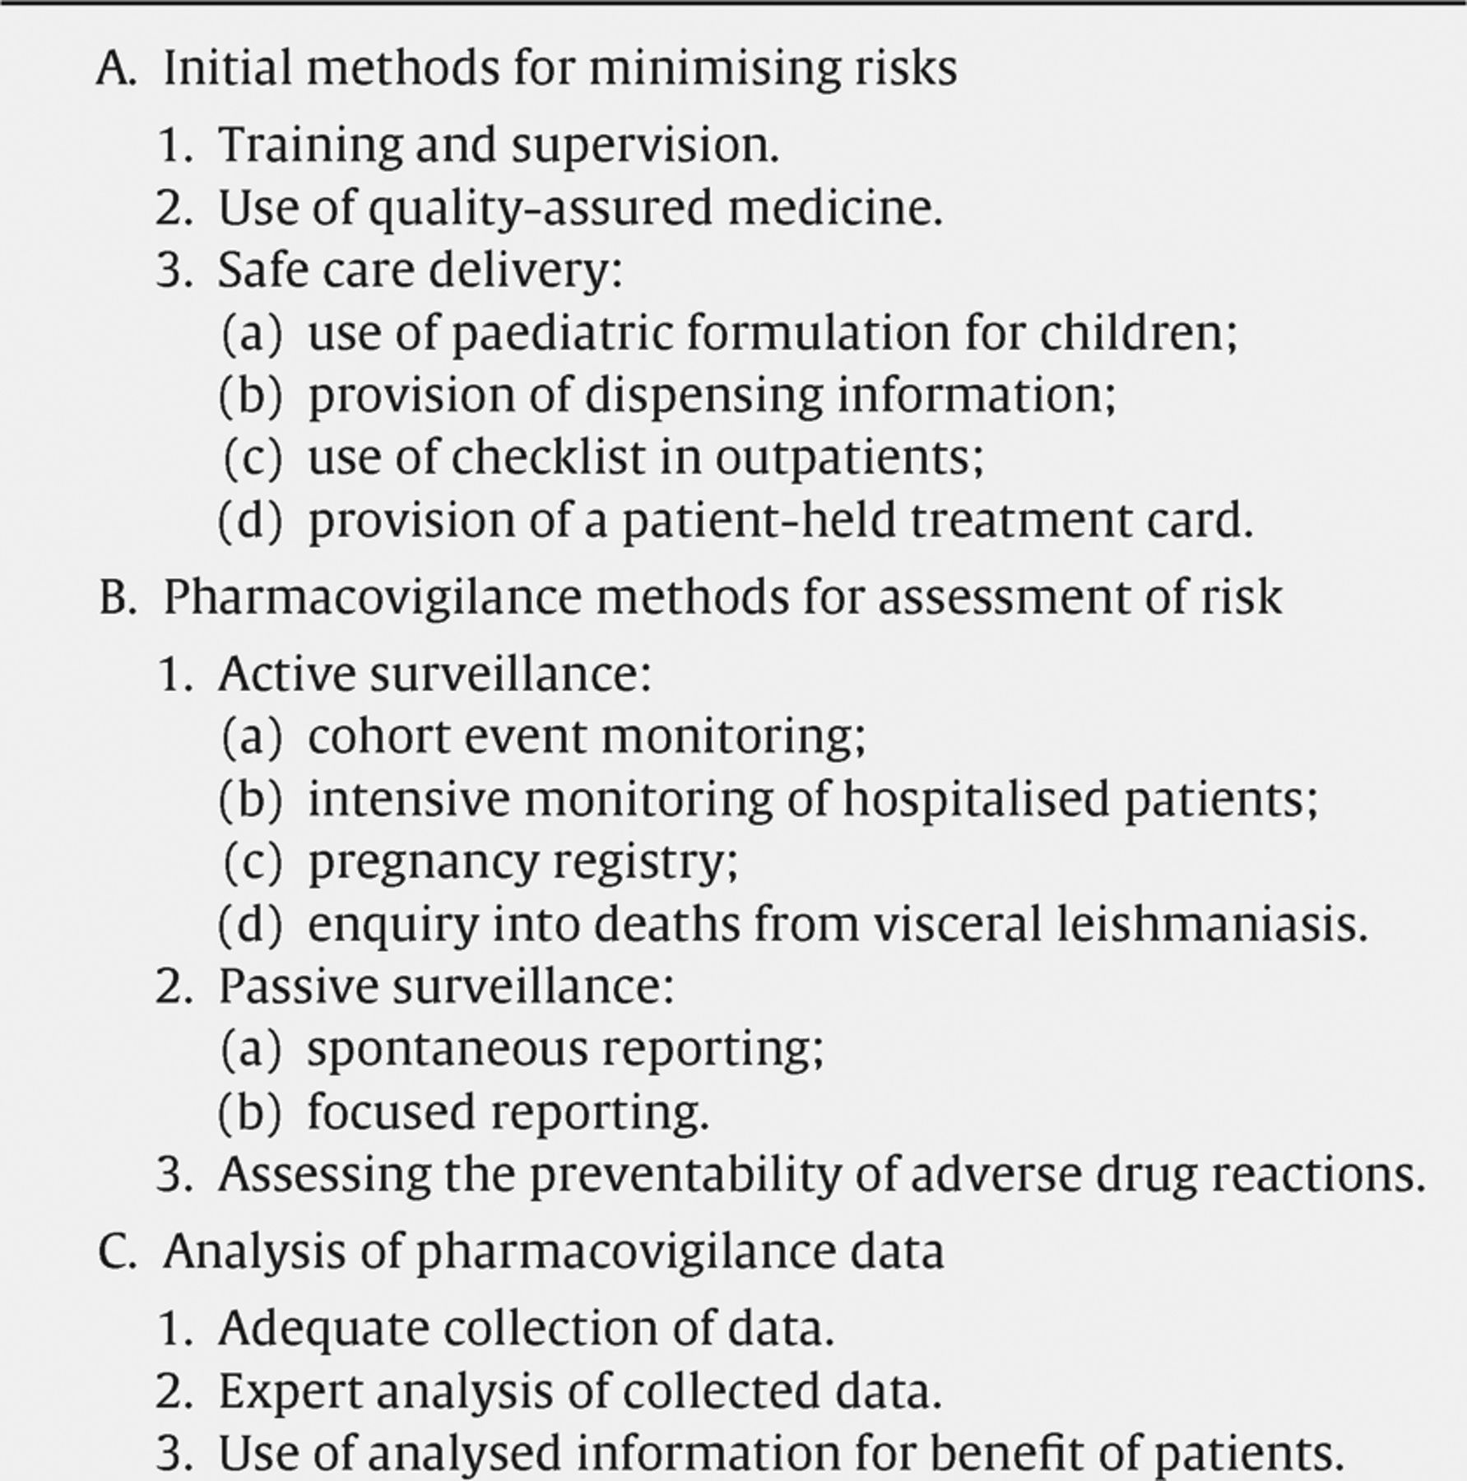
Box 2 Pharmacovigilance methods and risk minimisation
Notes:
Box 2 Pharmacovigilance methods and risk minimisation
Unless provided in the caption above, the following copyright applies to the content of this slide: © Royal Society of Tropical Medicine and Hygiene 2010

Slide 3
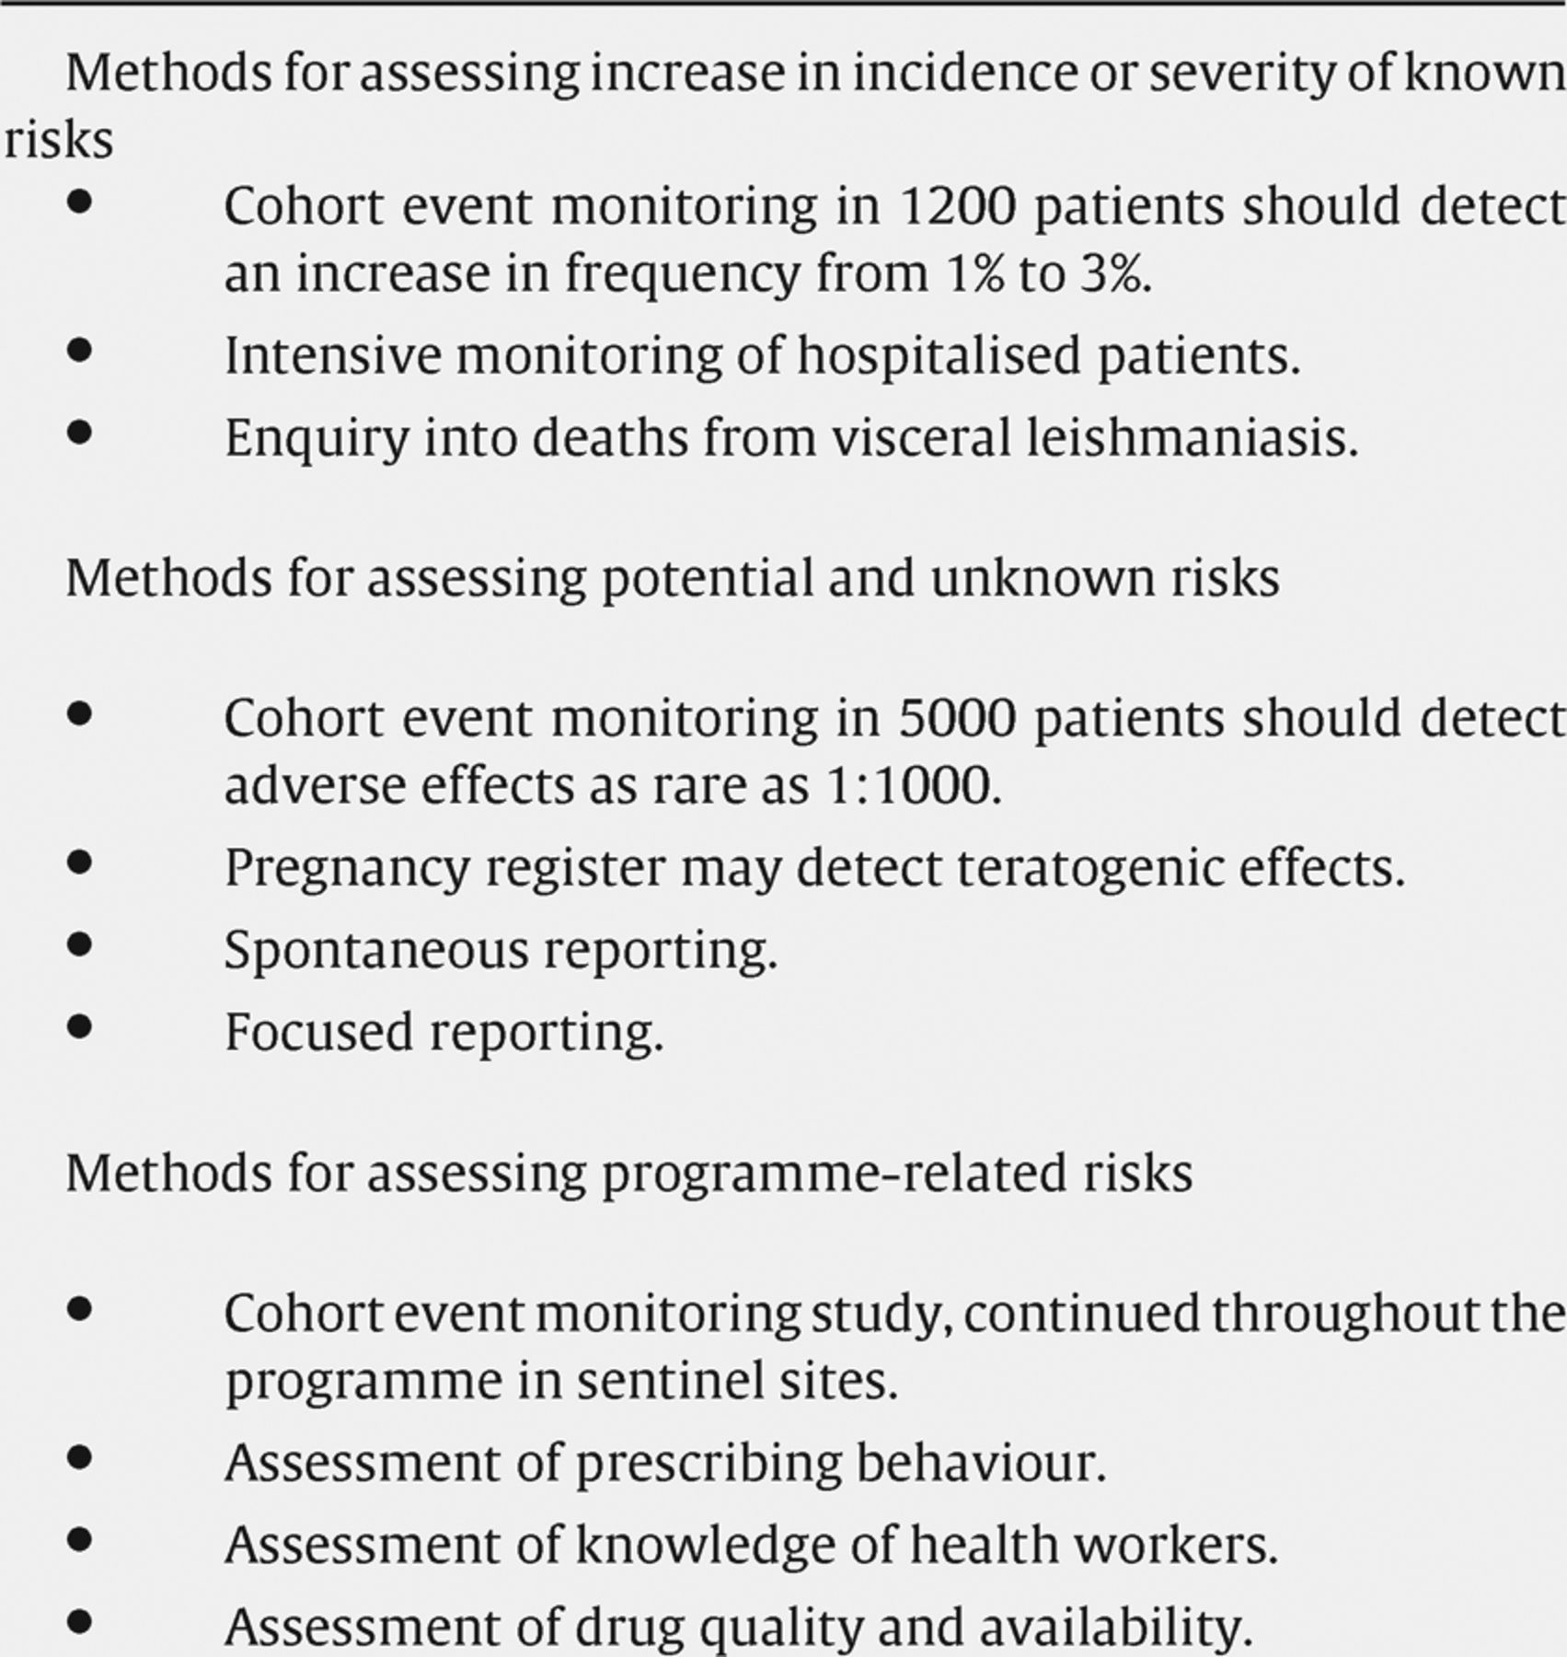
Box 3 Studies to assess specific risks
Notes:
Box 3 Studies to assess specific risks
Unless provided in the caption above, the following copyright applies to the content of this slide: © Royal Society of Tropical Medicine and Hygiene 2010

