Slide 1
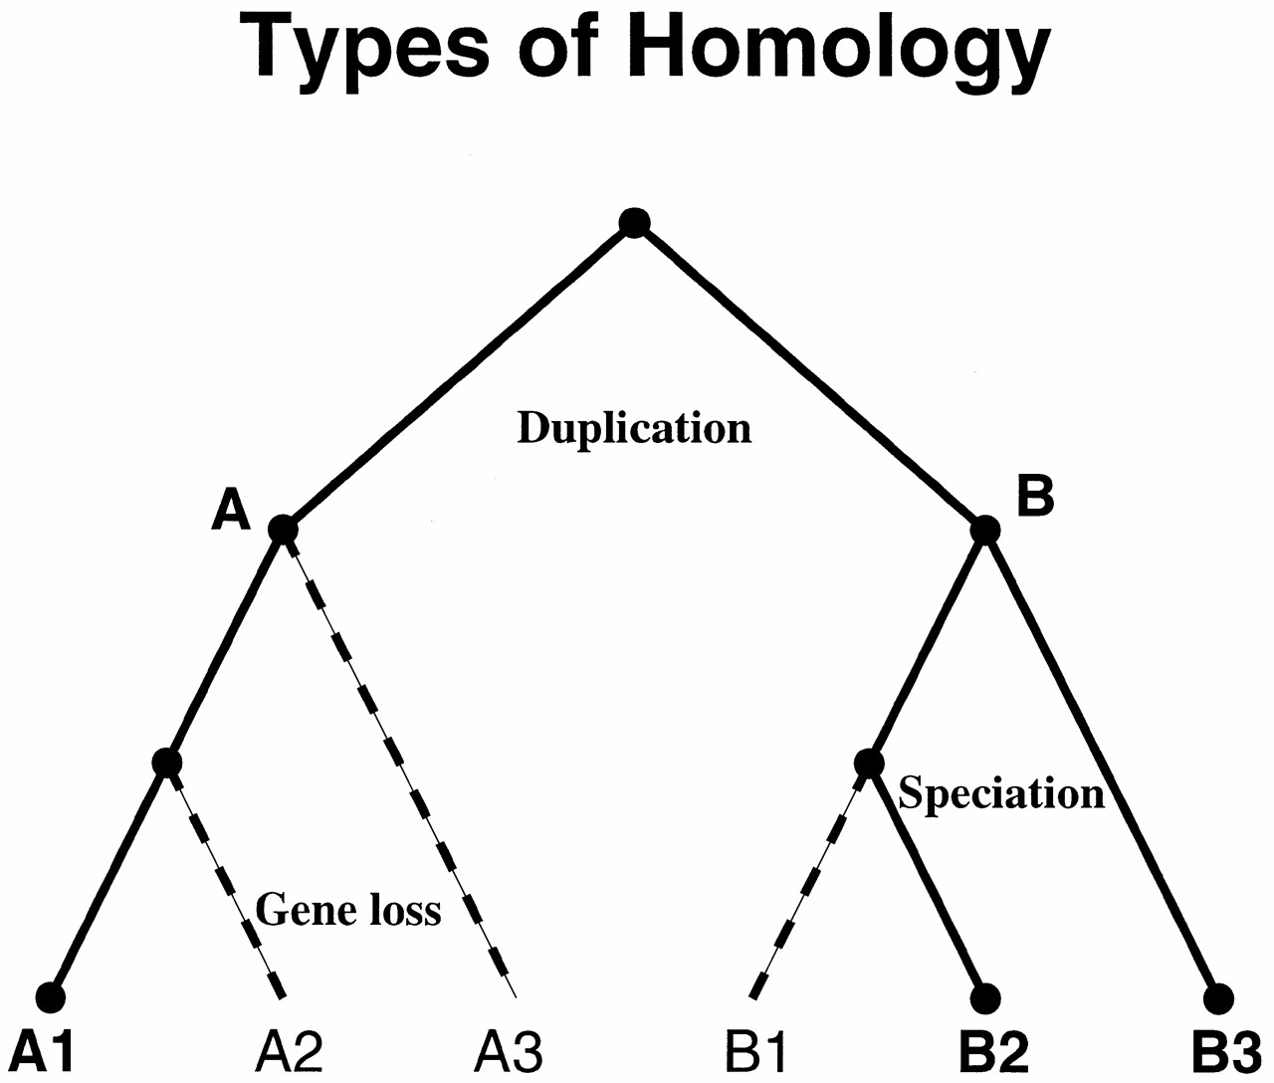
Figure 1. Homology relationships can be classified by evolutionary history, as shown in this model ...
Notes:
Figure 1. Homology relationships can be classified by evolutionary history, as shown in this model phylogenetic tree. The ancestral node, or root, is at the top. Duplication creates paralogs A and B with distinct function. Speciation creates an orthologous set A1, A2 and A3 from A, and B1, B2 and B3 from B. If B1, B2 and B3 share the same function, they are equivalogs as well as orthologs. Dashed lines indicate a possible pattern of gene loss that leaves only A1, B2 and B3. The resulting protein subfamily should exhibit bi-directional best hits across species but is not orthologous and does not show conserved function.
Unless provided in the caption above, the following copyright applies to the content of this slide:

