Slide 1
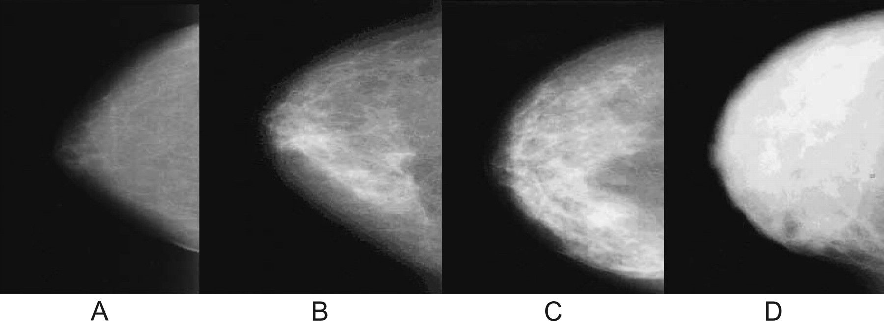
Figure 1 Breast density patterns. A ) BI-RADS I = fatty breast (<25% dense). B ) BI-RADS II = scattered densities ...
Notes:
Figure 1 Breast density patterns. A ) BI-RADS I = fatty breast (75% dense). BI-RADS = Breast Imaging Reporting Data System.
Unless provided in the caption above, the following copyright applies to the content of this slide: © The Author 2009. Published by Oxford University Press.

Slide 2
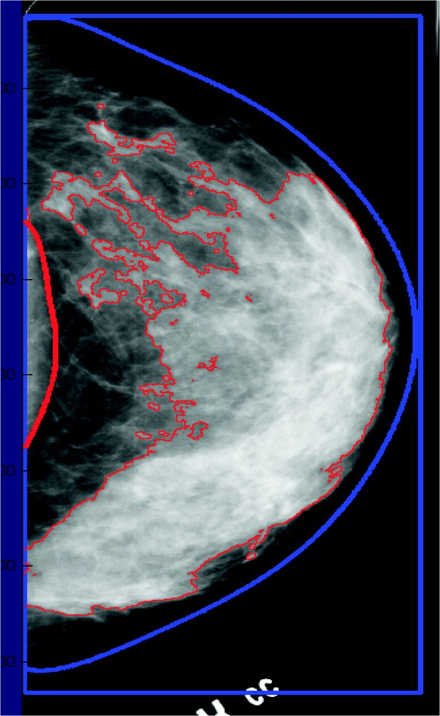
Figure 2 Illustration of the quantitative estimation of breast density from a digitized image of a mammogram. The ...
Notes:
Figure 2 Illustration of the quantitative estimation of breast density from a digitized image of a mammogram. The image of the breast is outlined, and the areas that exceed any certain threshold value of density are also outlined. Percent density is calculated as [(dense area%total area) x 100]. Dense tissue in this breast area of this mammogram accounts for 48% of its area.
Unless provided in the caption above, the following copyright applies to the content of this slide: © The Author 2009. Published by Oxford University Press.

Slide 3
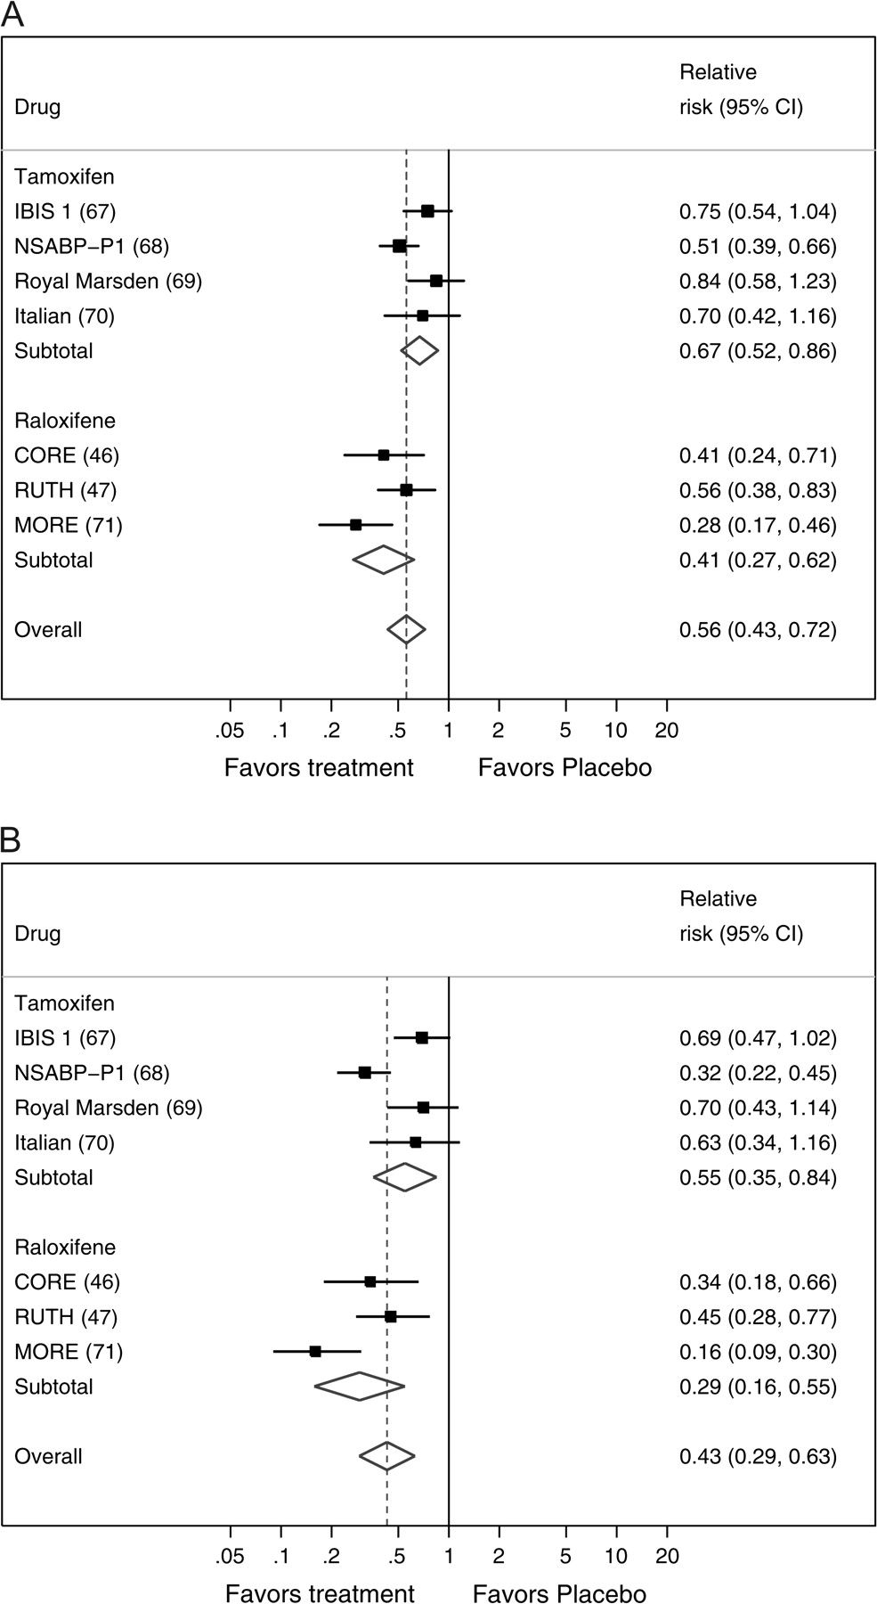
Figure 3 Forest plots of the risk of breast cancer from placebo-controlled trials of tamoxifen or raloxifene, with ...
Notes:
Figure 3 Forest plots of the risk of breast cancer from placebo-controlled trials of tamoxifen or raloxifene, with pooled estimates overall and for each treatment separately. A ) All invasive breast cancer. B ) Estrogen receptor–positive invasive breast cancer. The solid squares are centered on the point estimate from each study, and the horizontal line through each square represents the 95% CI for the study estimate. The size of each square represents the weight of the study in the meta-analysis. The center of each diamond represents the summary estimate of the effect size, and the horizontal tips represent the 95% CI. The solid vertical line corresponds to no effect, and the dashed vertical line corresponds to the summary estimate. CI = confidence interval.
Unless provided in the caption above, the following copyright applies to the content of this slide: © The Author 2009. Published by Oxford University Press.

