Slide 1
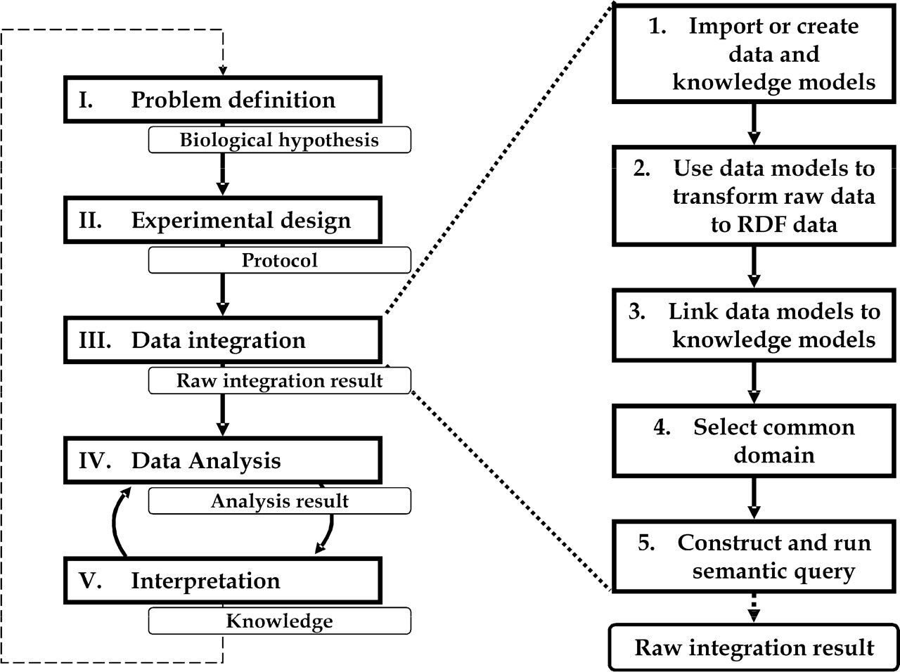
Fig. 1. Integrative bioinformatics experimentation cycle with five distinct phases. At the end of a phase, an outcome ...
Notes:
Fig. 1. Integrative bioinformatics experimentation cycle with five distinct phases. At the end of a phase, an outcome is generated that is input for the next phase. Our semantic data integration approach is applied to phase II, which can be further divided into five steps.
Unless provided in the caption above, the following copyright applies to the content of this slide: © 2007 The Author(s)This is an Open Access article distributed under the terms of the Creative Commons Attribution Non-Commercial License (http://creativecommons.org/licenses/by-nc/2.0/uk/) which permits unrestricted non-commercial use, distribution, and reproduction in any medium, provided the original work is properly cited.

Slide 2
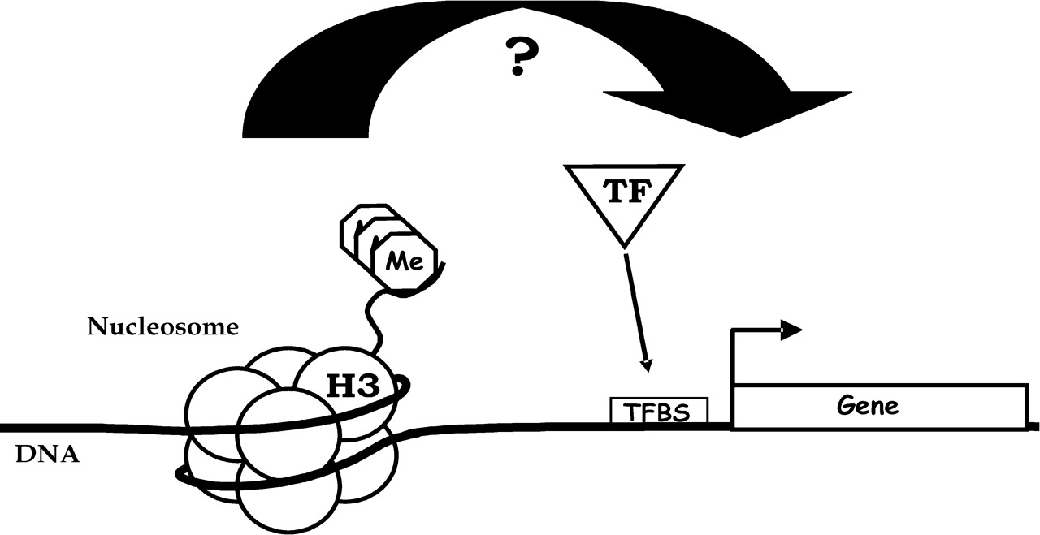
Fig. 2. Cartoon representation of the hypothesis of our biological use case. Nucleosomes are bound to DNA and consist ...
Notes:
Fig. 2. Cartoon representation of the hypothesis of our biological use case. Nucleosomes are bound to DNA and consist of eight histones. One, histone 3 (H3), has a lysine on the fourth position of its N-terminal tail (K4), which can accept 3 methyl (me) groups and this modification H3K4me3 was shown to be a mark for active gene transcription. Generally, gene expression (arrow on gene) is regulated by transcription factors (TF) that recognize and bind to specific DNA sequences upstream of genes, i.e. transcription factor binding sites (TFBS). Our hypothesis predicts a relationship between histone modification H3K4me3 and gene expression regulation through TFBSs.
Unless provided in the caption above, the following copyright applies to the content of this slide: © 2007 The Author(s)This is an Open Access article distributed under the terms of the Creative Commons Attribution Non-Commercial License (http://creativecommons.org/licenses/by-nc/2.0/uk/) which permits unrestricted non-commercial use, distribution, and reproduction in any medium, provided the original work is properly cited.

Slide 3
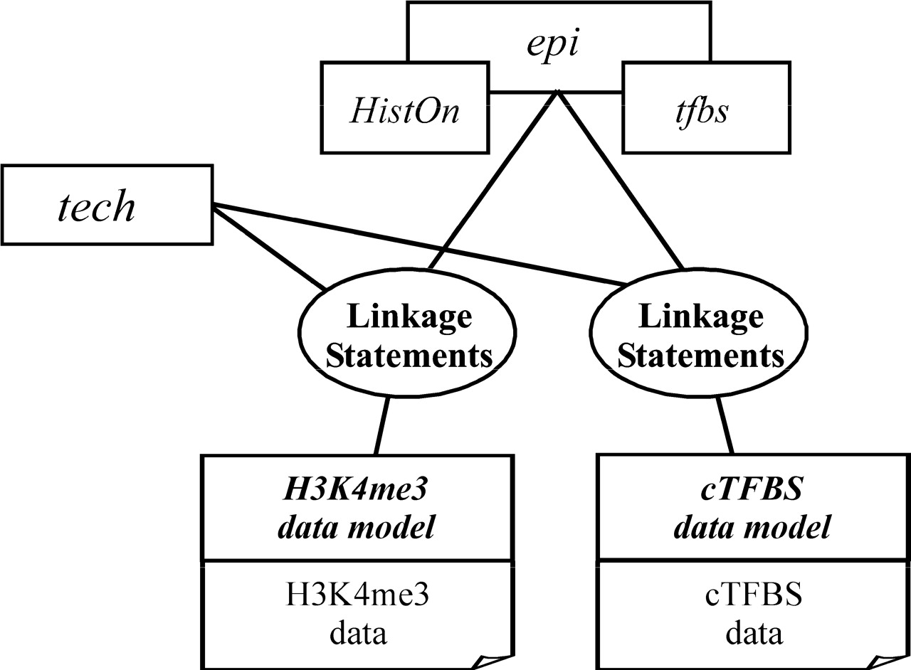
Fig. 3. Schematic overview of the OWL knowledge models, epi (epigenetics), HistOn (histone), tfbs (TFBS) and tech ...
Notes:
Fig. 3. Schematic overview of the OWL knowledge models, epi (epigenetics), HistOn (histone), tfbs (TFBS) and tech (technical); the RDFS data models, H3K4me3 and cTFBS; and how they are linked.
Unless provided in the caption above, the following copyright applies to the content of this slide: © 2007 The Author(s)This is an Open Access article distributed under the terms of the Creative Commons Attribution Non-Commercial License (http://creativecommons.org/licenses/by-nc/2.0/uk/) which permits unrestricted non-commercial use, distribution, and reproduction in any medium, provided the original work is properly cited.

Slide 4
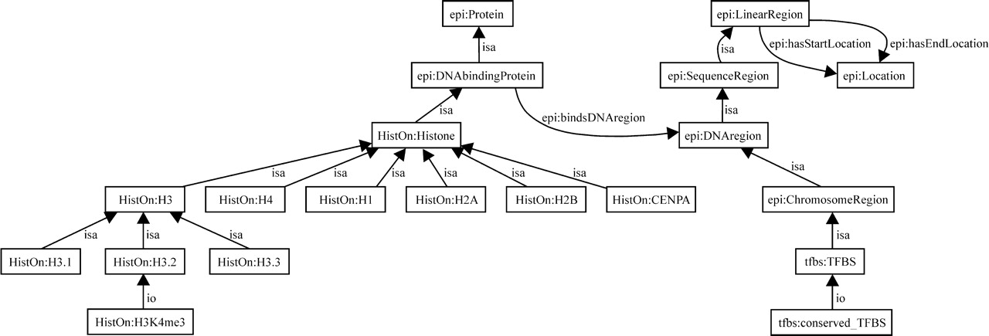
Fig. 4. Schematic overview on how the data is linked. Conserved transcription factor binding site (cTFBS) data and ...
Notes:
Fig. 4. Schematic overview on how the data is linked. Conserved transcription factor binding site (cTFBS) data and Histone 3 Lysine 4 tri-methylation (H3K4me3) data are integrated using our semantic models. The subsection of the model shows a path between the two data sets. The concept ChromosomeRegion is selected as the common domain to base the overlap query on.
Unless provided in the caption above, the following copyright applies to the content of this slide: © 2007 The Author(s)This is an Open Access article distributed under the terms of the Creative Commons Attribution Non-Commercial License (http://creativecommons.org/licenses/by-nc/2.0/uk/) which permits unrestricted non-commercial use, distribution, and reproduction in any medium, provided the original work is properly cited.

