Slide 1
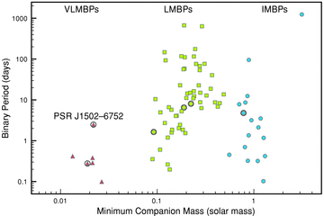
Figure 1 Figure showing minimum companion mass and binary period for all known binary pulsars with spin period below ...
Notes:
Figure 1 Figure showing minimum companion mass and binary period for all known binary pulsars with spin period below 100 ms. Pulsars with discoveries presented in this paper are circled. We have split the binary MSP population into three categories as shown; the different symbols mark VLMBP (triangle), LMBP (square) and IMBPs (circle) as described in the text.
Unless provided in the caption above, the following copyright applies to the content of this slide: © 2011 The Authors Monthly Notices of the Royal Astronomical Society © 2011 RAS

Slide 2
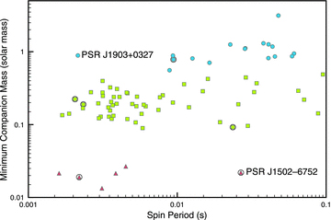
Figure 2 Figure showing spin period and minimum companion mass for all known binary pulsars with spin period below ...
Notes:
Figure 2 Figure showing spin period and minimum companion mass for all known binary pulsars with spin period below 100 ms. Pulsars with discoveries presented in this paper are circled. The different symbols mark VLMBP (triangle), LMBP (square) and IMBPs (circle) as described in the text.
Unless provided in the caption above, the following copyright applies to the content of this slide: © 2011 The Authors Monthly Notices of the Royal Astronomical Society © 2011 RAS

Slide 3
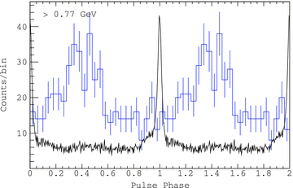
Figure 3 Result of folding the LAT gamma-ray photons with the radio ephemeris of PSR J1446−4701 (histogram), overlaid ...
Notes:
Figure 3 Result of folding the LAT gamma-ray photons with the radio ephemeris of PSR J1446−4701 (histogram), overlaid with the 1369-MHz radio profile (curve). The profiles are aligned assuming a DM of 55.83 cm−3 pc, and an arbitrary scaling for the radio flux density.
Unless provided in the caption above, the following copyright applies to the content of this slide: © 2011 The Authors Monthly Notices of the Royal Astronomical Society © 2011 RAS

Slide 4
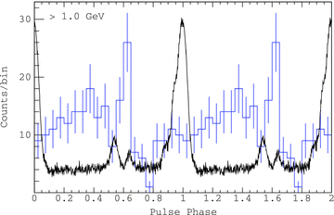
Figure 4 Result of folding the LAT gamma-ray photons with the radio ephemeris of PSR J1125−5825 (histogram), overlaid ...
Notes:
Figure 4 Result of folding the LAT gamma-ray photons with the radio ephemeris of PSR J1125−5825 (histogram), overlaid with the 1369-MHz radio profile (curve). The profiles are aligned assuming a DM of 124.79 cm−3 pc, and an arbitrary scaling for the radio flux density.
Unless provided in the caption above, the following copyright applies to the content of this slide: © 2011 The Authors Monthly Notices of the Royal Astronomical Society © 2011 RAS

Slide 5
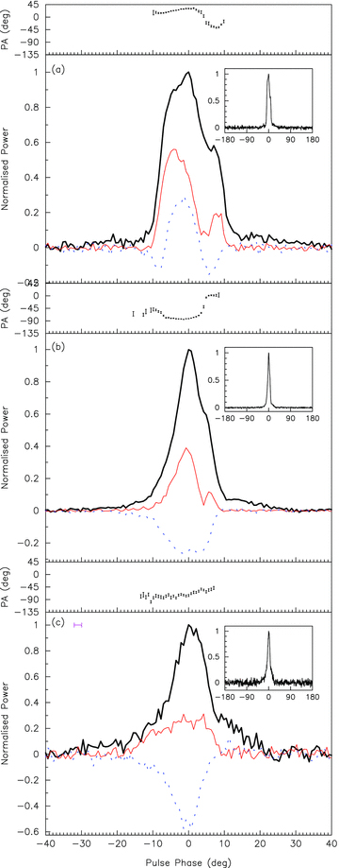
Figure 5 Polarization profiles of PSR J1017−7156 at (a) 732, (b) 1369 and (c) 3100 MHz, showing phases within ±40° of ...
Notes:
Figure 5 Polarization profiles of PSR J1017−7156 at (a) 732, (b) 1369 and (c) 3100 MHz, showing phases within ±40° of the pulse peak. The solid black line shows total intensity, the thinner solid line shows linear polarization and the dotted line shows circular polarization. The inset figures show the profile over the full 360° of pulse phase. The data at 732 and 1369 MHz have been coherently dedispersed and so do not exhibit any DM smearing.
Unless provided in the caption above, the following copyright applies to the content of this slide: © 2011 The Authors Monthly Notices of the Royal Astronomical Society © 2011 RAS

Slide 6
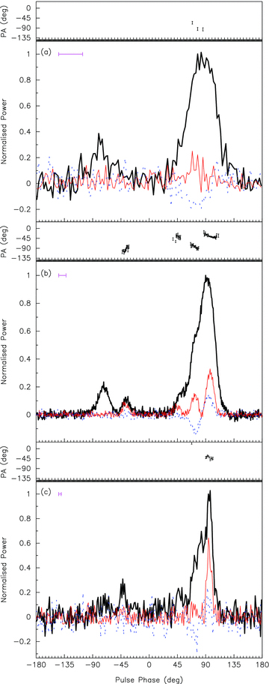
Figure 6 Polarization profiles of PSR J1125−5825 at (a) 732, (b) 1369 and (c) 3100 MHz.
Notes:
Figure 6 Polarization profiles of PSR J1125−5825 at (a) 732, (b) 1369 and (c) 3100 MHz.
Unless provided in the caption above, the following copyright applies to the content of this slide: © 2011 The Authors Monthly Notices of the Royal Astronomical Society © 2011 RAS

Slide 7
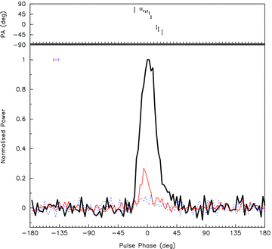
Figure 7 Polarization profile of PSR J1337−6423 at 1369 MHz.
Notes:
Figure 7 Polarization profile of PSR J1337−6423 at 1369 MHz.
Unless provided in the caption above, the following copyright applies to the content of this slide: © 2011 The Authors Monthly Notices of the Royal Astronomical Society © 2011 RAS

Slide 8
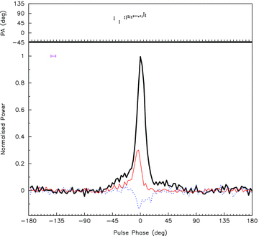
Figure 8 Polarization profile of PSR J1446−4701 at 1369 MHz.
Notes:
Figure 8 Polarization profile of PSR J1446−4701 at 1369 MHz.
Unless provided in the caption above, the following copyright applies to the content of this slide: © 2011 The Authors Monthly Notices of the Royal Astronomical Society © 2011 RAS

Slide 9
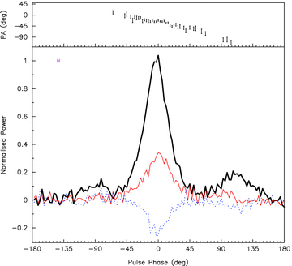
Figure 9 Polarization profile of PSR J1502−6752 at 1369 MHz.
Notes:
Figure 9 Polarization profile of PSR J1502−6752 at 1369 MHz.
Unless provided in the caption above, the following copyright applies to the content of this slide: © 2011 The Authors Monthly Notices of the Royal Astronomical Society © 2011 RAS

Slide 10
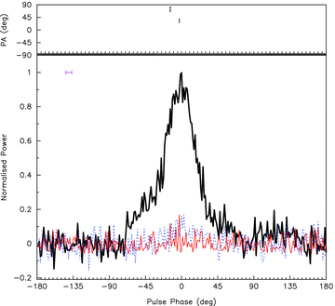
Figure 10 Polarization profile of PSR J1543−5149 at 1369 MHz.
Notes:
Figure 10 Polarization profile of PSR J1543−5149 at 1369 MHz.
Unless provided in the caption above, the following copyright applies to the content of this slide: © 2011 The Authors Monthly Notices of the Royal Astronomical Society © 2011 RAS

Slide 11
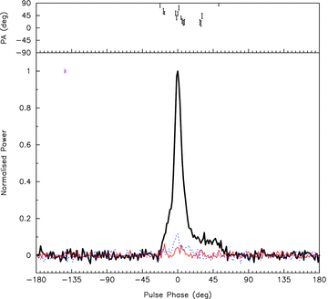
Figure 11 Polarization profile of PSR J1622−6617 at 1369 MHz.
Notes:
Figure 11 Polarization profile of PSR J1622−6617 at 1369 MHz.
Unless provided in the caption above, the following copyright applies to the content of this slide: © 2011 The Authors Monthly Notices of the Royal Astronomical Society © 2011 RAS

Slide 12
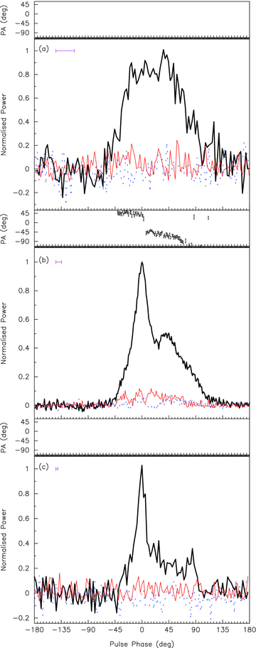
Figure 12 Polarization profiles of PSR J1708−3506 at (a) 732, (b) 1369 and (c) 3100 MHz.
Notes:
Figure 12 Polarization profiles of PSR J1708−3506 at (a) 732, (b) 1369 and (c) 3100 MHz.
Unless provided in the caption above, the following copyright applies to the content of this slide: © 2011 The Authors Monthly Notices of the Royal Astronomical Society © 2011 RAS

Slide 13
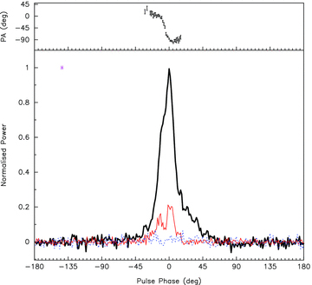
Figure 13 Polarization profile of PSR J1719−1438 at 1369 MHz.
Notes:
Figure 13 Polarization profile of PSR J1719−1438 at 1369 MHz.
Unless provided in the caption above, the following copyright applies to the content of this slide: © 2011 The Authors Monthly Notices of the Royal Astronomical Society © 2011 RAS

Slide 14
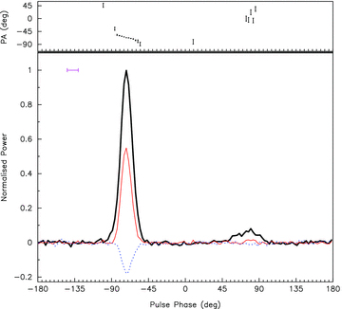
Figure 14 Polarization profile of PSR J1731−1845 at 1369 MHz.
Notes:
Figure 14 Polarization profile of PSR J1731−1845 at 1369 MHz.
Unless provided in the caption above, the following copyright applies to the content of this slide: © 2011 The Authors Monthly Notices of the Royal Astronomical Society © 2011 RAS

Slide 15
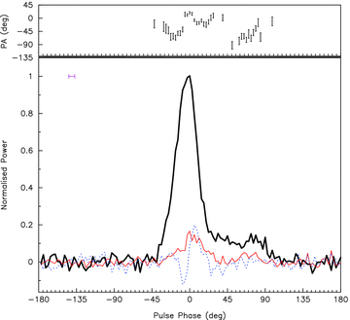
Figure 15 Polarization profile of PSR J1801−3212 at 1369 MHz.
Notes:
Figure 15 Polarization profile of PSR J1801−3212 at 1369 MHz.
Unless provided in the caption above, the following copyright applies to the content of this slide: © 2011 The Authors Monthly Notices of the Royal Astronomical Society © 2011 RAS

Slide 16
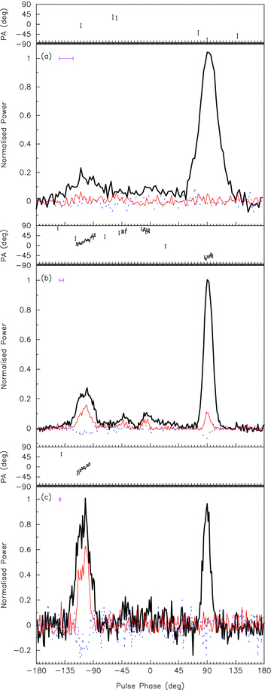
Figure 16 Polarization profiles of PSR J1811−2404 at (a) 732, (b) 1369 and (c) 3100 MHz.
Notes:
Figure 16 Polarization profiles of PSR J1811−2404 at (a) 732, (b) 1369 and (c) 3100 MHz.
Unless provided in the caption above, the following copyright applies to the content of this slide: © 2011 The Authors Monthly Notices of the Royal Astronomical Society © 2011 RAS

Slide 17
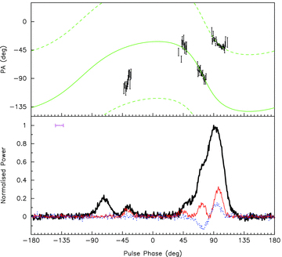
Figure 17 Polarization profile of PSR J1125−5825 at 1369 MHz, showing the observed PAs overplayed with the model ...
Notes:
Figure 17 Polarization profile of PSR J1125−5825 at 1369 MHz, showing the observed PAs overplayed with the model obtained from fitting the RVM. The dashed line is separated by 90° from the model PA to indicate orthogonal modes.
Unless provided in the caption above, the following copyright applies to the content of this slide: © 2011 The Authors Monthly Notices of the Royal Astronomical Society © 2011 RAS

Slide 18
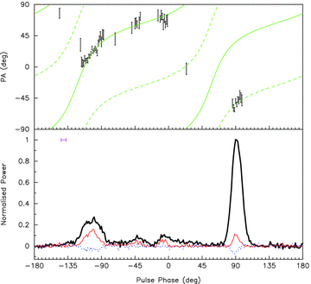
Figure 18 Polarization profile of PSR J1811−2404 at 1369 MHz, showing the observed PAs overlaid with the model obtained ...
Notes:
Figure 18 Polarization profile of PSR J1811−2404 at 1369 MHz, showing the observed PAs overlaid with the model obtained from fitting the RVM. The dashed line is separated by 90° from the model PA to indicate orthogonal modes.
Unless provided in the caption above, the following copyright applies to the content of this slide: © 2011 The Authors Monthly Notices of the Royal Astronomical Society © 2011 RAS

