Slide 1
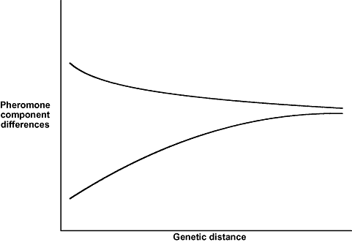
Figure 1. Predicted relationship between phenotypic (pheromonal) difference and genetic distances given by two ...
Notes:
Figure 1. Predicted relationship between phenotypic (pheromonal) difference and genetic distances given by two different modes of evolution: gradual (bottom line) and saltational (top line). Based on the results of simulations performed by Symonds & Elgar (2004a).
Unless provided in the caption above, the following copyright applies to the content of this slide: © 2009 The Linnean Society of London

Slide 2
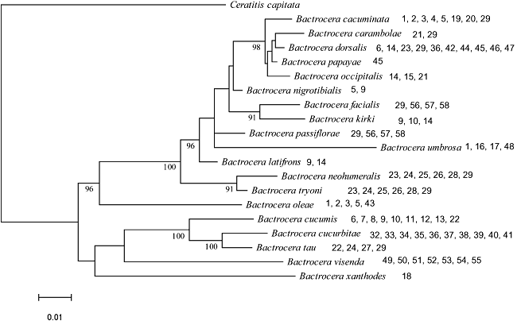
Figure 2. Bayesian posterior Majority Rule (all compatible partitions) consensus tree pruned to the 20 focal taxa. ...
Notes:
Figure 2. Bayesian posterior Majority Rule (all compatible partitions) consensus tree pruned to the 20 focal taxa. Phylogenetic reconstruction is based on a three partition (1, 16S + 12S; 2, ND1 + COII; 3, White Eye) mixed model analysis with topology and branch lengths linked across partitions. Nodes having > 90% posterior probability are indicated. The branch length scale bar indicates number of substitutions per site. Numbers after species names indicate the chemical components of the pheromone for each species (for component information, see Table 1).
Unless provided in the caption above, the following copyright applies to the content of this slide: © 2009 The Linnean Society of London

Slide 3
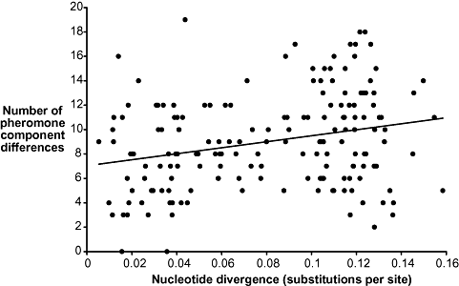
Figure 3. Relationship between number of differences in pheromone components and nucleotide divergence between ...
Notes:
Figure 3. Relationship between number of differences in pheromone components and nucleotide divergence between Bactrocera species.
Unless provided in the caption above, the following copyright applies to the content of this slide: © 2009 The Linnean Society of London

Slide 4
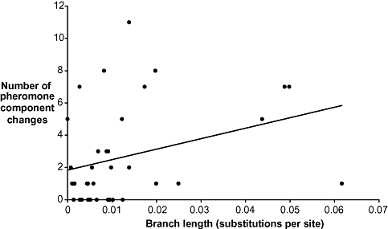
Figure 4. Estimated number of changes in pheromone components along each branch in the phylogeny in relation to the ...
Notes:
Figure 4. Estimated number of changes in pheromone components along each branch in the phylogeny in relation to the length of the branch. Longer branches tend to show greater amounts of change.
Unless provided in the caption above, the following copyright applies to the content of this slide: © 2009 The Linnean Society of London

Slide 5
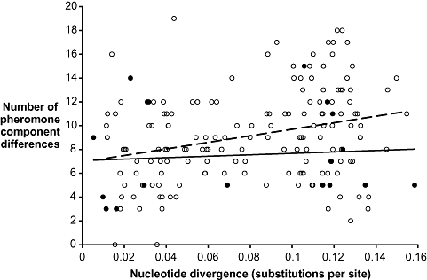
Figure 5. Relationship between number of difference in pheromone components and nucleotide divergence between species ...
Notes:
Figure 5. Relationship between number of difference in pheromone components and nucleotide divergence between species for syntopic (filled circles, solid line) and allotopic (open squares, dotted line) Bactrocera species.
Unless provided in the caption above, the following copyright applies to the content of this slide: © 2009 The Linnean Society of London

