Slide 1
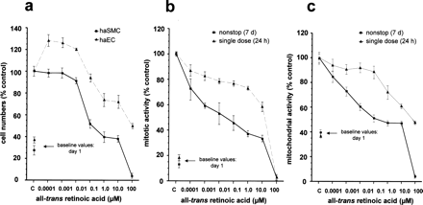
Fig. 1 atRA-induced inhibition of haSMC- and haEC-growth. Cells numbers, mitotic indices and mitochondrial ...
Notes:
Fig. 1 atRA-induced inhibition of haSMC- and haEC-growth. Cells numbers, mitotic indices and mitochondrial activities at the commencement of treatment (day 1) are shown as single graph points below the 100% values of controls (day 7) and labeled as ‘baseline values, day 1’. (a) Comparison of percentage of cell numbers of haEC and haSMC after 7 days non-stop incubation with atRA measured by cell counting assays. Significant growth inhibitory effects on haSMC (P<0.01 vs. controls) were found in a concentration range between 0.1 and 100.0 μM atRA. In contrast, haEC-growth was stimulated first by lower atRA doses but was also inhibited at higher doses between 1.0 and 100.0 μM. haEC-inhibition curve runs in parallel with the inhibition curve of haSMC. However, the haEC curve was completely shifted to higher atRA-concentrations. (b) Comparison of the mitotic activity of haSMC after single dose (24 h) and non-stop application (7 days) of atRA determined by BrdU-ELISA. (c) Comparison of the mitochondrial activity of haSMC after single dose (24 h) and non-stop application (7 days) of atRA determined by MTT tests. Data are shown as mean±S.E.M. values.
Unless provided in the caption above, the following copyright applies to the content of this slide: Copyright © 2001, European Society of Cardiology

Slide 2
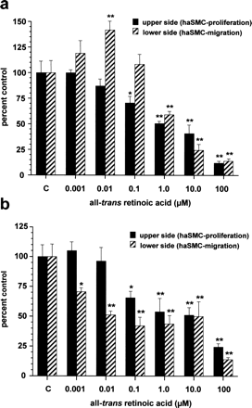
Fig. 2 Growth inhibition of haSMC in transfilter cocultures with proliferating haEC. (a) Effect on ...
Notes:
Fig. 2 Growth inhibition of haSMC in transfilter cocultures with proliferating haEC. (a) Effect on haSMC-proliferation and -migration after a single dose application of atRA for 24 h applied to the endothelial side. Cell numbers were determined 14 days after drug replacement by standard medium. (b) Effect on haSMC-proliferation and -migration after non-stop application of atRA for 14 days applied to the endothelial compartment. Solid bars show haSMC numbers on the upper filter side, broken bars the total of haEC and migrated haSMC on the lower side. Data are shown as mean±S.E.M. (*P<0.05, **P<0.01 vs. controls).
Unless provided in the caption above, the following copyright applies to the content of this slide: Copyright © 2001, European Society of Cardiology

Slide 3
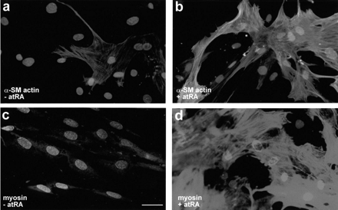
Fig. 3 Immunofluorescence micrographs demonstrating the effect of atRA on the formation of the contractile filament ...
Notes:
Fig. 3 Immunofluorescence micrographs demonstrating the effect of atRA on the formation of the contractile filament α-smooth muscle actin and heavy chain myosin in proliferating, subconfluent haSMC. (a) α-Smooth muscle actin staining of control cultures showing the typical straight α-actin filaments only sporadically in a few cells. (b) After treatment with 0.1 μM atRA nearly all haSMC showed densely packed α-actin bundles. (c) Heavy chain myosin staining at untreated control cells: unspecific background staining is visible but no specific filament formation. (d) atRA treatment caused remarkable effects on heavy chain myosin filament expression in the cytoplasm with the characteristic straight bundle formation along the cell axis. The scale bar indicates magnification for all figures and represents 10 μm.
Unless provided in the caption above, the following copyright applies to the content of this slide: Copyright © 2001, European Society of Cardiology

Slide 4
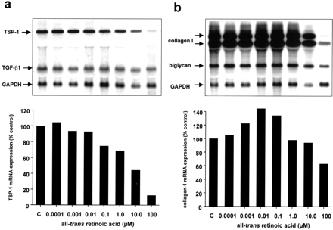
Fig. 4 Effect of atRA on mRNA-expression of several ECM-proteins analyzed at subconfluent haSMC. Representative ...
Notes:
Fig. 4 Effect of atRA on mRNA-expression of several ECM-proteins analyzed at subconfluent haSMC. Representative Northern blots of two independent experiments after 48 h. (a) Dose dependent inhibition of thrombospondin-1 (TSP-1) mRNA-expression with significant effects at atRA doses ≥0.1 μM determined by densitometric evaluation. TGF-β1 mRNA-expression was not influenced significantly by atRA. (b) Collagen-1 mRNA expression was slightly increased after treatment with 0.001–0.1 μM atRA. At the highest dose of 100.0 μM, inhibitory effects were caused by overlapping toxic effects. The small proteoglycan biglycan was not influenced by atRA. (c) Fibronectin mRNA expression was slightly inhibited at atRA doses ≥0.1 μM determined by densitometric evaluation. (d) Stimulation of α-smooth muscle actin expression, predominantly at nM atRA-doses. The weaker signal at 0.1 μM was due to loading problems shown by the corresponding GAPDH signal.
Unless provided in the caption above, the following copyright applies to the content of this slide: Copyright © 2001, European Society of Cardiology

Slide 5
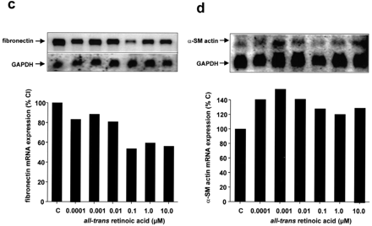
Fig. 4 Effect of atRA on mRNA-expression of several ECM-proteins analyzed at subconfluent haSMC. Representative ...
Notes:
Fig. 4 Effect of atRA on mRNA-expression of several ECM-proteins analyzed at subconfluent haSMC. Representative Northern blots of two independent experiments after 48 h. (a) Dose dependent inhibition of thrombospondin-1 (TSP-1) mRNA-expression with significant effects at atRA doses ≥0.1 μM determined by densitometric evaluation. TGF-β1 mRNA-expression was not influenced significantly by atRA. (b) Collagen-1 mRNA expression was slightly increased after treatment with 0.001–0.1 μM atRA. At the highest dose of 100.0 μM, inhibitory effects were caused by overlapping toxic effects. The small proteoglycan biglycan was not influenced by atRA. (c) Fibronectin mRNA expression was slightly inhibited at atRA doses ≥0.1 μM determined by densitometric evaluation. (d) Stimulation of α-smooth muscle actin expression, predominantly at nM atRA-doses. The weaker signal at 0.1 μM was due to loading problems shown by the corresponding GAPDH signal.
Unless provided in the caption above, the following copyright applies to the content of this slide: Copyright © 2001, European Society of Cardiology

Slide 6
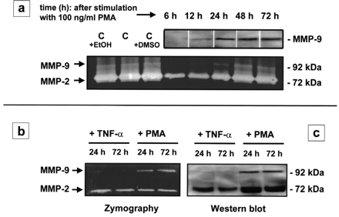
Fig. 5 Gelatinolytic activity and protein expression of MMP-2 and MMP-9. (a) Supernatants of haSMC-cultures were ...
Notes:
Fig. 5 Gelatinolytic activity and protein expression of MMP-2 and MMP-9. (a) Supernatants of haSMC-cultures were examined after 12-, 24-, 48- and 72-h cultivation time determined by SDS–PAGE zymography (lower lanes) and Western blotting (upper lanes). Unstimulated haSMC constitutively secreted MMP-2 but not MMP-9. Significant gelatinolytic activity and protein expression of MMP-9 was induced after ≥12-h stimulation with phorbol ester (PMA). In contrast to PMA, TNF-α did not stimulate (b) gelatinolytic activity or (c) protein expression of MMP-9 in haSMC significantly after 24- or 72-h incubation time.
Unless provided in the caption above, the following copyright applies to the content of this slide: Copyright © 2001, European Society of Cardiology

Slide 7
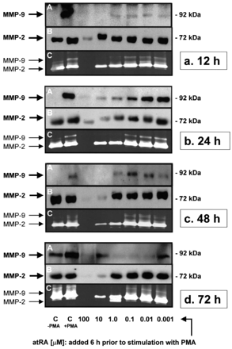
Fig. 6 Effects of atRA after preincubation of haSMC 6 h prior to the stimulation with PMA. Western blot analysis for ...
Notes:
Fig. 6 Effects of atRA after preincubation of haSMC 6 h prior to the stimulation with PMA. Western blot analysis for MMP-9 (A) and MMP-2 (B) and zymography (C). (a) A dose dependent inhibition of gelatinolytic activity, as well as protein expression of MMP-9 in a concentration range between 0.01 and 100.0 μM is first visible 12 h after stimulation with PMA whereas MMP-2 is inhibited only partially at high atRA-doses between 1.0 and 100.0 μM. The inhibitory effects persisted for (b) 24 h, (c) 48 h and (d) 72 h.
Unless provided in the caption above, the following copyright applies to the content of this slide: Copyright © 2001, European Society of Cardiology

