Slide 1
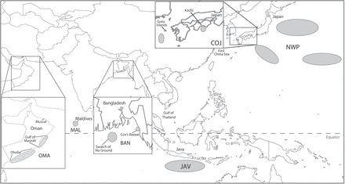
Figure 1. Schematic illustrating the extent of the study region and approximate sampling locations shaded in gray: OMA, ...
Notes:
Figure 1. Schematic illustrating the extent of the study region and approximate sampling locations shaded in gray: OMA, Oman; MAL, Maldives; BAN, Bangladesh; JAV, south of Java; COJ, coast of Japan; NWP, Northwest Pacific. New samples were collected from Oman, the Maldives, and Bangladesh. Existing samples had been previously collected from south of Java, coast of Japan, and Northwest Pacific (Yoshida and Kato 1999; Kanda et al. 2007). The eastern portion of the schematic (JAV, COJ, and NWP) was adapted from Yoshida and Kato (1999) and Kanda et al. (2007).
Unless provided in the caption above, the following copyright applies to the content of this slide: © The American Genetic Association 2013. All rights reserved. For permissions, please e-mail: journals.permissions@oup.com

Slide 2
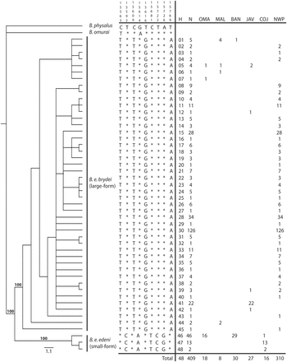
Figure 2. Phylogenetic reconstruction of mtDNA control region haplotypes of Bryde’s whales sampled from across the ...
Notes:
Figure 2. Phylogenetic reconstruction of mtDNA control region haplotypes of Bryde’s whales sampled from across the Western and Central Indo-Pacific and Northwest Pacific Ocean. The bootstrap 50% majority rule consensus parsimony tree is shown with bootstrap values supporting phylogenetic differentiation of haplotypes identified as Balaenoptera edeni brydei and Balaenopteraedeni edeni. The 9 characteristic attributes (CAs) used to identify the taxa are shown to the immediate right of the tree. Nucleotide positions correspond to the B. e. brydei mitochondrial genome positions 15477–16410 (ACCN: AB201259). Positions 15609, 15616, and 15769 diagnose the B. e. brydei subspecies. Positions 15592, 15681, 15722, and 15726 diagnose the B. e. edeni subspecies. * represents conserved nucleotides in relation to the outgroup, Balaenoptera physalus. H, haplotype number; N, sample size; and sampling location (i.e., OMA, Oman; MAL, Maldives; BAN, Bangladesh; JAV, south of Java; COJ, coast of Japan; NWP, Northwest Pacific), are shown adjacent to the termini in the table to the far right. See Supplementary Material online for details of haplotype accession numbers.
Unless provided in the caption above, the following copyright applies to the content of this slide: © The American Genetic Association 2013. All rights reserved. For permissions, please e-mail: journals.permissions@oup.com

