Slide 1
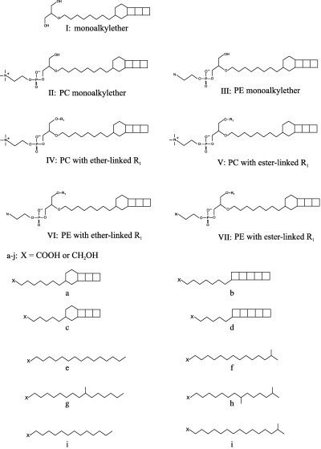
1 Structures of anammox ladderane lipids. The molecular structure of ladderane monoalkyl glycerol ether lipid ...
Notes:
1 Structures of anammox ladderane lipids. The molecular structure of ladderane monoalkyl glycerol ether lipid is depicted (I). Structures II and III represent the phosphocholine and phosphoethanolamine monoalkyl glycerol ether lipids, respectively. The general structure of phosphocholine diether and phosphocholine ester/ether ladderane lipids is shown by IV and V, respectively. The general structure of phosphoethanolamine diether and phosphoethanolamine ester/ether ladderane lipids is shown by VI and VII, respectively. Other structures detected in this study are: (a) C20-[3]-ladderane; (b) C20-[5]-ladderane; (c) C18-[3]-ladderane; (d) C18-[5]-ladderane; (e) n-C16; (f) iso-C16; (g) 10-methylhexadecane; (h) 9,14-dimethylpentadecane, (i) n-C14; (j) iso-C17.
Unless provided in the caption above, the following copyright applies to the content of this slide: © 2006 Federation of European Microbiological Societies Published by Blackwell Publishing Ltd. All rights reserved

Slide 2
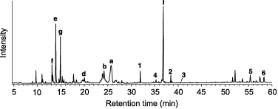
2 Basic lipid structures of anammox cell material determined by gas chromatography-mass spectrometry (GC-MS). ...
Notes:
2 Basic lipid structures of anammox cell material determined by gas chromatography-mass spectrometry (GC-MS). The total lipid extract of anammox bacteria obtained from waste water treatment plants was acid hydrolyzed before GC-MS, thereby identifying: (1) squalene; (2) diploptene; (3) diploterol; (4) hopanoid ketone; (a) C20-[3]-ladderane; (b) C20-[5]-ladderane; (d) C18-[5]-ladderane; (e) n-C16; (f) 14-methylpentadecanoic acid; (g) 10-methylhexadecanoic acid; (I) mono alkyl glycerol ether with [3]-ladderane; (5) ether/ester glycerol with C20-[3]-ladderane and iso-C16; (6) ether/ester glycerol with C20-[3]-ladderane and 10-methylhexadecanoic acid. Numbers refer to structures in Fig. 1.
Unless provided in the caption above, the following copyright applies to the content of this slide: © 2006 Federation of European Microbiological Societies Published by Blackwell Publishing Ltd. All rights reserved

Slide 3
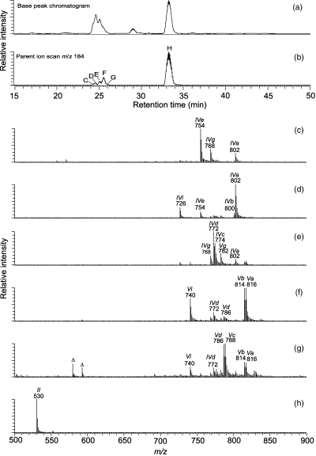
3 High performance liquid chromatography-ion base chromatogram and electrospray ionization tandem mass ...
Notes:
3 High performance liquid chromatography-ion base chromatogram and electrospray ionization tandem mass spectrometry analysis of the total lipid extract of anammox cells for phosphocholine lipid species. (a) Full scan analysis of the base peak chromatogram of a total anammox lipid extract. (b) Base peak mass chromatogram obtained by parent ion scanning for m/z 184. (c–h) Mass chromatograms of [M+H]+ ions of the identified ladderane phosphocholine lipids. For more details, see Results section. For structures, see Fig. 1. The Δ-marked peaks denote unknown components.
Unless provided in the caption above, the following copyright applies to the content of this slide: © 2006 Federation of European Microbiological Societies Published by Blackwell Publishing Ltd. All rights reserved

Slide 4
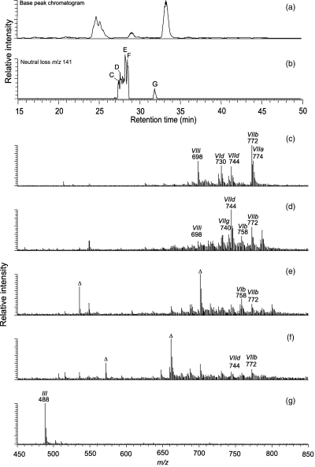
4 High performance liquid chromatography electrospray ionization tandem mass spectrometry analysis of the total ...
Notes:
4 High performance liquid chromatography electrospray ionization tandem mass spectrometry analysis of the total lipid extract of anammox cells for phosphoethanolamine lipid species. (a) Full scan analysis of the base peak chromatogram of a total anammox lipid extract. (b) Base peak mass chromatogram obtained by neutral loss scanning for m/z 141. (c–g) Mass chromatograms of [M+H]+ ions of the identified ladderane phosphoethanolamine lipids. For more details, see Results section. For structures, see Fig. 1. The Δ-marked peaks denote unknown components.
Unless provided in the caption above, the following copyright applies to the content of this slide: © 2006 Federation of European Microbiological Societies Published by Blackwell Publishing Ltd. All rights reserved

Slide 5
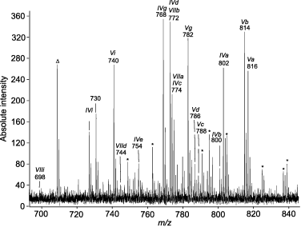
5 Matrix-assisted laser desorption/ionization time-of-flight mass spectrometry spectrum of the total lipid ...
Notes:
5 Matrix-assisted laser desorption/ionization time-of-flight mass spectrometry spectrum of the total lipid extract of anammox cells showing the diether and ester/ether specific mass range (m/z 680–845). The peaks are assigned in accordance with the lipid structures depicted in Fig. 1. The asterisk marks denote [M+Na]+ ions, and the Δ-marked peak denotes an unknown component.
Unless provided in the caption above, the following copyright applies to the content of this slide: © 2006 Federation of European Microbiological Societies Published by Blackwell Publishing Ltd. All rights reserved

