Slide 1
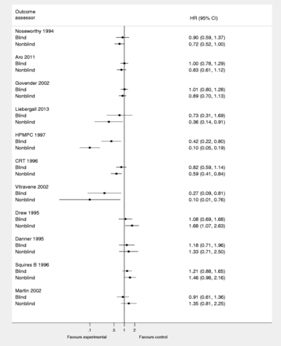
Figure 1. Estimated treatment effect in randomized trials with time-to-event outcomes according to type of outcome ...
Notes:
Figure 1. Estimated treatment effect in randomized trials with time-to-event outcomes according to type of outcome assessor: blind or nonblind. HR: hazard ratio.
Unless provided in the caption above, the following copyright applies to the content of this slide: © The Author 2014; all rights reserved. Published by Oxford University Press on behalf of the International Epidemiological Association

Slide 2
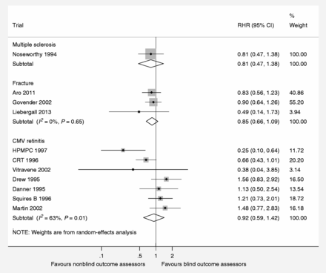
Figure 2. The impact of nonblind outcome assessors on the estimated treatment effect in randomized clinical trials with ...
Notes:
Figure 2. The impact of nonblind outcome assessors on the estimated treatment effect in randomized clinical trials with time-to-event outcomes—stratified by clinical condition. RHR: ratio of hazard ratios = HRnonblind/HRblind.
Unless provided in the caption above, the following copyright applies to the content of this slide: © The Author 2014; all rights reserved. Published by Oxford University Press on behalf of the International Epidemiological Association

Slide 3
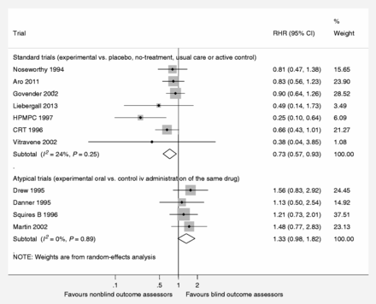
Figure 3. The impact of nonblind outcome assessors on the estimated treatment effect in randomized clinical trials with ...
Notes:
Figure 3. The impact of nonblind outcome assessors on the estimated treatment effect in randomized clinical trials with time-to-event outcomes—stratified by type of trial. RHR: ratio of hazard ratios = HRnonblind/HRblind.
Unless provided in the caption above, the following copyright applies to the content of this slide: © The Author 2014; all rights reserved. Published by Oxford University Press on behalf of the International Epidemiological Association

