Slide 1
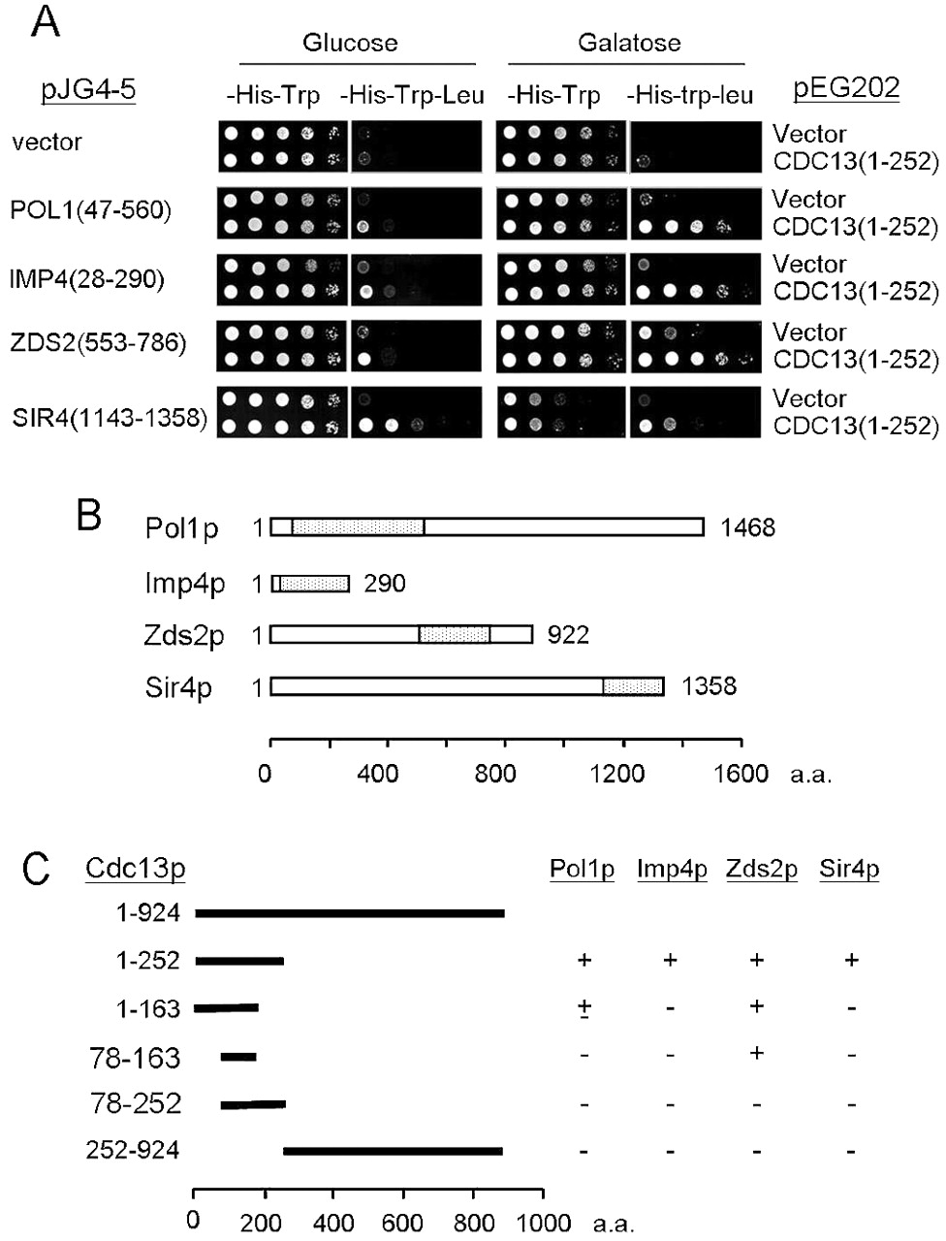
Figure 1. Interaction of Cdc13(1–252)p with Pol1(47–560)p, Imp4(28–290)p, Zds2(553–786)p and ...
Notes:
Figure 1. Interaction of Cdc13(1–252)p with Pol1(47–560)p, Imp4(28–290)p, Zds2(553–786)p and Sir4(1143–1358)p. (A) Two‐hybrid analysis of Cdc13(1–252)p and its interacting proteins. Yeast cells YEM1α/pEG202 or YEM1α/pEG‐CDC13(1–252) carrying plasmid pJG4‐5, pJG‐POL1(47–560), pJG‐IMP4(28–290), pJG‐ZDS2(553–786) or pJG‐SIR4(1143–1358) were grown on YC medium lacking histidine and tryptophan at 30°C. Cells were then analyzed by their ability to grow in the absence of leucine. Ten‐fold serial dilution of cells were spotted on glucose or galactose plates either without histidine and tryptophan or without leucine, tryptophan and histidine and incubated at 30°C until colonies formed. Photographs of the plates are shown. (B) Polypeptides that interact with Cdc13(1–252)p in two‐hybrid analysis. Dotted regions indicate the portion of proteins expressed from the two‐hybrid vector pJG4‐5. (C) Defining the region of Cdc13p that interacted with Pol1(47–560)p, Imp4(28–290)p, Zds2(553–786)p and Sir4(1143–1358)p. Yeast cells YEM1α/pEG202, YEM1α/pEG‐CDC13(1–252), YEM1α/pEG‐CDC13(1–163), YEM1α/pEG‐CDC13(78–163) or YEM1α/pEG‐CDC13(78–252) carrying plasmid pJG4‐5, pJG‐POL1(47–560), pJG‐IMP4(28–290), pJG‐ZDS2(553–786) or pJG‐SIR4(1143–1358) were analyzed in two‐hybrid system. The results are summarized. The plus sign (+) indicates cells that are able to grow on medium lacking leucine whereas the minus sign (–) indicates the opposite.
Unless provided in the caption above, the following copyright applies to the content of this slide: Oxford University Press

Slide 2
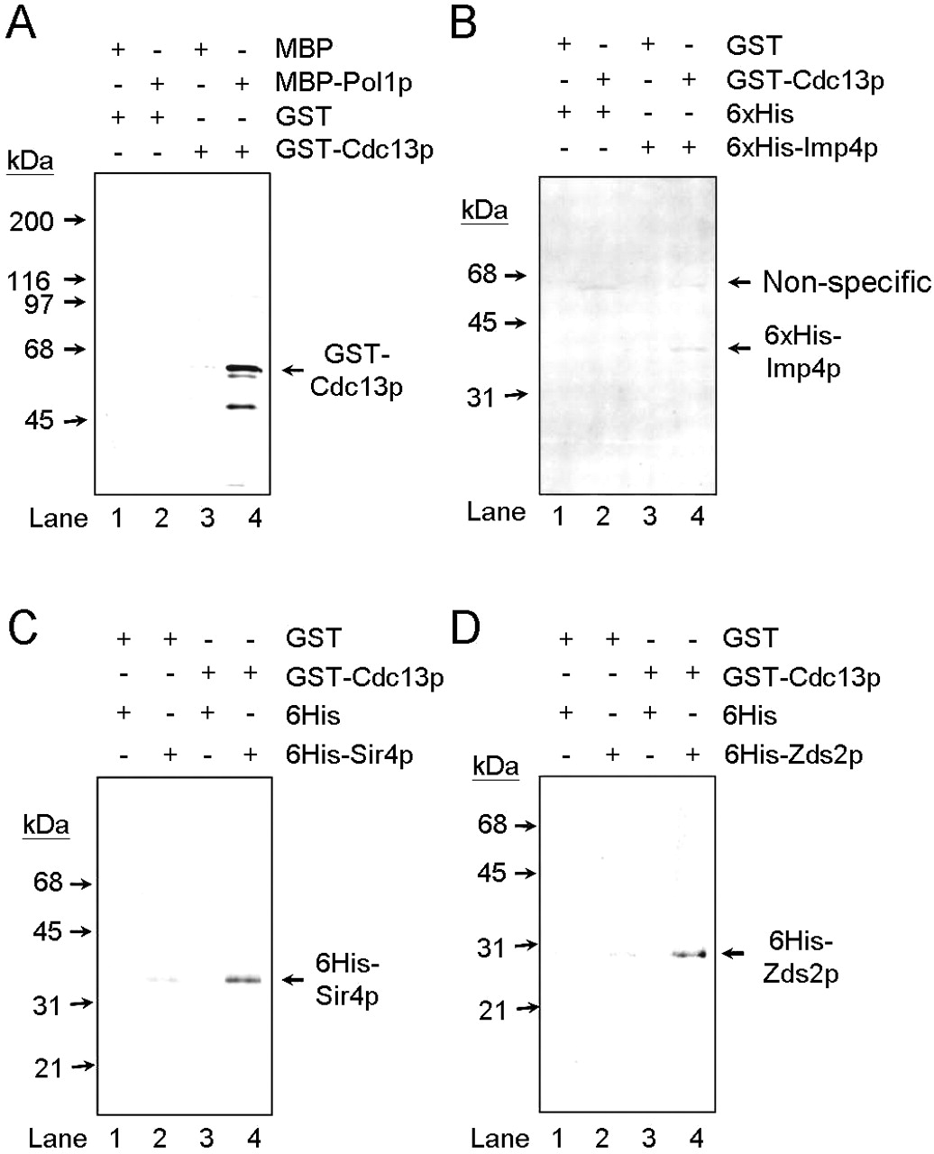
Figure 2. Interactions between Cdc13p and its binding proteins in vitro. (A) Bacterial extracts containing ...
Notes:
Figure 2. Interactions between Cdc13p and its binding proteins in vitro. (A) Bacterial extracts containing MBP or MBP‐Pol1(47–412)p were incubated with 50 µl of amylose resin at 4°C for 1 h. The resins were then washed and mixed with the extracts containing GST or GST–Cdc13(1–252)p. The incubation was allowed to continue for 1 h and proteins that bound to resins were eluted with 200 µl of 10 mM maltose. Aliquots of 10 µl of the eluates were analyzed by 10% SDS–PAGE. The results of immunoblotting analysis using an antibody against Cdc13(1–252)p are presented. The bands were visualized by chemiluminescence using an ECL kit (Amersham‐Pharmacia). The molecular standard and the position of GST–Cdc13(1–252)p are indicated. Similar experiments were conducted in (B)–(D) with the exception of use of GST–Sepharose resin and detection using anti‐6×His antibody. The non‐specific band in (B) was detected by the anti‐6×His antibody.
Unless provided in the caption above, the following copyright applies to the content of this slide: Oxford University Press

Slide 3
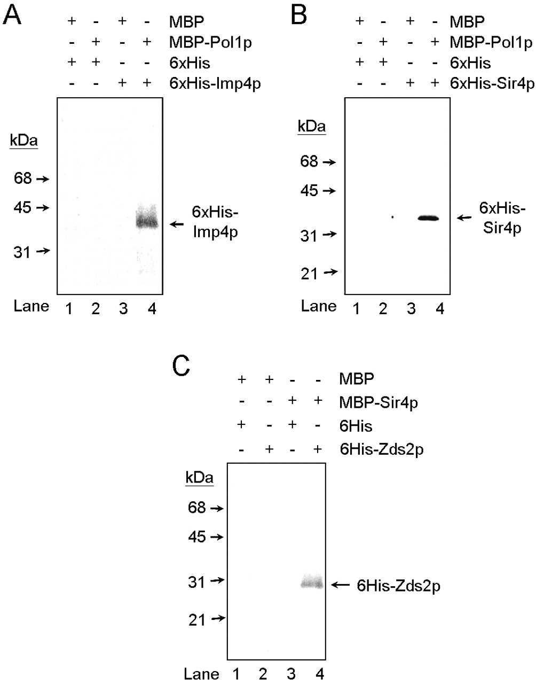
Figure 3. Interactions between Pol1p, Imp4p, Sir4p and Zds2p in vitro. The experimental procedures were ...
Notes:
Figure 3. Interactions between Pol1p, Imp4p, Sir4p and Zds2p in vitro. The experimental procedures were similar to those described in Figure 5. Bacterial extracts containing MBP, MBP‐Pol1(47–412)p (A and B) or MBP‐Sir4(1143–1358)p (C) were incubated with 50 µl of amylose resin at 4°C for 1 h. The resins were then washed and mixed with the extracts containing 6×His or 6×His–Imp4p (A), 6×His–Sir4(1143–1358)p (B) or 6×His–Zds2(553–786)p (C). The incubation was allowed to continue for 1 h and proteins that bound to resins were eluted with 200 µl of 10 mM maltose. Aliquots of 10 µl of the eluates were analyzed by 10% SDS–PAGE. The result of immunoblotting analysis using an antibody against 6×His is presented. The bands were visualized by chemiluminescence using an ECL kit (Amersham‐Pharmacia).
Unless provided in the caption above, the following copyright applies to the content of this slide: Oxford University Press

Slide 4
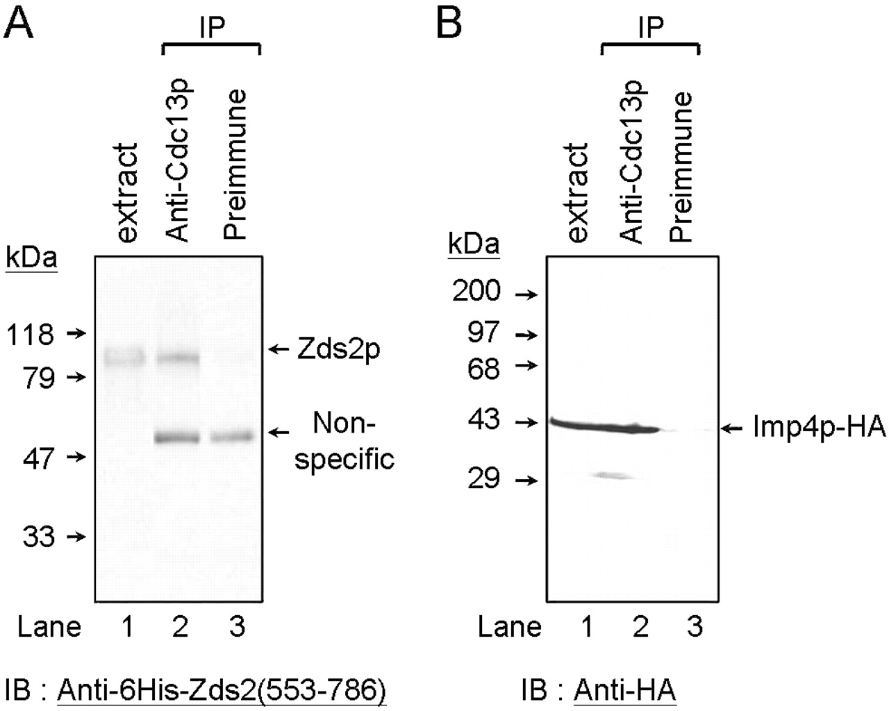
Figure 4. Interactions between Cdc13p and Zds2p and Imp4p in vivo. (A) Yeast extracts were incubated with ...
Notes:
Figure 4. Interactions between Cdc13p and Zds2p and Imp4p in vivo. (A) Yeast extracts were incubated with polyclonal anti‐Cdc13(451–693)p antibodies. Protein A resin was then added to the mixtures to immunoprecipitate the Cdc13–protein complexes. The immunoprecipitates were analyzed by immunoblotting analysis using anti‐6×His–Zds2(553–786)p antibodies. The bands were visualized by chemiluminescence using an ECL kit (Amersham‐Pharmacia). The molecular standard and the position of Zds2p are indicated. The non‐specific bands detected by the anti‐Zds2p serum in lanes 2 and 3 are rabbit IgG used in immunoprecipitation. Similar experiments were conducted in (B) with the exceptions that the cell extracts were prepared from yeast cells carrying a HA tag on the C‐terminus of Imp4p (Imp4p–HA) and detected using anti‐HA antibody. In both blots, one tenth of the cell extracts used in the experiments were loaded as a control (lane 1).
Unless provided in the caption above, the following copyright applies to the content of this slide: Oxford University Press

Slide 5
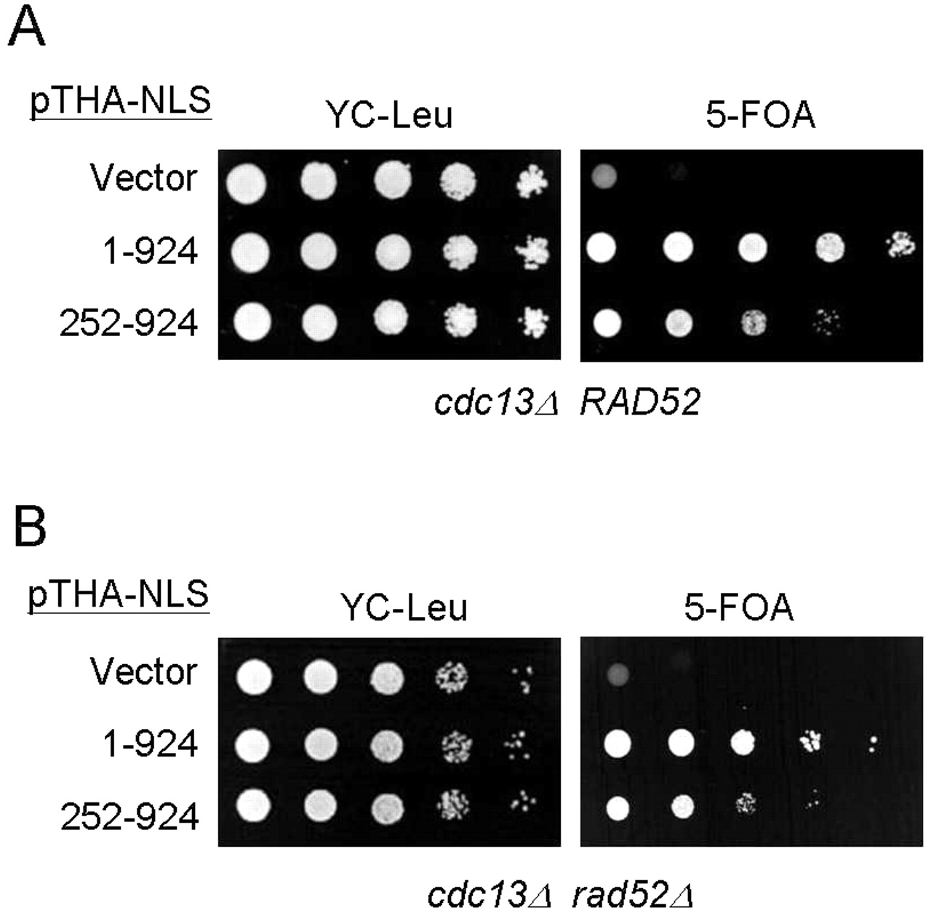
Figure 5. Complementation of a cdc13Δ mutant by CDC13(252–924). Yeast strain YJL501 ...
Notes:
Figure 5. Complementation of a cdc13Δ mutant by CDC13(252–924). Yeast strain YJL501 (cdc13Δ::HIS3/YEP24‐CDC13) (A) or YJL501rad52 (cdc13Δ::HIS3 rad52Δ::TRP1/YEP24‐CDC13) (B) carrying plasmid pTHA‐NLS (vector), pTHA‐NLS‐CDC13 (1–924) or pTHA‐NLS‐CDC13(252–924) was spotted in 10‐fold serial dilutions on YC‐Leu plates or plates containing 5‐FOA and incubated at 30°C until colonies were formed. The plates are shown here.
Unless provided in the caption above, the following copyright applies to the content of this slide: Oxford University Press

Slide 6
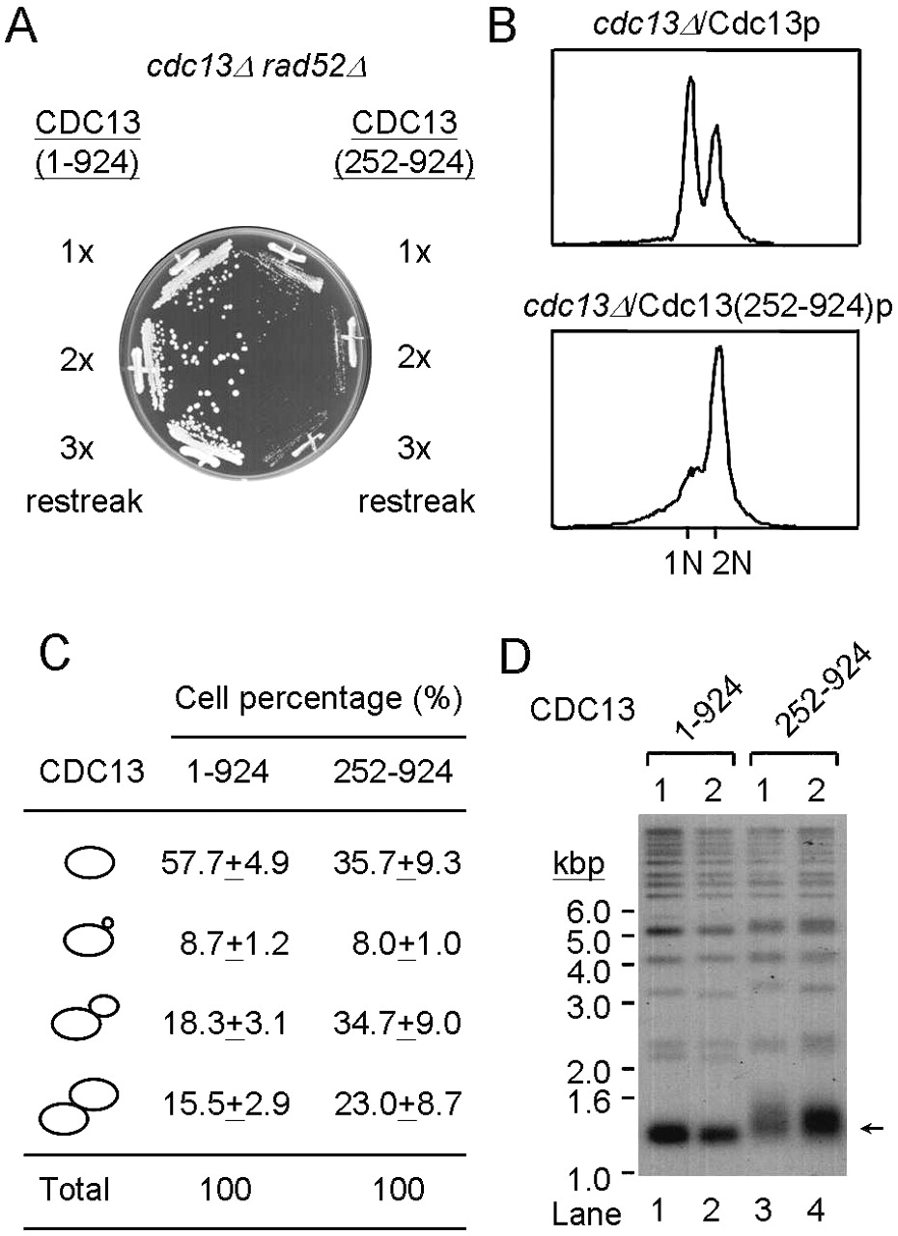
Figure 6. Yeast cdc13Δ/Cdc13(252–924)p cells cause a cell cycle defect and telomere lengthening. (A) ...
Notes:
Figure 6. Yeast cdc13Δ/Cdc13(252–924)p cells cause a cell cycle defect and telomere lengthening. (A) 5‐FOA‐resistant cells from Figure 5 were restreaked on YEPD plates. A photograph of cells that had been grown for the indicated cell divisions is given. (B) A 5 ml overnight culture of cdc13Δ/Cdc13p or cdc13Δ/Cdc13(252–924)p cells was stained with propidium iodide and subjected to FACS analysis. FACS profiles of these cultures are presented. (C) A 5 ml overnight culture of cdc13Δ/Cdc13p or cdc13Δ/Cdc13(252–924)p cells was fixed and sonicated before scoring under a light microscope. The morphologies and the percentage of cells in a specific stage are presented. In each experiment, a total of ∼300–400 cells were scored. The values presented are the averages of three independent determinations. (D) Telomere phenotype of cdc13Δ/Cdc13(252–924)p cells. Yeast DNA was isolated from two different cultures of the indicated strain, digested with XhoI, separated on a 1% agarose gel and analyzed by Southern blotting. The blot was hybridized with probes prepared from 270 bp TG1–3/C1–3A. Arrow indicates the Y′ bearing telomeres.
Unless provided in the caption above, the following copyright applies to the content of this slide: Oxford University Press

Slide 7
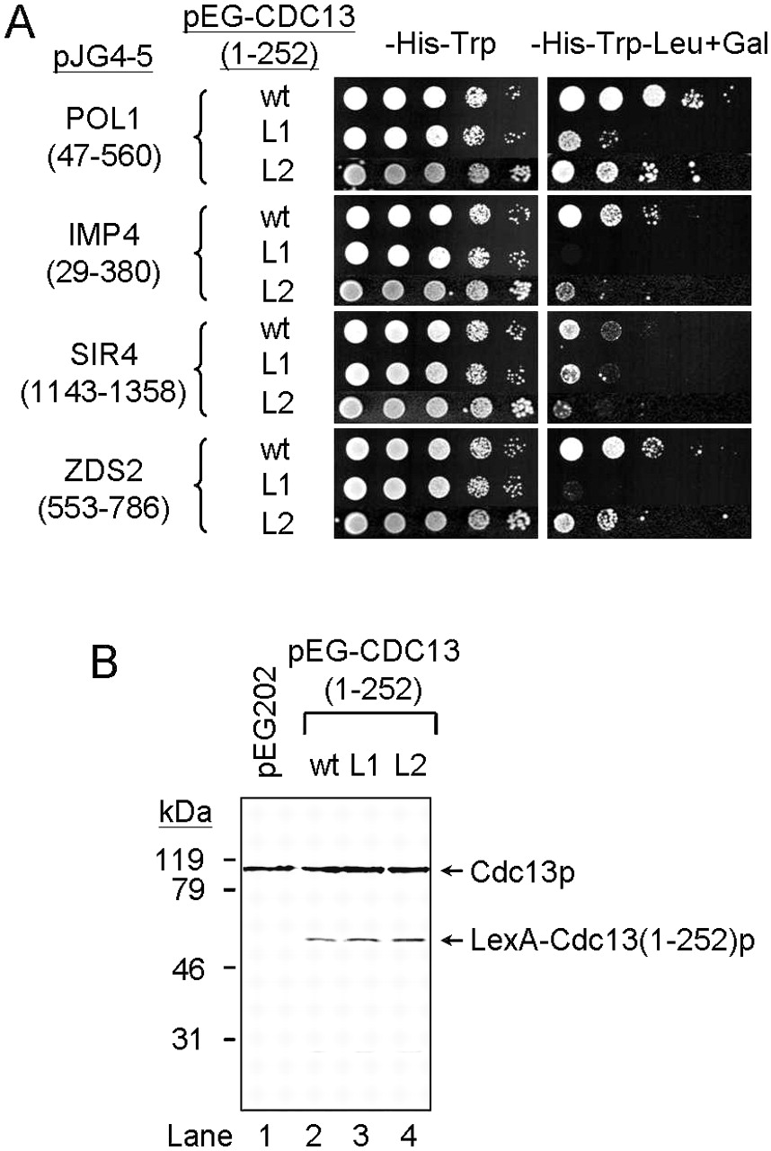
Figure 7. Identification of mutant Cdc13p that failed to interact with Pol1(47–560)p, Imp4(28–290)p, ...
Notes:
Figure 7. Identification of mutant Cdc13p that failed to interact with Pol1(47–560)p, Imp4(28–290)p, Zds2(553–786)p or Sir4(1143–1358)p. (A) Two‐hybrid analysis of cdc13 mutants, L1 and L2, and their interacting proteins. Yeast cells YEM1α/pEG‐CDC13(1–252), YEM1α/pEG‐CDC13(1–252)‐L1 or YEM1α/pEG‐CDC13(1–252)‐L2 carrying plasmid pJG4‐5, pJG‐POL1(47–560), pJG‐IMP4(28–290), pJG‐ZDS2(553–786) or pJG‐SIR4(1143–1358) were grown on YC medium lacking histidine and tryptophan at 30°C. Cells were then analyzed by their abilities to grow in the absence of leucine. Ten‐fold serial dilution of cells were spotted on glucose or galactose plates either without histidine and tryptophan or without leucine, tryptophan and histidine and incubated at 30°C until colonies formed. Photographs of the plates are shown. (B) Western analysis of cdc13 mutants that disrupt interactions with its binding proteins. Extracts prepared from the indicated strains were analyzed by SDS–PAGE and western blotting using an anti‐Cdc13(1–252)p antiserum. The positions of endogenous Cdc13p and LexA‐Cdc13(1–252)p are indicated.
Unless provided in the caption above, the following copyright applies to the content of this slide: Oxford University Press

Slide 8
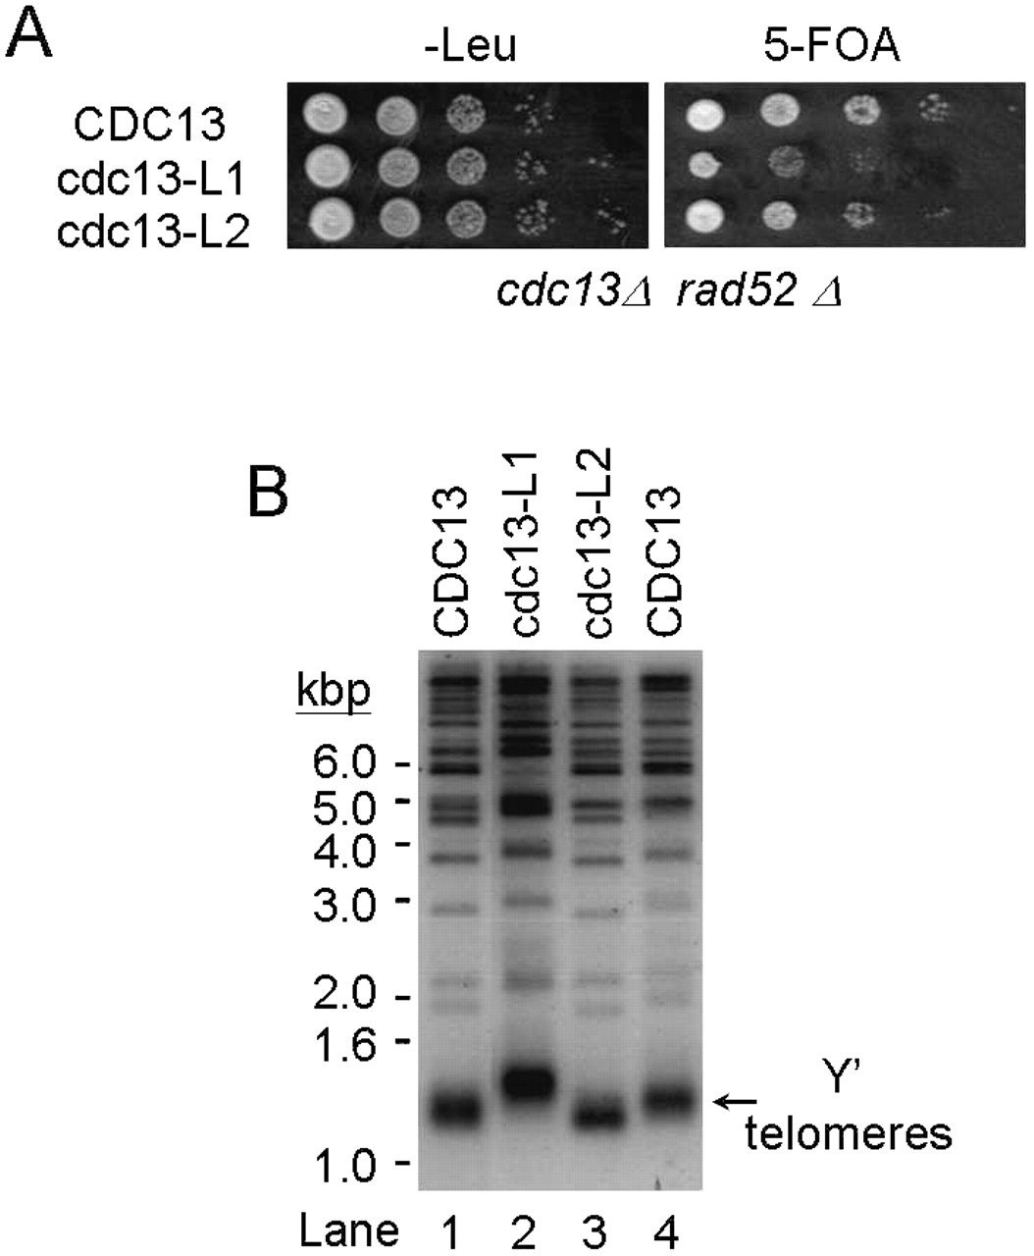
Figure 8. The cdc13 mutants cause telomere maintenance defects. (A) Complementation of a cdc13Δ mutant by ...
Notes:
Figure 8. The cdc13 mutants cause telomere maintenance defects. (A) Complementation of a cdc13Δ mutant by cdc13‐L1 or cdc13‐L2. Yeast strain YJL501rad52 (cdc13Δ::HIS3 rad52Δ::TRP1/YEP24‐CDC13) carrying plasmid pTHA‐NLS‐CDC13(1–924), pTHA‐NLS‐CDC13‐L1 or pTHA‐NLS‐CDC13‐L2 was spotted in 10‐fold serial dilutions on YC‐Leu plates or plates containing 5‐FOA and incubated at 30°C until colonies were formed. The plates are shown here. (B) Telomere phenotype of cdc13Δ/Cdc13‐L1p and cdc13Δ/Cdc13‐L2p cells. Yeast DNA was isolated from two different cultures of the indicated strain, digested with XhoI, separated on a 1% agarose gel and analyzed by Southern blotting. The blot was hybridized with probes prepared from 270 bp TG1–3/C1–3A. Arrow indicates the Y′ bearing telomeres.
Unless provided in the caption above, the following copyright applies to the content of this slide: Oxford University Press

