Slide 1
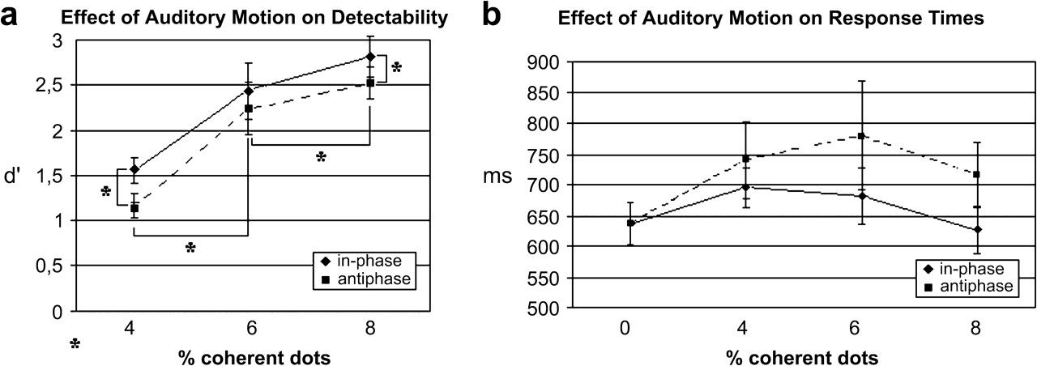
Figure 1. (a) Mean d′ values and standard errors of 11 subjects for the in phase and antiphase condition as a function ...
Notes:
Figure 1. (a) Mean d′ values and standard errors of 11 subjects for the in phase and antiphase condition as a function of motion coherence. (b) Mean response times (measured from the offset of the stimulus) and standard errors of eleven subjects for the same experimental conditions.
Unless provided in the caption above, the following copyright applies to the content of this slide: © The Author 2006. Published by Oxford University Press. All rights reserved. For permissions, please e-mail: journals.permissions@oxfordjournals.org

Slide 2
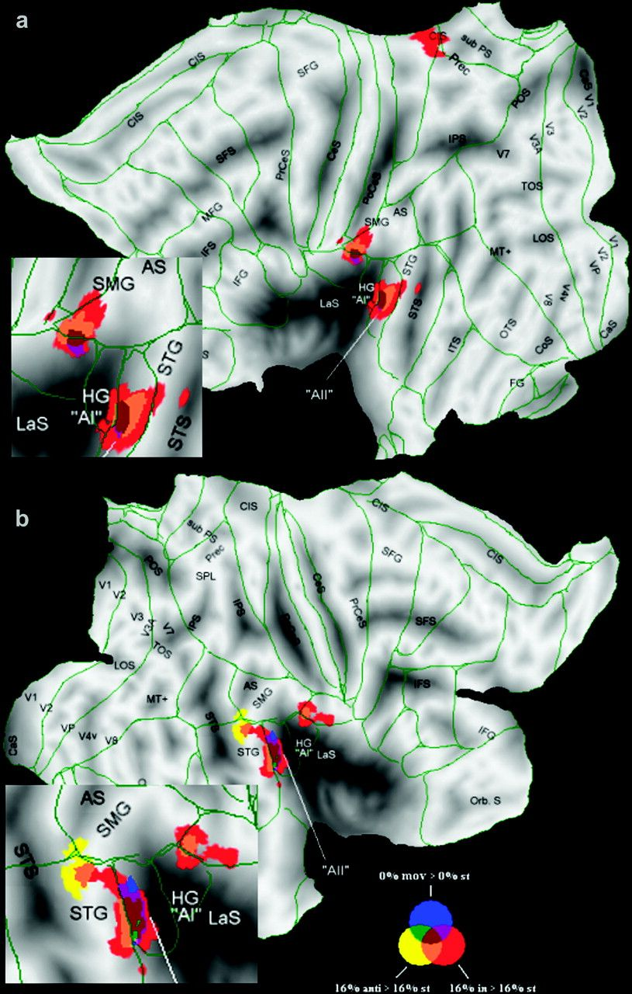
Figure 2. (a) Left-hemispheric group activation maps for moving versus stationary sounds of 12 subjects with detail ...
Notes:
Figure 2. (a) Left-hemispheric group activation maps for moving versus stationary sounds of 12 subjects with detail magnification of the activated region. (b) Right-hemispheric group activation maps for moving versus stationary sounds of 12 subjects with detail magnification of the activated region. The different colors indicate the effect of the visual RDK on this activation (red = 16% in phase moving > stationary, yellow = 16% antiphase moving > stationary, blue = 0% moving > stationary). Flat map representation of significant fMRI activity. Overlaps are indicated by intermediate colors (see color inset). Activation is shown overlaid onto MNI-normalized single subject right hemisphere flat map (Van Essen 2002) template (significant clusters surpassing a threshold of alpha = 0.05 [corrected for multiple comparisons] are presented). Identified visual areas (V1, V2, MT+, etc.) are from the Colin atlas database. The borders represent Brodmann areas from the Colin atlas. Abbreviations: AI = primary auditory cortex, AII = secondary auditory cortex, AS = angular sulcus, CaS = calcarine sulcus, CeS = central sulcus, CiG = cingulate gyrus, CiS = cingulate sulcus, CoS = collateral sulcus, FG = fusiform gyrus, GL = lingual gyrus, IFG = inferior frontal gyrus, HG = Heschl's gyrus, ITG = inferior temporal gyrus, ITS = inferiotemporal sulcus, LaS = lateral sulcus, LOS = lateral occipital sulcus, MFG = middle frontal gyrus, Orb. S = orbital sulcus, PoCeG = posterior central gyrus, PoCeS = posterior central Sulcus, Prec = precuneus, PrCeG = precentral gyrus, SFS = superior frontal sulcus, SPL = superior parietal lobule, STS = superior temporal sulcus, subPS = subparietal sulcus, TOS = transverse occipital sulcus.
Unless provided in the caption above, the following copyright applies to the content of this slide: © The Author 2006. Published by Oxford University Press. All rights reserved. For permissions, please e-mail: journals.permissions@oxfordjournals.org

Slide 3
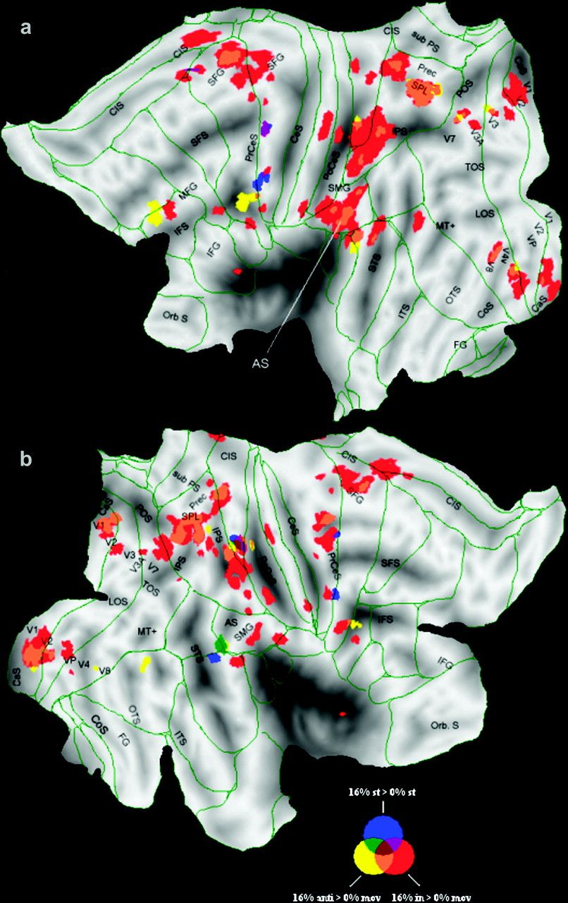
Figure 3. (a) Left-hemispheric group activation maps for coherent versus random visual motion of 12 subjects. (b) ...
Notes:
Figure 3. (a) Left-hemispheric group activation maps for coherent versus random visual motion of 12 subjects. (b) Right-hemispheric group activation maps for the data of 12 subjects. The different colors indicate the effect of the different sound conditions on this activation (red = in phase, yellow = antiphase and blue = stationary). Flat map representation of fMRI activity. Overlaps are indicated by intermediate colors (see color inset). Activation is shown overlaid onto MNI-normalized single subject right hemisphere flat map (Van Essen 2002) template (significant clusters surpassing a threshold of alpha = 0.05 [corrected for multiple comparisons] are presented). Identified visual areas (V1, V2, MT+, etc.) are from the Colin atlas database. The borders represent Brodmann areas from the Colin atlas. For abbreviations see Figure 2.
Unless provided in the caption above, the following copyright applies to the content of this slide: © The Author 2006. Published by Oxford University Press. All rights reserved. For permissions, please e-mail: journals.permissions@oxfordjournals.org

