Slide 1
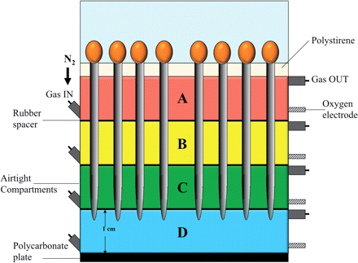
Fig. 1 Scheme of the growth chamber utilized to submit different regions of the root apex to hypoxic conditions. ...
Notes:
Fig. 1 Scheme of the growth chamber utilized to submit different regions of the root apex to hypoxic conditions. Each of the 4 different compartments of the growth chamber (A, B, C and D) can be separately made hypoxic by flowing it with N2. Each compartment is 1 cm deep; each root apex penetrates in the D compartment for 4 mm.
Unless provided in the caption above, the following copyright applies to the content of this slide: © The Author 2012. Published by Oxford University Press on behalf of Japanese Society of Plant Physiologists. All rights reserved. For permissions, please email: journals.permissions@oup.com

Slide 2
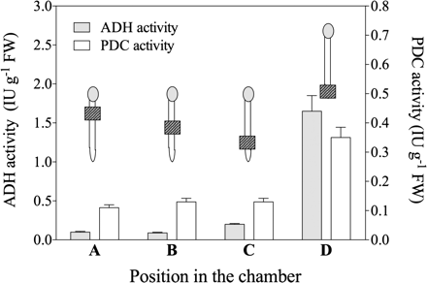
Fig. 2 Acclimation requires local root apex hypoxia. ADH and PDC activities have been measured in the whole root ...
Notes:
Fig. 2 Acclimation requires local root apex hypoxia. ADH and PDC activities have been measured in the whole root after different regions of the roots were subjected to 1 h of hypoxia ([O2] <10 nmol). ADH and PDC increase in the whole root just in the case that the root apex was subjected to hypoxia (D). Data are the means ± SD (n = 18). The position from A to D corresponds to the positions in the chamber represented in Fig. 1.
Unless provided in the caption above, the following copyright applies to the content of this slide: © The Author 2012. Published by Oxford University Press on behalf of Japanese Society of Plant Physiologists. All rights reserved. For permissions, please email: journals.permissions@oup.com

Slide 3
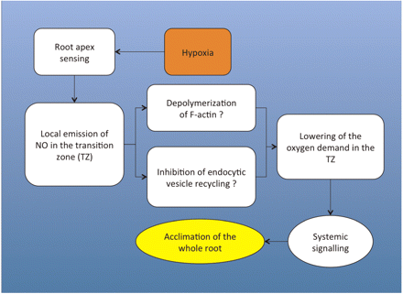
Fig. 9 A generalized model of the auto-regulatory loop between NO emission and oxygen consumption in the transition ...
Notes:
Fig. 9 A generalized model of the auto-regulatory loop between NO emission and oxygen consumption in the transition zone of the root apex.
Unless provided in the caption above, the following copyright applies to the content of this slide: © The Author 2012. Published by Oxford University Press on behalf of Japanese Society of Plant Physiologists. All rights reserved. For permissions, please email: journals.permissions@oup.com

Slide 4
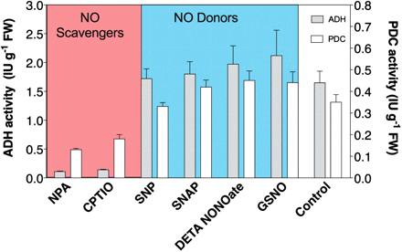
Fig. 8 ADH and PDC activities in the whole root after 1 h treatment of the root apex with NO donors in normoxic ...
Notes:
Fig. 8 ADH and PDC activities in the whole root after 1 h treatment of the root apex with NO donors in normoxic conditions and/or NO scavengers in hypoxic conditions ([O2] <10 nmol). Control is under hypoxic conditions. Data are the means ± SD (n = 22).
Unless provided in the caption above, the following copyright applies to the content of this slide: © The Author 2012. Published by Oxford University Press on behalf of Japanese Society of Plant Physiologists. All rights reserved. For permissions, please email: journals.permissions@oup.com

Slide 5
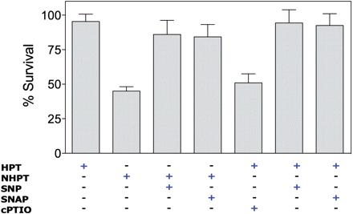
Fig. 7 Effect of NO donors (SNP and SNAP) and a scavenger (cPTIO) on the survival rates of maize seedlings, ...
Notes:
Fig. 7 Effect of NO donors (SNP and SNAP) and a scavenger (cPTIO) on the survival rates of maize seedlings, previously subjected to hypoxic treatment (HPT) or not (NHPT), under anoxic conditions. Data are the means ± SD (n = 18).
Unless provided in the caption above, the following copyright applies to the content of this slide: © The Author 2012. Published by Oxford University Press on behalf of Japanese Society of Plant Physiologists. All rights reserved. For permissions, please email: journals.permissions@oup.com

Slide 6
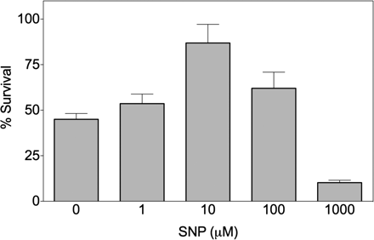
Fig. 6 Dose-dependent effect of SNP on the survival rate of maize roots under anoxia. Data are the means ± SD (n = ...
Notes:
Fig. 6 Dose-dependent effect of SNP on the survival rate of maize roots under anoxia. Data are the means ± SD (n = 23).
Unless provided in the caption above, the following copyright applies to the content of this slide: © The Author 2012. Published by Oxford University Press on behalf of Japanese Society of Plant Physiologists. All rights reserved. For permissions, please email: journals.permissions@oup.com

Slide 7
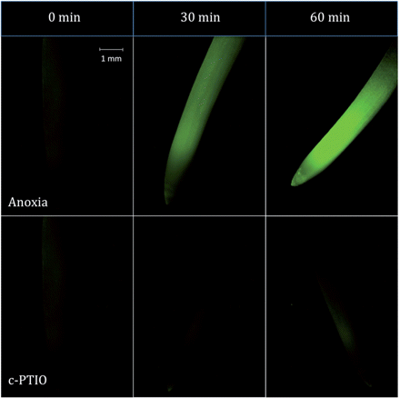
Fig. 5 NO production in mays roots exposed to different anoxia treatment (30 and 60 min). Three-day-old seedlings ...
Notes:
Fig. 5 NO production in mays roots exposed to different anoxia treatment (30 and 60 min). Three-day-old seedlings were loaded with 10 µM DAF-2A for 60 min and then subjected to anoxia for 30 and 60 min. Results are from one of four representative experiments.
Unless provided in the caption above, the following copyright applies to the content of this slide: © The Author 2012. Published by Oxford University Press on behalf of Japanese Society of Plant Physiologists. All rights reserved. For permissions, please email: journals.permissions@oup.com

Slide 8
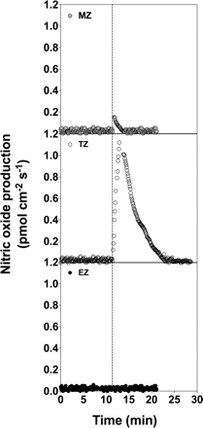
Fig. 4 A representative graph showing NO production in the different regions of the root apex after hypoxia (dotted ...
Notes:
Fig. 4 A representative graph showing NO production in the different regions of the root apex after hypoxia (dotted line): DZ (Division Zone); TZ (Transition Zone); EZ Elongation Zone).
Unless provided in the caption above, the following copyright applies to the content of this slide: © The Author 2012. Published by Oxford University Press on behalf of Japanese Society of Plant Physiologists. All rights reserved. For permissions, please email: journals.permissions@oup.com

Slide 9
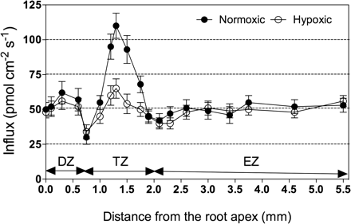
Fig. 3 Oxygen fluxes obtained by measurements in different regions of intact root apices (DZ, division zone; TZ, ...
Notes:
Fig. 3 Oxygen fluxes obtained by measurements in different regions of intact root apices (DZ, division zone; TZ, transition zone; EZ, elongation zone) under normoxic (filled circles) or hypoxic (open circles) conditions. Data are the means ± SD (n = 16).
Unless provided in the caption above, the following copyright applies to the content of this slide: © The Author 2012. Published by Oxford University Press on behalf of Japanese Society of Plant Physiologists. All rights reserved. For permissions, please email: journals.permissions@oup.com

