Slide 1
Fig. 1 Brain imaging in five females with FLNA mutations demonstrates extensive contiguous (B, C, D) or ...
Notes:
Fig. 1 Brain imaging in five females with FLNA mutations demonstrates extensive contiguous (B, C, D) or non-contiguous (A) PNH involving the body and trigones of the lateral ventricles with overlying normal cortex, except that heterotopia are seen only on the right in one patient (B). The sagittal section (E) shows extensive heterotopia beneath the walls of the body and trigones of the lateral ventricle, with sparing of the temporal horn and hippocampal formation. The associated FLNA mutations in these patients are: Q668X in patient 2-II.2 (A), S149P in patient 2-III.1 (as reported in Guerrini et al., 2004) (B), c.4038 delG in patient 5-I.2 (C) who is the mother of 5-II.2, A39G in patient F8 who has EDS (D), and IVS5+2T→A in Patient 1 (E).
Unless provided in the caption above, the following copyright applies to the content of this slide: © The Author (2006). Published by Oxford University Press on behalf of the Guarantors of Brain. All rights reserved. For Permissions, please email: journals.permissions@oxfordjournals.org

Slide 2
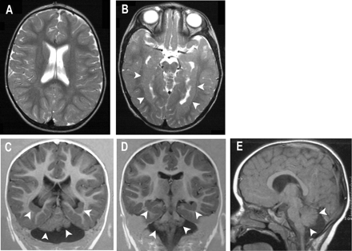
Fig. 2 Brain imaging in two patients with bilateral PNH involving the temporo-occipital horns and trigones with ...
Notes:
Fig. 2 Brain imaging in two patients with bilateral PNH involving the temporo-occipital horns and trigones with hippocampal malformation and cerebellar hypoplasia. A–D are from the same patient, a 6-year-old, girl. A sagittal section through the bodies of the lateral ventricles (A), shows that there is no subependymal heterotopia at this level; a lower sagittal section, through the temporal horns (B) shows contiguous bilateral subependymal heterotopia (arrowheads) which reaches the tip of the temporal horns where it merges with the hippocampal formations. Coronal sections show heterotopia surrounding the trigones (C) and merging with the hippocampal formation (D) as well as severe cerebellar hypoplasia. A sagittal section in a 15-year-old, girl (E), shows severe cerebellar hypoplasia involving both cerebellar hemispheres and the vermis (C and D).
Unless provided in the caption above, the following copyright applies to the content of this slide: © The Author (2006). Published by Oxford University Press on behalf of the Guarantors of Brain. All rights reserved. For Permissions, please email: journals.permissions@oxfordjournals.org

Slide 3
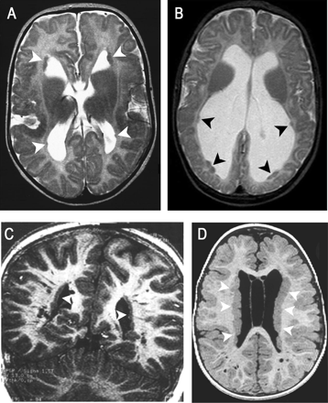
Fig. 3 Brain imaging in four children with different forms of PNH. In A, axial section showing bilateral PNH with ...
Notes:
Fig. 3 Brain imaging in four children with different forms of PNH. In A, axial section showing bilateral PNH with fronto-perisylvian polymicrogyria in a 4-year-old boy. Small subependymal nodules are visible in both frontal and occipital horns (arrows). There is polymicrogyria in the perisylvian and fronto-opercular cortex bilaterally. In B, axial section in a 6-year-old boy with PNH and hydrocephalus. There is severe enlargement of both lateral ventricles, especially involving the occipital horns where small clusters of subependymal nodules are present (arrowheads). C and D are coronal and axial sections in two 7-years-old boys with bilateral PNH with frontonasal dysplasia. Both children present bilateral contiguous subependymal nodules (arrowheads) and structural abnormality in the white matter where scattered cystic formations are present, possibly representing dilated Virchow-Robin spaces.
Unless provided in the caption above, the following copyright applies to the content of this slide: © The Author (2006). Published by Oxford University Press on behalf of the Guarantors of Brain. All rights reserved. For Permissions, please email: journals.permissions@oxfordjournals.org

Slide 4
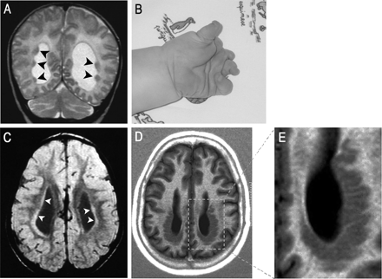
Fig. 4 A and B illustrate PNH and severe limb limb reduction abnormality in a 2-year-old girl. In A, a coronal ...
Notes:
Fig. 4 A and B illustrate PNH and severe limb limb reduction abnormality in a 2-year-old girl. In A, a coronal section shows non-contiguous heterotopic nodules (arrowheads) and dilated ventricles. In B, the left hand is shown. In C, an axial section in a 15-year-old girl with diffuse linear PH surrounding the lateral ventricles (arrowheads); no nodules can be seen. There is thickening of the cortex with simplified gyral pattern especially in the frontal lobes. D and E show PH with ribbon-like aspect in a 25 years old woman. D is an axial section showing grey matter heterotopia surrounding the posterior aspect of the lateral ventricles and E is a magnification showing the nearly sinusoidal ribbon like structure of the heterotopic grey matter that is reminiscent of a simplified gyral pattern.
Unless provided in the caption above, the following copyright applies to the content of this slide: © The Author (2006). Published by Oxford University Press on behalf of the Guarantors of Brain. All rights reserved. For Permissions, please email: journals.permissions@oxfordjournals.org

Slide 5
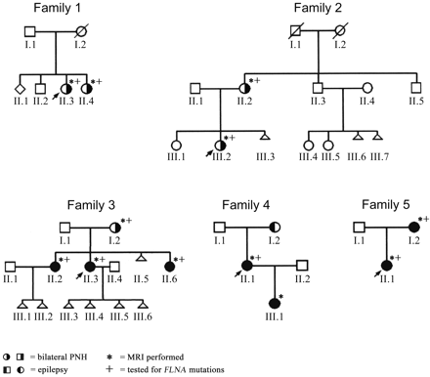
Fig. 5 Pedigrees of families 1–5.
Notes:
Fig. 5 Pedigrees of families 1–5.
Unless provided in the caption above, the following copyright applies to the content of this slide: © The Author (2006). Published by Oxford University Press on behalf of the Guarantors of Brain. All rights reserved. For Permissions, please email: journals.permissions@oxfordjournals.org

Slide 6
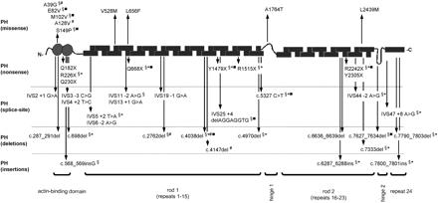
Fig. 6 Location of FLNA mutations (see Table 2 and Table A in Supplementary online material) on the structure of the ...
Notes:
Fig. 6 Location of FLNA mutations (see Table 2 and Table A in Supplementary online material) on the structure of the FLNA monomer containing repeat blocks of 96 amino acids (Gorlin et al., 1990). In the upper part of the panel are shown FLNA missense mutations associated with periventricular heterotopia (PH). In the bottom part of the panel are shown FLNA mutations causing frame-shift or protein truncation (nonsense, splice-site, deletions and insertions) that are associated with PH. §Known FLNA mutations also observed in this study; *new FLNA mutations reported in this study; familial cases in this study; #EDS associated mutations.
Unless provided in the caption above, the following copyright applies to the content of this slide: © The Author (2006). Published by Oxford University Press on behalf of the Guarantors of Brain. All rights reserved. For Permissions, please email: journals.permissions@oxfordjournals.org

