Slide 1
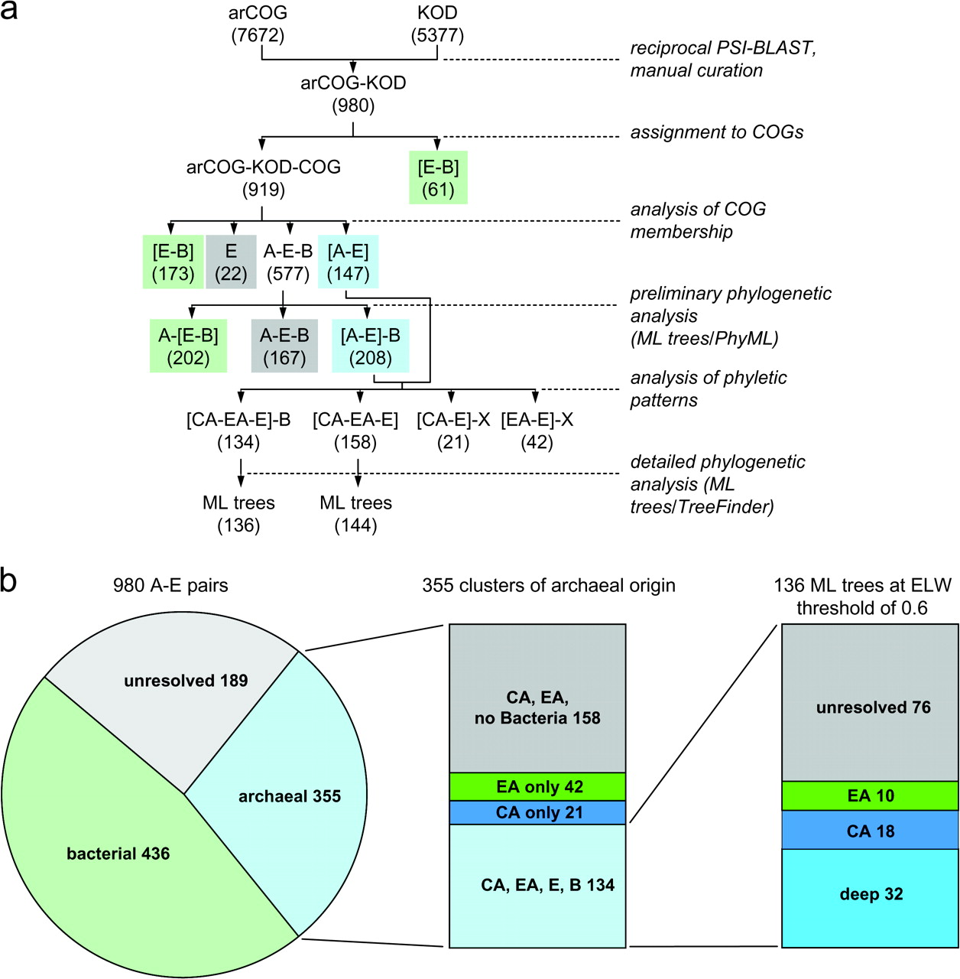
FIG. 1.— Phylogenetic classification of the archaeal–eukaryotic orthologs. (a) Flowchart of the procedure. (b) ...
Notes:
FIG. 1.— Phylogenetic classification of the archaeal–eukaryotic orthologs. (a) Flowchart of the procedure. (b) Breakdown of orthologous clusters by inferred origin A, archaea; B, bacteria; CA, Crenarchaeota; E, eukaryotes; and EA, Euryarchaeota. For further details, see text.
Unless provided in the caption above, the following copyright applies to the content of this slide: Published by Oxford University Press 2008.This is an Open Access article distributed under the terms of the Creative Commons Attribution Non-Commercial License (http://creativecommons.org/licenses/by-nc/2.0/uk/) which permits unrestricted non-commercial use, distribution, and reproduction in any medium, provided the original work is properly cited.

Slide 2
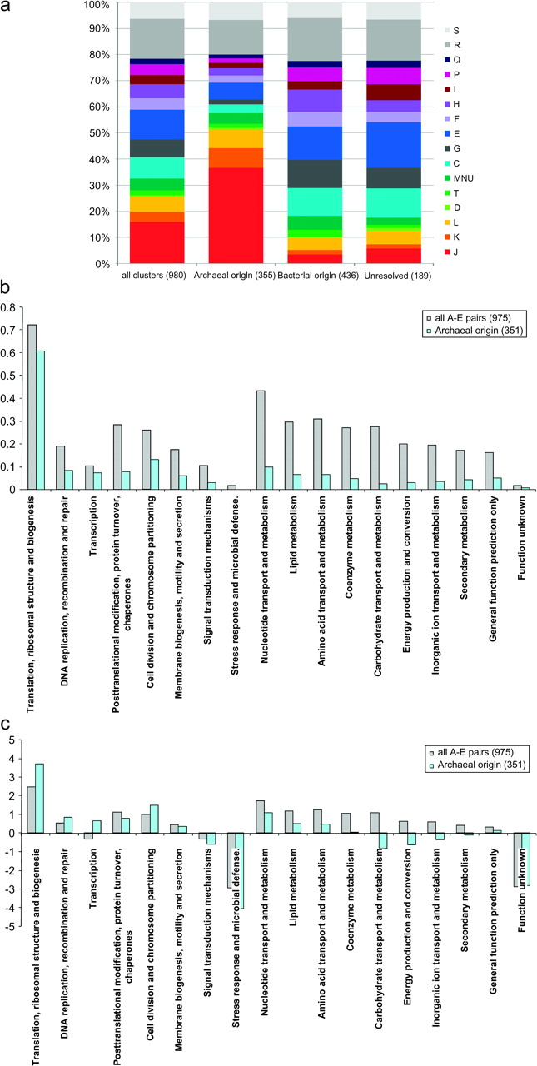
FIG. 2.— Functional classification of ancestral eukaryotic genes of different probable origins. (a) Distribution of ...
Notes:
FIG. 2.— Functional classification of ancestral eukaryotic genes of different probable origins. (a) Distribution of ancestral eukaryotic genes of different inferred origins by functional categories. The functional classes are as in the COG database: C, energy production and conversion; D, cell division; E, amino acid metabolism and transport; F, nucleotide metabolism and transport; G, carbohydrate metabolism and transport; H, coenzyme metabolism; I, lipid metabolism; J, translation; K, transcription; L, replication and repair; O, posttranslational modification, protein turnover, and chaperone functions; Q, secondary metabolism; T, signal transduction; U, intracellular trafficking and secretion; V, defense and resistance; R, general functional prediction only (typically, prediction of biochemical activity); and S, function unknown. (b) Fractions of arCOGs belonging to different functional classes in the set of 975 A–E pairs and in the set of 351 eukaryotic genes of inferred archaeal origin. (c) Log-odds ratio of the fraction of arCOGs belonging to different functional classes relative to the fraction of arCOGs that belong to the A–E set and the set of eukaryotic genes of inferred archaeal origin (1,008/7,538 and 286/7,538, respectively). The log base is 2.
Unless provided in the caption above, the following copyright applies to the content of this slide: Published by Oxford University Press 2008.This is an Open Access article distributed under the terms of the Creative Commons Attribution Non-Commercial License (http://creativecommons.org/licenses/by-nc/2.0/uk/) which permits unrestricted non-commercial use, distribution, and reproduction in any medium, provided the original work is properly cited.

Slide 3
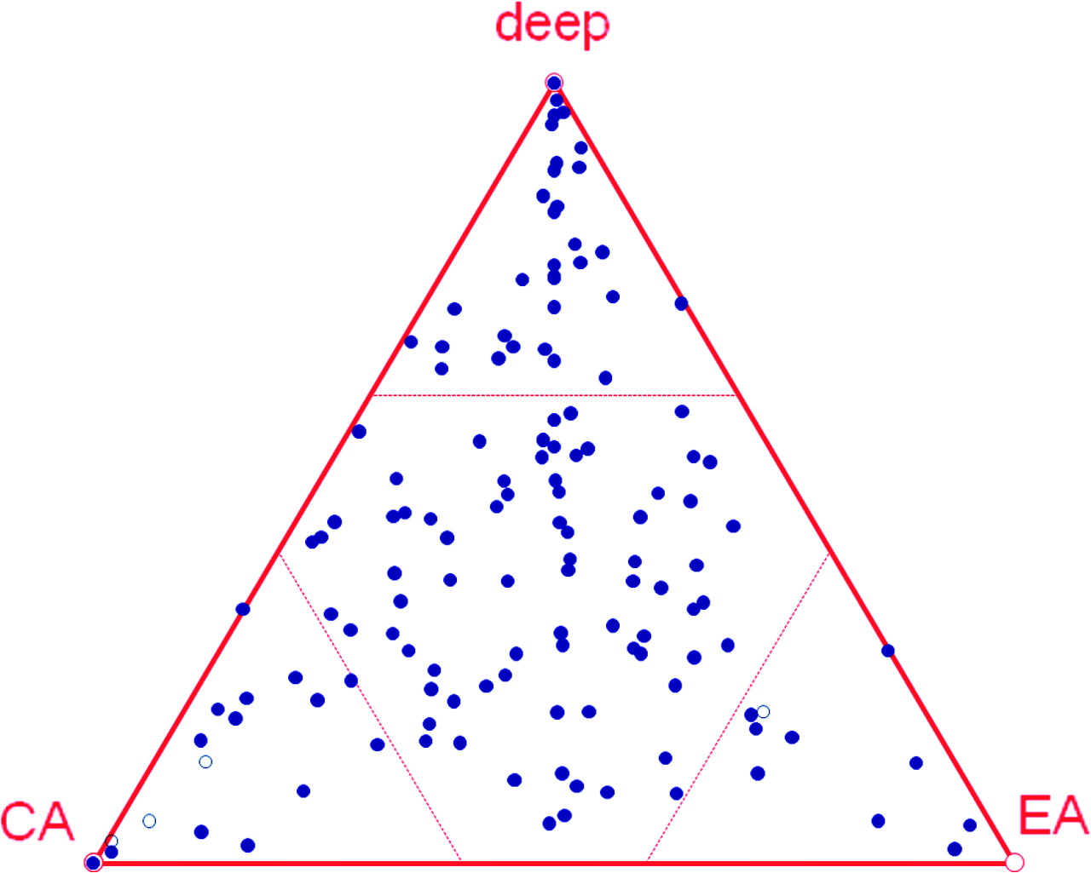
FIG. 3.— The evolutionary relationship between archaea and eukaryotes assessed by phylogenetic analysis of 136 A–E–B ...
Notes:
FIG. 3.— The evolutionary relationship between archaea and eukaryotes assessed by phylogenetic analysis of 136 A–E–B clusters. The ELW values are plotted on a simplex surface.
Unless provided in the caption above, the following copyright applies to the content of this slide: Published by Oxford University Press 2008.This is an Open Access article distributed under the terms of the Creative Commons Attribution Non-Commercial License (http://creativecommons.org/licenses/by-nc/2.0/uk/) which permits unrestricted non-commercial use, distribution, and reproduction in any medium, provided the original work is properly cited.

Slide 4
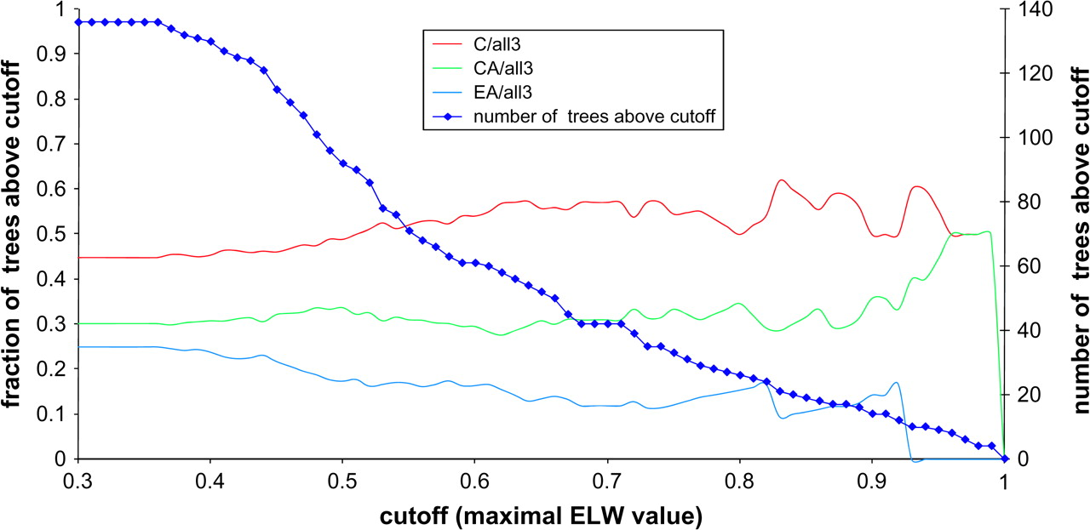
FIG. 4.— Distribution of the deep, crenarchaeal, and euryarchaeal topologies depending on the ELW value cutoff.
Notes:
FIG. 4.— Distribution of the deep, crenarchaeal, and euryarchaeal topologies depending on the ELW value cutoff.
Unless provided in the caption above, the following copyright applies to the content of this slide: Published by Oxford University Press 2008.This is an Open Access article distributed under the terms of the Creative Commons Attribution Non-Commercial License (http://creativecommons.org/licenses/by-nc/2.0/uk/) which permits unrestricted non-commercial use, distribution, and reproduction in any medium, provided the original work is properly cited.

Slide 5
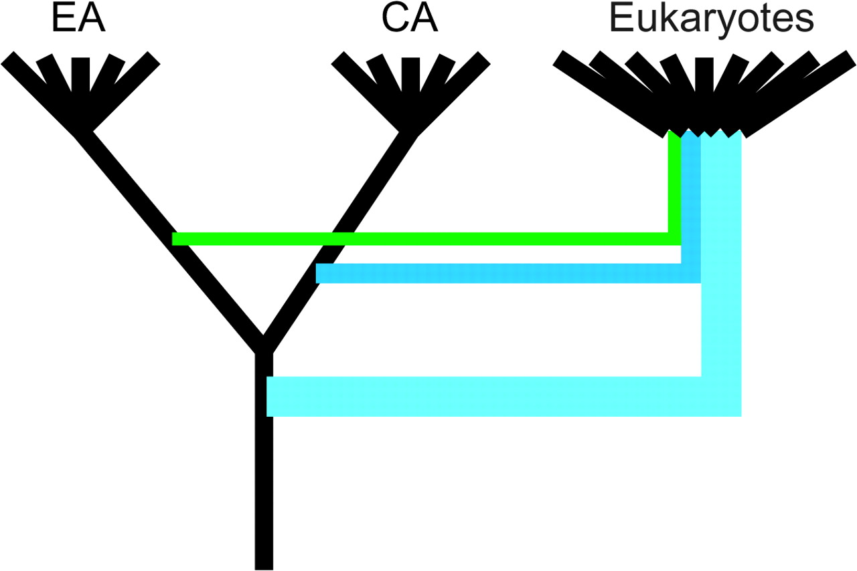
FIG. 5.— A cartoon representation of the deep, crenarchaeal, and euryarchaeal inferred origins of the archaeal genes ...
Notes:
FIG. 5.— A cartoon representation of the deep, crenarchaeal, and euryarchaeal inferred origins of the archaeal genes in eukaryotes.
Unless provided in the caption above, the following copyright applies to the content of this slide: Published by Oxford University Press 2008.This is an Open Access article distributed under the terms of the Creative Commons Attribution Non-Commercial License (http://creativecommons.org/licenses/by-nc/2.0/uk/) which permits unrestricted non-commercial use, distribution, and reproduction in any medium, provided the original work is properly cited.

