Slide 1
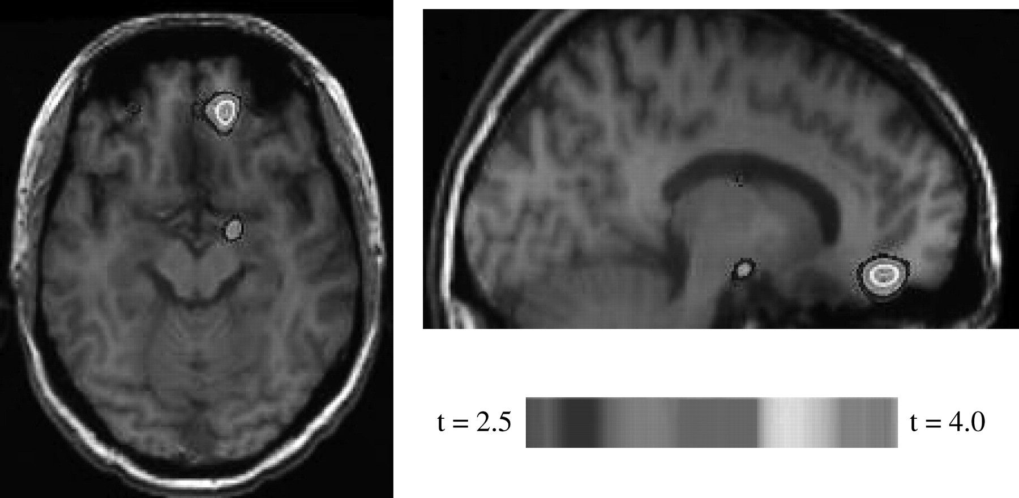
Figure 1. Altering image duration from 3 to 6 s significantly interacted with emotional activation of the IMPC, ...
Notes:
Figure 1. Altering image duration from 3 to 6 s significantly interacted with emotional activation of the IMPC, changing the significant deactivation of the area found during 3 s to activation.
Unless provided in the caption above, the following copyright applies to the content of this slide: © The Author 2007. Published by Oxford University Press. All rights reserved. For permissions, please e-mail: journals.permissions@oxfordjournals.org

Slide 2
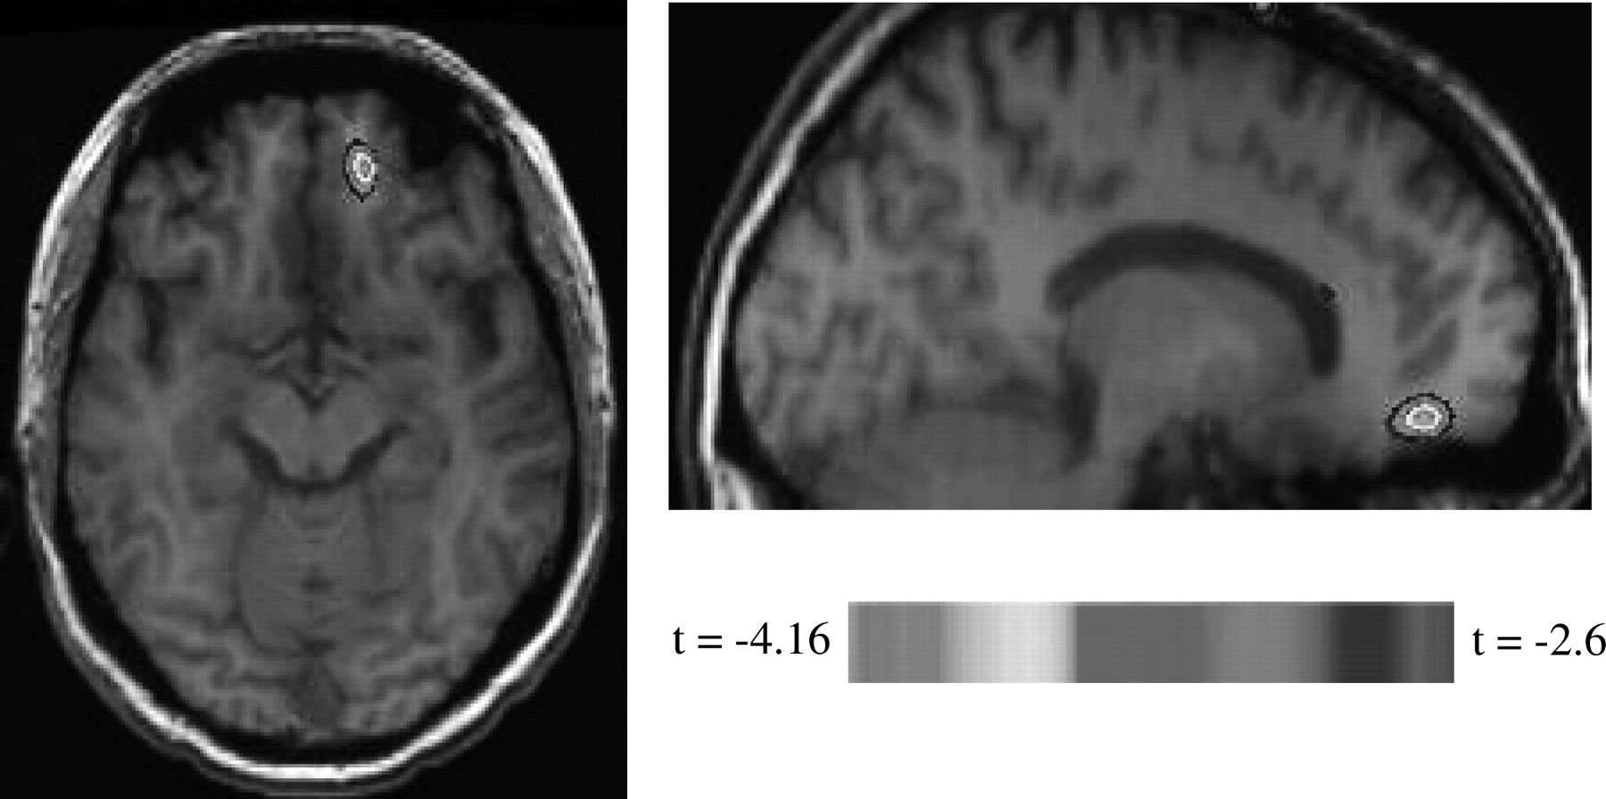
Figure 2. When images were displayed for 3 s, emotional content decreased rCBF in the IMPC at the right middle frontal ...
Notes:
Figure 2. When images were displayed for 3 s, emotional content decreased rCBF in the IMPC at the right middle frontal gyrus compared with neutral.
Unless provided in the caption above, the following copyright applies to the content of this slide: © The Author 2007. Published by Oxford University Press. All rights reserved. For permissions, please e-mail: journals.permissions@oxfordjournals.org

Slide 3
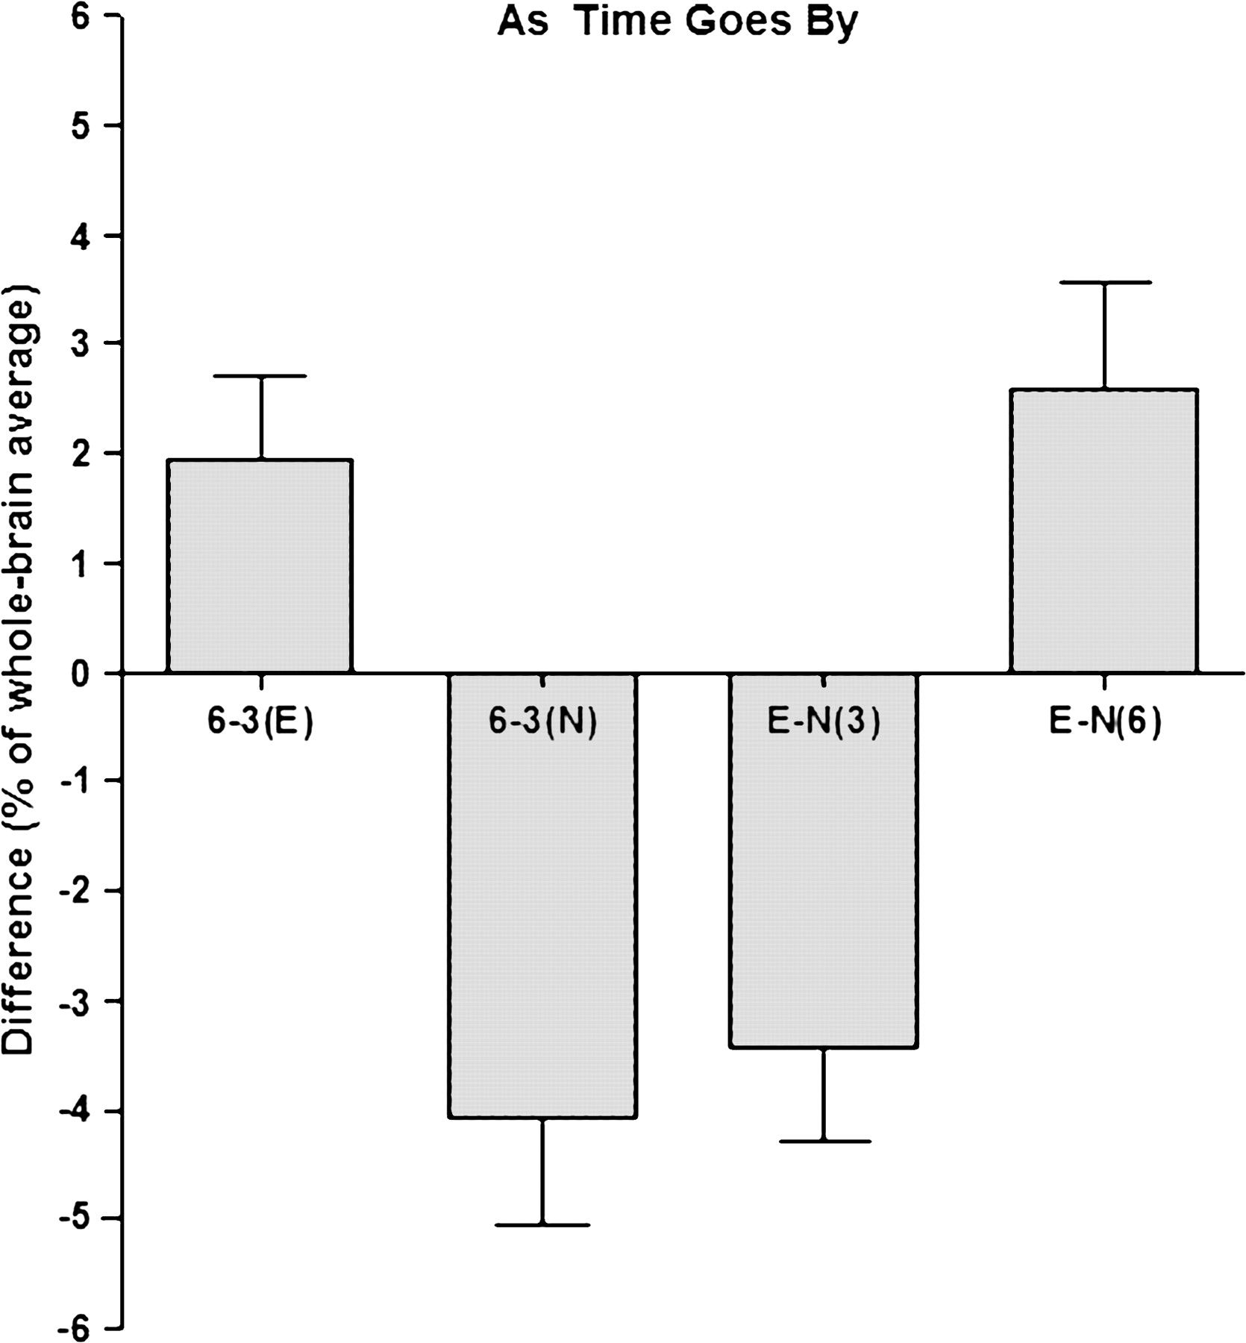
Figure 3. At coordinates of maximum interaction in the ROI changing stimulus duration from 3 to 6 s for emotional ...
Notes:
Figure 3. At coordinates of maximum interaction in the ROI changing stimulus duration from 3 to 6 s for emotional images increased rCBF in IMPC (P value [2 tailed] = 0.0242), whereas extended exposure for the neutral stimuli decreased rCBF (P value [2 tailed] = 0.0015). Stratifying for emotional content versus neutral, rCBF falls, when images are displayed for 3 s (P value [2 tailed] = 0.0021) and rises for 6 s (P value [2 tailed] = 0.0236).
Unless provided in the caption above, the following copyright applies to the content of this slide: © The Author 2007. Published by Oxford University Press. All rights reserved. For permissions, please e-mail: journals.permissions@oxfordjournals.org

Slide 4
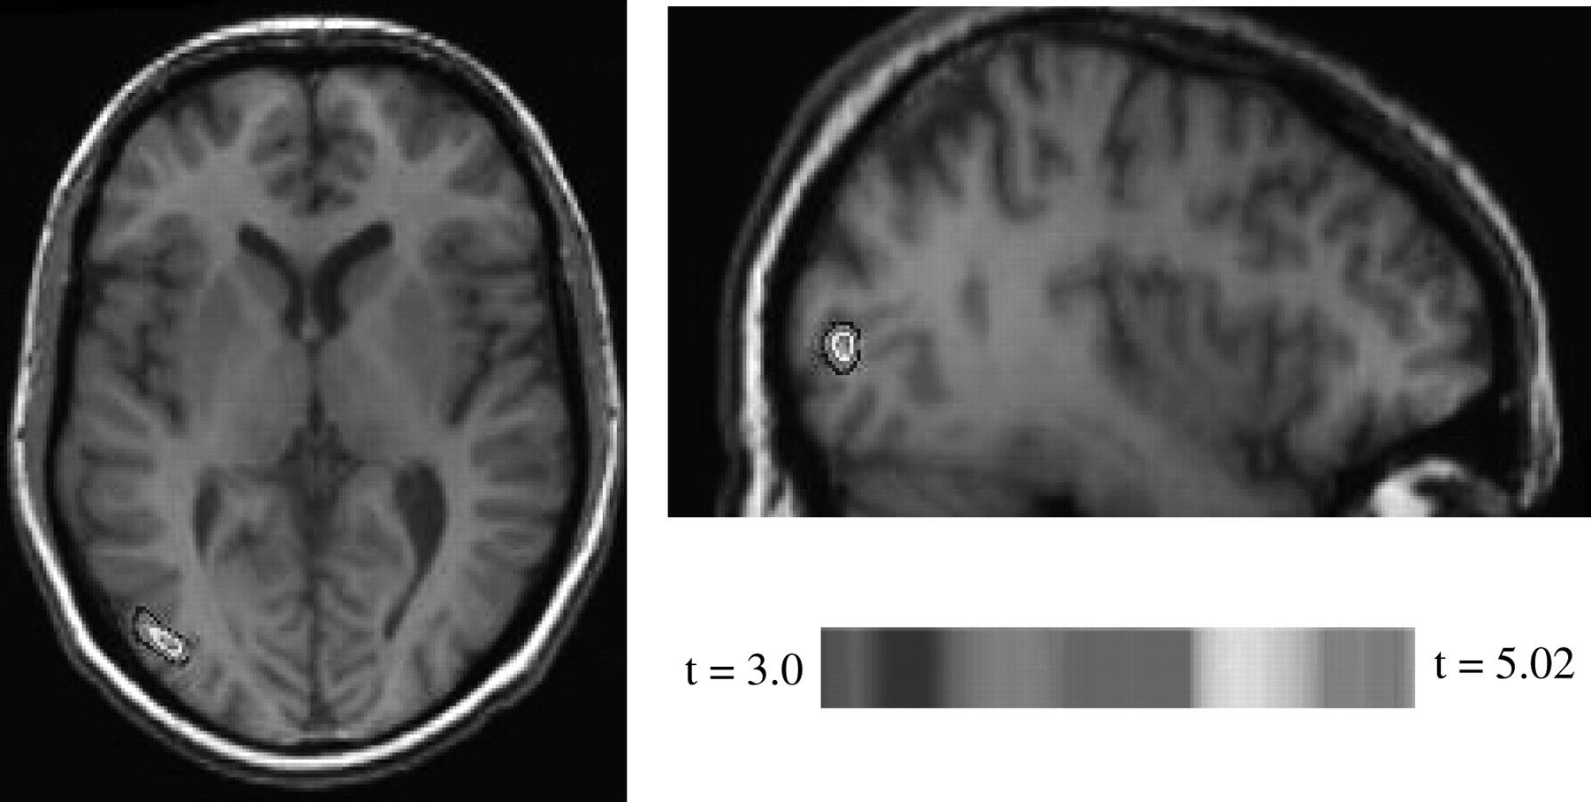
Figure 4. Compared with neutral images, regardless of stimulus duration, emotional content increased rCBF in the left ...
Notes:
Figure 4. Compared with neutral images, regardless of stimulus duration, emotional content increased rCBF in the left inferior occipital gyrus.
Unless provided in the caption above, the following copyright applies to the content of this slide: © The Author 2007. Published by Oxford University Press. All rights reserved. For permissions, please e-mail: journals.permissions@oxfordjournals.org

Slide 5
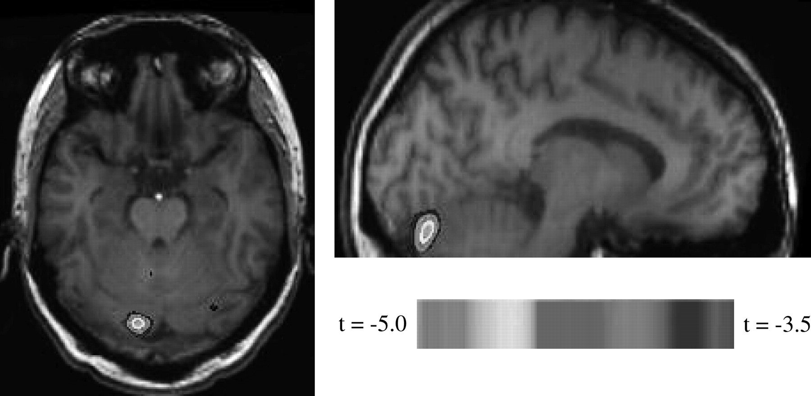
Figure 5. Emotion-induced activation in the left cerebellar hemisphere was significantly reduced when image duration ...
Notes:
Figure 5. Emotion-induced activation in the left cerebellar hemisphere was significantly reduced when image duration went up from 3 to 6 s.
Unless provided in the caption above, the following copyright applies to the content of this slide: © The Author 2007. Published by Oxford University Press. All rights reserved. For permissions, please e-mail: journals.permissions@oxfordjournals.org

