Slide 1
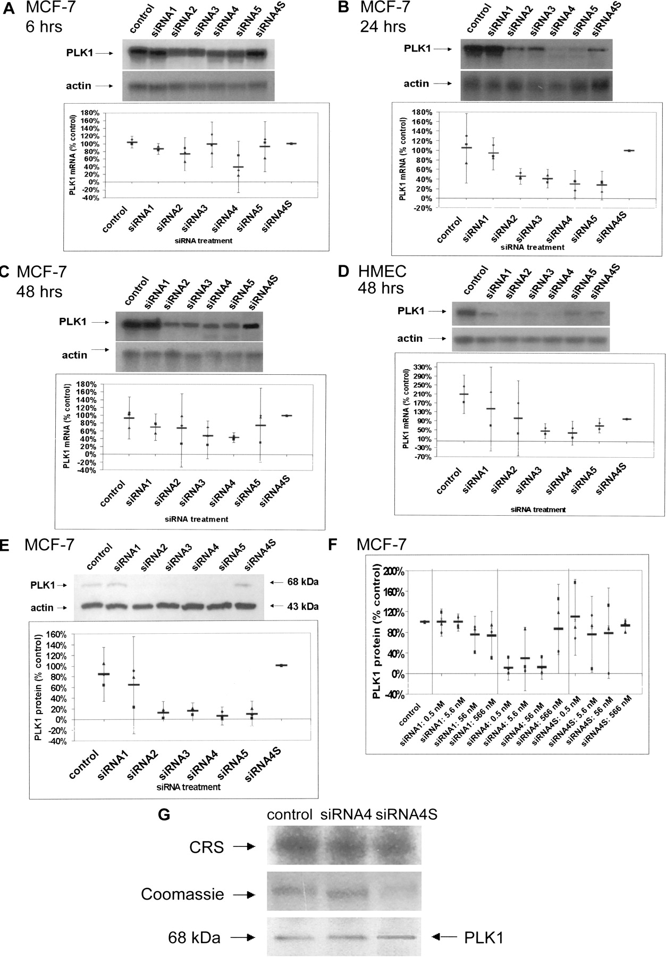
Fig. 1. Effect of small interfering RNA (siRNA) transfection on polo-like kinase-1 (PLK1) mRNA and protein levels in ...
Notes:
Fig. 1. Effect of small interfering RNA (siRNA) transfection on polo-like kinase-1 (PLK1) mRNA and protein levels in MCF-7 breast cancer cells and human mammary epithelial cells (HMECs). A–C) PLK1 mRNA was subject to northern blot analysis 6 (A), 24 (B), and 48 (C) hours after the beginning of transfection of MCF-7 breast cancer cells with 56 nM siRNA. To control for variability of loading and transfer, membranes were reprobed for human β-actin, and actin-normalized PLK1 mRNA levels were compared. The amount of PLK1 mRNA expression remaining is given as a percentage of PLK1 mRNA levels in cells transfected with siRNA4S. Control cells were incubated with Opti-MEM I alone (no siRNA or oligofectamine). Scatterplots show results of three independent experiments (three different symbols), their means (indicated as a horizontal bar), and 95% confidence intervals (CIs). D) PLK1 mRNA levels in HMECs were measured 48 hours after the beginning of transfection with 2 μM siRNAs. Normalization, standardization, and comparison with siRNA4S-transfected cells were as in A–C.Fig. 1. E) Western blot analysis of PLK1 protein was carried out 48 hours after the beginning of transfection of MCF-7 breast cancer cells with 56 nM siRNA. Actin served as a loading control. The amount of PLK1 protein remaining is given as a percentage of levels in cells transfected with siRNA4S after standardization to actin levels. Control cells were incubated with Opti-MEM I alone (no siRNA or oligofectamine). Scatterplot shows results of three independent experiments, their means, and 95% CIs. A–E) siRNA1 is targeted against lamins, siRNA2–5 are targeted against PLK1, and siRNA4S is a scrambled version of siRNA4. F) Western blot analysis of PLK1 protein expression in MCF-7 cells 48 hours after transfection with varying concentrations (0.56–566 nM) of siRNA1, siRNA4, and siRNA4S. In this particular analysis, remaining PLK1 protein levels were standardized to levels in untransfected control cells (i.e., MCF-7 cells incubated with Opti-MEM I alone without siRNA or oligofectamine). Scatterplot shows results of four independent experiments, their means, and 95% CIs. G) Kinase activity of immunoprecipitated PLK1 protein 48 hours after transfection of MCF-7 cells with 56 nM siRNA4, compared with control and siRNA4S-transfected cells. Kinase activity was visualized by phosphorylation of the substrate, cytoplasmic retention signal (CRS) (upper panel). Coomassie blue staining served as control for variability of loading of substrate CRS (middle panel). Western blot analysis of immunoprecipitated PLK1 demonstrates that equal amounts of PLK1 were subjected to kinase assays (lower panel). For quantification, signal intensities of phosphorylated substrate (kinase activity) were normalized to the amount of CRS loaded in each lane, and the kinase activity remaining after siRNA transfection was compared to that in untransfected control cells (incubated with Opti-MEM I alone, without siRNA or oligofectamine).
Unless provided in the caption above, the following copyright applies to the content of this slide: © Oxford University Press

Slide 2
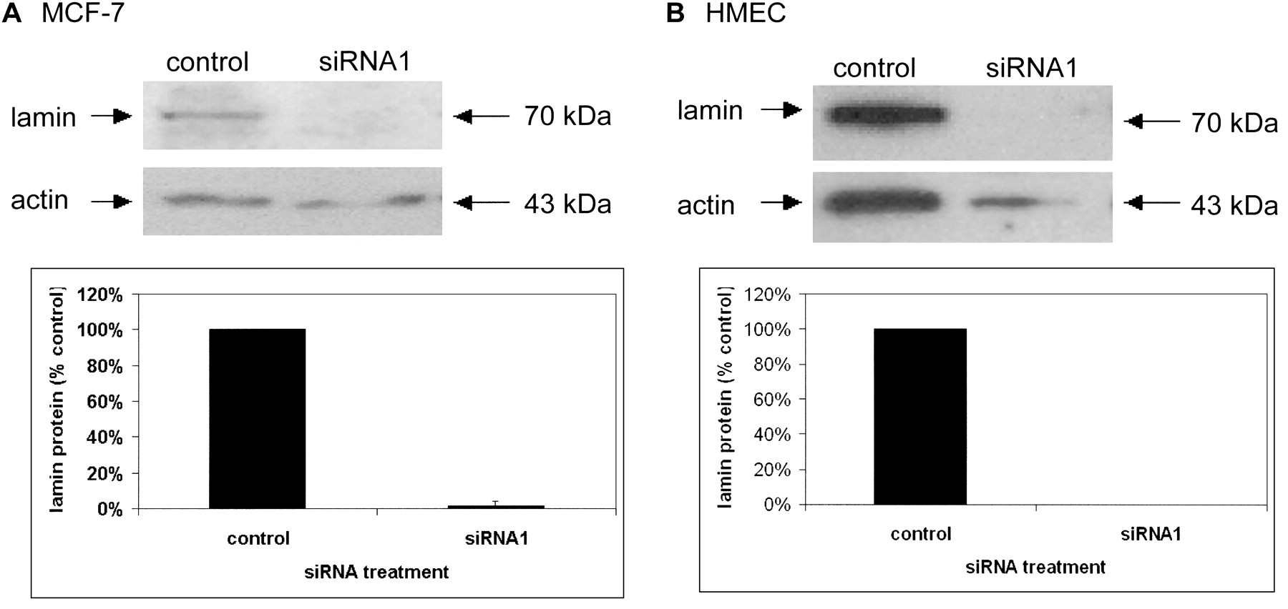
Fig. 2. Effect of small interfering RNA (siRNA) transfection on lamin protein levels in MCF-7 breast cancer cells and ...
Notes:
Fig. 2. Effect of small interfering RNA (siRNA) transfection on lamin protein levels in MCF-7 breast cancer cells and human mammary epithelial cells (HMECs). Reduction of lamin protein was determined 48 hours after the beginning of transfection with 56 nM siRNA1 (MCF-7 cells; A) and 2 μM siRNA1 (HMECs; B). Actin served as a control for equal loading. Percentage of remaining levels was calculated as a percentage of lamin protein levels in control cells (incubated with Opti-MEM I alone and without siRNA or oligofectamine) after standardization to actin levels. Two replicate experiments were performed, and means and 95% confidence intervals are indicated if the confidence intervals differed from zero.
Unless provided in the caption above, the following copyright applies to the content of this slide: © Oxford University Press

Slide 3
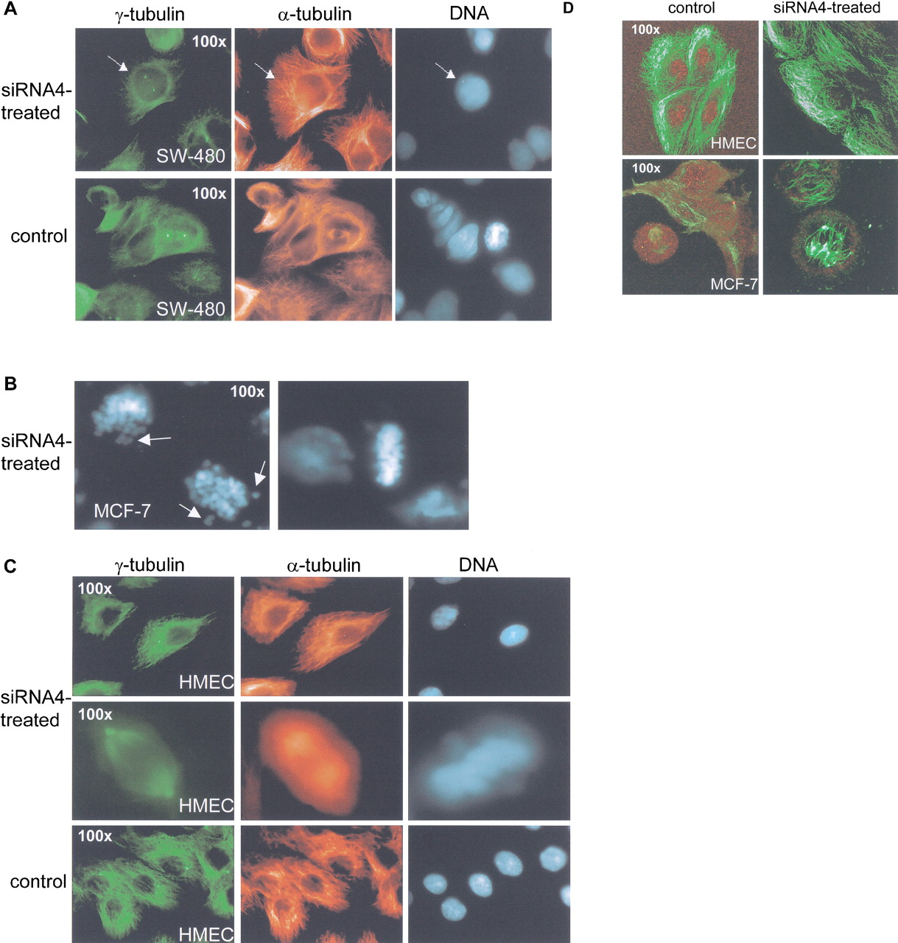
Fig. 3. Immunofluorescence analysis of SW-480 colon cancer cells, MCF-7 breast cancer cells, and human mammary ...
Notes:
Fig. 3. Immunofluorescence analysis of SW-480 colon cancer cells, MCF-7 breast cancer cells, and human mammary epithelial cells (HMECs) transfected with small interfering RNA (siRNA). Cells were transfected with siRNA4 (SW-480, 56 nM; MCF-7, 56 nM; HMECs, 2 μM) and analyzed 48 hours later for DNA by 2-(4-amidinophenyl)-6-indolecarbamidine dihydrochloride (DAPI) staining (blue), for γ-tubulin by immunostaining (green), for α-tubulin by immunostaining (red in panels A–C, green in panel D), and for PLK1 by immunostaining (red in panel D). A) siRNA4 transfection of SW-480 cells resulted in abrogated spindle formation at centrosomes (upper panel). Arrows point to a cell with centrosomes devoid of any microtubule connection. Untransfected cells (incubated with Opti-MEM I alone, with no siRNA or oligofectamine) show normal spindle formation (lower panel). B) Supernatant of MCF-7 cell cultures after siRNA4 transfection contained many mitotic cells that were characterized by highly condensed, knoblike chromosomes. Some chromosomes were located adjacent to the nucleus, as indicated by arrows. C) siRNA4-transfected HMECs displayed centrosomes that were able to organize microtubules (upper panel). These cells proceeded through mitosis with normal phenotype (middle panel). Phenotypes of control cells were similar to those of siRNA4-transfected cells. D) Both MCF-7 cells and HMECs showed reduction of PLK1 protein after siRNA4 transfection. Untransfected MCF-7 cells had normal mitotic phenotypes, whereas siRNA4-transfected MCF-7 cells showed impaired mitoses. In HMECs no mitotic cells could be found; therefore, PLK1 reduction is shown in interphase cells.
Unless provided in the caption above, the following copyright applies to the content of this slide: © Oxford University Press

Slide 4
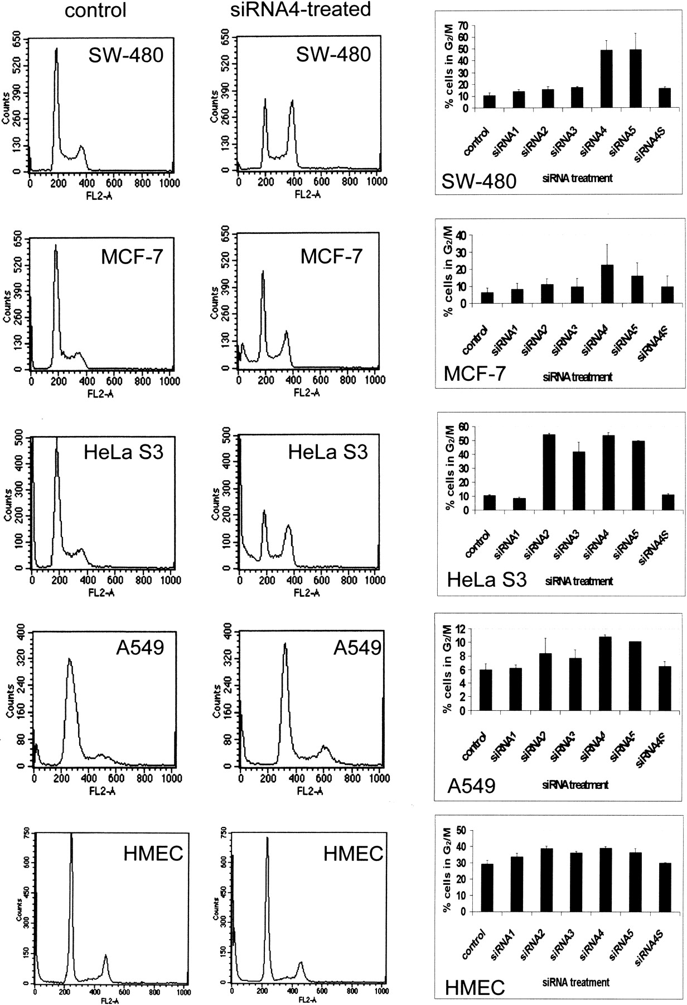
Fig. 4. Effect of transfection with small interfering RNA (siRNA) against PLK1 (siRNA4) on cell cycle distribution of ...
Notes:
Fig. 4. Effect of transfection with small interfering RNA (siRNA) against PLK1 (siRNA4) on cell cycle distribution of cancer cells and human mammary epithelial cells (HMECs). FACScan analysis of SW-480 colon cancer, MCF-7 breast cancer, HeLa S3 cervical cancer, and A549 lung cancer cells 48 hours after transfection with 56 nM siRNA4 and in HMECs 48 hours after transfection with 2 μM siRNA4 (left panel). Controls were incubated with Opti-MEM I alone (no siRNA or oligofectamine). The intensity of fluorescence (which is proportional to the DNA content) is given on the x-axis, and the number of fluorescent cells is given on the y-axis. Graph is a representation of the effects of siRNA1–5 and siRNA4S on cell cycle distribution in cancer cell lines and HMECs (right panel). Bars show means and 95% confidence intervals of three independent experiments.
Unless provided in the caption above, the following copyright applies to the content of this slide: © Oxford University Press

Slide 5
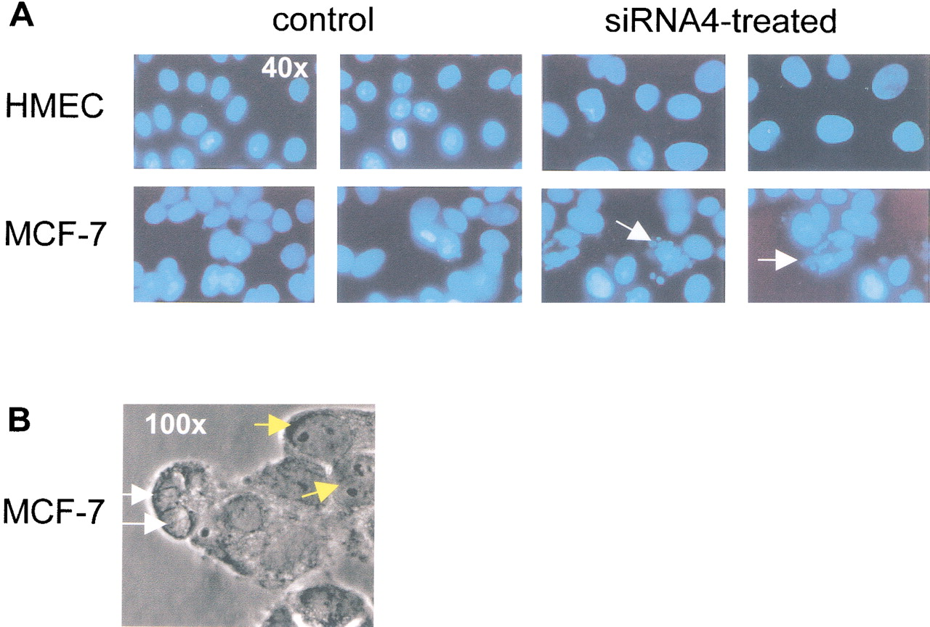
Fig. 5. Effect of transfection with small interfering RNA (siRNA) against PLK1 (siRNA4) on apoptosis of cancer cells ...
Notes:
Fig. 5. Effect of transfection with small interfering RNA (siRNA) against PLK1 (siRNA4) on apoptosis of cancer cells and human mammary epithelial cells (HMECs). A) DAPI (2-(4-amidinophenyl)-6-indolecarbamidine dihydrochloride) staining for DNA of HMECs and MCF-7 cells 48 hours after transfection with siRNA4 (56 nM for MCF-7 cells, and 2 μM for HMECs) reveals apoptotic phenotypes in MCF-7 cells (arrows). B) Confocal laser scanning microscope analysis revealed apoptotic cells with disintegrated nuclear membranes and condensed chromatin in this phase-contrast image of MCF-7 cells. White arrows indicate apoptotic nuclei, and yellow arrows indicate normal nuclei.
Unless provided in the caption above, the following copyright applies to the content of this slide: © Oxford University Press

Slide 6
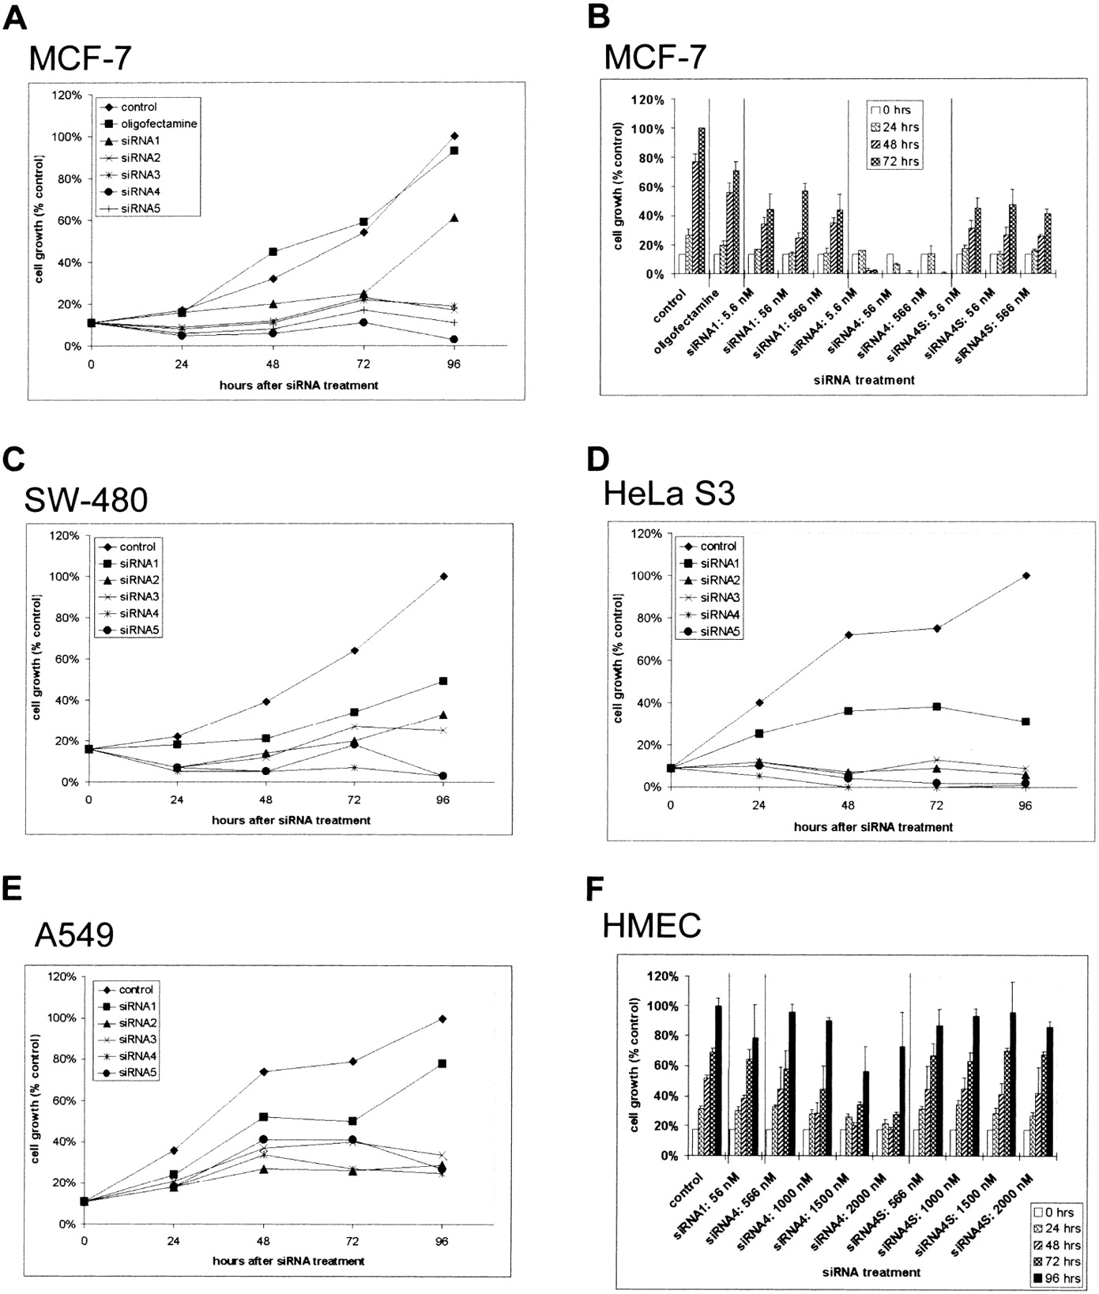
Fig. 6. Effect of small interfering RNA (siRNA) transfection on proliferation of cancer cells and human mammary ...
Notes:
Fig. 6. Effect of small interfering RNA (siRNA) transfection on proliferation of cancer cells and human mammary epithelial cells (HMECs). Percentage of surviving cells is given as a percentage of the number of control cells after 96 hours of incubation with Opti-MEM I alone (no siRNA or oligofectamine). A, C–E) Survival of MCF-7 breast cancer cells (A), SW-480 colon cancer cells (C), HeLa S3 cervical cancer cells (D), and A549 lung cancer cells (E) over a period of 96 hours after transfection. B and F) Proliferation of MCF-7 cells (B) and HMECs (F) at various times after transfection with various concentrations of siRNA1, siRNA4, and siRNA4S (5.6–566 nM for MCF-7 cells, 56 nM–2 μM for HMECs). Line graphs (A, C–E) represent means of three independent experiments. Bar graphs (B and F) represent means and 95% confidence intervals of three different experiments.
Unless provided in the caption above, the following copyright applies to the content of this slide: © Oxford University Press

Slide 7
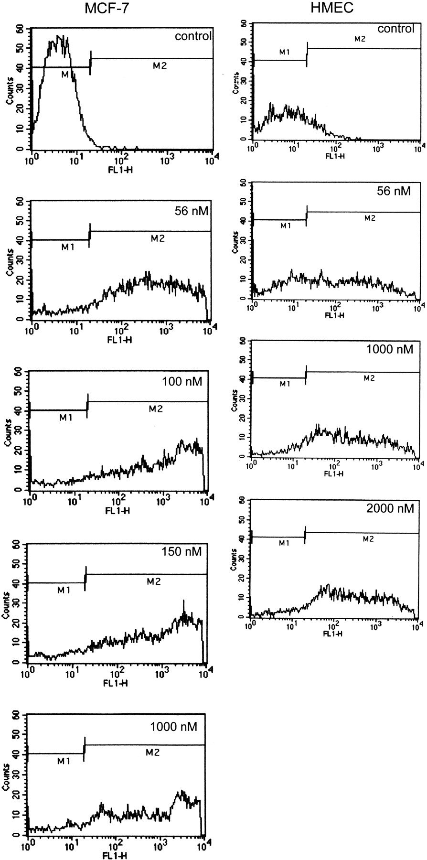
Fig. 7. Uptake of fluorescein-labeled small interfering RNA4 (siRNA4) by MCF-7 breast cancer cells and human mammary ...
Notes:
Fig. 7. Uptake of fluorescein-labeled small interfering RNA4 (siRNA4) by MCF-7 breast cancer cells and human mammary epithelial cells (HMECs). Fluorescence-activated cell sorting (FACScan) analysis of control cells (i.e., incubated with Opti-MEM I alone, no siRNA or oligofectamine) and fluorescein-labeled siRNA4-transfected MCF-7 cells (left panel) and HMECs (right panel). The concentration of siRNA4 is indicated at the upper right of each graph. All transfections were carried out for 24 hours. M1 denotes the fluorescence of control cells (background) and M2 that of fluorescein-labeled siRNA4-containing cells. The intensity of fluorescence, representing the uptake of fluorescein-labeled siRNA4, is indicated on the x-axis; the number of fluorescent cells is given on the y-axis.
Unless provided in the caption above, the following copyright applies to the content of this slide: © Oxford University Press

