Slide 1
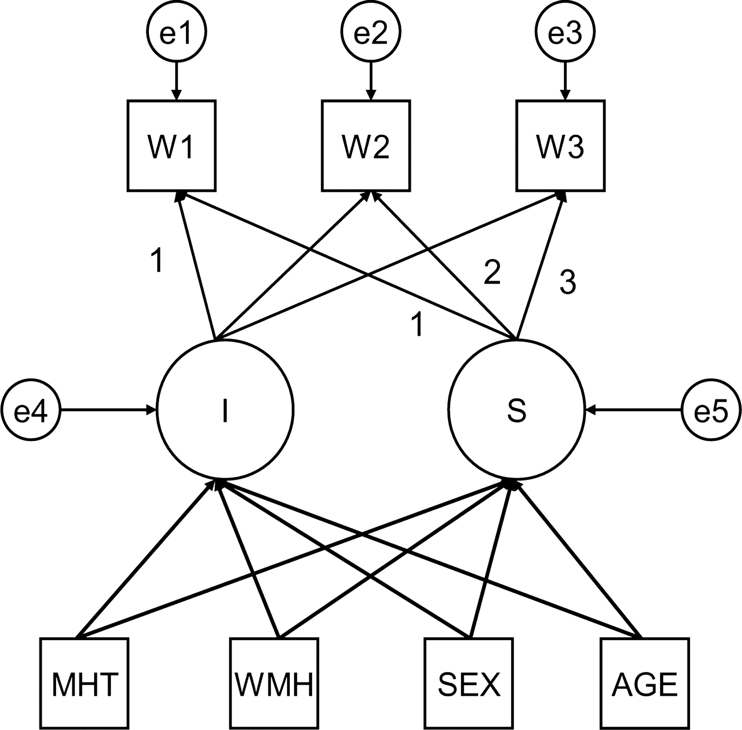
Figure 1. The latent growth model. W1, W2 and W3 represent the RPM scores at 3 waves, respectively. I and S represent ...
Notes:
Figure 1. The latent growth model. W1, W2 and W3 represent the RPM scores at 3 waves, respectively. I and S represent the intercept and slope. MHT is the Moray House Test score. Age is the age of the participant when first imaged.
Unless provided in the caption above, the following copyright applies to the content of this slide: © The Author 2011. Published by Oxford University Press on behalf of the British Geriatrics Society. All rights reserved. For Permissions, please email: journals.permissions@oup.com

