Slide 1
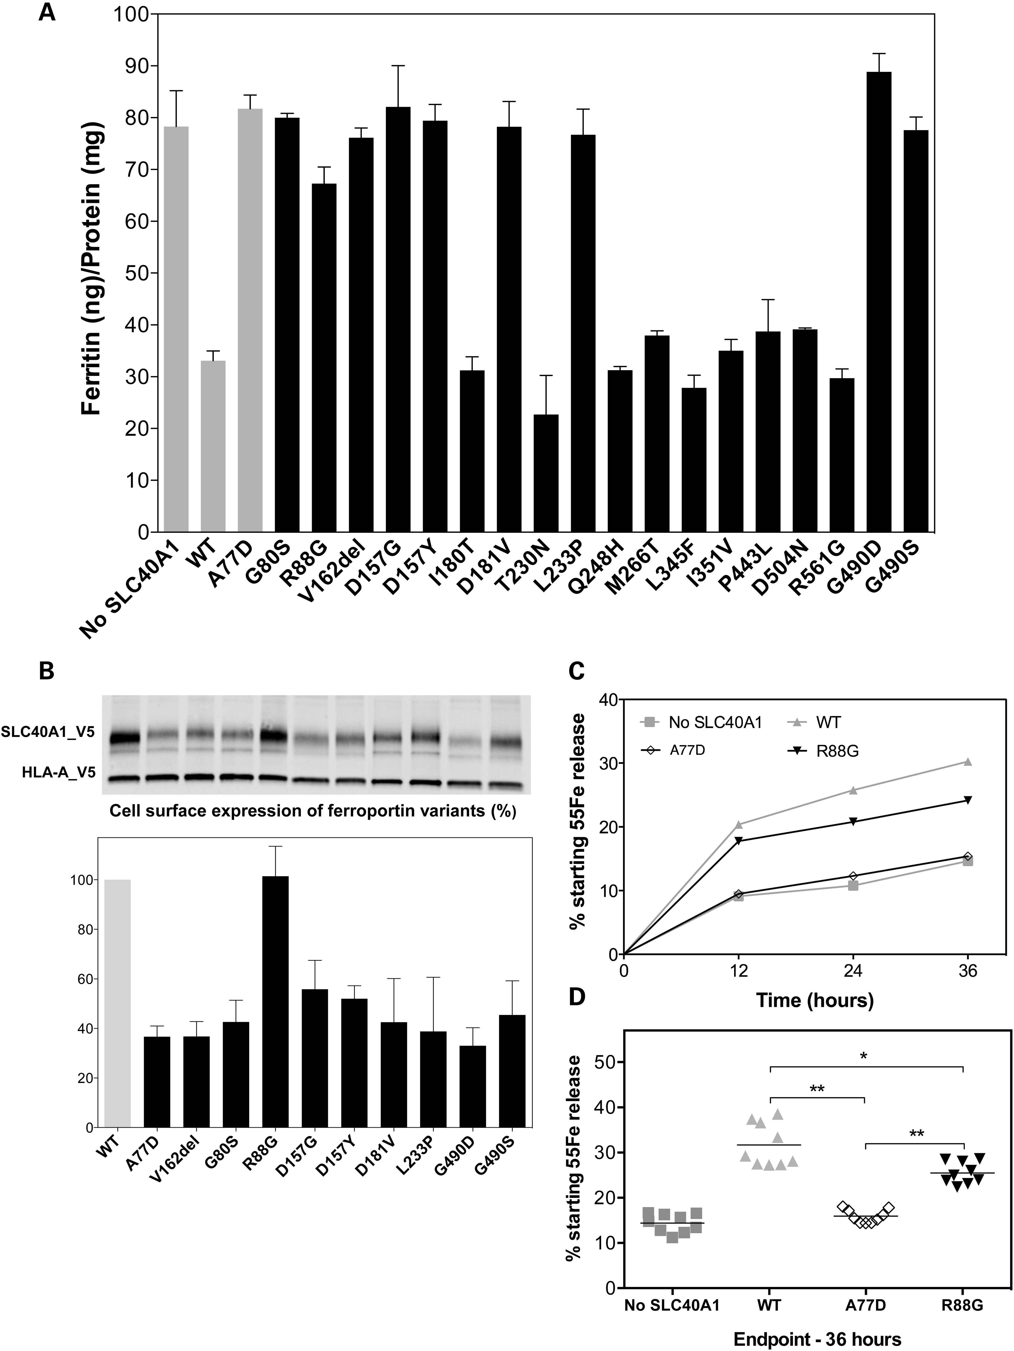
Figure 1. Effect of ferroportin variants on intracellular iron accumulation, cell-surface expression and iron export. ...
Notes:
Figure 1. Effect of ferroportin variants on intracellular iron accumulation, cell-surface expression and iron export. (A) HEK293T cells were transiently transfected with CMV-regulated plasmids containing no ferroportin sequence (no-SLC40A1), full-length WT human ferroportin cDNA or a mutated sequence in the presence of 1 mg/ml holotransferrin. After 48 h, intracellular ferritin levels were determined by ELISA and normalized to the total protein concentration. Error bars represent the SD of three independent experiments (performed in triplicate). (B) HEK293T cells were transiently co-transfected with plasmids encoding either a V5-tagged ferroportin protein (WT or variant) or a V5-tagged HLA-A protein. HLA-A was used as a control and as a standard for normalization, being a cell-surface protein with no known role in iron metabolism. At 24 h after transfection, cell-surface proteins were selectively purified and analyzed by western blotting using a peroxidase-conjugated mouse anti-V5 antibody. Densitometric scans of SLC40A1 levels (normalized to HLA-A) are shown in the lower part of the figure. The error bars represent the standard deviation of three independent experiments. (C) HEK293T cells were grown in 20 µg/ml 55Fe-transferrin for 24 h before being washed and transiently transfected with WT or mutated SLC40A1-V5 expression plasmids. After 15 h, cells were washed and then serum starved for up to 36 h. The 55Fe exported into the supernatant was collected at various time points. Data are presented as percentage cellular radioactivity at time zero. Each point represents the mean SD; n = 3 in each group. The data are representative of three separate experiments (see below). (D) The graph shows the percentage of 55Fe collected from the supernatant of SLC40A1-transfected and no-SLC40A1-transfected cells at 36 h. The error bars represent the SD of three independent experiments (performed in triplicate; n = 9). P-values were calculated using Student's t-test. *P < 0.01 and **P < 0.001, compared with WT SLC40A1.
Unless provided in the caption above, the following copyright applies to the content of this slide: © The Author 2014. Published by Oxford University Press. All rights reserved. For Permissions, please email: journals.permissions@oup.com

Slide 2
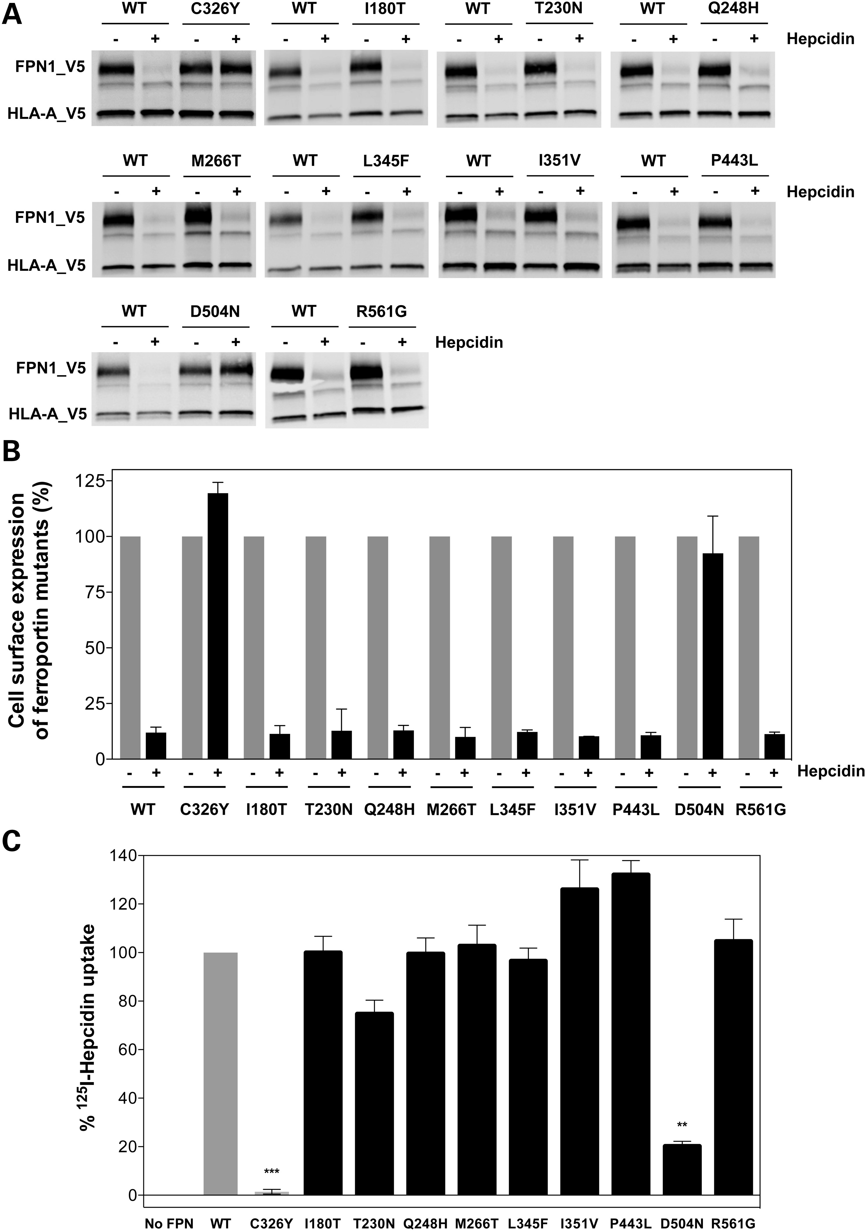
Figure 2. Effect of ferroportin variants on hepcidin-induced internalization. (A and B) HEK293T cells were transiently ...
Notes:
Figure 2. Effect of ferroportin variants on hepcidin-induced internalization. (A and B) HEK293T cells were transiently co-transfected with CMV-regulated plasmids expressing HLA(A)-V5 and either WT SLC40A1-V5 or SLC40A1-V5 variants. At 16 h posttransfection, the cells were incubated in the presence or absence of hepcidin (0.5 µm; Biochem) for 3 h. Plasma membrane proteins were purified and analyzed by western blotting and densitometry. The data are expressed as percentage ferroportin in cells not treated by hepcidin, according to the formula 100 × (SLC40A1 – hepcidin/SLC40A1 + hepcidin). Error bars are the SD of three independent experiments. (C) HEK293T cells expressing WT SLC40A1-V5 or variant SLC40A1-V5 were treated with [125I]-hepcidin and cell-associated radioactivity was measured. Each bar represents the average of three independent experiments (performed in triplicate). Data were normalized to the amount of radioactivity bound to WT SLC40A1-V5-expressing cells, and the amount bound to untransfected cells was subtracted as background for each point. P-values were calculated using Student's t-test. **P < 0.001 and ***P < 0.0001, compared with WT SLC40A1.
Unless provided in the caption above, the following copyright applies to the content of this slide: © The Author 2014. Published by Oxford University Press. All rights reserved. For Permissions, please email: journals.permissions@oup.com

Slide 3
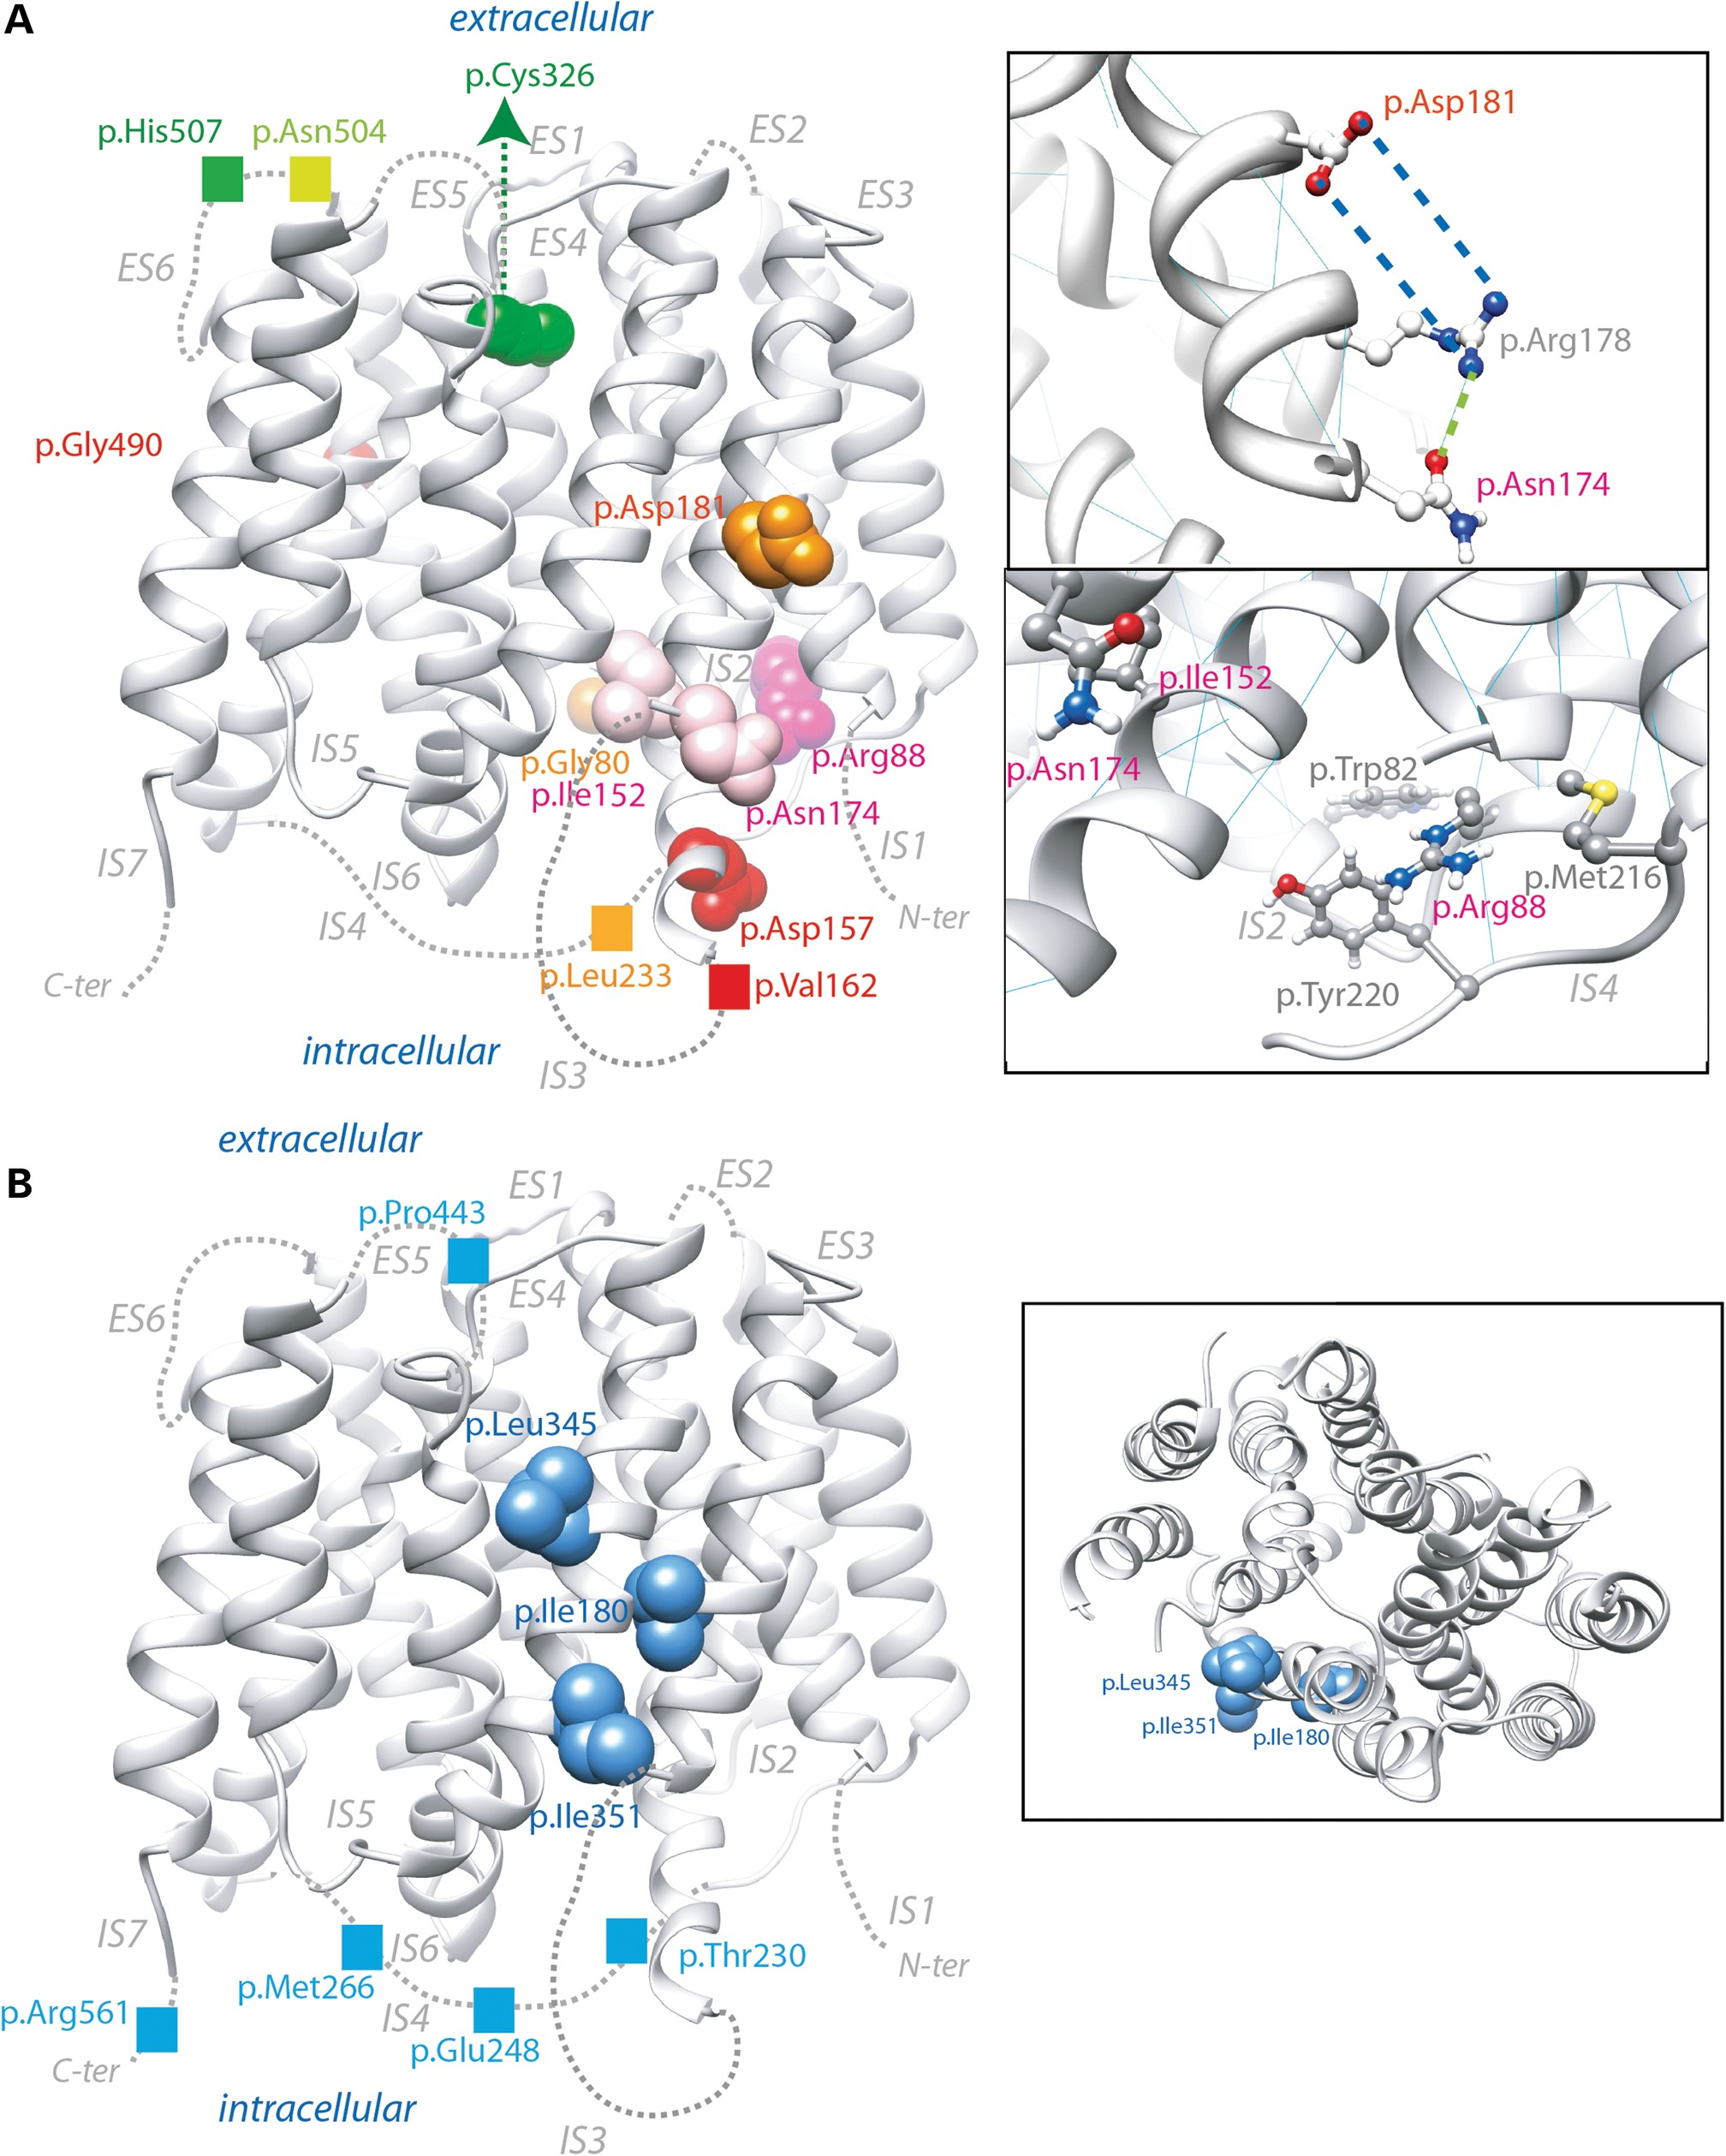
Figure 3. Structural analysis of variants. The variants were localized within a ribbon representation (lateral view) of ...
Notes:
Figure 3. Structural analysis of variants. The variants were localized within a ribbon representation (lateral view) of the previously reported 3D structural model of human ferroportin (15). Non-modeled loops are indicated by dotted lines. (A) Loss-of-function (red, orange and pink) and gain-of-function (green) mutations. Pink indicates amino acid positions at which variants did not impair membrane localization, in contrast to red and orange positions. The two insets focus on the environment of p.Asp181/pAsn174 (top) and p.Arg88 (bottom). (B) Positions of amino acids showing neutral variations. The inset provides an orthogonal view of the 3D model, viewed from the extracellular side.
Unless provided in the caption above, the following copyright applies to the content of this slide: © The Author 2014. Published by Oxford University Press. All rights reserved. For Permissions, please email: journals.permissions@oup.com

Slide 4
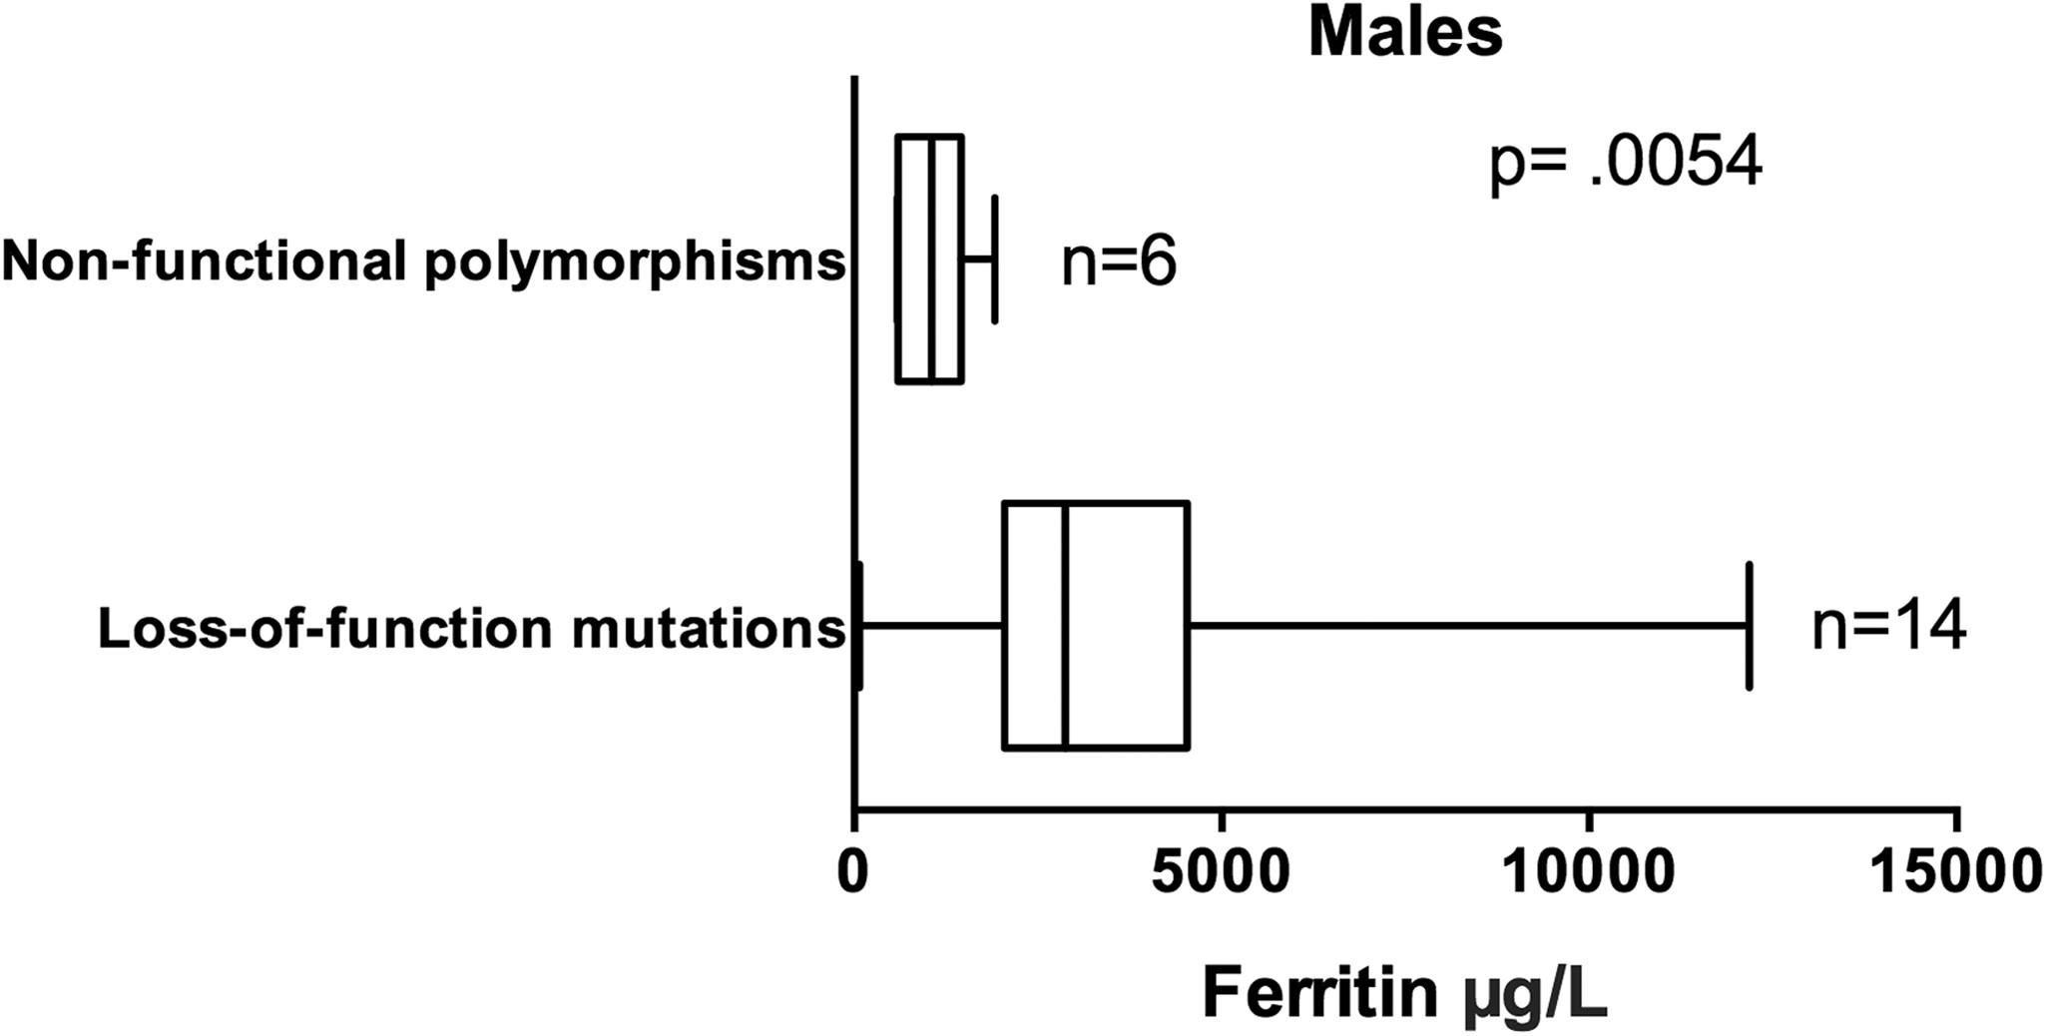
Figure 4. Serum ferritin levels in male carriers of a loss-of-function mutation or a non-functional polymorphism at the ...
Notes:
Figure 4. Serum ferritin levels in male carriers of a loss-of-function mutation or a non-functional polymorphism at the SLC40A1 locus. Box and whisker plots showing median and interquartile range in the box (50th, 25th and 75th percentiles) and minimum to maximum range (whiskers). P-value was calculated using Mood's median test – Pearson's χ2-test.
Unless provided in the caption above, the following copyright applies to the content of this slide: © The Author 2014. Published by Oxford University Press. All rights reserved. For Permissions, please email: journals.permissions@oup.com

