Slide 1
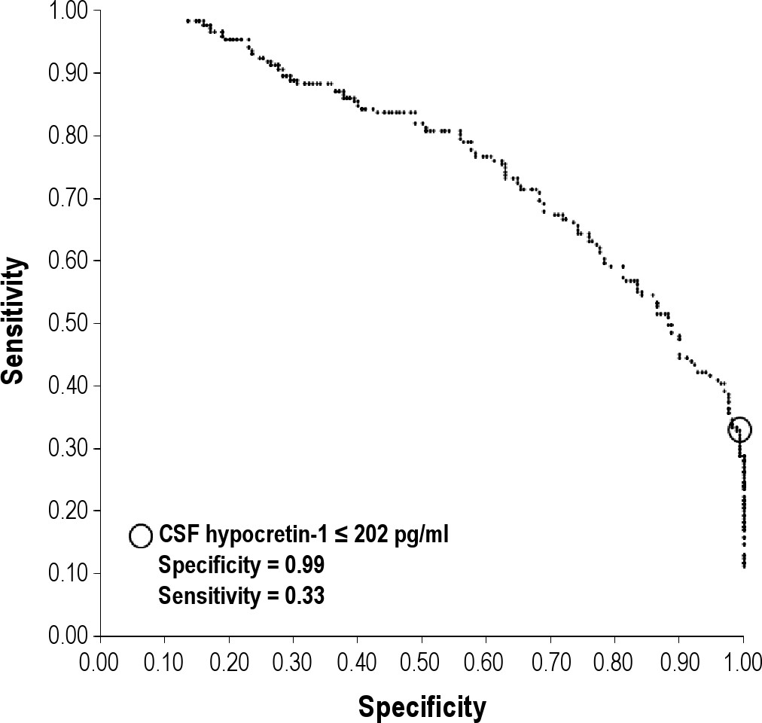
Figure 1 Receiver operating characteristic curve for cerebrospinal fluid (CSF) hypocretin-1 levels as a predictor of ...
Notes:
Figure 1 Receiver operating characteristic curve for cerebrospinal fluid (CSF) hypocretin-1 levels as a predictor of narcolepsy without cataplexy (171 narcolepsy without cataplexy patients versus 170 control patients). The circle highlights the best CSF-hypocretin-1 (≤ 202 pg/ml) cutoff point.
Unless provided in the caption above, the following copyright applies to the content of this slide: © 2012 Associated Professional Sleep Societies, LLC.

Slide 2
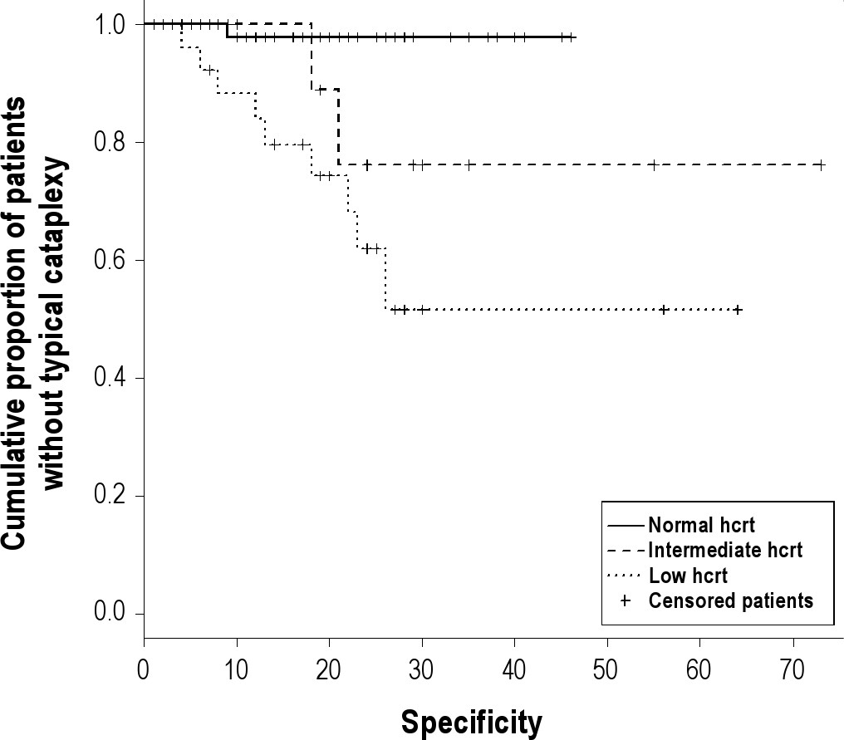
Figure 2 Survival (Kaplan-Meier) curve of patients by cerebrospinal fluid (CSF) hypocretin-1 concentration according ...
Notes:
Figure 2 Survival (Kaplan-Meier) curve of patients by cerebrospinal fluid (CSF) hypocretin-1 concentration according to their cataplexy status. Hcrt: CSF hypocretin-1.
Unless provided in the caption above, the following copyright applies to the content of this slide: © 2012 Associated Professional Sleep Societies, LLC.

