Slide 1
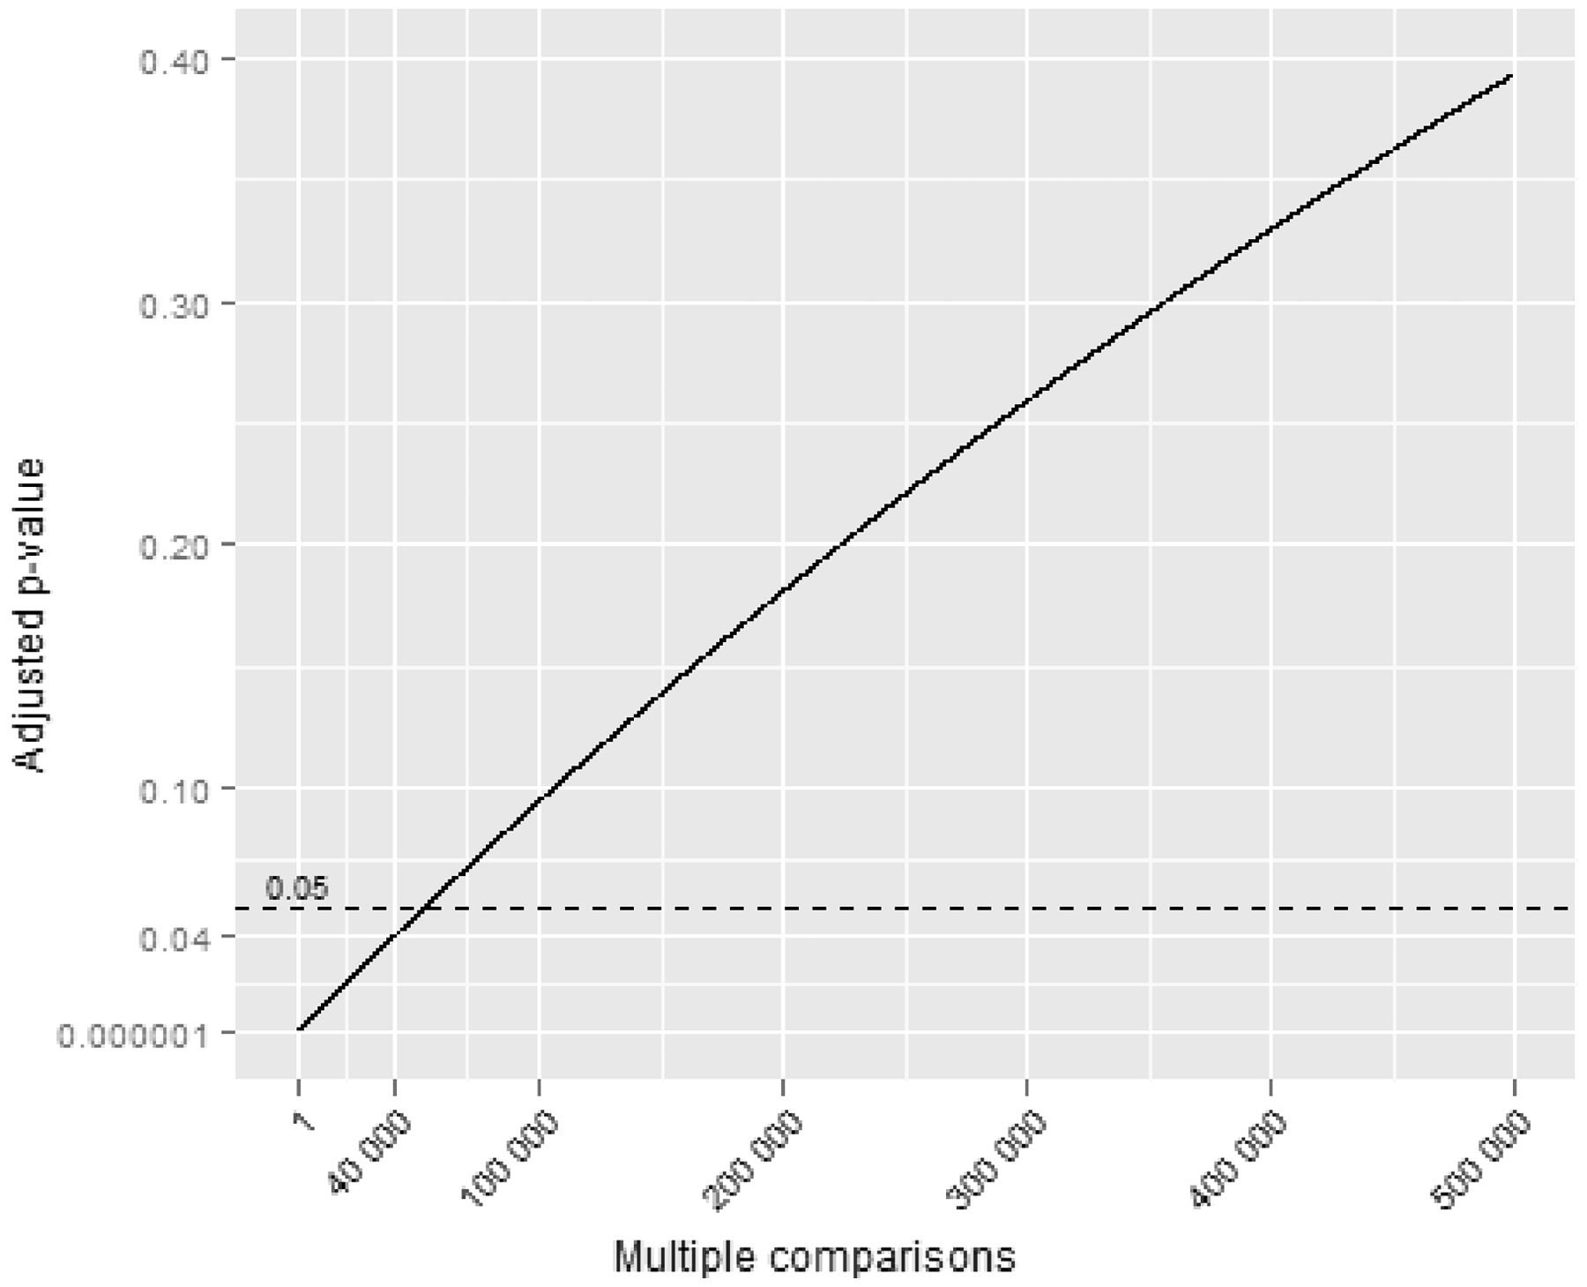
Figure 1 ABC cluster, showing adjusted P-values for different numbers of multiple comparisons. In cluster ...
Notes:
Figure 1 ABC cluster, showing adjusted P-values for different numbers of multiple comparisons. In cluster investigations the number of multiple comparisons is large (>10 000) and unknown. In such circumstances chance is not a useful theoretical construct
Unless provided in the caption above, the following copyright applies to the content of this slide: Published by Oxford University Press on behalf of the International Epidemiological Association © The Author 2013; all rights reserved.

Slide 2
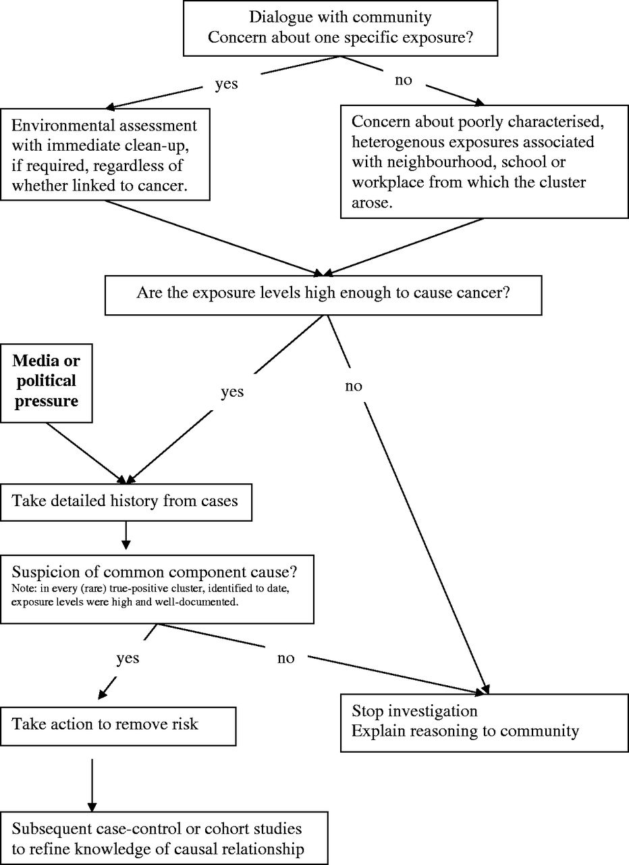
Figure 2 Illustrative flow chart for cluster investigation that emphasises exposure assessment
Notes:
Figure 2 Illustrative flow chart for cluster investigation that emphasises exposure assessment
Unless provided in the caption above, the following copyright applies to the content of this slide: Published by Oxford University Press on behalf of the International Epidemiological Association © The Author 2013; all rights reserved.

