Slide 1
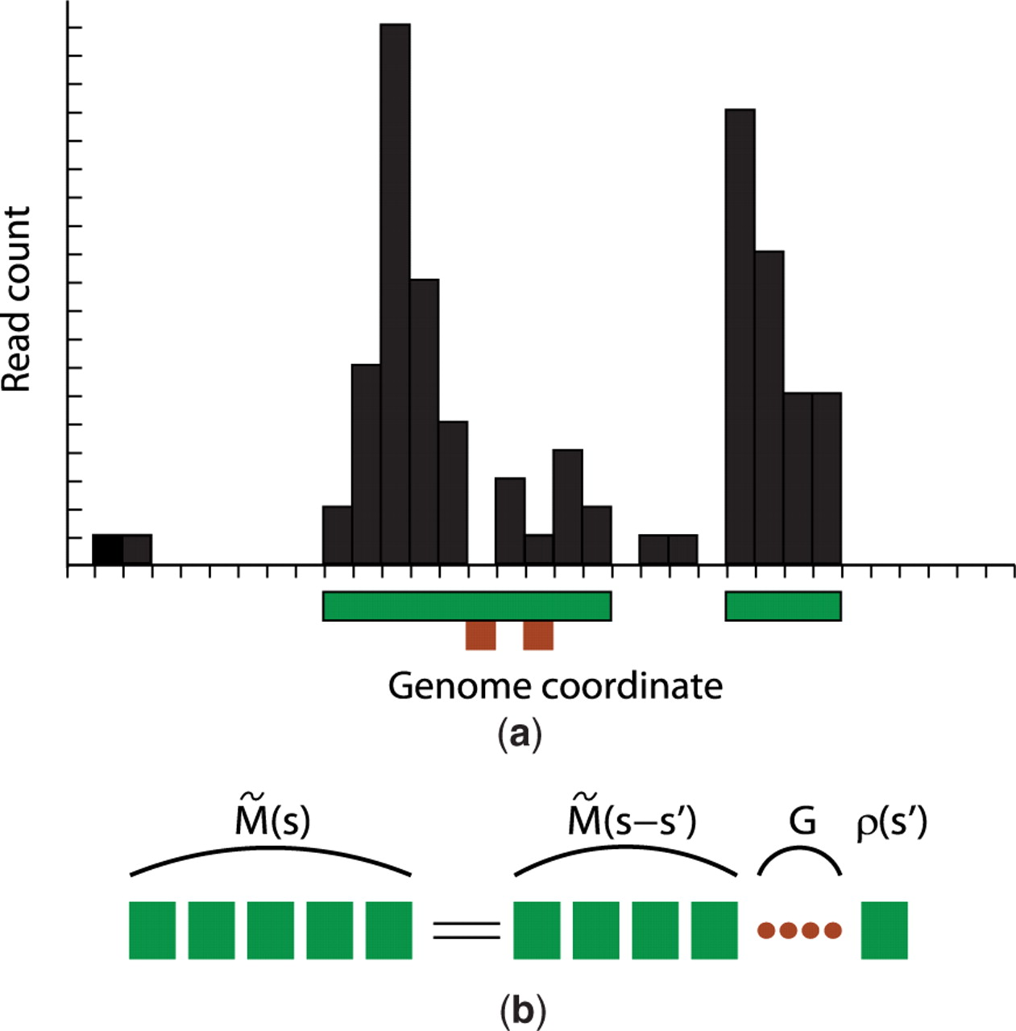
Fig. 1. (a) Schematic illustration of definition of islands. Shown is a segment of a genomic landscape of ChIP-Seq ...
Notes:
Fig. 1. (a) Schematic illustration of definition of islands. Shown is a segment of a genomic landscape of ChIP-Seq reads. The x-axis denotes the genome coordinates, where each interval represents a window. The y-axis denotes the read count. Each black vertical bar represents the read count in the respective window. The regions underlined by the green horizontal bars are the two identified islands under g=1 and l0=2. The two windows underlined by brown boxes are gaps in the first island. (b) Schematic illustration of the recursion relation in Equation (6).
Unless provided in the caption above, the following copyright applies to the content of this slide: © The Author 2009. Published by Oxford University Press. All rights reserved. For Permissions, please email: journals.permissions@oxfordjournals.org

Slide 2
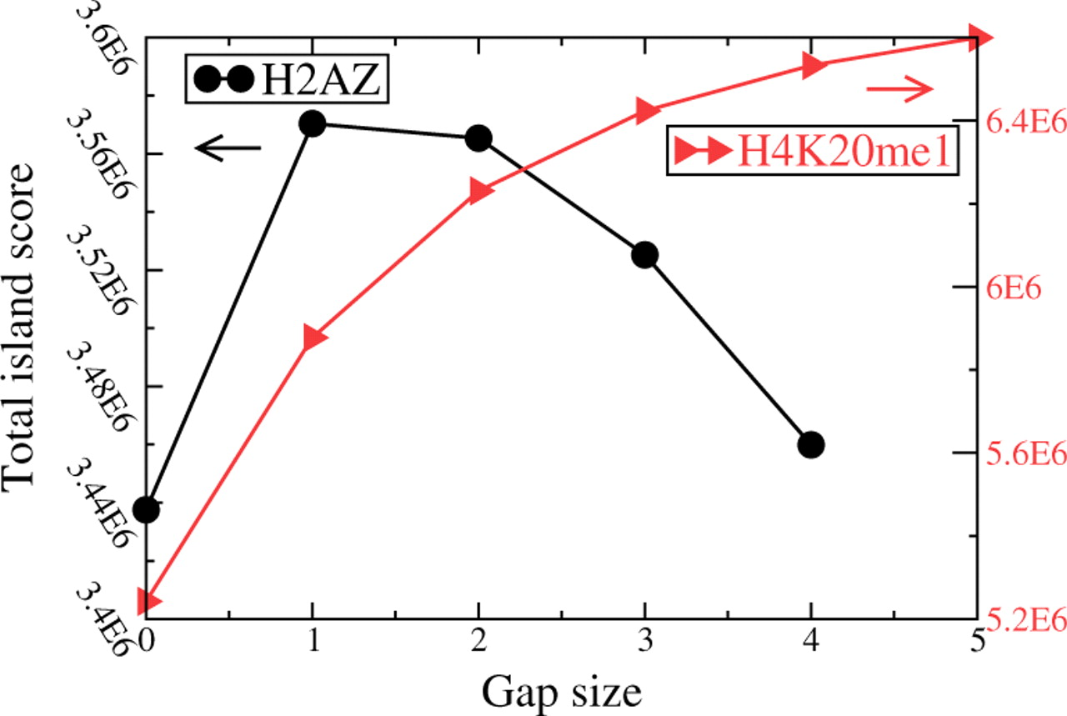
Fig. 2. Aggregate score of all significant islands versus gap size for H2A.Z (black) and H4K20me1 (red). The gap size ...
Notes:
Fig. 2. Aggregate score of all significant islands versus gap size for H2A.Z (black) and H4K20me1 (red). The gap size is measured in units of windows. Here, l0=2 and E-value is 0.1.
Unless provided in the caption above, the following copyright applies to the content of this slide: © The Author 2009. Published by Oxford University Press. All rights reserved. For Permissions, please email: journals.permissions@oxfordjournals.org

Slide 3
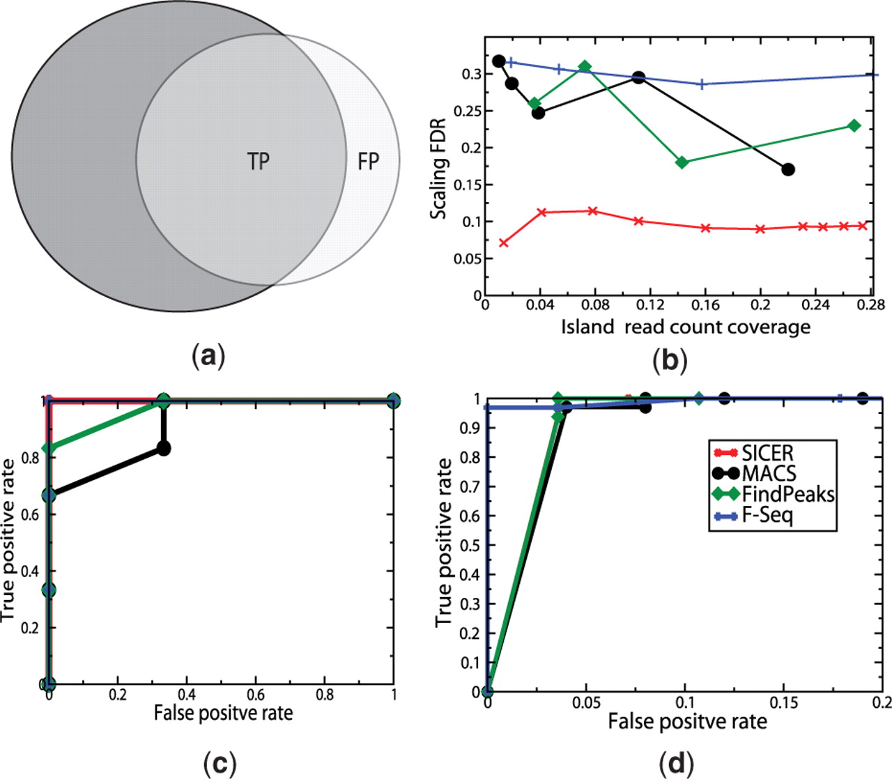
Fig. 3. Comparison of SICER with other methods. (a) Schematic illustration of the scaling FDR determination. The dark ...
Notes:
Fig. 3. Comparison of SICER with other methods. (a) Schematic illustration of the scaling FDR determination. The dark (light) gray circle represent ChIP-enriched regions identified in the full (half-size) library. The non-overlapping area of the light gray circle represents the false positives. (b) FDR versus the island read count coverage. (c) ROC analysis of using the epigenetic states at genes encoding signature cytokines in mouse CD4+ cell Th1, Th2 and Th17 lineages. (d) ROC analysis of H3K4me3 and H3K27me3 in mouse ES cells.
Unless provided in the caption above, the following copyright applies to the content of this slide: © The Author 2009. Published by Oxford University Press. All rights reserved. For Permissions, please email: journals.permissions@oxfordjournals.org

Slide 4
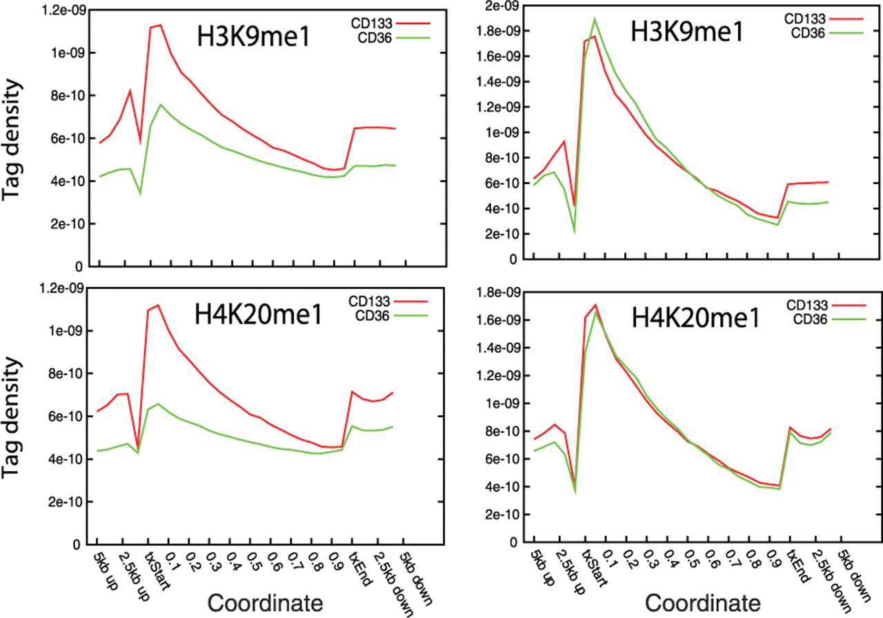
Fig. 4. Composite histone modification profiles across genic regions in human CD133⁺ (red) and ...
Notes:
Fig. 4. Composite histone modification profiles across genic regions in human CD133+ (red) and CD36+ (green) cells. The figures in the left (right) panel are made with all reads in the library (only reads on islands, which are identified using ‘input’ library as control).
Unless provided in the caption above, the following copyright applies to the content of this slide: © The Author 2009. Published by Oxford University Press. All rights reserved. For Permissions, please email: journals.permissions@oxfordjournals.org

