Slide 1
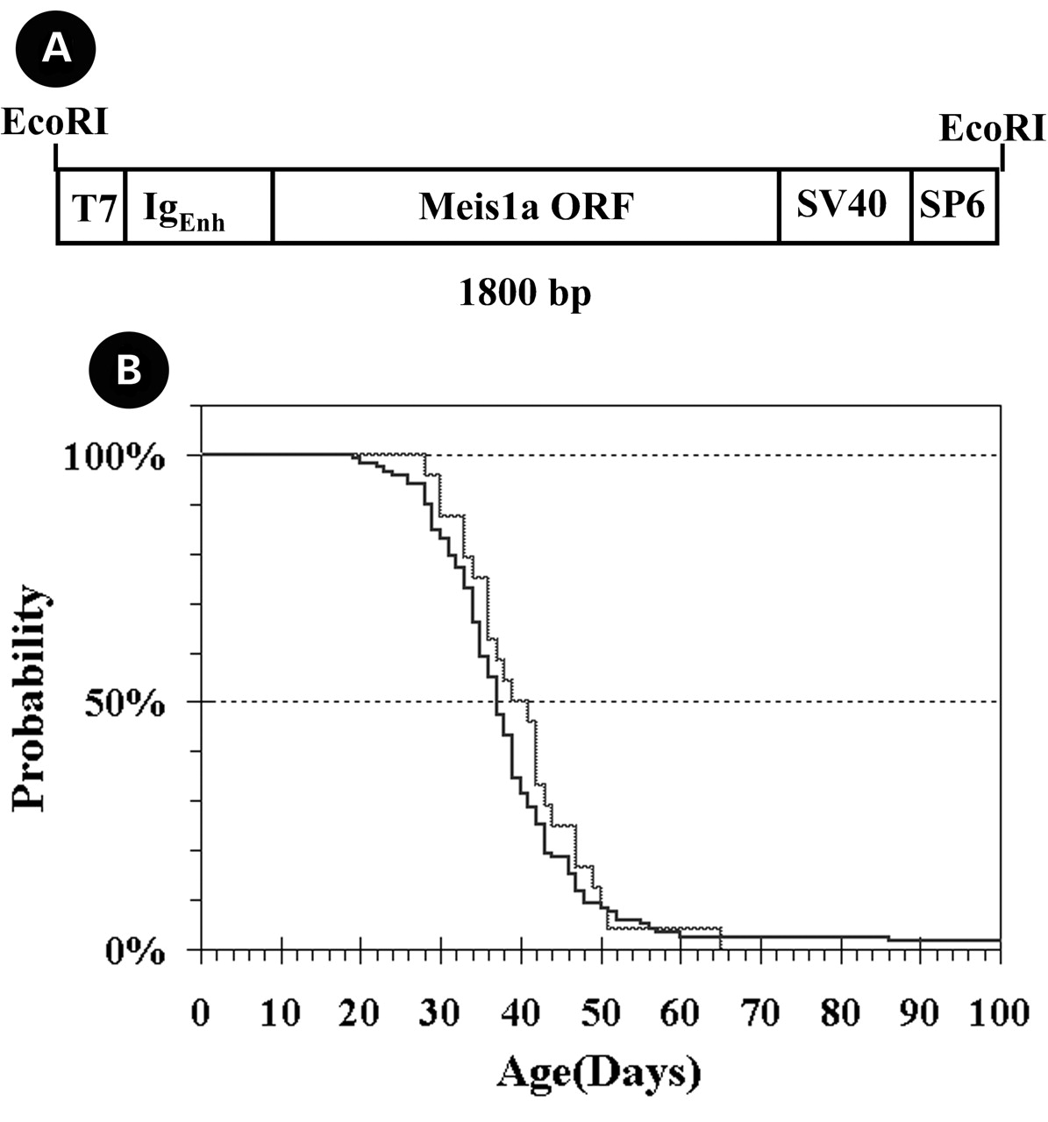
Figure 1. The Meis1a transgene and Tg2770 male-specific lethality. (A) The Meis1a open reading frame (ORF) ...
Notes:
Figure 1. The Meis1a transgene and Tg2770 male-specific lethality. (A) The Meis1a open reading frame (ORF) was inserted into the pGem-7Zf+ vector from Promega (Madison, WI) containing additional immunoglobulin heavy-chain promoter/enhancer element sequences (14) and SV40 transcription stop sequences. The construct was placed in the MCS of the vector for DNA production, then excised by restriction enzyme digestion and purified for microinjection to generate transgenic mice. (B) Kaplan–Meier plot of the lethality data in the Tg2770 strain. The solid black line represents data for the Tg2770 mutation on the original FVB background, while the gray line shows the results of a single outcross of Tg2770 heterozygotes to Mus castaneus followed by a backcross to Tg2770 to generate homozygous males. Heterozygous males and heterozygous or homozygous females exhibited no premature morbidity. A total of 118 homozygous males were scored on the FVB background, resulting in a mean lifetime of 39.5±14.5 days. A total of 24 homozygous males were scored on the M. castaneus background, resulting in a mean lifetime of 40.5±8.3 days. There is no significant difference in the mean lifetime on either background.
Unless provided in the caption above, the following copyright applies to the content of this slide:

Slide 2
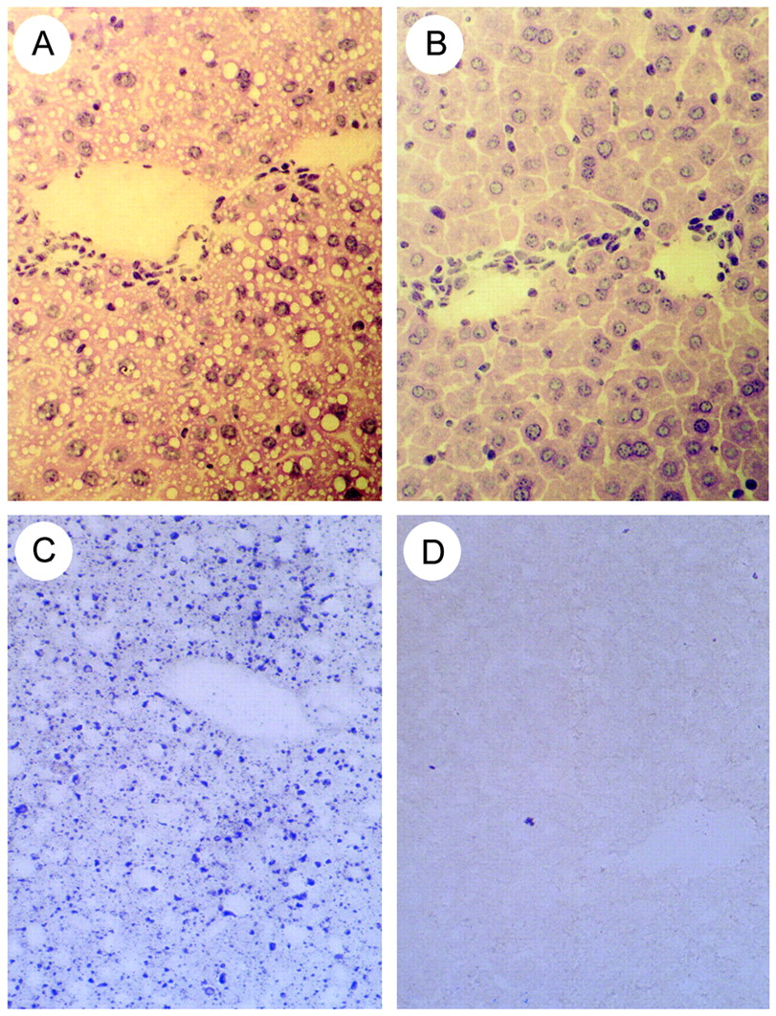
Figure 2. Male-specific microvesicular steatosis. Cross-sections of livers from (A) homozygous male Tg2770 ...
Notes:
Figure 2. Male-specific microvesicular steatosis. Cross-sections of livers from (A) homozygous male Tg2770 and (B) homozygous female Tg2770 mice stained with H&E. Hepatocytes from the males contain numerous small vesicles that are absent in the females (B) and heterozygous males (data not shown). (C and D) When cross-sections are stained with OsO4, the vesicles are stained, indicating that the vesicles contain dense amounts of lipids.
Unless provided in the caption above, the following copyright applies to the content of this slide:

Slide 3
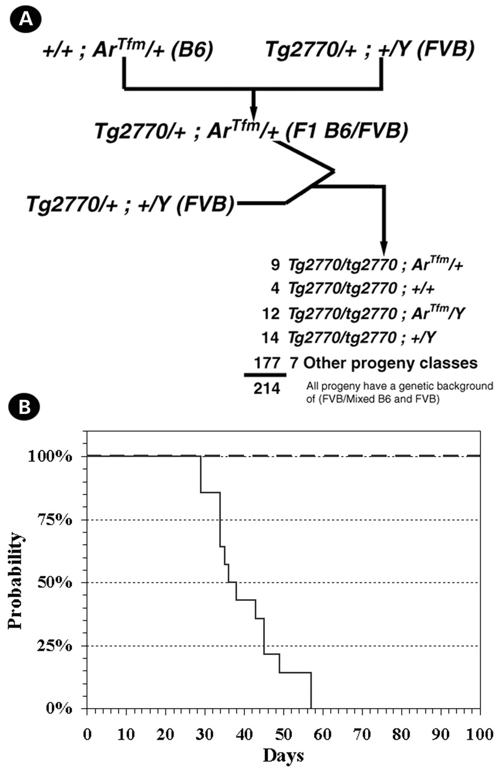
Figure 3. Rescue of Tg2770 lethality by abolishment of androgen responsiveness. (A) Diagram of the genetic ...
Notes:
Figure 3. Rescue of Tg2770 lethality by abolishment of androgen responsiveness. (A) Diagram of the genetic crosses used to introduce the ArTfm mutation in Tg2770 homozygous males to assay for rescue of the male-specific lethality. In addition, the number of the various progeny types generated is displayed. (B) Kaplan–Meier plot of the lethality data of male homozygous Tg2770 mice with (dashed line) and without (solid line) ArTfm.
Unless provided in the caption above, the following copyright applies to the content of this slide:

Slide 4
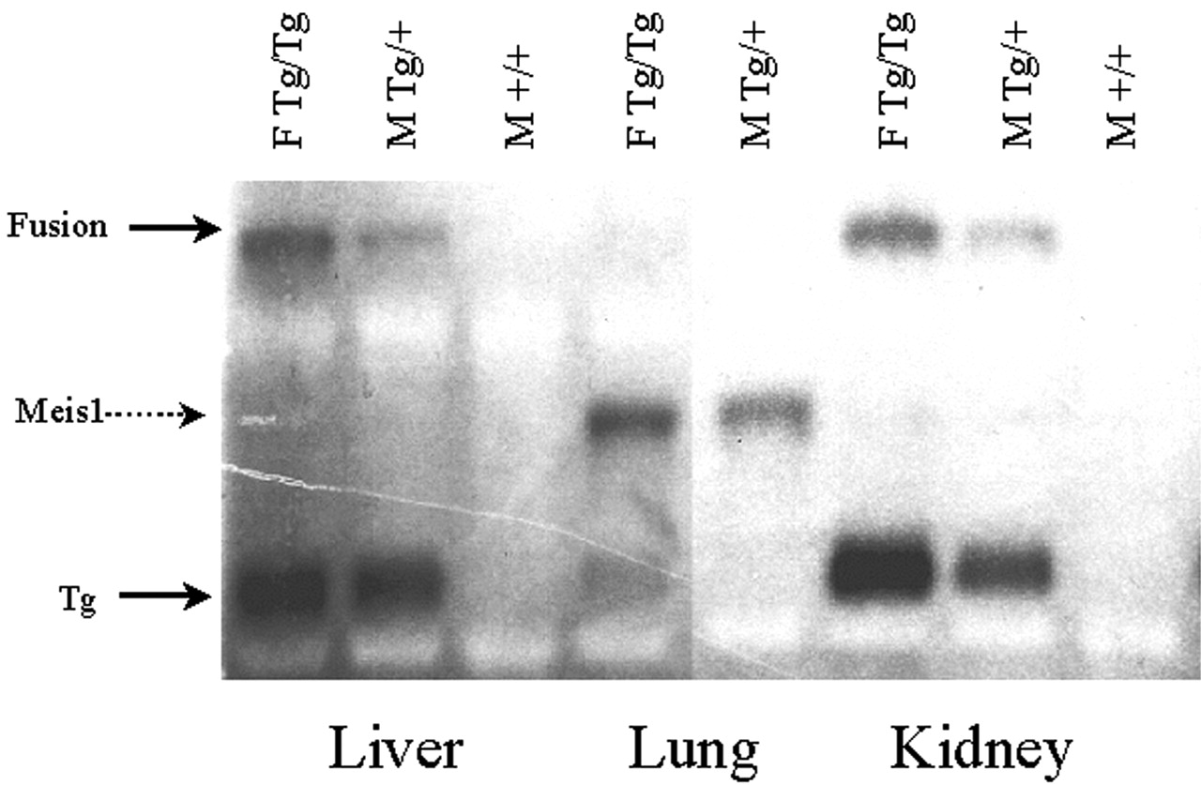
Figure 4. Northern blot analysis of Tg2770 mice. Total RNA was isolated from liver, lung and kidney harvested ...
Notes:
Figure 4. Northern blot analysis of Tg2770 mice. Total RNA was isolated from liver, lung and kidney harvested from homozygous Tg2770 females (F Tg/Tg), heterozygous Tg2770 males (MTg/+) and wild-type male (M +/+) littermates and was size-fractionated on a denaturing formaldehyde agarose gel. After transfer to nylon membrane, the blot was hybridized to a radioloabelled Meis1 cDNA clone. The results demonstrated the presence of the endogenous Meis1 transcript (3.8 kb) and two transgene-specific transcripts (2.0 and 6.5 kb). The lower 2.0 kb transcript is the expected transcript generated from the transgenic construct (and was observed in other Meis1 transgenic lines generated from the same construct (data not shown). The larger 6.5 kb transcript was unique to Tg2770 and was expressed equally in both males and females. Expression levels of the 6.5 kb transcript appear different owing to a dosage difference between the male and female RNA samples.
Unless provided in the caption above, the following copyright applies to the content of this slide:

Slide 5
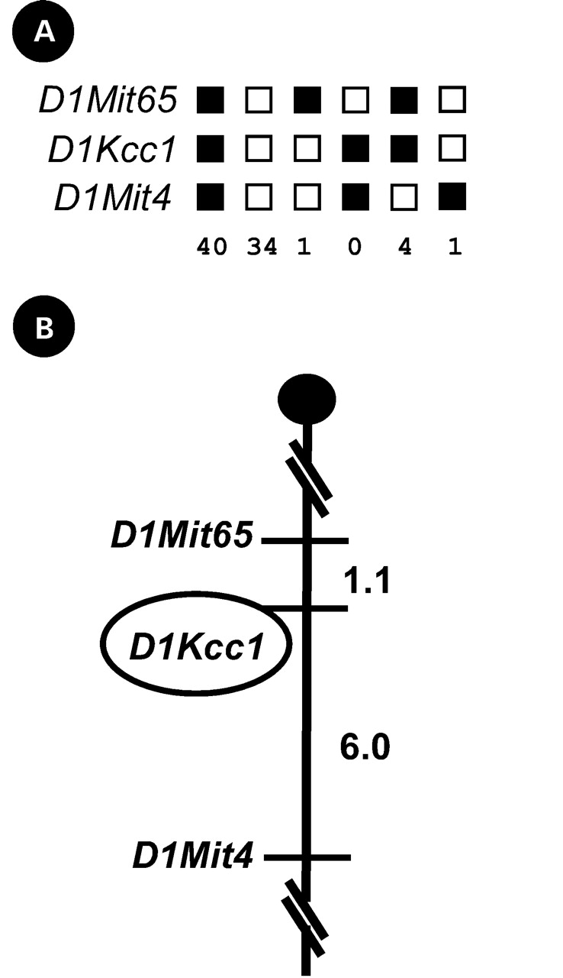
Figure 5. Interspecific backcross panel results. A microsatellite marker (D1Kcc1) located 1 kb downstream ...
Notes:
Figure 5. Interspecific backcross panel results. A microsatellite marker (D1Kcc1) located 1 kb downstream from the 3′ end of the FVB/NJ Tg2770 integration site was found to be polymorphic between AEJ/Gn and M. spretus. This polymorphism was used in backcross analysis of N2 progeny from the cross (AEJ/Gn×M. spretus) F1 X AEJ/Gn. (A) Summary of the results of the interspecific backcross analysis of Tg2770. The segregating markers isolated in the analysis are listed on the left. D1Mit65 is located 8.4 cM from the centromere, while D1Mit4 is located 12.0 cM from the centromere. Closed boxes represent inheritance from M. spretus and open boxes represent inheritance from AEJ/Gn, Numbers below the boxes represent the number of each type of chromosome inherited in the N2 generation. (B) Order of the loci examined on the region of chromosome 1 progeny from their F1 hybrid parent in the backcross analysis, with the centromere displayed at the top. To the right of each chromosome are the genetic distances in centimorgans, with the location of the loci displayed on the left.
Unless provided in the caption above, the following copyright applies to the content of this slide:

Slide 6
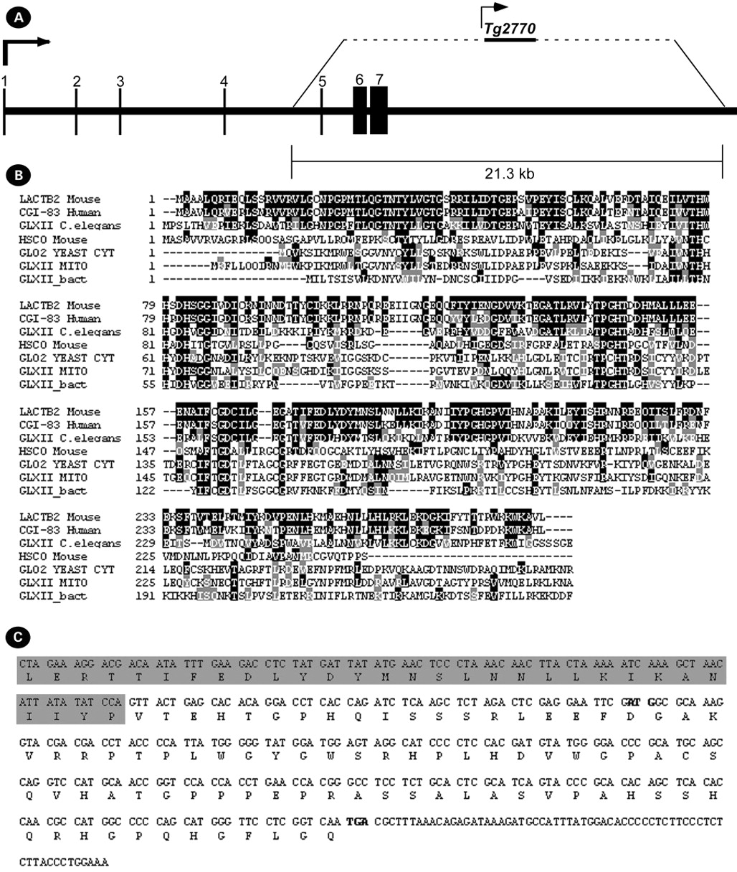
Figure 6. Analysis of the integration site of the transgene. (A) Gene structure of Lactb2. The seven exons ...
Notes:
Figure 6. Analysis of the integration site of the transgene. (A) Gene structure of Lactb2. The seven exons that make up the mature Lactb2 transcript are depicted in this schematic of the genomic region of Lactb2. The 21.3 kb region deleted in the Tg2770 strain is also indicated, which includes exons 5–7. (B) Protein comparison of LACTB2 with the closest members of the metallo-β-lactamase fold family. The human CGI-83 homologue is depicted, as well as the closest family members in homology in Caenorhabditis elegans, mouse, yeast, mitochondria and bacteria. The active site of the metallo-β-lactamase fold (HxHxDH) starting at amino acid 77 is conserved in LACTB2. (C) Sequence of the fusion transcript at the fusion site as determined by RT–PCR. Shown here is 415 bp of sequence flanking the fusion site of the fusion transcript between Lactb2 and Meis1a. The protein sequence resulting from translation of this mRNA is shown underneath the mRNA sequence. The shaded area represents mRNA and protein sequence derived from the Lactb2 gene. The normal start codon for the transgene is in bold, as well at the stop codon of the fusion transcript.
Unless provided in the caption above, the following copyright applies to the content of this slide:

