Slide 1
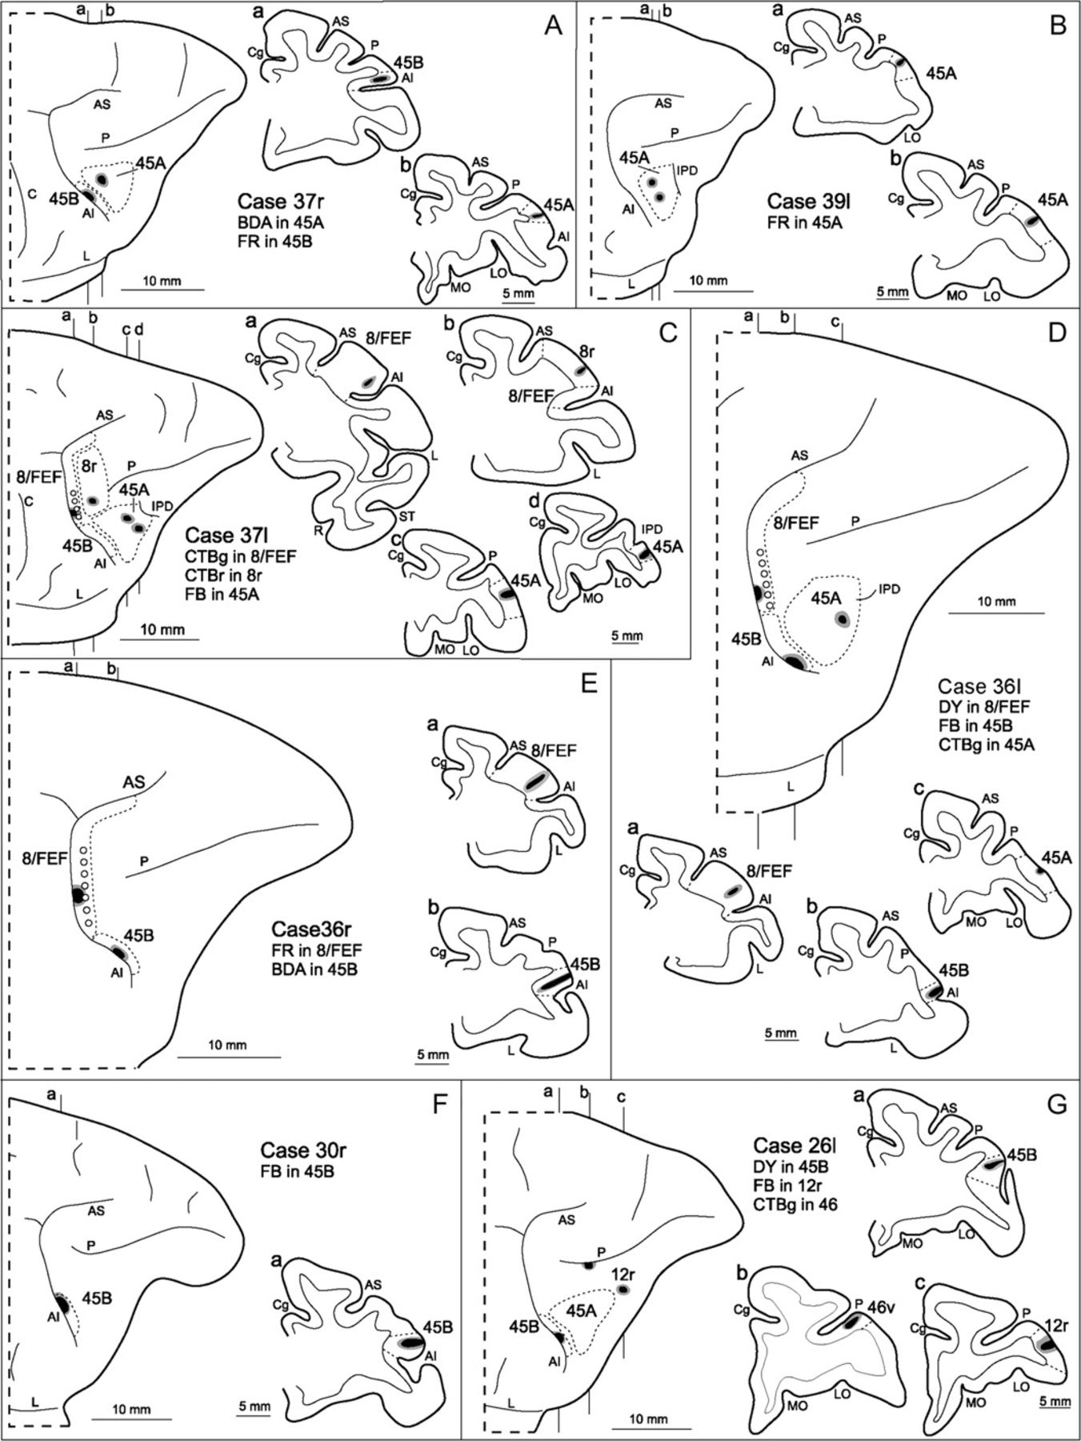
Figure 1. Location of injection sites in Cases 37r (A), 39l (B), 37l (C), 36l (D), 36r (E), 30r (F), and 26l (G), shown ...
Notes:
Figure 1. Location of injection sites in Cases 37r (A), 39l (B), 37l (C), 36l (D), 36r (E), 30r (F), and 26l (G), shown on dorsolateral views of the injected hemispheres and in coronal sections through the core (shown in black) and the halo (shown in lighter gray). Dashed lines on the drawings of the hemispheres and of the sections mark the cytoarchitectonic borders of the injected areas. Empty circles on the prearcuate cortex of Cases 37l (C), 36l (D), and 36r (E) mark the insertion points of electrode penetrations from which eye movements were evoked with ICMS (current intensity <50 μA). For the sake of comparison, all the reconstructions in this and in the subsequent figures are shown as a right hemisphere. AI = inferior arcuate sulcus; AS = superior arcuate sulcus; C = central sulcus; Cg = cingulate sulcus; L = lateral fissure; LO = lateral orbital sulcus; MO = medial orbital sulcus; P = principal sulcus; R = rhinal fissure; ST = superior temporal sulcus.
Unless provided in the caption above, the following copyright applies to the content of this slide: © The Author 2009. Published by Oxford University Press. All rights reserved. For permissions, please e-mail: journals.permissions@oxfordjournals.org

Slide 2
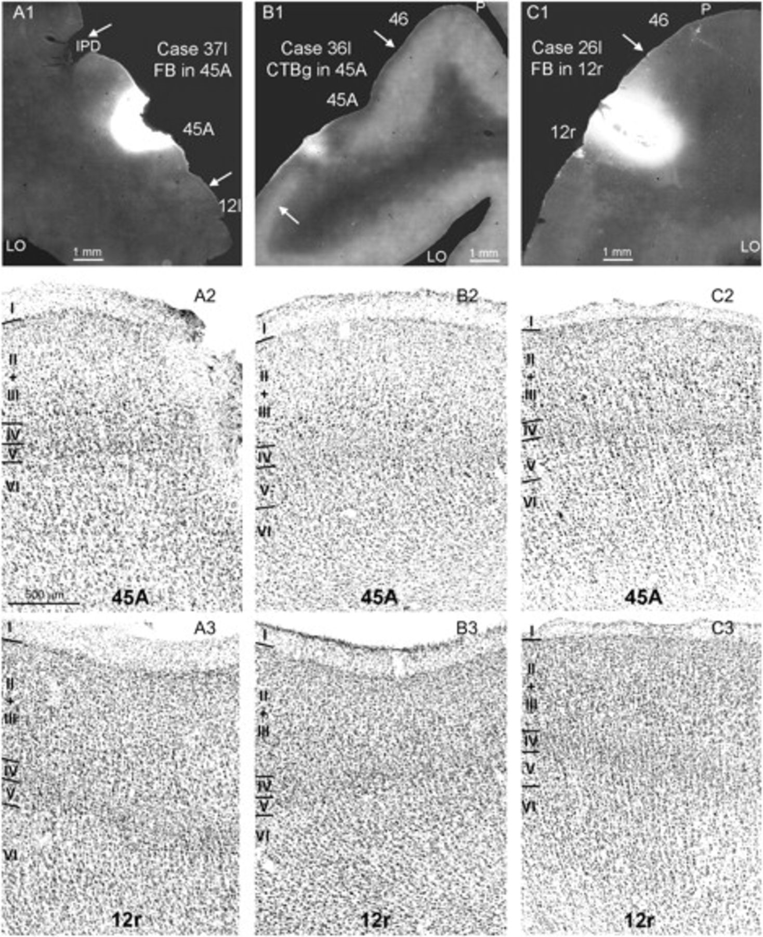
Figure 2. Injections sites in areas 45A and 12r and major cytoarchitectonic features used for their areal attribution. ...
Notes:
Figure 2. Injections sites in areas 45A and 12r and major cytoarchitectonic features used for their areal attribution. Upper row: low-power photomicrographs showing, in A1 and B1, the injection sites in area 45A of Cases 37l FB and 36l CTBg, respectively, and, in C1, the injection site in area 12r of Case 26l FB; arrows mark the borders of the injected area. Middle row: photomicrographs of Nissl-stained sections through area 45A from Cases 37l (A2), 36l (B2), and 26l (C2) showing the evident increase in cell size from the upper to the lower part of layer III, which is a distinguishing architectonic feature of area 45A; the fields in A2 and B2 were taken from sections adjacent to those in A1 and B1, respectively. Lower row: photomicrographs of Nissl-stained sections through area 12r from Cases 37l (A3), 36l (B3), and 26l (C3) showing a cell-dense, rather homogeneous layer III, which distinguish this area from area 45A; the field in C3 was taken from a section adjacent to that in C1. Calibration bar, shown in A2, applies to A2-C3. Abbreviations as in Figure 1.
Unless provided in the caption above, the following copyright applies to the content of this slide: © The Author 2009. Published by Oxford University Press. All rights reserved. For permissions, please e-mail: journals.permissions@oxfordjournals.org

Slide 3
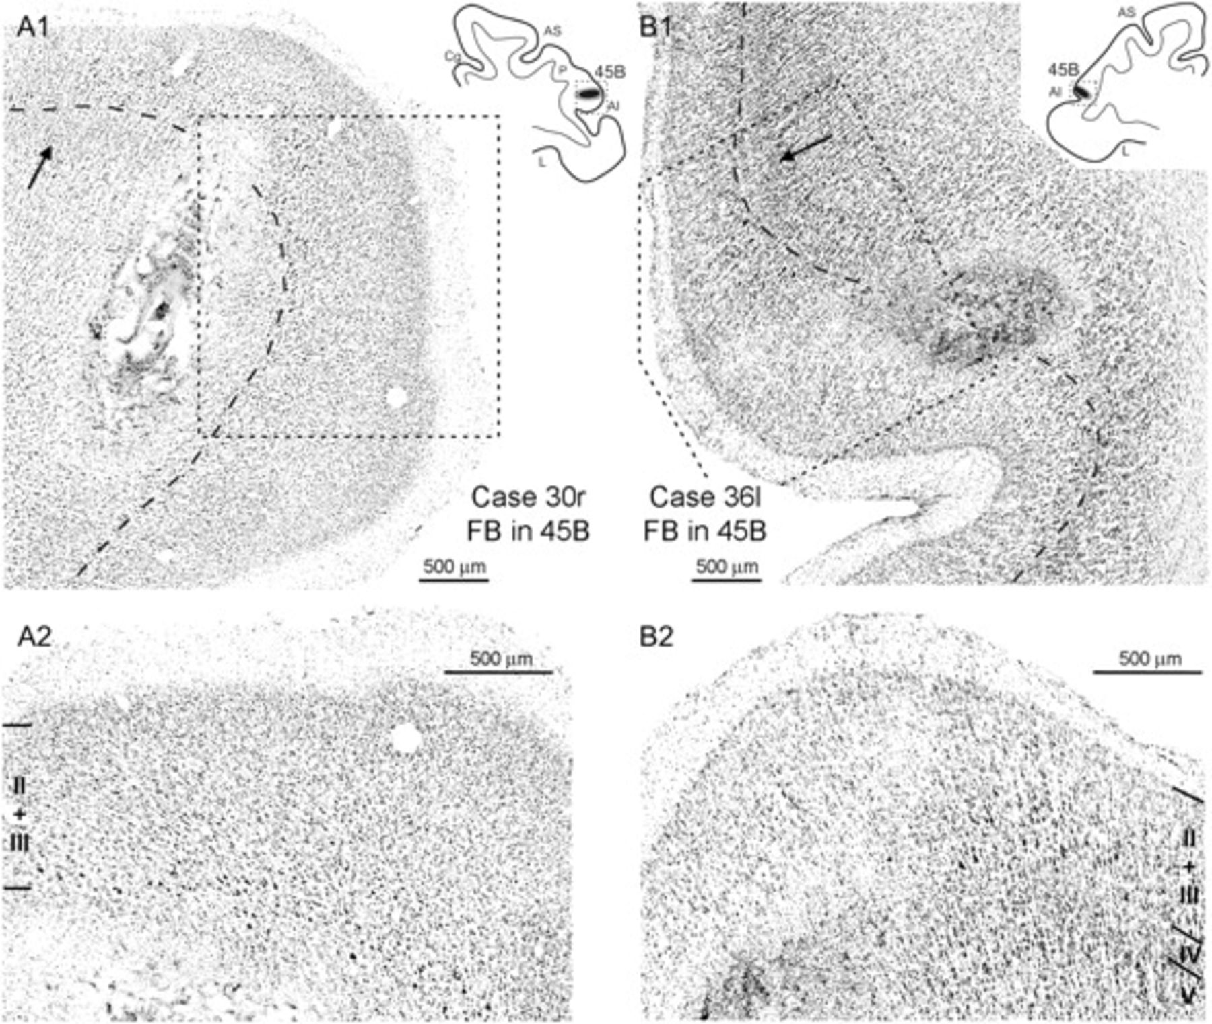
Figure 3. Injections sites in area 45B and major cytoarchitectonic features used for their areal attribution. In A1 and ...
Notes:
Figure 3. Injections sites in area 45B and major cytoarchitectonic features used for their areal attribution. In A1 and B1 low-power photomicrographs of Nissl-stained sections show the injection sites in area 45B of Cases 30r FB and 36l FB, respectively; dashed boxes on the section drawings indicate the locations of the photomicrographs; in each photomicrograph, the dashed line marks the border between layer III and layer IV and the arrow marks the cytoarchitectonic border with area 8r (A1) or 45A (B1). A2 and B2: higher magnification views of the fields indicated by dashed boxes in A1 and B1, respectively, showing the presence, close to the injection sites, of large pyramids in the lowest part of layer III, which are a distinguishing architectonic feature of area 45B. Abbreviations as in Figure 1.
Unless provided in the caption above, the following copyright applies to the content of this slide: © The Author 2009. Published by Oxford University Press. All rights reserved. For permissions, please e-mail: journals.permissions@oxfordjournals.org

Slide 4
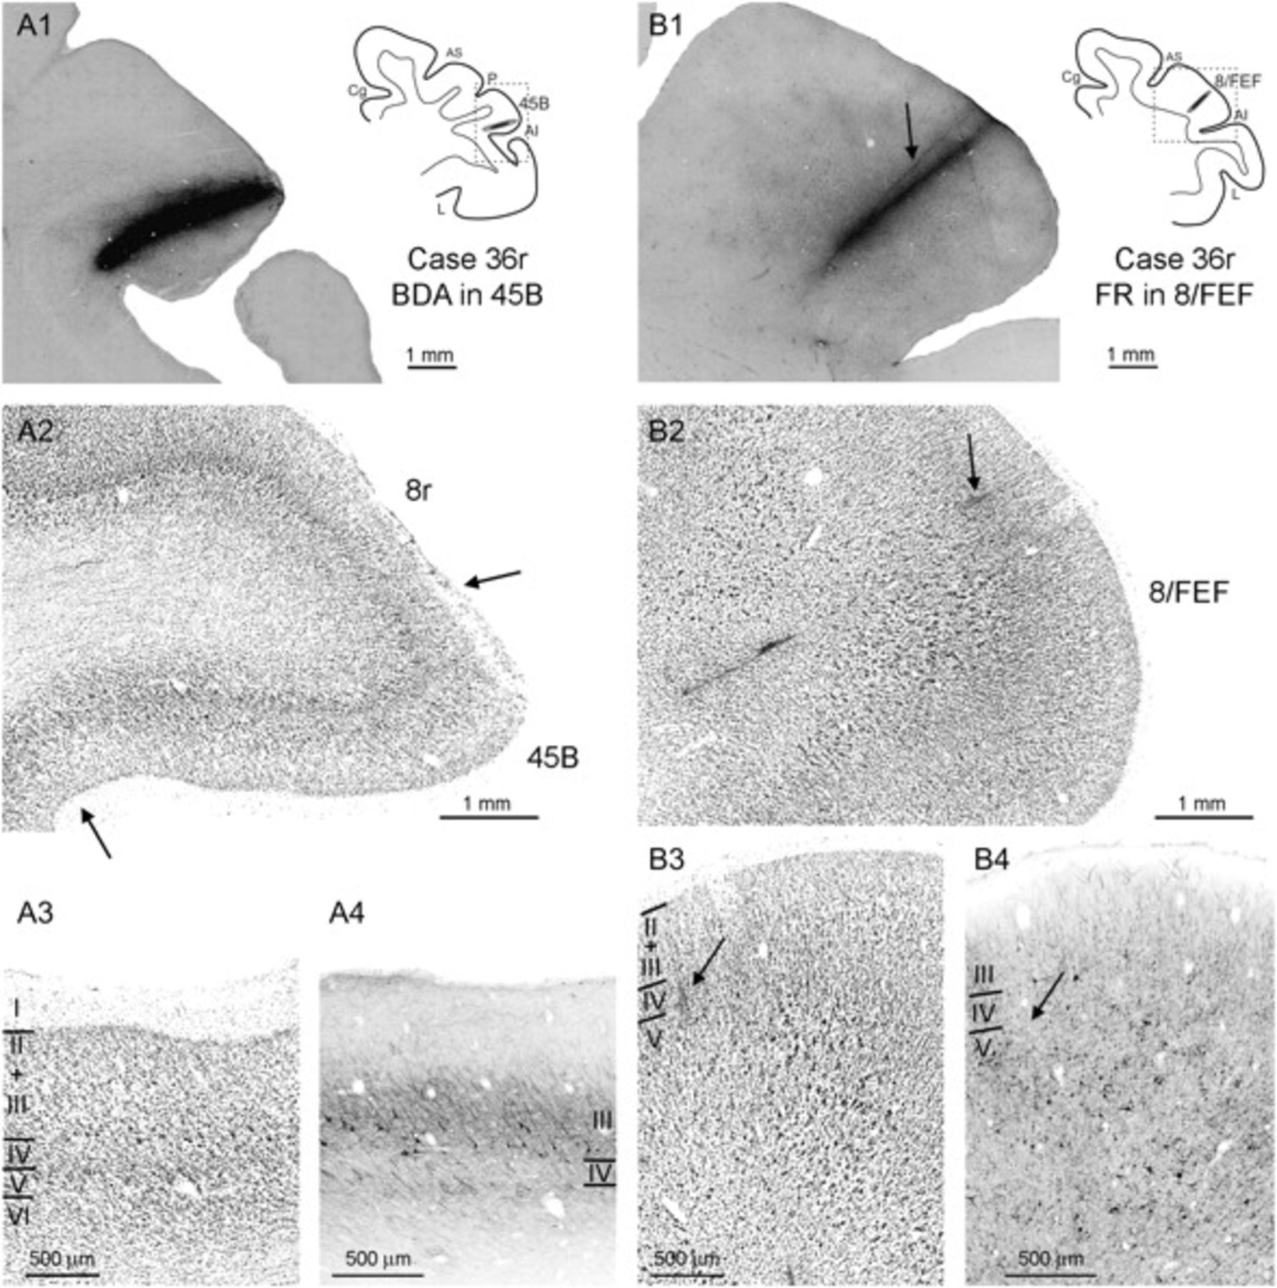
Figure 4. Injections sites in Case 36r and major architectonic features used for their areal attribution. (A1 and B1) ...
Notes:
Figure 4. Injections sites in Case 36r and major architectonic features used for their areal attribution. (A1 and B1) Low-power photomicrographs of the BDA (A1) and the FR (B1) injection sites, placed in areas 45B and 8/FEF, respectively; dashed boxes on the section drawings indicate the locations of the photomicrographs. (A2 and B2) Low-power photomicrographs of Nissl-stained sections adjacent to the sections shown in (A1) and (B1), respectively; arrows in A2 mark the border of area 45B. (A3 and B3) higher magnification views of fields taken from the Nissl-stained sections shown in A2 and B2, respectively, showing the presence of large, lowest layer III pyramids in area 45B and of large layer V pyramids in area 8/FEF. (A4 and B4) Higher magnification views of the same fields shown in A3 and B3, respectively, taken from adjacent SMI-32 immunoreacted sections, showing the presence of large layer III immunopositive pyramids in area 45B and of large immunopositive layer V pyramids in area 8/FEF. Arrows in B1-B4, mark the track of an electrode penetration in which ICMS was effective in evoking eye movements with current intensities <50 μA. Abbreviations as in Figure 1.
Unless provided in the caption above, the following copyright applies to the content of this slide: © The Author 2009. Published by Oxford University Press. All rights reserved. For permissions, please e-mail: journals.permissions@oxfordjournals.org

Slide 5
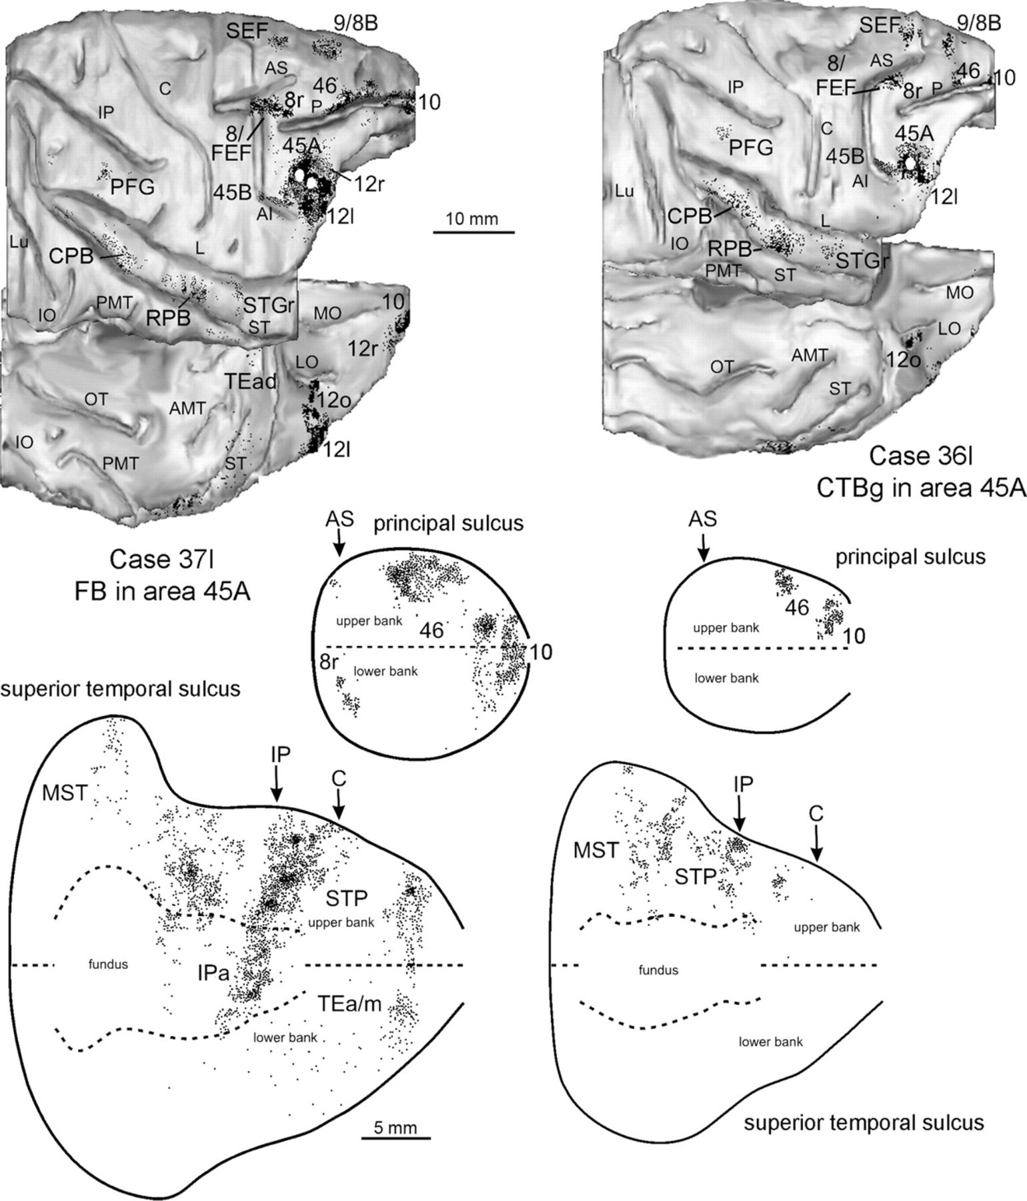
Figure 5. Distribution of the retrograde labeling observed following injections in area 45A in Cases 37l (FB) and 36l ...
Notes:
Figure 5. Distribution of the retrograde labeling observed following injections in area 45A in Cases 37l (FB) and 36l (CTBg), shown in dorsolateral and bottom views of the 3D reconstructions of the injected hemispheres (upper part) and in 2D reconstructions of the PS and of the STS (lower part). Each dot corresponds to one labeled neuron. Each 2D reconstruction of the PS was aligned to correspond with the fundus. The dashed line indicates the fundus and the continuous lines the lips of the sulcus. The arrow marks the rostralmost level of the superior arcuate sulcus (AS). Each 2D reconstruction of the STS was aligned to correspond with the fundus and middle of the floor. The dashed lines indicate the fundus and the upper and lower edges of the floor, the continuous lines the lips of the sulcus. Arrows mark the rostralmost level of the IPS (IP) and of the central sulcus (C). The location of each tracer injection, is shown as a white area on the dorsolateral view of the hemisphere. AMT = anterior middle temporal sulcus; IO = inferior occipital sulcus; Lu = lunate sulcus; OT = occipitotemporal sulcus; PMT = posterior middle temporal sulcus. Other abbreviations as in Figure 1.
Unless provided in the caption above, the following copyright applies to the content of this slide: © The Author 2009. Published by Oxford University Press. All rights reserved. For permissions, please e-mail: journals.permissions@oxfordjournals.org

Slide 6
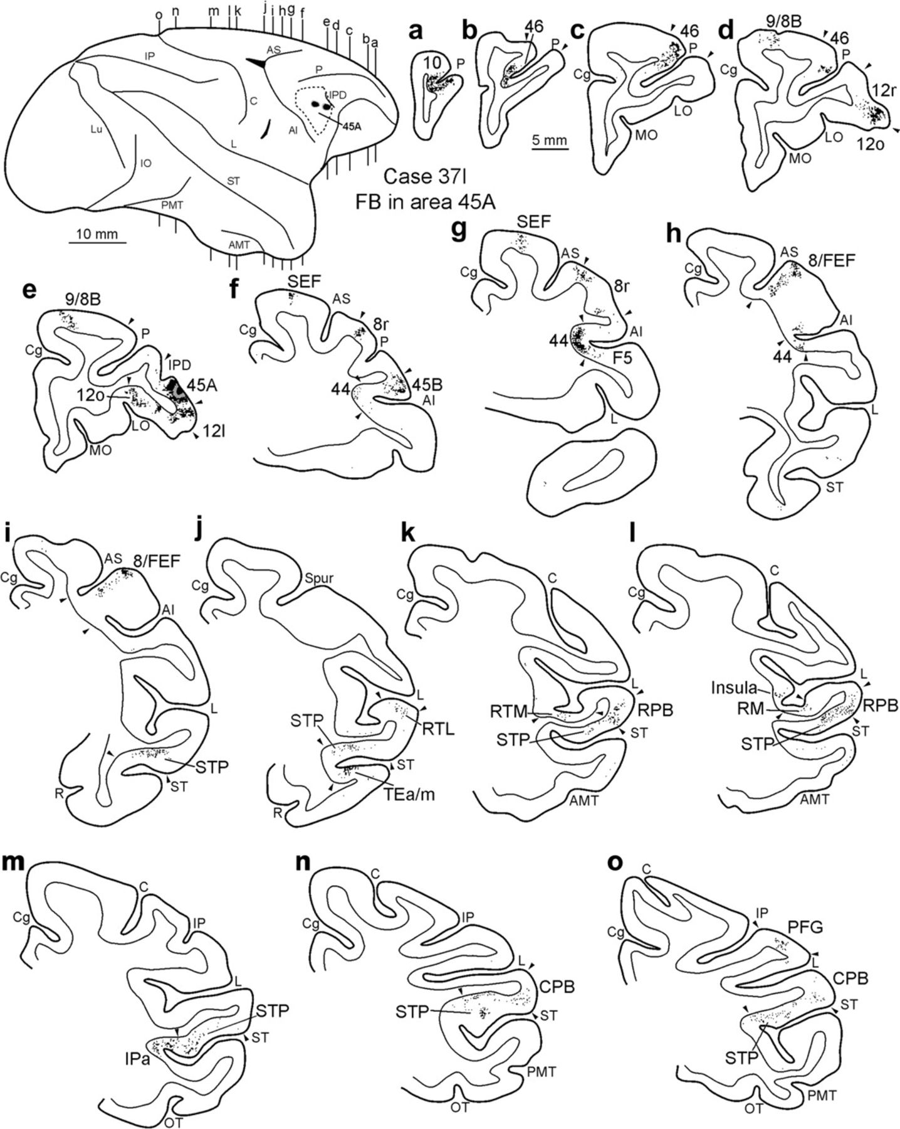
Figure 6. Distribution of the retrograde labeling observed in Case 37l FB, shown in drawings of coronal sections. ...
Notes:
Figure 6. Distribution of the retrograde labeling observed in Case 37l FB, shown in drawings of coronal sections. Sections are shown in a rostral to caudal order (a–o). Arrowheads indicate borders between different areas. The dorsolateral view of the injected hemisphere in the upper left part of the figure shows the levels at which the sections were taken, the border of area 45A and the location of the injection sites. Conventions and abbreviations as in Figures 1 and 5.
Unless provided in the caption above, the following copyright applies to the content of this slide: © The Author 2009. Published by Oxford University Press. All rights reserved. For permissions, please e-mail: journals.permissions@oxfordjournals.org

Slide 7
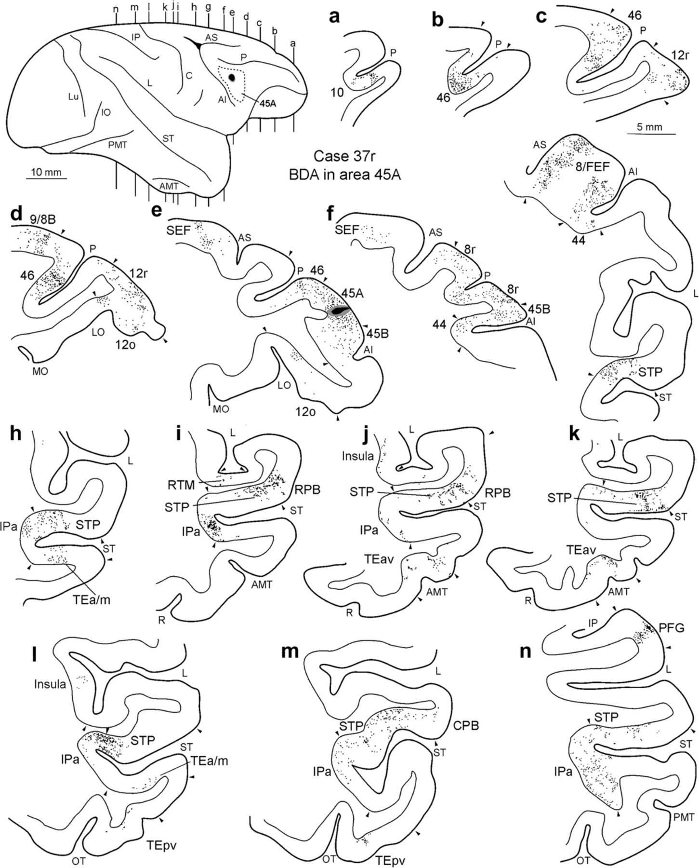
Figure 7. Distribution of the anterograde labeling observed in Case 37r BDA, shown in drawings of coronal sections. ...
Notes:
Figure 7. Distribution of the anterograde labeling observed in Case 37r BDA, shown in drawings of coronal sections. Sections are shown in a rostral to caudal order (a–n). The dot density is proportional to the density of the observed labeled terminals. Arrowheads indicate borders between different areas. The dorsolateral view of the injected hemisphere in the upper left part of the figure shows the levels at which the sections were taken, the border of area 45A and the location of the injection site. Abbreviations as in Figures 1 and 5.
Unless provided in the caption above, the following copyright applies to the content of this slide: © The Author 2009. Published by Oxford University Press. All rights reserved. For permissions, please e-mail: journals.permissions@oxfordjournals.org

Slide 8
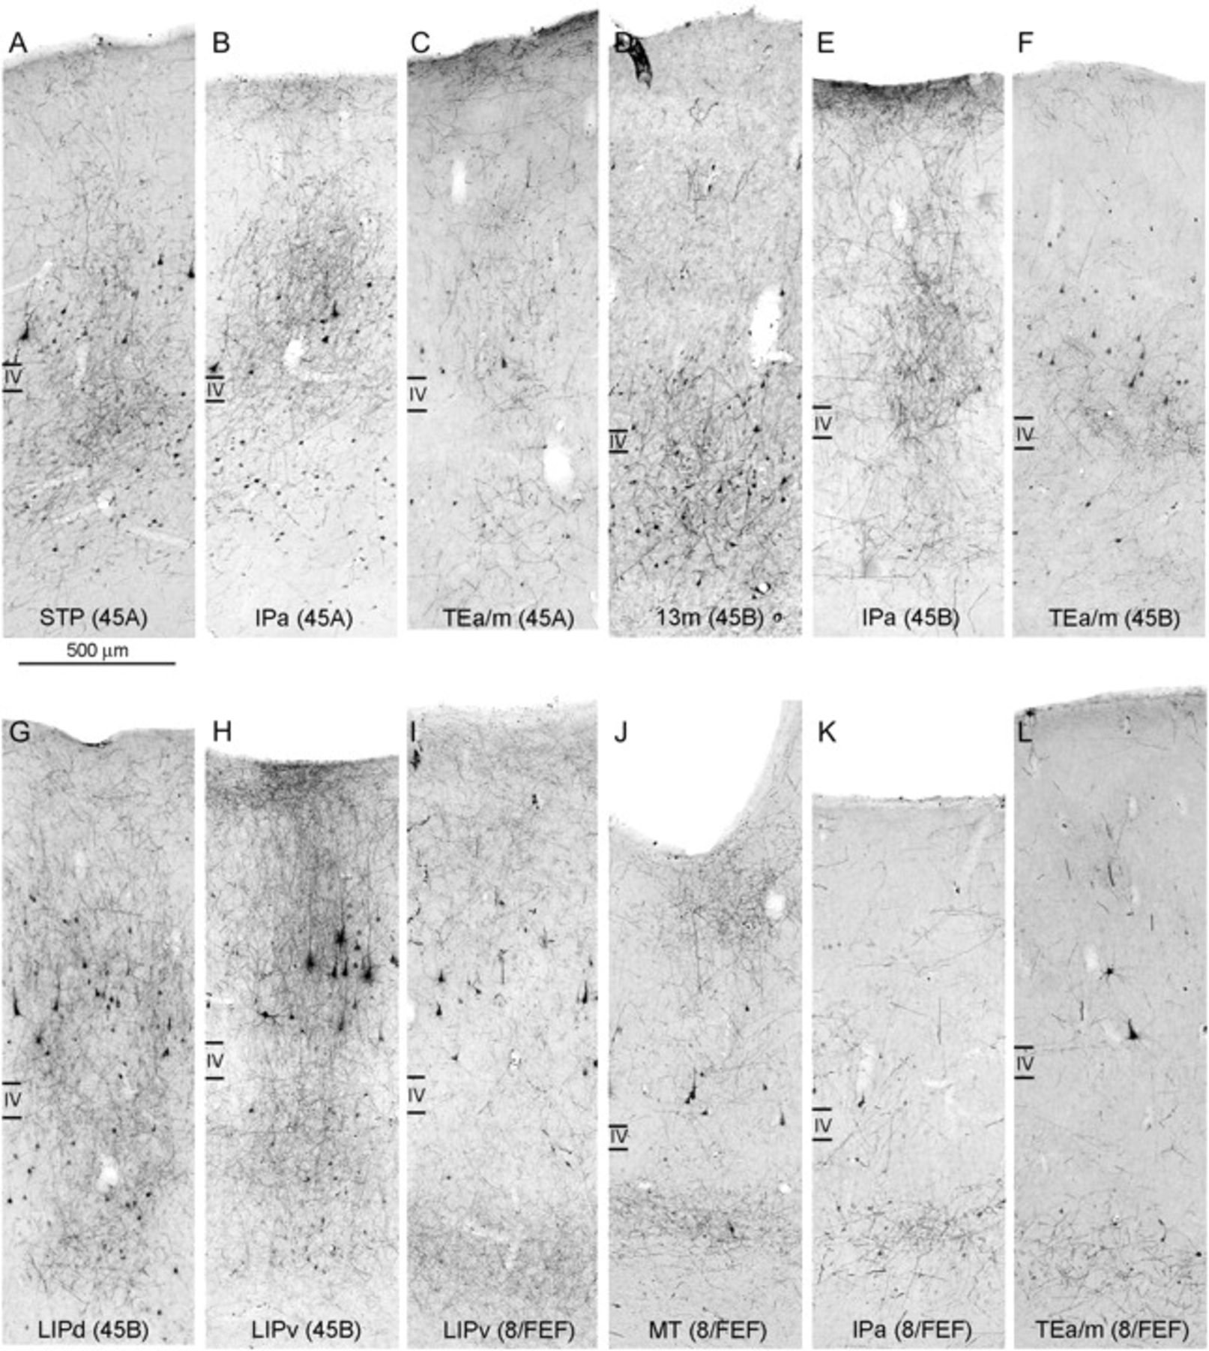
Figure 8. Examples of laminar patterns of retrograde and anterograde labeling observed following injections in areas ...
Notes:
Figure 8. Examples of laminar patterns of retrograde and anterograde labeling observed following injections in areas 45A (A–C), 45B (D–H), and 8/FEF (I–L). In each photomicrographs is indicated the area in which the labeling was observed and, in parentheses, the injected area. (A–C) Taken from Case 39l FR, (D and F–H) from Case 37r FR, (E) from Case 36r BDA, and (I–L) from Case 36r FR. Calibration bar applies to all photomicrographs.
Unless provided in the caption above, the following copyright applies to the content of this slide: © The Author 2009. Published by Oxford University Press. All rights reserved. For permissions, please e-mail: journals.permissions@oxfordjournals.org

Slide 9
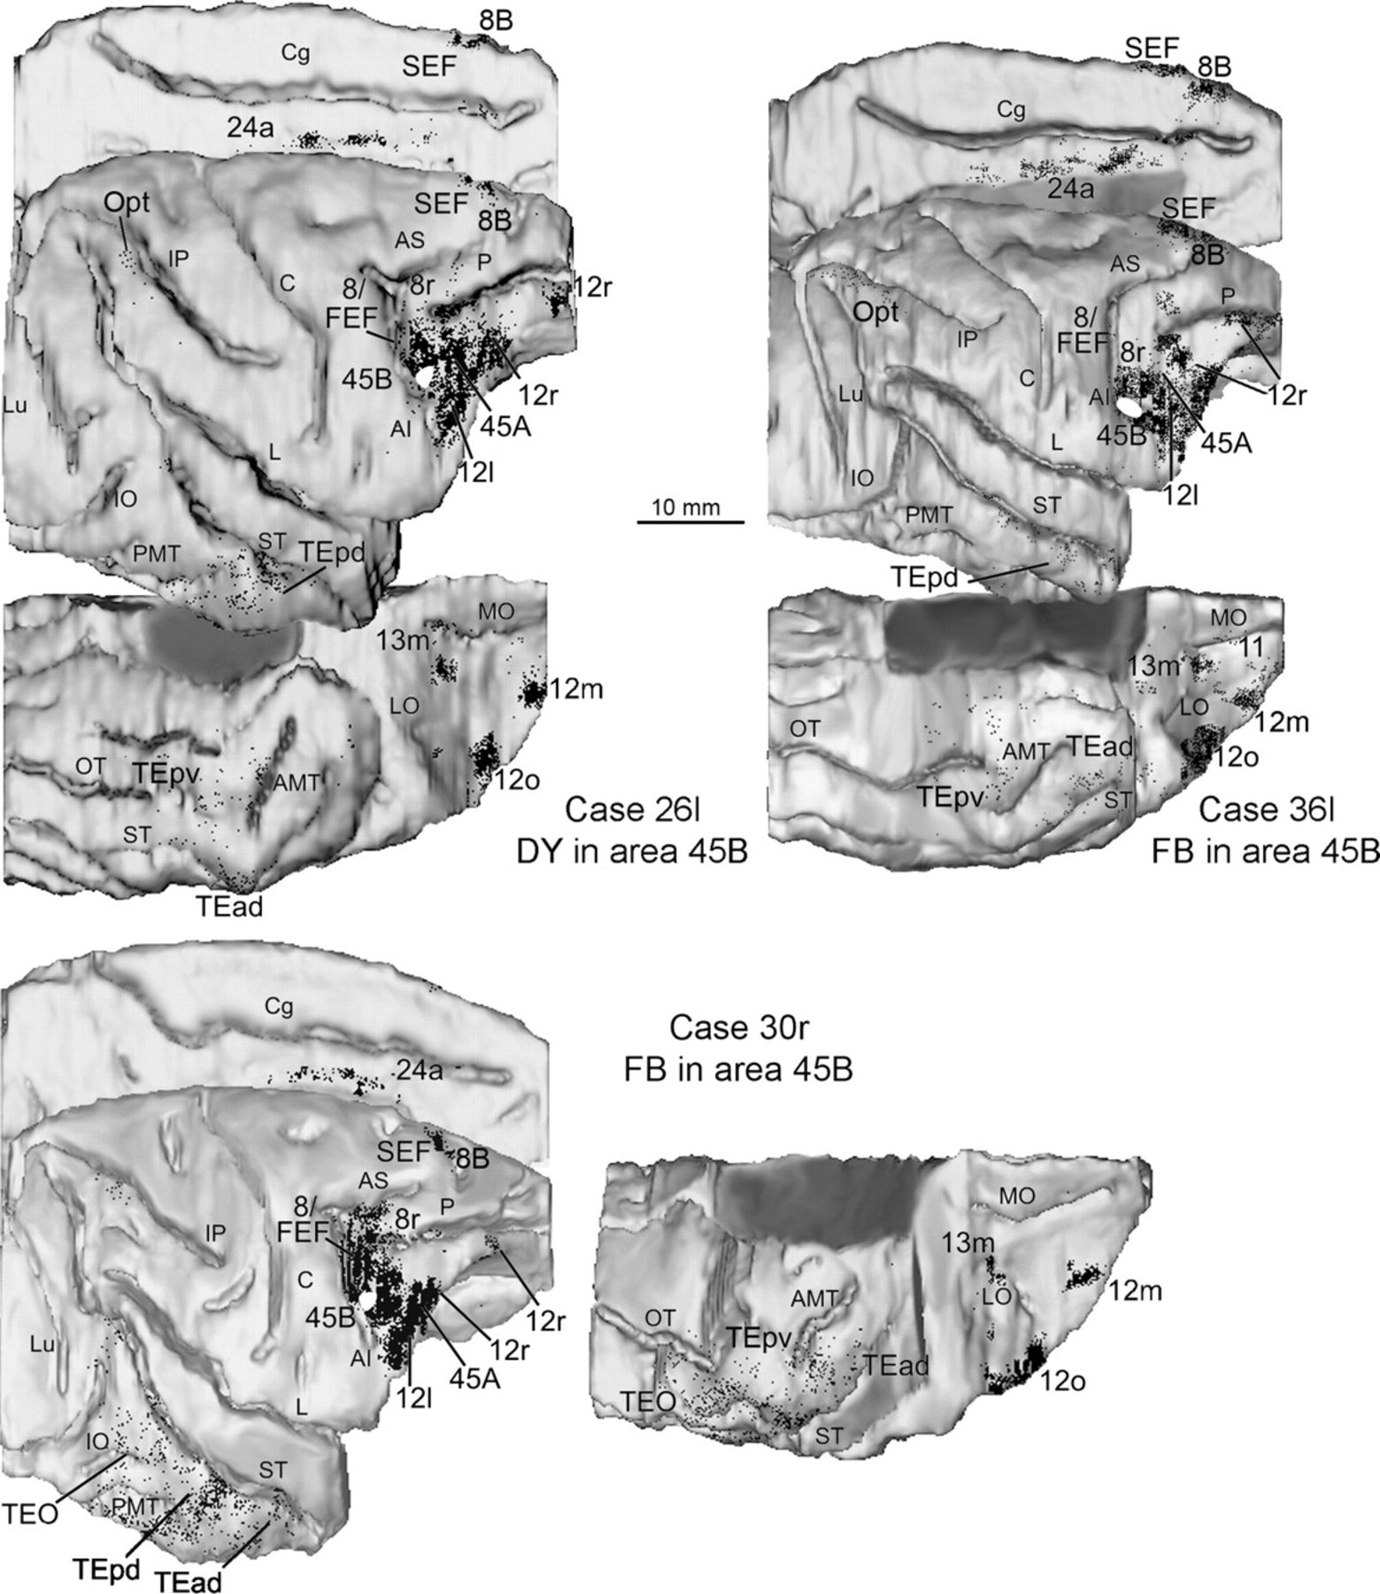
Figure 9. Distribution of the retrograde labeling observed following injections in area 45B in Cases 26l DY, 36l FB, ...
Notes:
Figure 9. Distribution of the retrograde labeling observed following injections in area 45B in Cases 26l DY, 36l FB, and 30r FB, shown in dorsolateral, mesial and bottom views of the 3D reconstructions of the injected hemispheres. Conventions and abbreviations as in Figures 1 and 5.
Unless provided in the caption above, the following copyright applies to the content of this slide: © The Author 2009. Published by Oxford University Press. All rights reserved. For permissions, please e-mail: journals.permissions@oxfordjournals.org

Slide 10
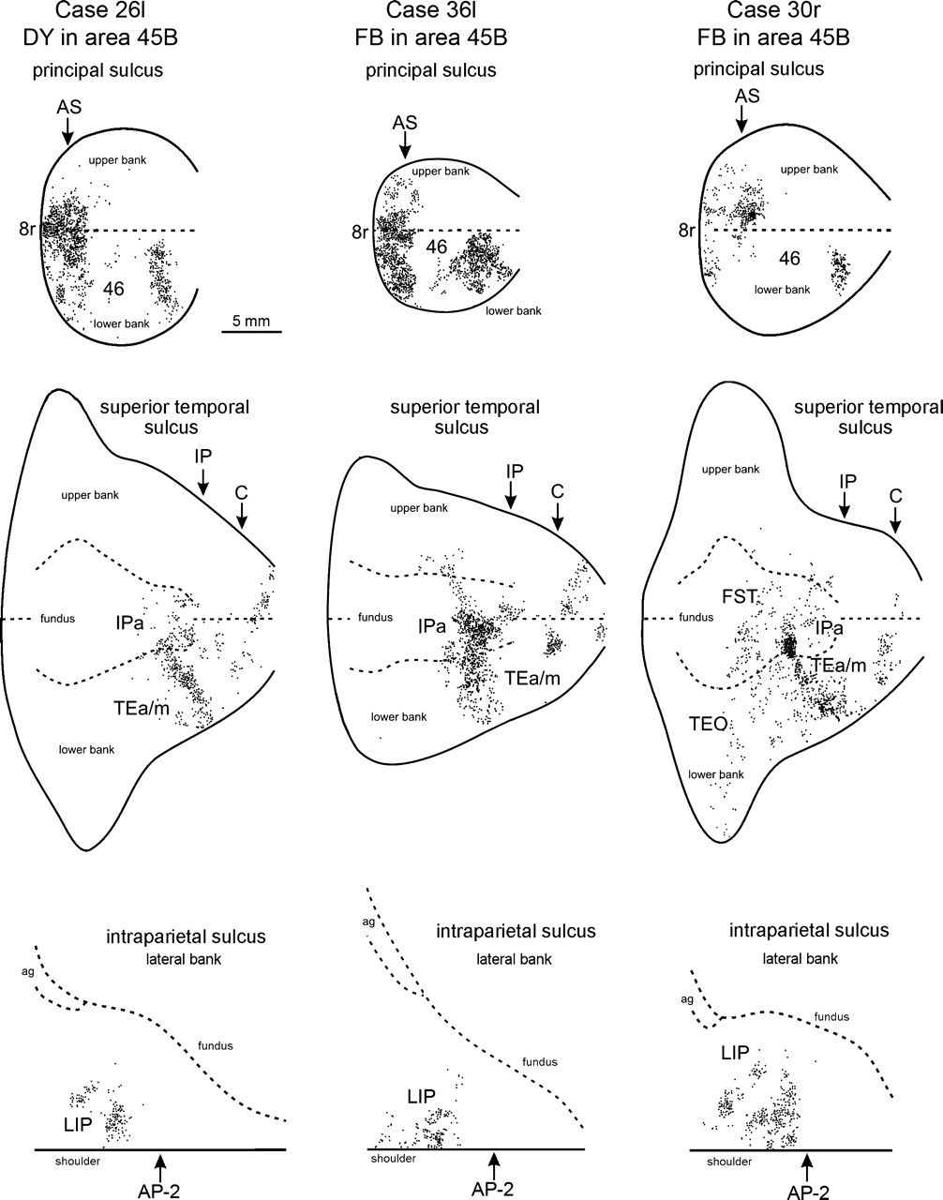
Figure 10. Distribution of the retrograde labeling observed following injections in area 45B in Cases 26l DY, 36l FB, ...
Notes:
Figure 10. Distribution of the retrograde labeling observed following injections in area 45B in Cases 26l DY, 36l FB, and 30r FB, shown in 2D reconstructions of the PS, the STS and the lateral bank of the IPS. Each 2D reconstruction of the lateral bank of the IPS was aligned to correspond with the lip of the bank, indicated by a continuous line. The dotted line corresponds to the fundus. The arrow marks the antero-posterior stereotaxic level −2, corresponding to the border of area AIP with area LIP (Borra et al., 2008). ag = annectant gyrus. Other conventions and abbreviations as in Figures 1 and 5.
Unless provided in the caption above, the following copyright applies to the content of this slide: © The Author 2009. Published by Oxford University Press. All rights reserved. For permissions, please e-mail: journals.permissions@oxfordjournals.org

Slide 11
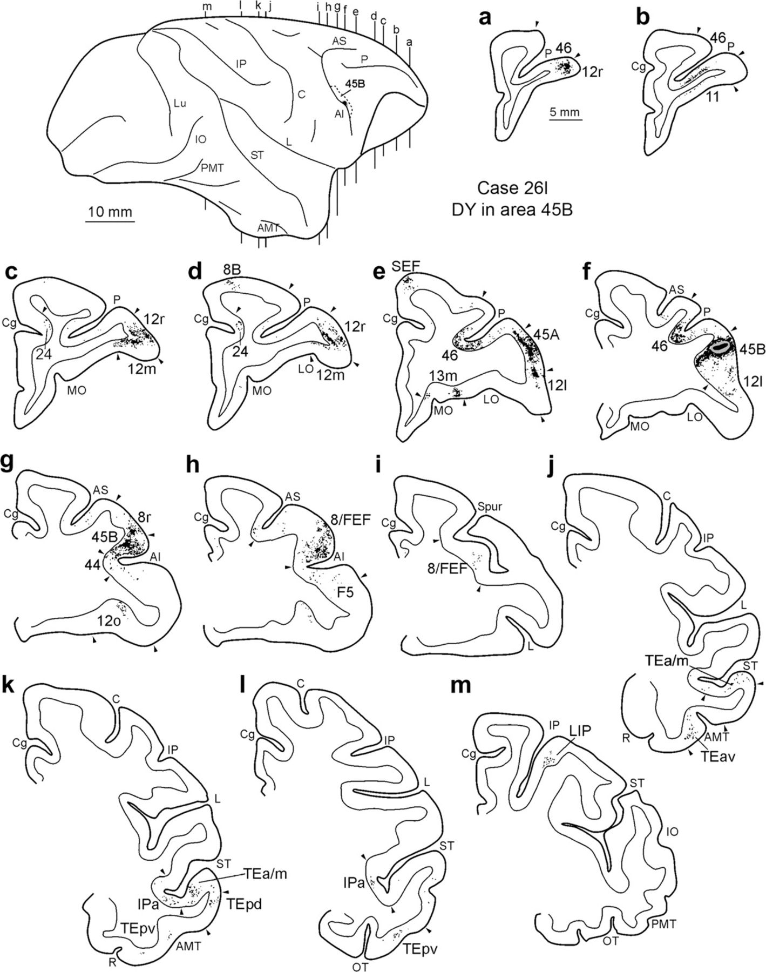
Figure 11. Distribution of the retrograde labeling observed in Case 26l DY, shown in drawings of coronal sections. ...
Notes:
Figure 11. Distribution of the retrograde labeling observed in Case 26l DY, shown in drawings of coronal sections. Sections are shown in a rostral to caudal order (a–m). The dorsolateral view of the injected hemisphere in the upper left part of the figure shows the levels at which the sections were taken, the border of area 45B and the location of the injection site. Conventions and abbreviations as in Figures 1, 5, and 6.
Unless provided in the caption above, the following copyright applies to the content of this slide: © The Author 2009. Published by Oxford University Press. All rights reserved. For permissions, please e-mail: journals.permissions@oxfordjournals.org

Slide 12
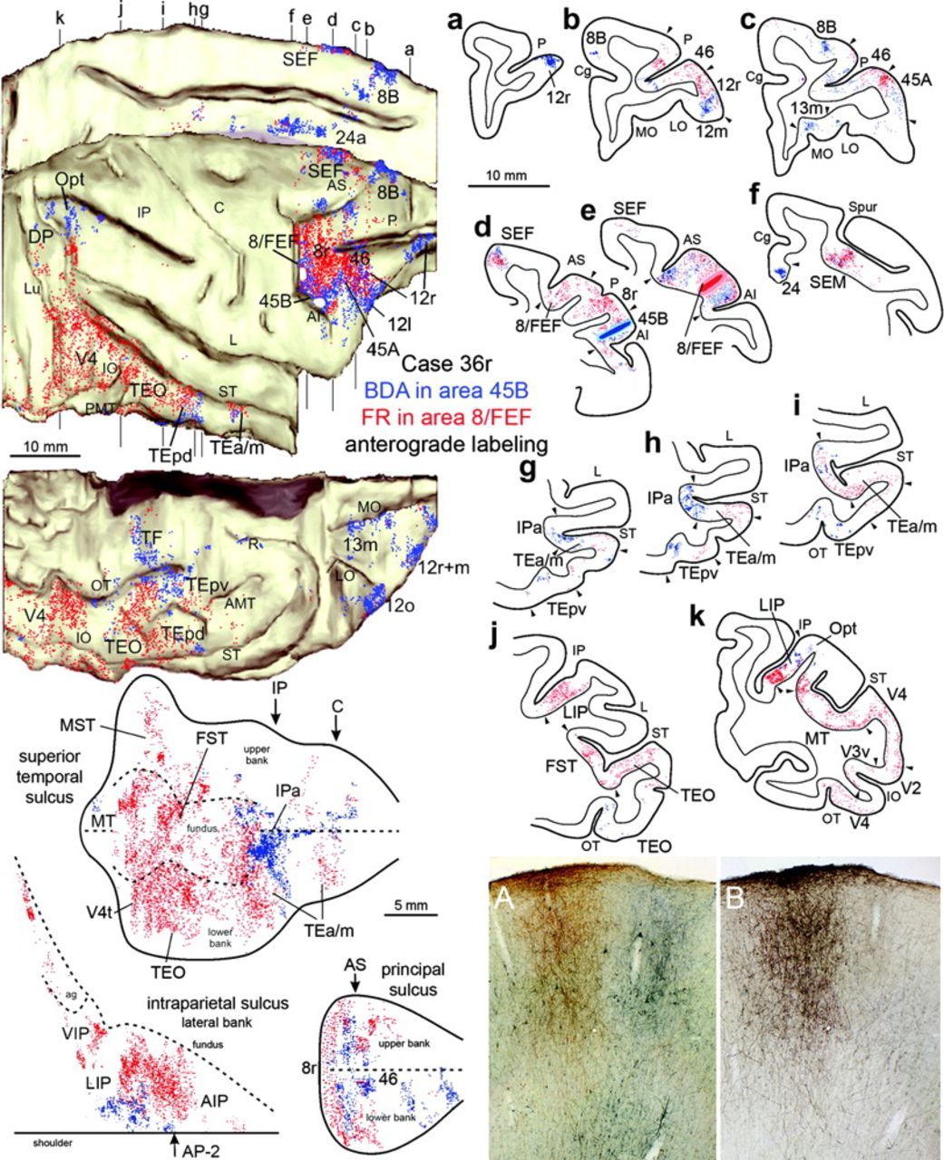
Figure 12. Distribution of the anterograde labeling observed following injections in areas 45B (BDA injection, blue ...
Notes:
Figure 12. Distribution of the anterograde labeling observed following injections in areas 45B (BDA injection, blue dots) and ventral 8/FEF (FR injection, red dots) in Case 36r, shown in a dorsolateral, a mesial and a bottom view of the 3D reconstruction of the injected hemisphere (upper left), in 2D reconstructions of the STS, the lateral bank of the IPS, and the PS (lower left) and in drawings of coronal sections arranged in a rostral to caudal order (a–k; right). The levels at which the sections were taken are indicated in the dorsolateral and the mesial view of the injected hemisphere. Conventions and abbreviations as in Figures 1, 5, 7, and 10. In the lower right part of the figure, photomicrographs taken in correspondence of the SEF, show, in (A), an example of the BDA (stained in brown) and the FR (stained in blue) labeling, visualized with the double-labeling protocol and, in B, the BDA labeling visualized in the adjacent section with the standard protocol.
Unless provided in the caption above, the following copyright applies to the content of this slide: © The Author 2009. Published by Oxford University Press. All rights reserved. For permissions, please e-mail: journals.permissions@oxfordjournals.org

Slide 13
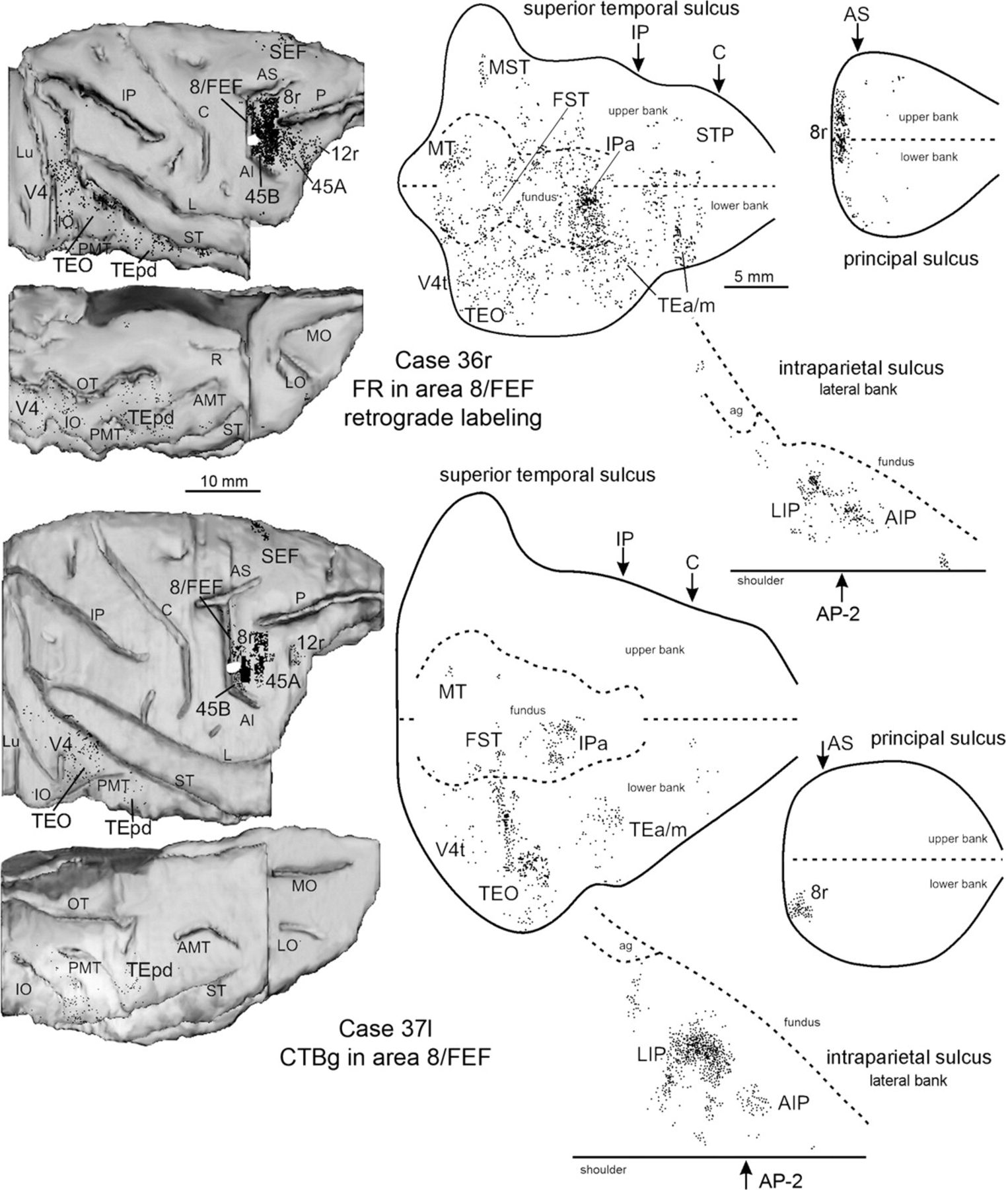
Figure 13. Distribution of the retrograde labeling observed following injections in ventral area 8/FEF in Cases 36r FR ...
Notes:
Figure 13. Distribution of the retrograde labeling observed following injections in ventral area 8/FEF in Cases 36r FR and 37l CTBg, shown in dorsolateral and bottom views of the 3D reconstructions of the injected hemispheres (left) and in 2D reconstructions of the lateral bank of the IPS, the PS and the STS (right). Conventions and abbreviations as in Figures 1, 5, and 10.
Unless provided in the caption above, the following copyright applies to the content of this slide: © The Author 2009. Published by Oxford University Press. All rights reserved. For permissions, please e-mail: journals.permissions@oxfordjournals.org

Slide 14
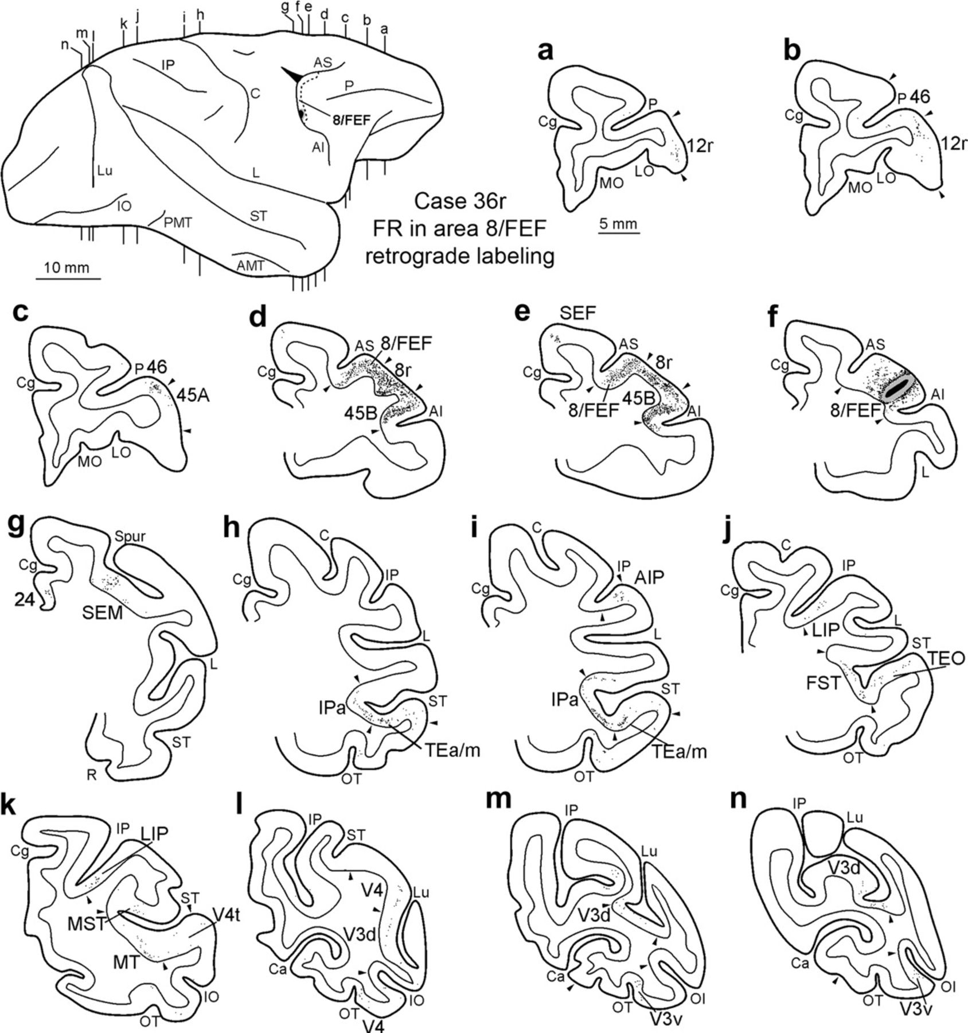
Figure 14. Distribution of the retrograde labeling observed in Case 36r FR, shown in drawings of coronal sections. ...
Notes:
Figure 14. Distribution of the retrograde labeling observed in Case 36r FR, shown in drawings of coronal sections. Sections are shown in a rostral to caudal order (a–n). The dorsolateral view of the injected hemisphere in the upper left part of the figure shows the levels at which the sections were taken, the border of area 8/FEF and the location of the injection site. Conventions and abbreviations as in Figures 1, 5, and 6.
Unless provided in the caption above, the following copyright applies to the content of this slide: © The Author 2009. Published by Oxford University Press. All rights reserved. For permissions, please e-mail: journals.permissions@oxfordjournals.org

Slide 15
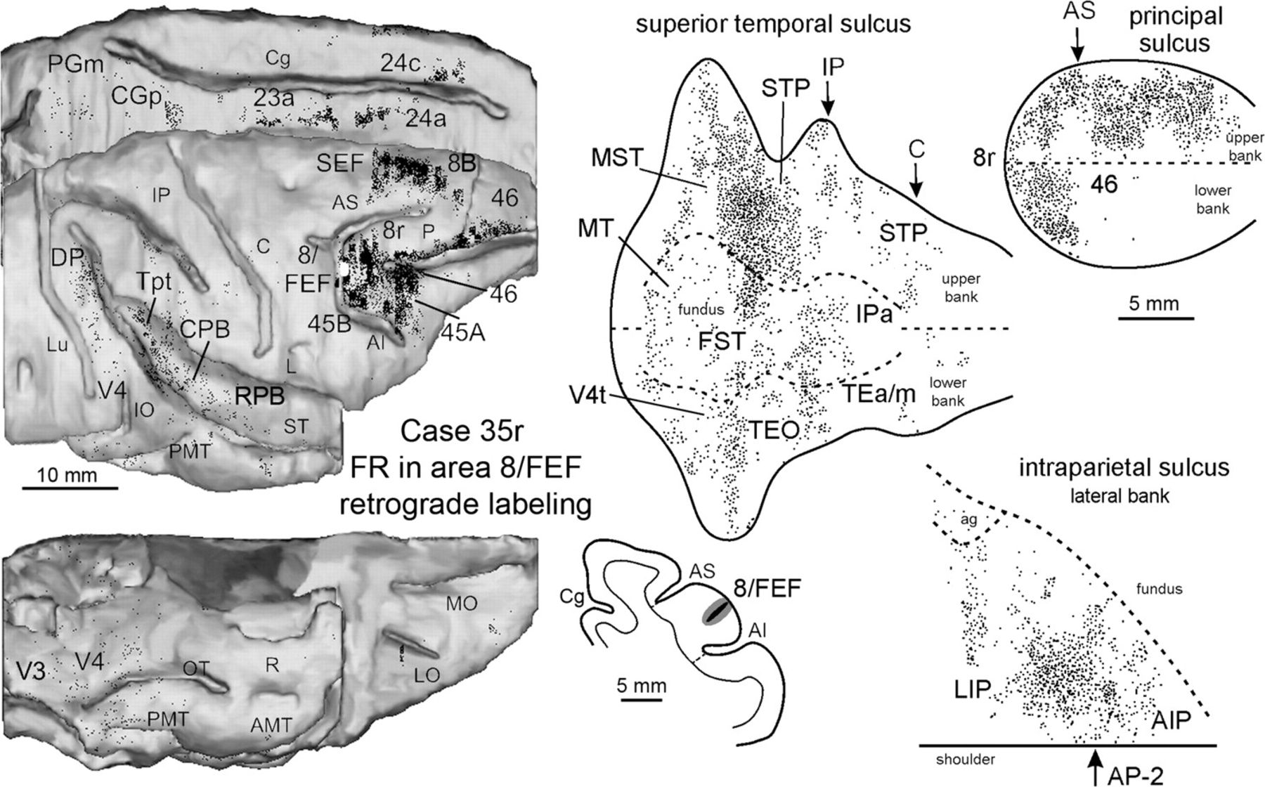
Figure 15. Distribution of the retrograde labeling observed following an injection of FR in a relatively dorsal part of ...
Notes:
Figure 15. Distribution of the retrograde labeling observed following an injection of FR in a relatively dorsal part of area 8/FEF in Case 35r, shown in a dorsolateral, a mesial and a bottom view of the 3D reconstruction of the injected hemispheres (left) and in 2D reconstructions of the lateral bank of the IPS, of the PS and of the STS (right). Conventions and abbreviations as in Figures 1, 5, and 10.
Unless provided in the caption above, the following copyright applies to the content of this slide: © The Author 2009. Published by Oxford University Press. All rights reserved. For permissions, please e-mail: journals.permissions@oxfordjournals.org

Slide 16
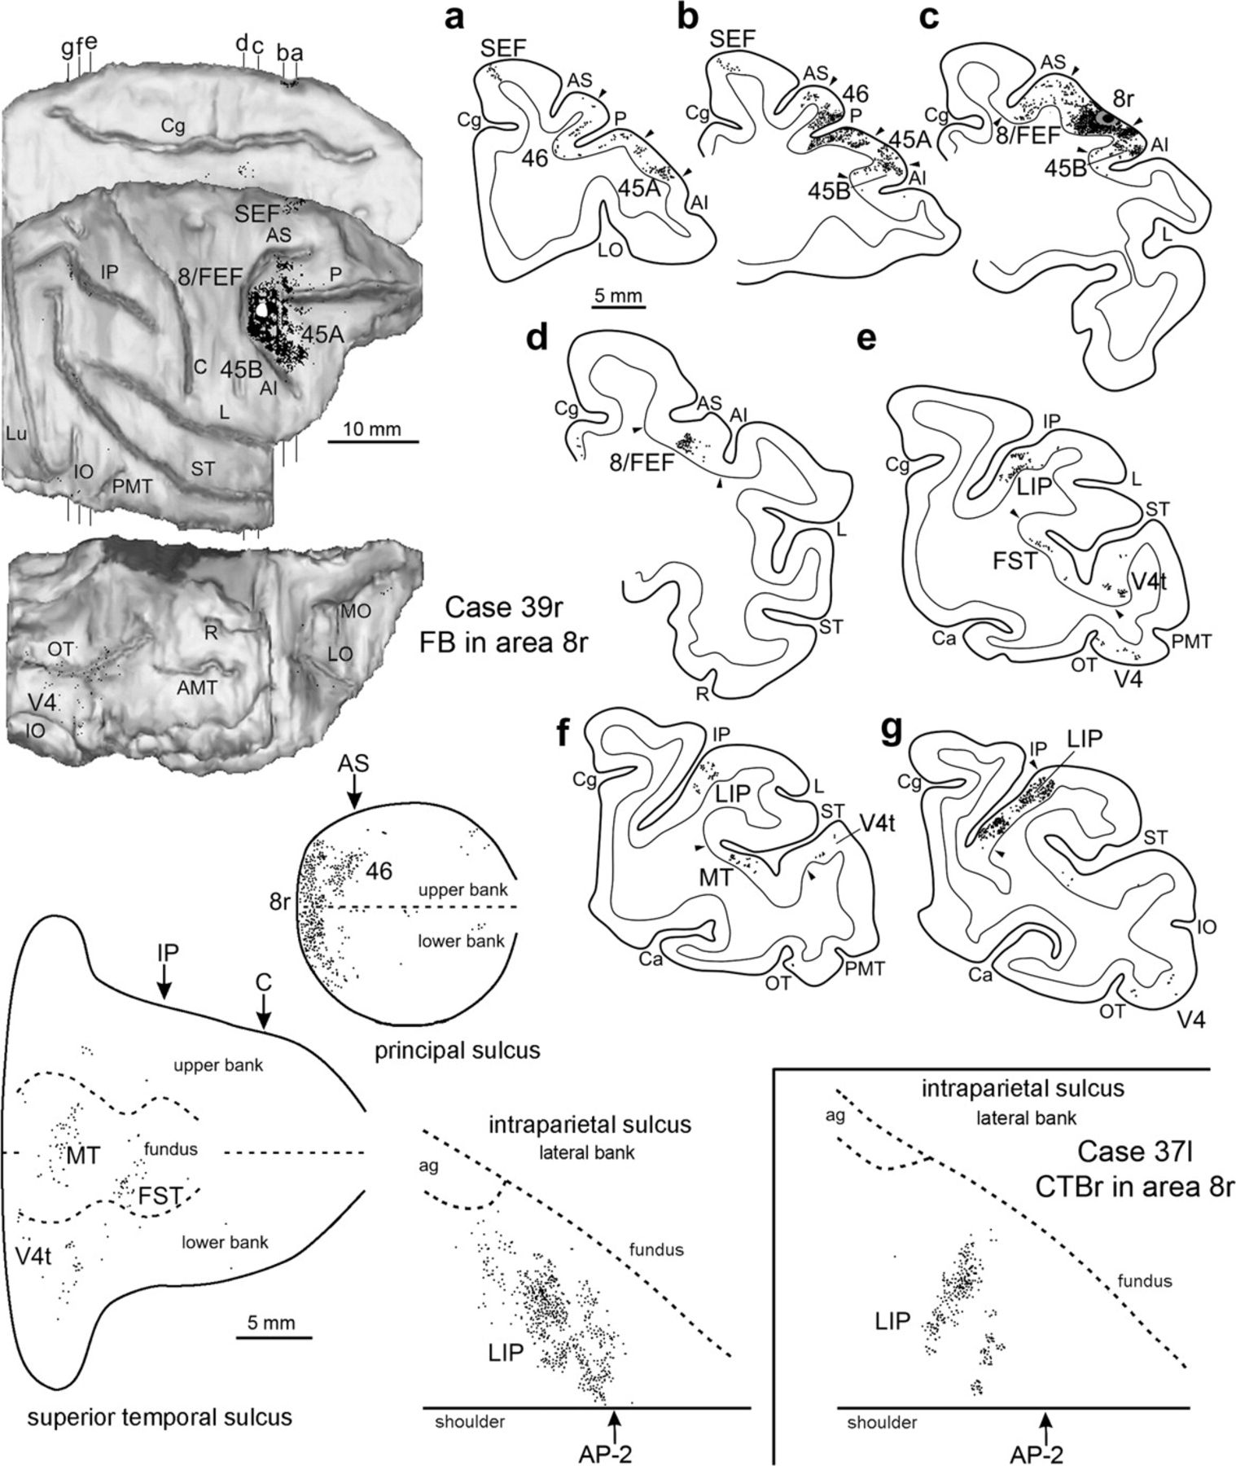
Figure 16. Distribution of the retrograde labeling observed following an injection of FB in area 8r in Case 39r shown in ...
Notes:
Figure 16. Distribution of the retrograde labeling observed following an injection of FB in area 8r in Case 39r shown in a dorsolateral, a mesial and a bottom view of the 3D reconstruction of the injected hemisphere (upper left), in 2D reconstructions of the STS, of the lateral bank of the IPS and of the PS (lower left) and in drawings of coronal sections arranged in a rostral to caudal order (a–g; right). The levels at which the sections were taken are indicated in the dorsolateral and mesial views of the injected hemisphere. The lower right part of the figure shows the distribution of the retrograde labeling observed in Case 37l CTBr in the lateral bank of the IPS. Conventions and abbreviations as in Figures 1, 5, and 10.
Unless provided in the caption above, the following copyright applies to the content of this slide: © The Author 2009. Published by Oxford University Press. All rights reserved. For permissions, please e-mail: journals.permissions@oxfordjournals.org

Slide 17
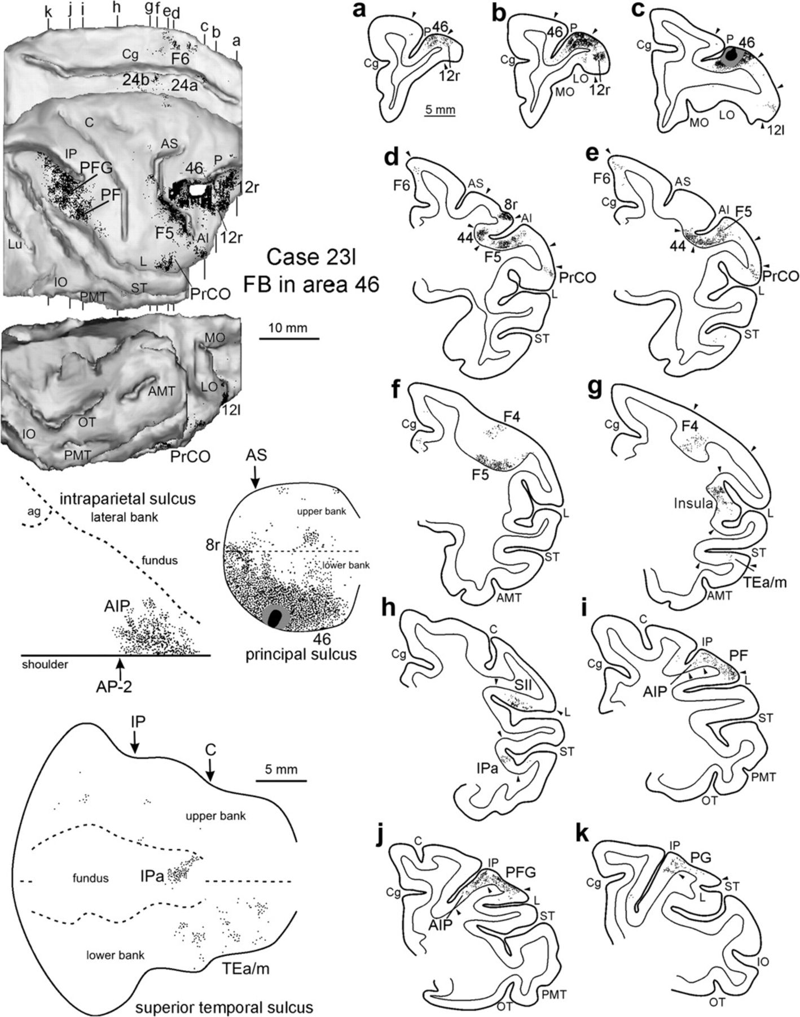
Figure 17. Distribution of the retrograde labeling observed following an injection of FB in ventrocaudal area 46 in Case ...
Notes:
Figure 17. Distribution of the retrograde labeling observed following an injection of FB in ventrocaudal area 46 in Case 23l, shown in a dorsolateral, a mesial and a bottom view of the 3D reconstruction of the injected hemisphere (upper left), in 2D reconstructions of the PS, of the lateral bank of the IPS and of the STS (lower left) and in drawings of coronal sections arranged in a rostral to caudal order (a–k; right). The levels at which the sections were taken are indicated in the dorsolateral and mesial views of the injected hemisphere. Conventions and abbreviations as in Figures 1, 5, and 10.
Unless provided in the caption above, the following copyright applies to the content of this slide: © The Author 2009. Published by Oxford University Press. All rights reserved. For permissions, please e-mail: journals.permissions@oxfordjournals.org

Slide 18
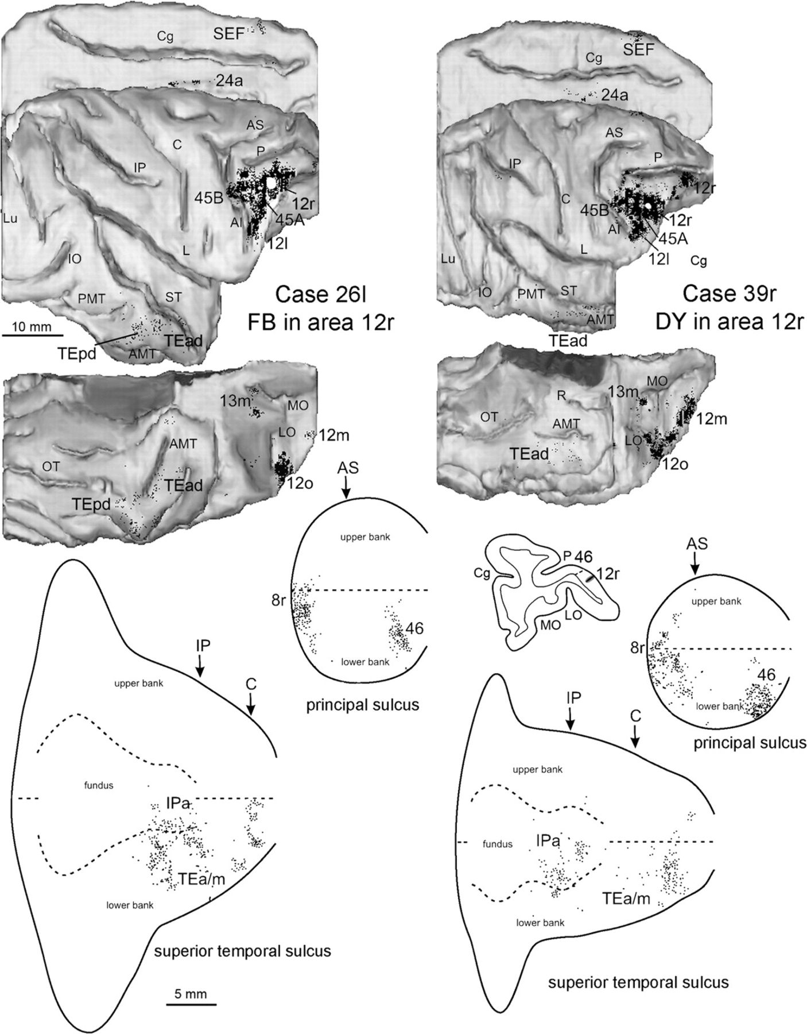
Figure 18. Distribution of the retrograde labeling observed following injections in caudal area 12r in Cases 26l (FB) ...
Notes:
Figure 18. Distribution of the retrograde labeling observed following injections in caudal area 12r in Cases 26l (FB) and 39r (DY), shown in dorsolateral, mesial and bottom views of the 3D reconstructions of the injected hemispheres (upper part) and in 2D reconstructions of the PS and of the STS (lower part). Conventions and abbreviations as in Figures 1 and 5.
Unless provided in the caption above, the following copyright applies to the content of this slide: © The Author 2009. Published by Oxford University Press. All rights reserved. For permissions, please e-mail: journals.permissions@oxfordjournals.org

Slide 19
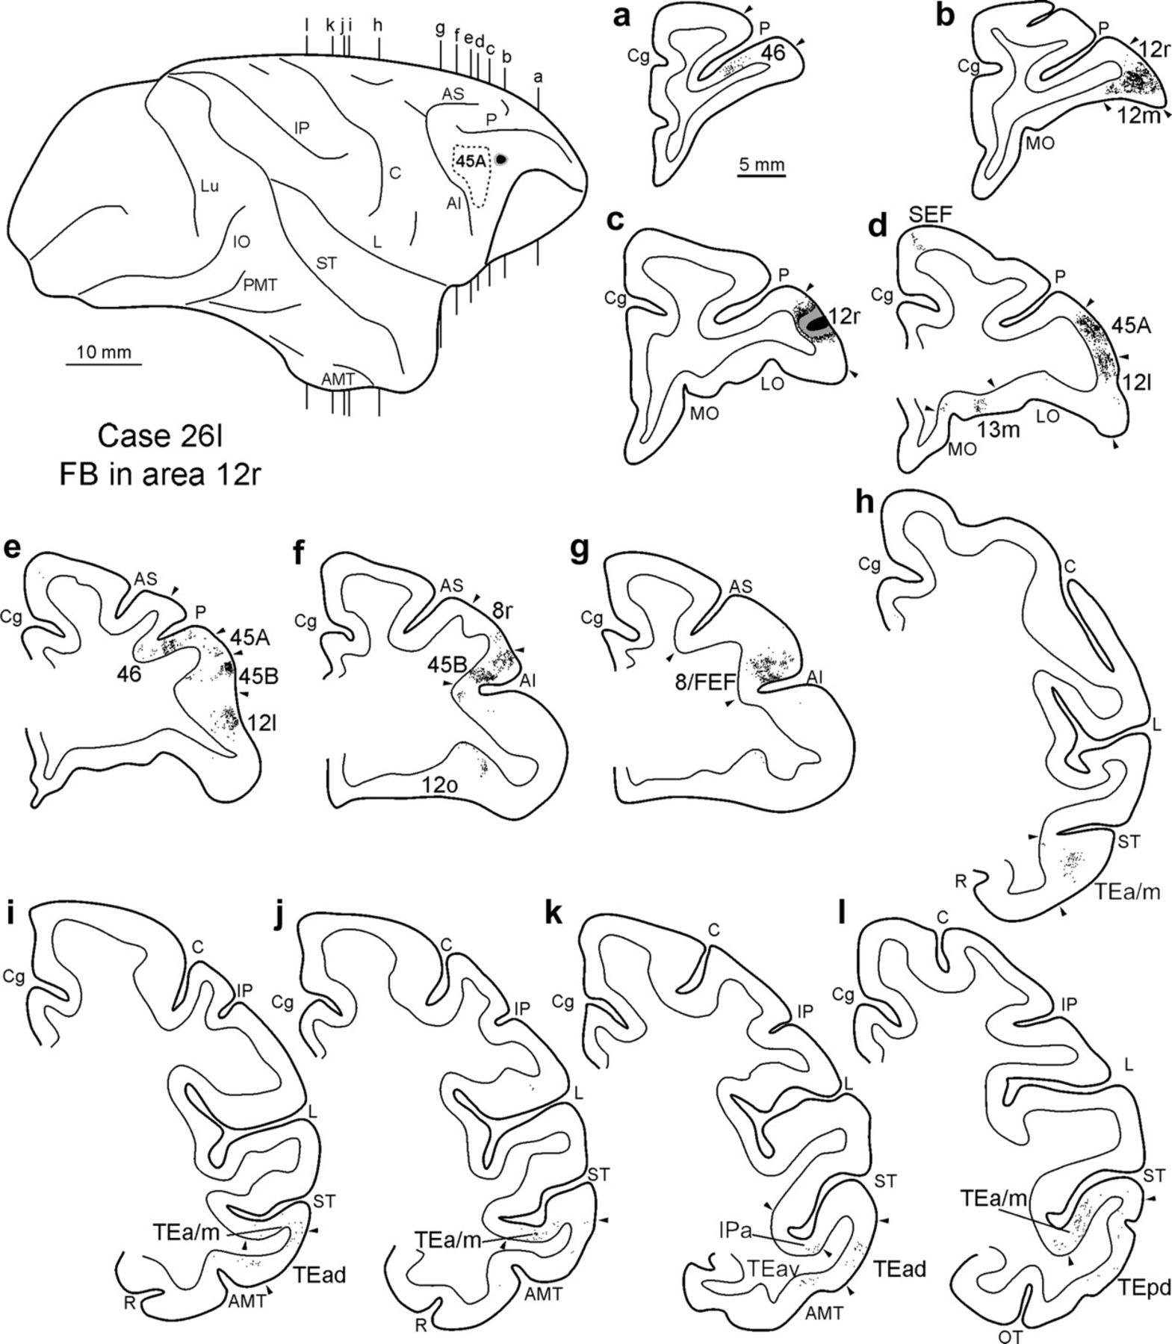
Figure 19. Distribution of the retrograde labeling observed in Case 26l FB, shown in drawings of coronal sections. ...
Notes:
Figure 19. Distribution of the retrograde labeling observed in Case 26l FB, shown in drawings of coronal sections. Sections are shown in a rostral to caudal order (a–l). The dorsolateral view of the injected hemisphere in the upper left part of the figure shows the levels at which the sections were taken, the border of area 45A and the location of the injection site. Conventions and abbreviations as in Figures 1 and 5.
Unless provided in the caption above, the following copyright applies to the content of this slide: © The Author 2009. Published by Oxford University Press. All rights reserved. For permissions, please e-mail: journals.permissions@oxfordjournals.org

Slide 20
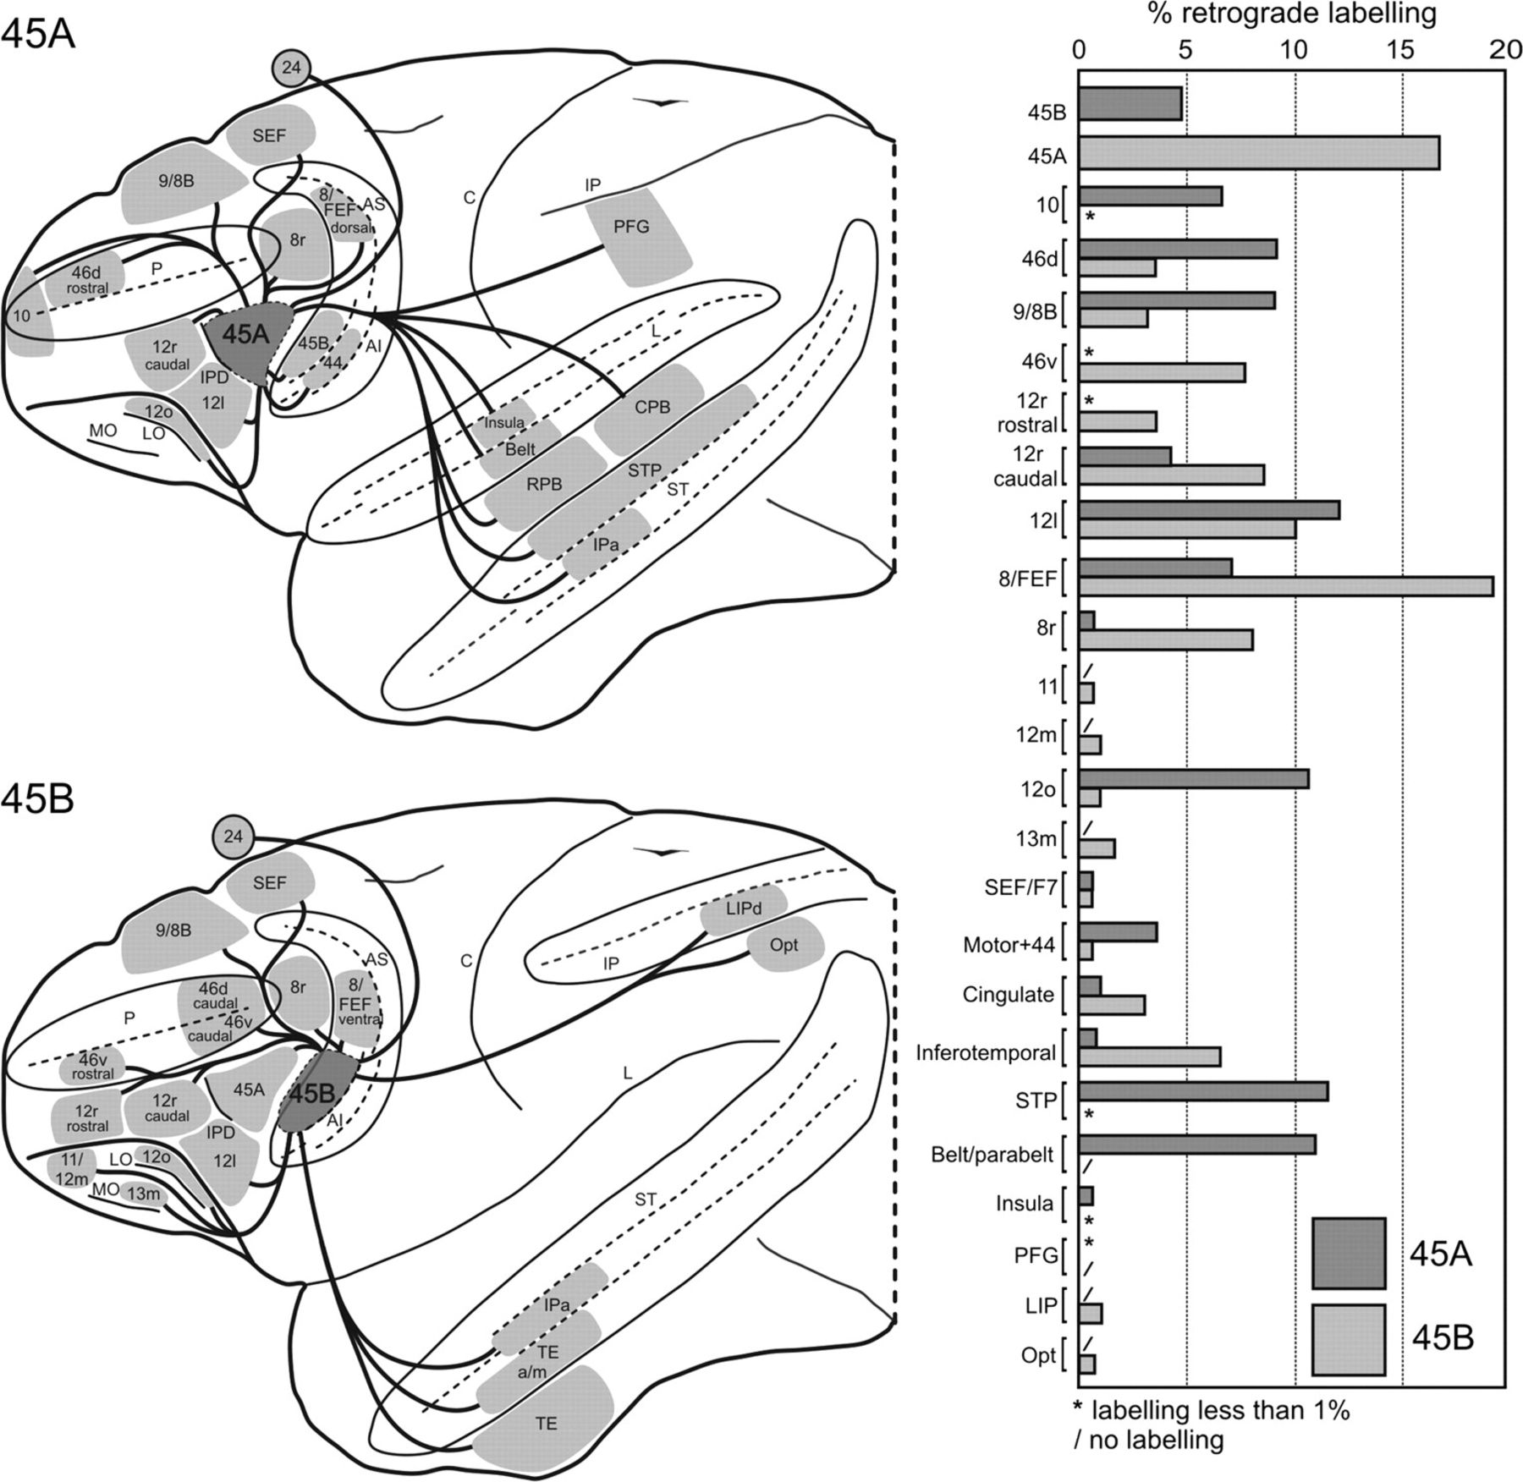
Figure 20. Summary view of the major ipsilateral cortical connections of areas 45A and 45B and mean percent distribution ...
Notes:
Figure 20. Summary view of the major ipsilateral cortical connections of areas 45A and 45B and mean percent distribution of the retrograde labeling observed in the cases of injections in areas 45A and 45B listed in Table 2. Abbreviations as in Figures 1 and 5.
Unless provided in the caption above, the following copyright applies to the content of this slide: © The Author 2009. Published by Oxford University Press. All rights reserved. For permissions, please e-mail: journals.permissions@oxfordjournals.org

