Slide 1
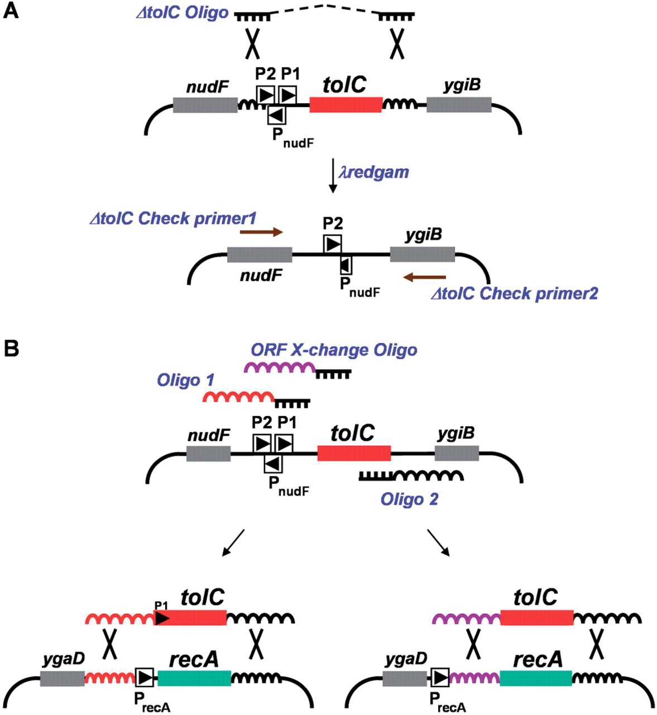
Figure 1. Deletion of tolC from the E. coli genome and cassette design. Fragments of chromosomal DNA are depicted with ...
Notes:
Figure 1. Deletion of tolC from the E. coli genome and cassette design. Fragments of chromosomal DNA are depicted with bent lines. Target genes ( tolC and recA ) are denoted by colored boxes; neighboring genes that encode open reading frames are shown with shaded boxes. P2 and P1 refer to the promoters of tolC ; P nudF and P recA drive expression of the nudF and recA genes, respectively. ( A ) Strategy for deleting tolC from the chromosome. Recombination using the single-stranded DNA molecule Δ tolC Oligo (Rx-P15) and λ redgam is depicted. The Rx-P15 oligo contains 35 bases of DNA directly homologous to sequences flanking tolC on the chromosome (curvy lines). The dotted line in Rx-P15 is merely a representation demonstrating that the two halves of the 70-base oligo are contiguous. Large X's denote λ red -mediated cross-over between regions of homologous DNA. Following recombination and selection for colicin E1 resistance, the deletion of tolC from the genome was confirmed by PCR with primers shown as brown arrows (Rx-P19 and -P20). ( B ) Amplification of the tolC cassette and deletion of recA . Oligo 1 (RxP-43) and Oligo 2 (Rx-P44) PCR amplify a double-stranded tolC expression cassette. ORF X-change oligo (Rx-P45) is used with RX-P46 (data not shown) to amplify only the tolC open reading frame without its promoter. Curvy lines represent homologous DNA shared by the linear DNA substrate and the bacterial chromosome while large X's again denote λ red -mediated cross-over between regions of homologous DNA. In this example, the tolC expression cassette replaces the entire recA transcription unit (red) or only the recA ORF (purple) conferring SDS resistance. A similar strategy was used to delete the ara regulon, dicB and ygeX (data not shown). PCR primers internal to tolC and complementary to neighboring genes were used to confirm insertion of tolC and deletion of the target gene (see Figure 2 for an example). Removing tolC from its new location followed the methodology in (A) above. The sequence and description of all primers and oligos can be found in Table S2. Illustrations not drawn to scale.
Unless provided in the caption above, the following copyright applies to the content of this slide: © 2007 The Author(s)This is an Open Access article distributed under the terms of the Creative Commons Attribution Non-Commercial License (http://creativecommons.org/licenses/by-nc/2.0/uk/) which permits unrestricted non-commercial use, distribution, and reproduction in any medium, provided the original work is properly cited.

Slide 2
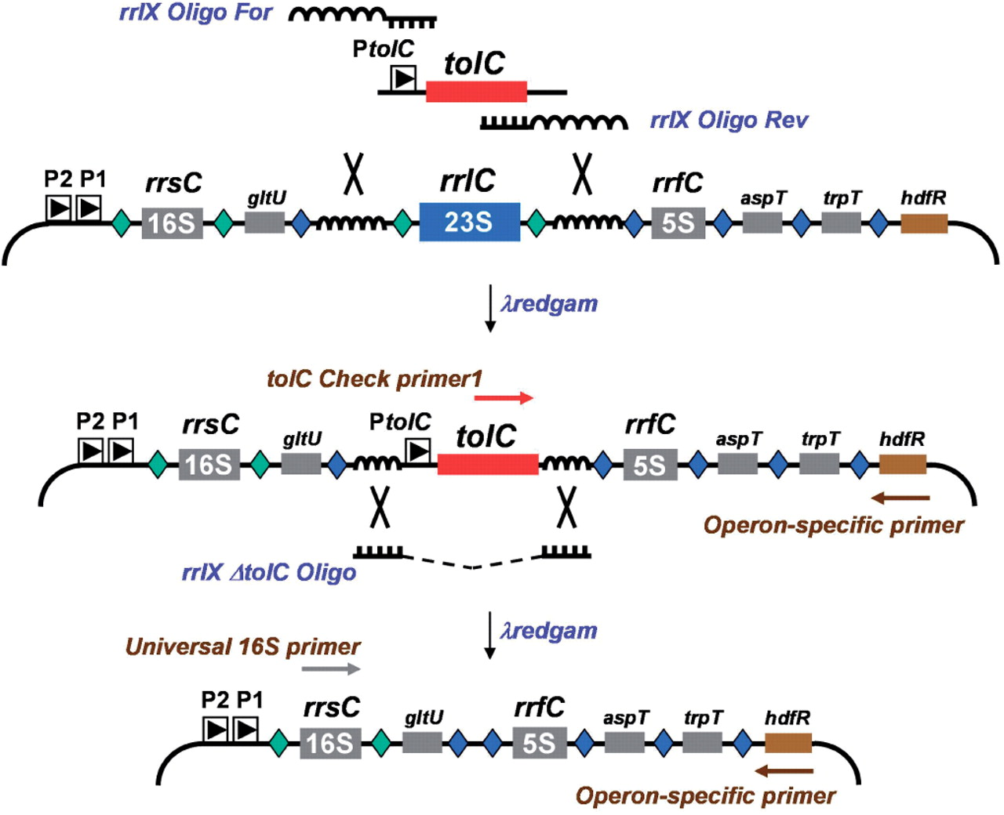
Figure 2. Strategy for remodeling the Escherichia coli rRNA operons. A tolC cassette is shown amplified by rrlX oligos ...
Notes:
Figure 2. Strategy for remodeling the Escherichia coli rRNA operons. A tolC cassette is shown amplified by rrlX oligos For and Rev (Rx-P50 and -P51, respectively) having universal homology arms that correspond to sequences flanking the 23S rRNA genes from all seven operons (Figure S3). In this example, removal of rrlC occurs following introduction of the tolC cassette and recombination. SDS-resistant colonies are screened by PCR using tolC Chk primer1 (Rx-P71) paired with an operon-specific primer (Px-P52 through P58). This screening can be multiplexed as primers were designed to amplify fragments of distinct sizes ( Figure 3 ). Following confirmation of tolC insertion, the cassette is removed by introducing universal single-stranded oligos (RX-P59 or P60, depending on the direction of replication). After selecting for colicin E1 resistance, transformants are screened by plating on SDS and by PCR using a 16S rDNA primer with the operon specific primers mentioned before. Fragments of chromosomal DNA are depicted with bent lines. P2 and P1 refer to the promoters that drive expression of the rRNA operons and P tolC represents the P1 promoter for that gene. Neighboring genes are shown with shaded boxes: gltU, aspT and trpT encode tRNA; rrsC and rrfC encodes 16S and 5S rRNA, respectively. Green diamonds represent RNase III processing sites. Blue diamonds represent RNAse E processing sites for tRNA and 5S RNA. Primers used for PCR screening are shown with brown arrows. Curvy lines represent homologous DNA shared by the linear DNA substrate and the bacterial chromosome while large X's again denote λ red -mediated cross-over between regions of homologous DNA. Illustrations not drawn to scale.
Unless provided in the caption above, the following copyright applies to the content of this slide: © 2007 The Author(s)This is an Open Access article distributed under the terms of the Creative Commons Attribution Non-Commercial License (http://creativecommons.org/licenses/by-nc/2.0/uk/) which permits unrestricted non-commercial use, distribution, and reproduction in any medium, provided the original work is properly cited.

Slide 3
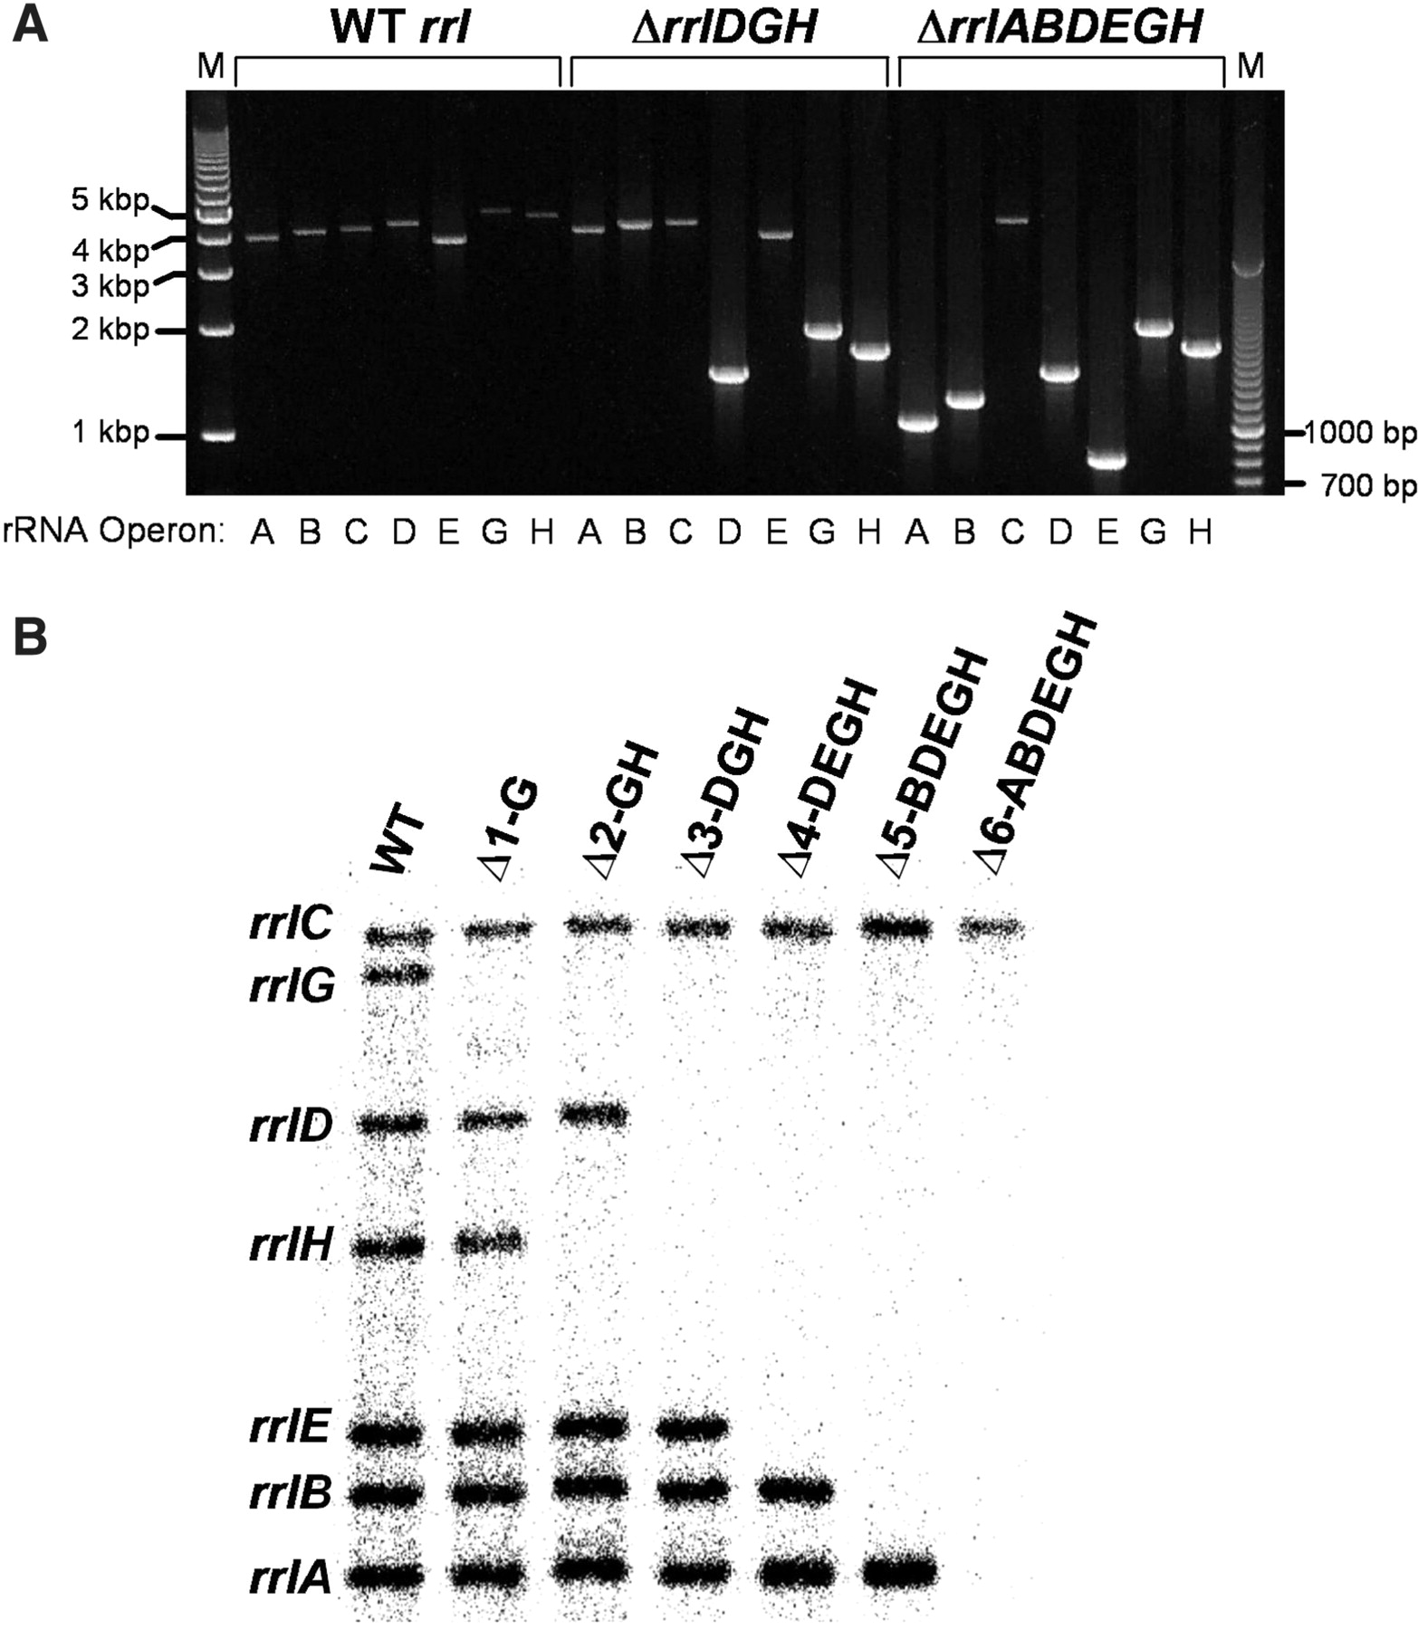
Figure 3. Confirmation of 23S rRNA deletions. ( A ) Agarose gel showing PCR products generated from gDNA of select E. ...
Notes:
Figure 3. Confirmation of 23S rRNA deletions. ( A ) Agarose gel showing PCR products generated from gDNA of select E. coli strains. Strain RS526 (WT rrl ) has all rRNA operons intact and yields large (∼4–5 kb) PCR products when the 16S and operon-specific primers are used ( Figure 2 ). The ΔrrlDGH strain (RS547) shows smaller PCR fragments demonstrating the deletion of 23S rRNA genes from the respective operons. Lastly, strain RS676 (ΔrrlABDEGH) has only one copy of the gene for 23S rRNA located in the rrnC operon. Lanes 1 and 23: Marker DNA (1 kb ladder and 0.1 kb ladder, respectively). ( B ) Southern blot demonstrating the step-wise removal of 23S rRNA genes from six of the seven operons. The sizes of the DNA bands and corresponding operons follow: rrnC —16.9 kb; rrnG —15.5 kb; rrnE —11.2 kb; rrnH —9.6 kb; rrnD —8.1 kb; rrnB —7.2 kb and rrnA —6.6 kb. Strain designations: WT- RS526, Δ1- RS537, Δ2- RS544, Δ3- RS547, Δ4- RS550, Δ5- RS554 and Δ6-RS676.
Unless provided in the caption above, the following copyright applies to the content of this slide: © 2007 The Author(s)This is an Open Access article distributed under the terms of the Creative Commons Attribution Non-Commercial License (http://creativecommons.org/licenses/by-nc/2.0/uk/) which permits unrestricted non-commercial use, distribution, and reproduction in any medium, provided the original work is properly cited.

Slide 4
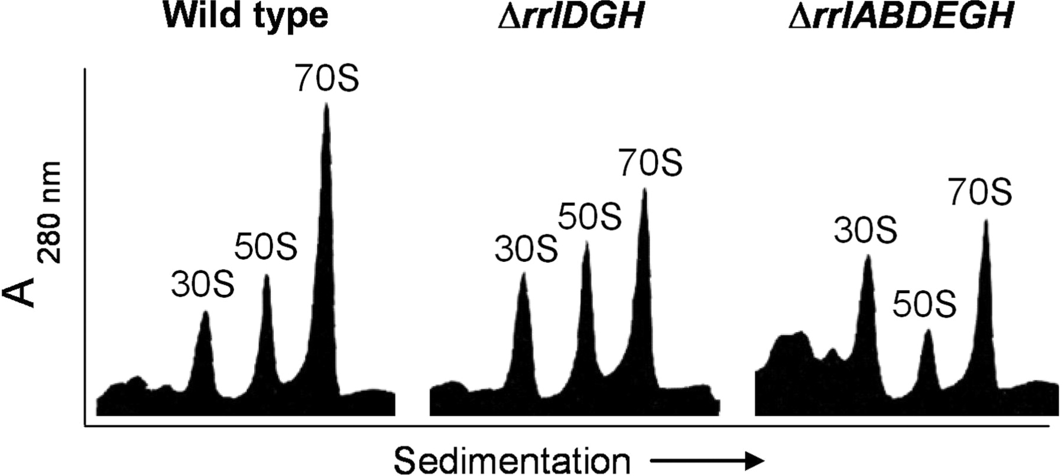
Figure 4. Ribosome sedimentation profiles from rrl mutants. Ribosomes were purified and analyzed by sucrose density ...
Notes:
Figure 4. Ribosome sedimentation profiles from rrl mutants. Ribosomes were purified and analyzed by sucrose density gradient sedimentation according to Materials and Methods. The positions and size (S = Svedberg units) are shown: 70S = mature ribosomes, 50S = large ribosomal subunits, 30S = small ribosomal subunits. WT- strain RS526 ( rrl+ ), Δ rrlDGH - strain RS547 and Δ rrlABDEGH - strain RS676.
Unless provided in the caption above, the following copyright applies to the content of this slide: © 2007 The Author(s)This is an Open Access article distributed under the terms of the Creative Commons Attribution Non-Commercial License (http://creativecommons.org/licenses/by-nc/2.0/uk/) which permits unrestricted non-commercial use, distribution, and reproduction in any medium, provided the original work is properly cited.

