Slide 1
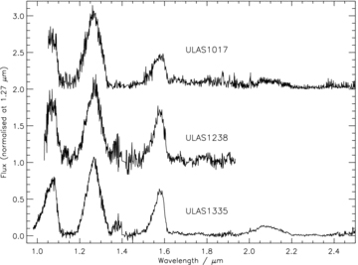
Figure 1 The NIRI JHK spectrum for ULAS1335 (bottom), the JH spectrum for ULAS1238 (middle). The IRCS J and NIRI HK ...
Notes:
Figure 1 The NIRI JHK spectrum for ULAS1335 (bottom), the JH spectrum for ULAS1238 (middle). The IRCS J and NIRI HK spectrum of ULAS1017 is shown on the top row.
Unless provided in the caption above, the following copyright applies to the content of this slide: © 2008 The Authors. Journal compilation © 2008 RAS

Slide 2
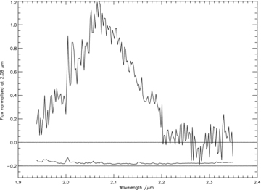
Figure 2 The NIRI K-band spectrum for ULAS1238. The error spectrum is shown offset by −0.2.
Notes:
Figure 2 The NIRI K-band spectrum for ULAS1238. The error spectrum is shown offset by −0.2.
Unless provided in the caption above, the following copyright applies to the content of this slide: © 2008 The Authors. Journal compilation © 2008 RAS

Slide 3
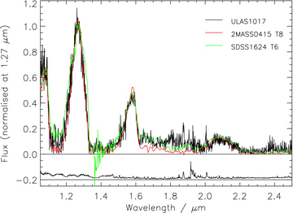
Figure 3 The IRCS + NIRI JHK spectrum of ULAS1017 (black line) overplotted with the spectra of the T8 standard ...
Notes:
Figure 3 The IRCS + NIRI JHK spectrum of ULAS1017 (black line) overplotted with the spectra of the T8 standard 2MASS0415 and the T6 standard SDSS1624. The error spectrum, offset by −0.2 in the y-axis, is plotted as a black line.
Unless provided in the caption above, the following copyright applies to the content of this slide: © 2008 The Authors. Journal compilation © 2008 RAS

Slide 4
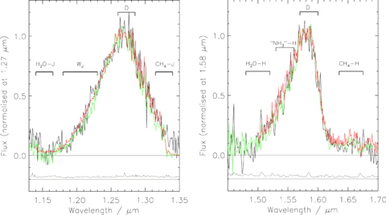
Figure 4 The J- and H-band flux peaks of ULAS1238 (black line), ULAS0034 (T9, see text; green line) and 2MASS0415 (T8; ...
Notes:
Figure 4 The J- and H-band flux peaks of ULAS1238 (black line), ULAS0034 (T9, see text; green line) and 2MASS0415 (T8; red line). The black line that is plotted offset by −0.2 in the y-axis is the error spectrum for ULAS1238. Also indicated are the spectral regions integrated to form the numerator of the spectral indices discussed in the text. The region that forms the denominator is indicated with the letter ‘D’.
Unless provided in the caption above, the following copyright applies to the content of this slide: © 2008 The Authors. Journal compilation © 2008 RAS

Slide 5
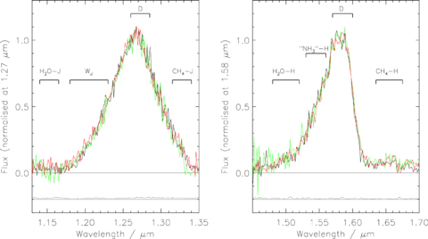
Figure 5 The J- and H-band flux peaks of ULAS1335 (black line), ULAS0034 (T9, see text; green line) and CFBDS0059 (T9, ...
Notes:
Figure 5 The J- and H-band flux peaks of ULAS1335 (black line), ULAS0034 (T9, see text; green line) and CFBDS0059 (T9, see text; red line). The black line that is plotted offset by −0.2 in the y-axis is the error spectrum for ULAS1335. Also indicated are the spectral regions integrated to form the numerator of the spectral indices discussed in the text. The region that forms the denominator is indicated with the letter ‘D’.
Unless provided in the caption above, the following copyright applies to the content of this slide: © 2008 The Authors. Journal compilation © 2008 RAS

Slide 6
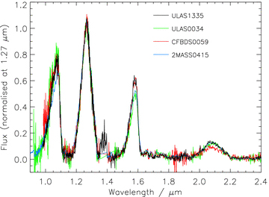
Figure 6 The full YJHK comparison of ULAS1335 to ULAS0034, CFBDS0059 and 2MASS0415.
Notes:
Figure 6 The full YJHK comparison of ULAS1335 to ULAS0034, CFBDS0059 and 2MASS0415.
Unless provided in the caption above, the following copyright applies to the content of this slide: © 2008 The Authors. Journal compilation © 2008 RAS

Slide 7
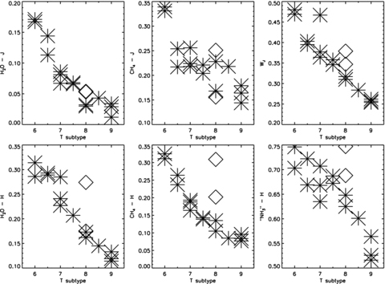
Figure 7 Spectral index versus T-subtype for T6–T9 dwarfs. Asterisks indicate ‘normal’ dwarfs, whilst the diamonds ...
Notes:
Figure 7 Spectral index versus T-subtype for T6–T9 dwarfs. Asterisks indicate ‘normal’ dwarfs, whilst the diamonds indicate two T8p dwarfs: ULAS1017 and 2MASS J07290002−3954043. Index values for these objects are drawn from Burgasser et al. (2006), Warren et al. (2007), Delorme et al. (2008) and Looper, Kirkpatrick & Burgasser (2007), or are calculated from the objects' spectra supplied by these authors. Uncertainties are smaller than the symbol sizes.
Unless provided in the caption above, the following copyright applies to the content of this slide: © 2008 The Authors. Journal compilation © 2008 RAS

Slide 8
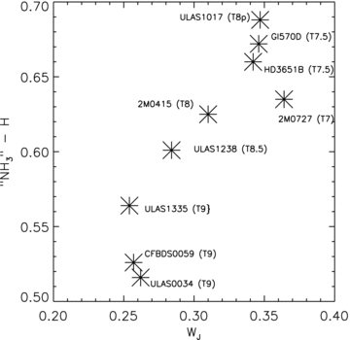
Figure 8 The ‘NH₃’–H index versus W_{J} index. Uncertainties are not displayed as they are smaller ...
Notes:
Figure 8 The ‘NH3’–H index versus WJ index. Uncertainties are not displayed as they are smaller than the symbol size.
Unless provided in the caption above, the following copyright applies to the content of this slide: © 2008 The Authors. Journal compilation © 2008 RAS

Slide 9
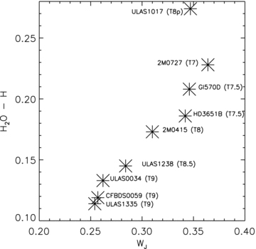
Figure 9 The H₂O–H index versus W_{J} index. Uncertainties are not displayed as they are smaller ...
Notes:
Figure 9 The H2O–H index versus WJ index. Uncertainties are not displayed as they are smaller than the symbol size.
Unless provided in the caption above, the following copyright applies to the content of this slide: © 2008 The Authors. Journal compilation © 2008 RAS

Slide 10
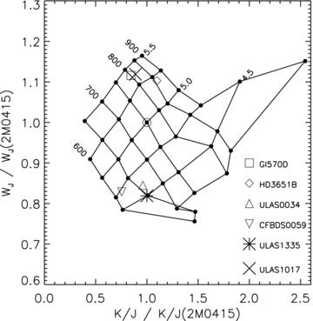
Figure 10 W_{J} versus K/J indices for a grid of solar metallicity BT-Settl model spectra. The grid has been ...
Notes:
Figure 10 WJ versus K/J indices for a grid of solar metallicity BT-Settl model spectra. The grid has been normalized by matching the Teff= 750 K, log g= 5.0 model indices to the empirical index values for 2MASS0415, which lies at (1.0, 1.0).
Unless provided in the caption above, the following copyright applies to the content of this slide: © 2008 The Authors. Journal compilation © 2008 RAS

Slide 11
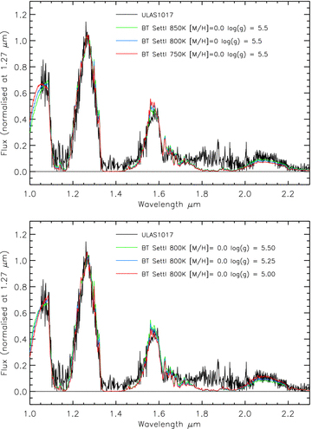
Figure 11 A comparison of model spectra for the parameters bracketing the location of ULAS1017 in the solar metallicity ...
Notes:
Figure 11 A comparison of model spectra for the parameters bracketing the location of ULAS1017 in the solar metallicity (WJ, K/J) plane.
Unless provided in the caption above, the following copyright applies to the content of this slide: © 2008 The Authors. Journal compilation © 2008 RAS

Slide 12
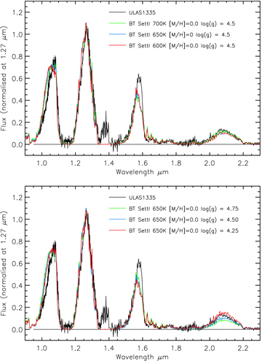
Figure 12 A comparison of model spectra for parameters bracketing the location of ULAS1335 in the solar metallicity ...
Notes:
Figure 12 A comparison of model spectra for parameters bracketing the location of ULAS1335 in the solar metallicity (WJ, K/J) plane.
Unless provided in the caption above, the following copyright applies to the content of this slide: © 2008 The Authors. Journal compilation © 2008 RAS

Slide 13
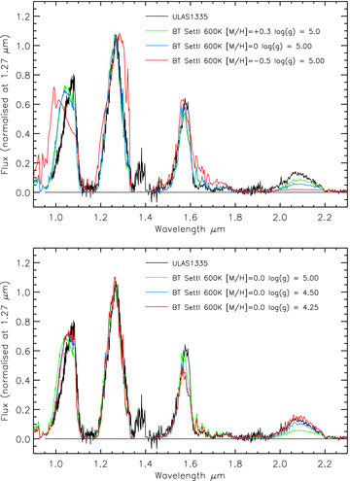
Figure 13 A comparison of model spectra with ULAS1335 for differing gravity and metallicity combinations at ...
Notes:
Figure 13 A comparison of model spectra with ULAS1335 for differing gravity and metallicity combinations at Teff= 600 K.
Unless provided in the caption above, the following copyright applies to the content of this slide: © 2008 The Authors. Journal compilation © 2008 RAS

Slide 14
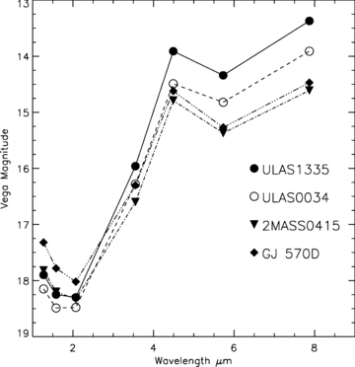
Figure 14 The 1–8 μm SEDs for ULAS1335, ULAS0034 (Warren et al. 2007), 2MASS0415 and Gl 570D. The photometry for the ...
Notes:
Figure 14 The 1–8 μm SEDs for ULAS1335, ULAS0034 (Warren et al. 2007), 2MASS0415 and Gl 570D. The photometry for the latter two objects, taken from Leggett et al. (2002) and Patten et al. (2006), has been offset by +2.5 mag to allow comparison with the T8+ dwarfs. Uncertainties are of comparable size to the symbols.
Unless provided in the caption above, the following copyright applies to the content of this slide: © 2008 The Authors. Journal compilation © 2008 RAS

Slide 15
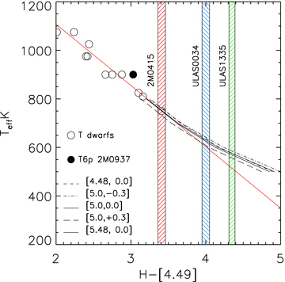
Figure 15 The T_{eff}–H−[4.49] relation for T dwarfs as defined by Warren et al. (2007). The shaded regions ...
Notes:
Figure 15 The Teff–H−[4.49] relation for T dwarfs as defined by Warren et al. (2007). The shaded regions indicate the colours (±1σ) for the coolest T dwarfs with IRAC magnitudes. The straight red line indicates the empirical fit the colours of warmer T dwarfs. Also plotted, as black lines are theoretical tracks from Marley et al. (2002) and Marley & Saumon (private communication). Values for log g and metallicity are indicated in brackets.
Unless provided in the caption above, the following copyright applies to the content of this slide: © 2008 The Authors. Journal compilation © 2008 RAS

Slide 16
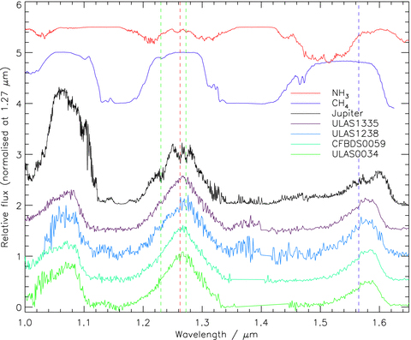
Figure 16 Spectra for ULAS0034, CFBDS0059, ULAS1238 and ULAS1335 compared with the NIR spectrum of Jupiter (Rayner, ...
Notes:
Figure 16 Spectra for ULAS0034, CFBDS0059, ULAS1238 and ULAS1335 compared with the NIR spectrum of Jupiter (Rayner, Cushing & Vacca, in preparation) and laboratory transmission spectra of methane (Cruikshank & Binder 1969) and ammonia (Irwin et al. 1999). The vertical green dashed lines highlight narrow features that appear to be common to ULAS1238, ULAS1335 and Jupiter. The vertical red dashed line highlights an interesting feature in the Jovian spectrum that is absent from the T dwarf spectra (see text). The vertical blue dotted line indicates the location of the red edge of the broad absorption attributed to ammonia by Delorme et al. (2008).
Unless provided in the caption above, the following copyright applies to the content of this slide: © 2008 The Authors. Journal compilation © 2008 RAS

