Slide 1
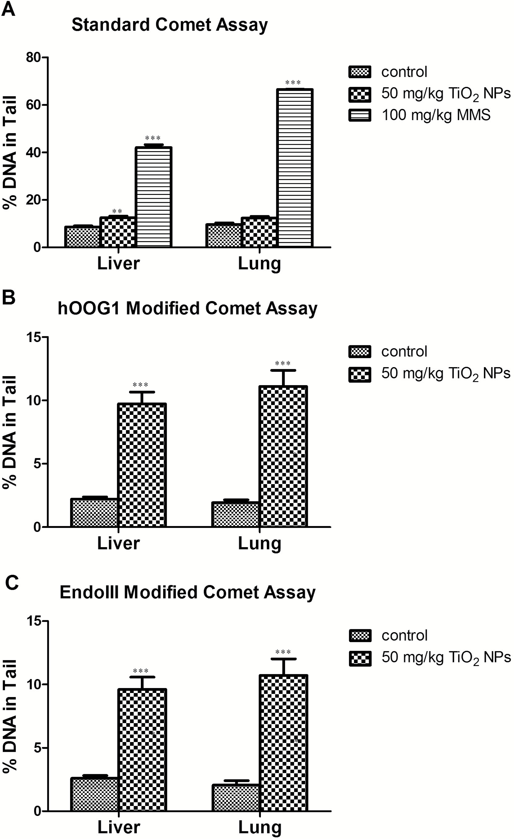
Figure 1. DNA damage and oxidative DNA adducts measured with the Comet assays in liver and lung tissues of the mice ...
Notes:
Figure 1. DNA damage and oxidative DNA adducts measured with the Comet assays in liver and lung tissues of the mice treated with 50 mg/kg TiO2 NPs. DNA strand breaks were measured in the standard Comet assay for liver and lung tissues. MMS at 100 mg/mg was used as the positive control (A). Oxidative DNA adducts were examined using endonucleases enzyme-modified Comet assay with addition of hOGG1 (B) or endo III enzymes (C). The value for % DNA in tail in (B) and (C) represent the net increase of DNA strand breaks resulted from oxidised DNA adducts. The error bars represent the standard errors of the mean. *, ** and ***indicates P < 0.05, P < 0.01 and P < 0.001, respectively.
Unless provided in the caption above, the following copyright applies to the content of this slide: Published by Oxford University Press on behalf of The UK Environmental Mutagen Society 2016.

Slide 2
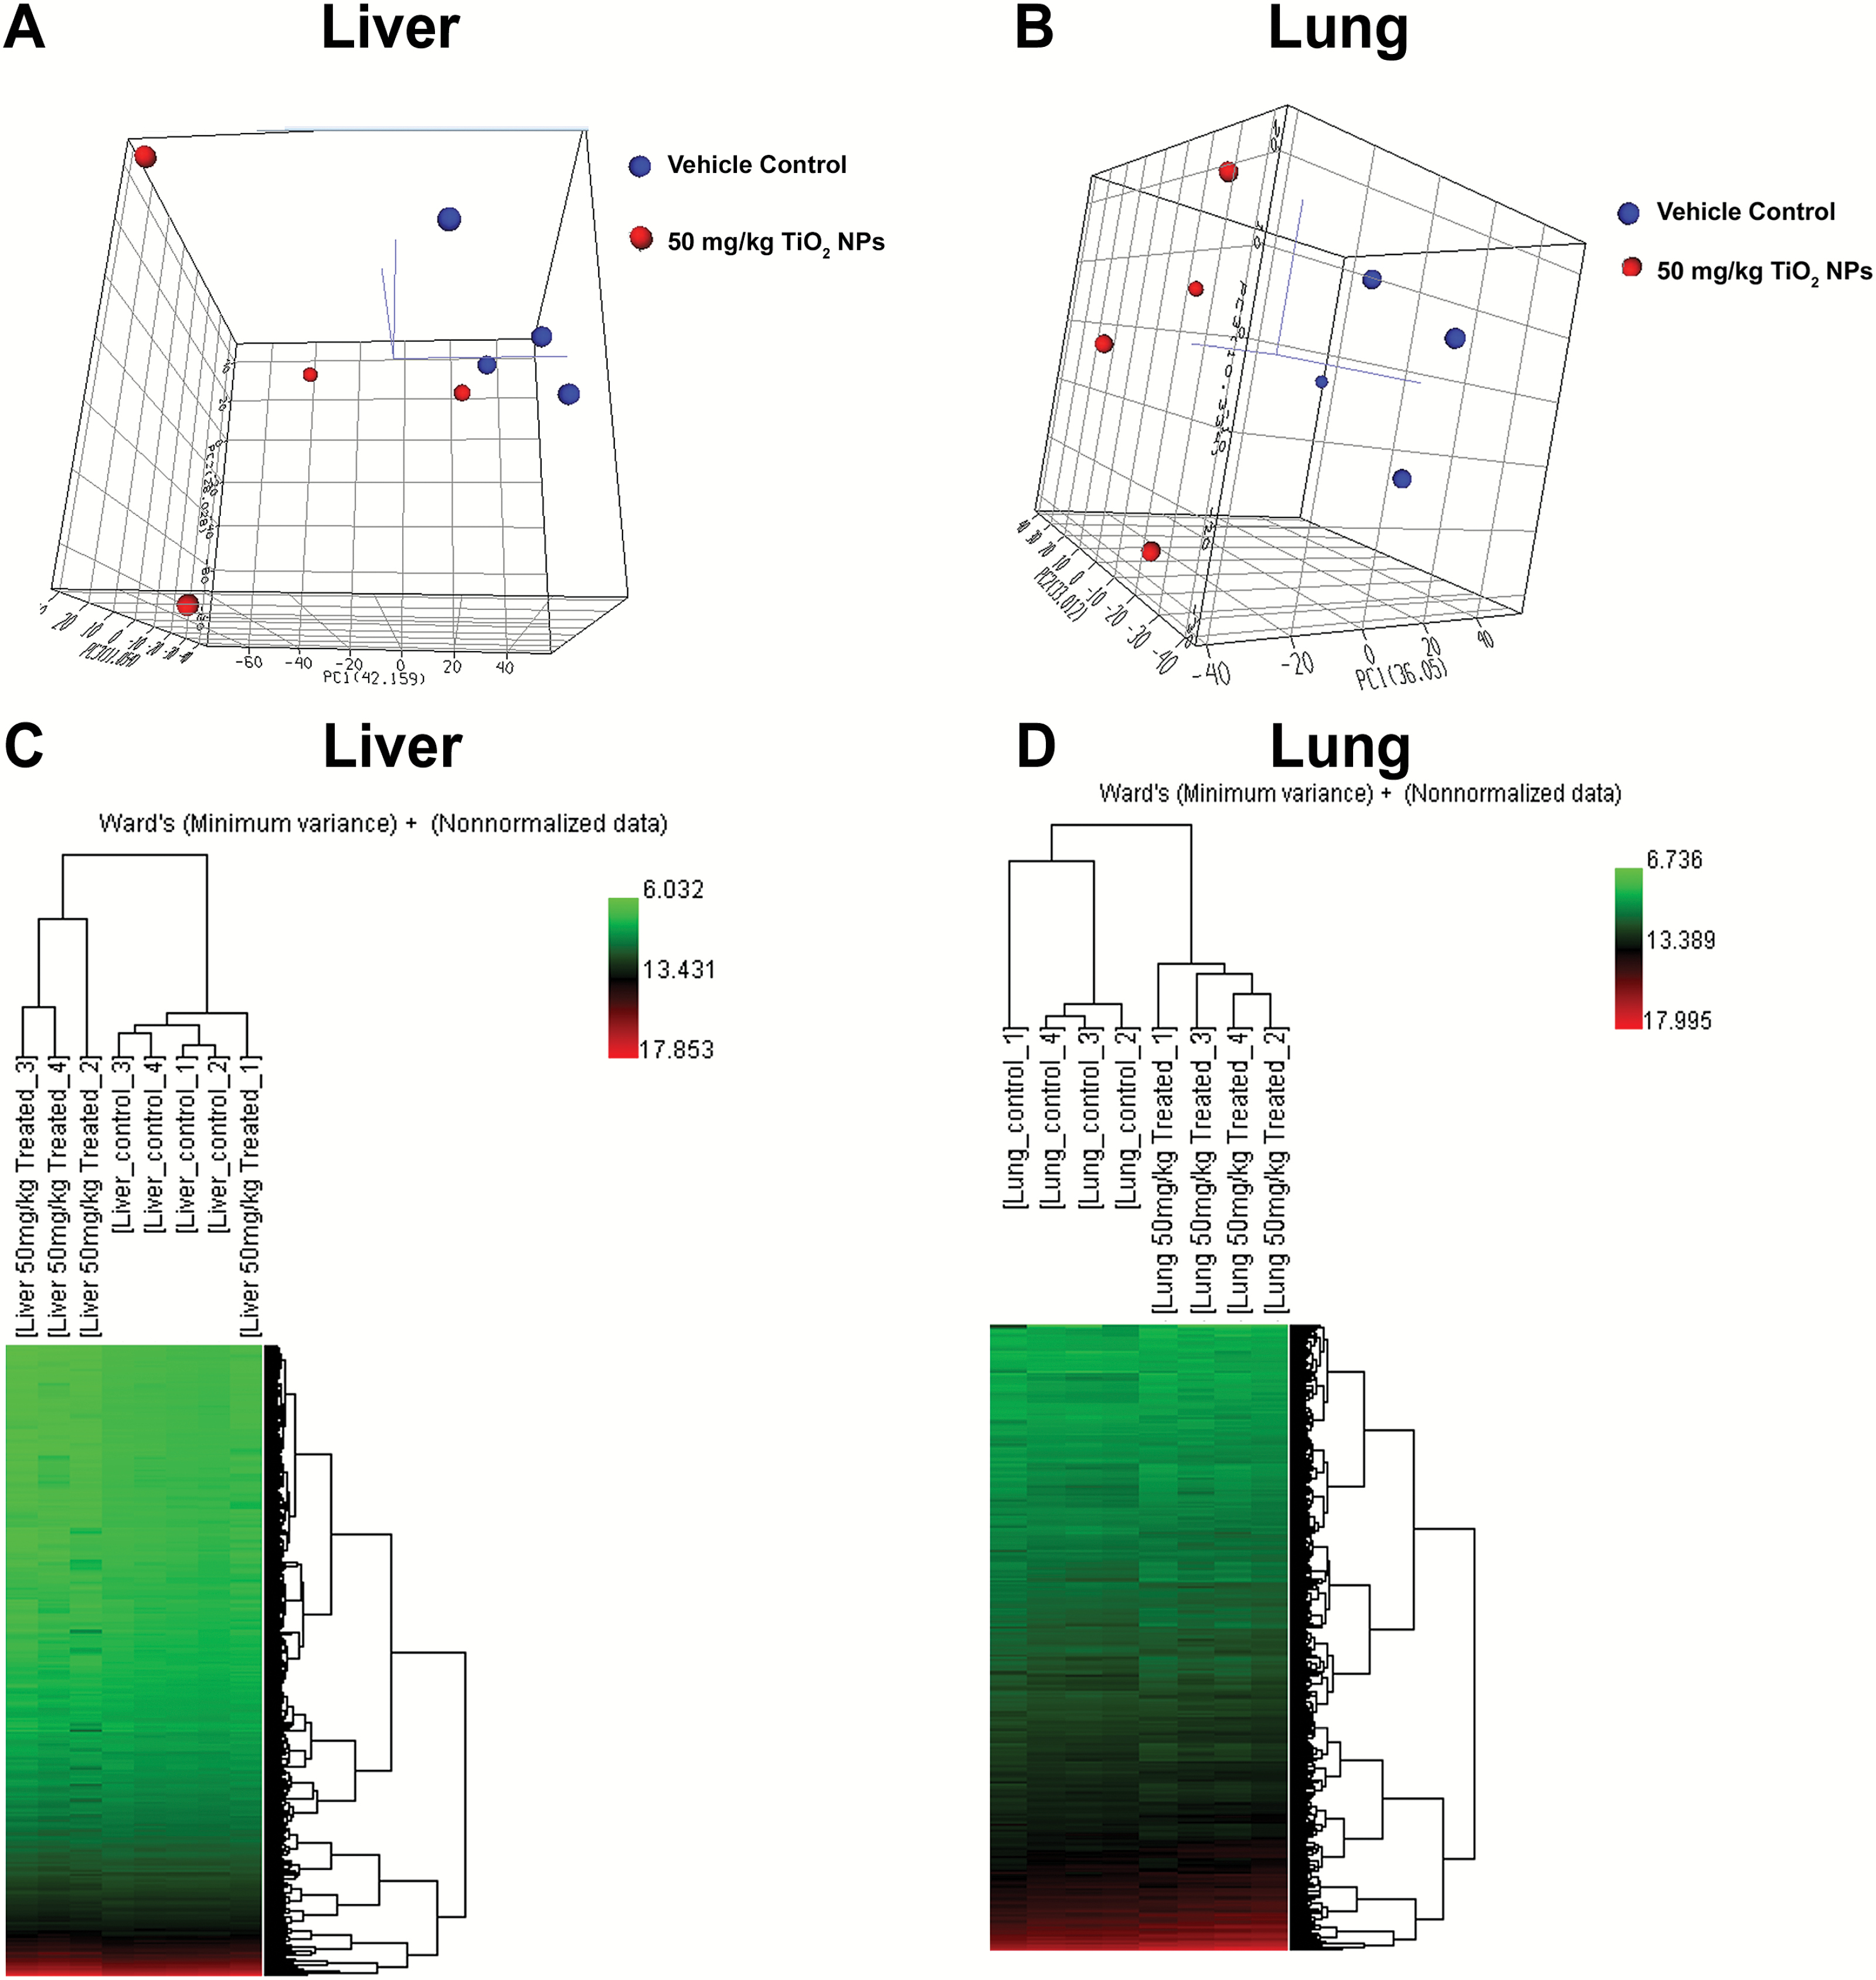
Figure 2. Global gene expression profiles in liver and lung of mice treated with 50 mg/kg TiO₂ NPs. The ...
Notes:
Figure 2. Global gene expression profiles in liver and lung of mice treated with 50 mg/kg TiO2 NPs. The principal component analysis using the first three principal components (PC1, PC2 and PC3) revealed a distinct separation of samples from the treatment and controls in liver (A) and lung (B). Hierarchical cluster analysis also grouped samples according to the treatment and control in liver (C) and lung (D). The hierarchical cluster analysis was performed using Ward’s method and the colour indicates the magnitude of the differences in the gene expression.
Unless provided in the caption above, the following copyright applies to the content of this slide: Published by Oxford University Press on behalf of The UK Environmental Mutagen Society 2016.

Slide 3
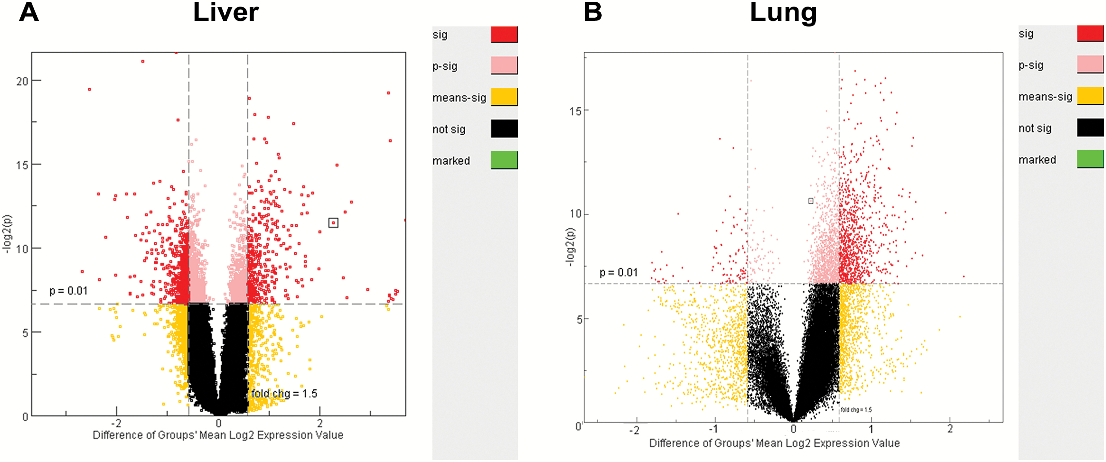
Figure 3. Volcano plot analysis of significantly differentially expressed genes in liver (A) and lung (B). Red dots ...
Notes:
Figure 3. Volcano plot analysis of significantly differentially expressed genes in liver (A) and lung (B). Red dots indicate the significant differentially expressed genes altered by TiO2 NP treatment over the control with a criterion of fold change >1.5 and P < 0.01.
Unless provided in the caption above, the following copyright applies to the content of this slide: Published by Oxford University Press on behalf of The UK Environmental Mutagen Society 2016.

Slide 4
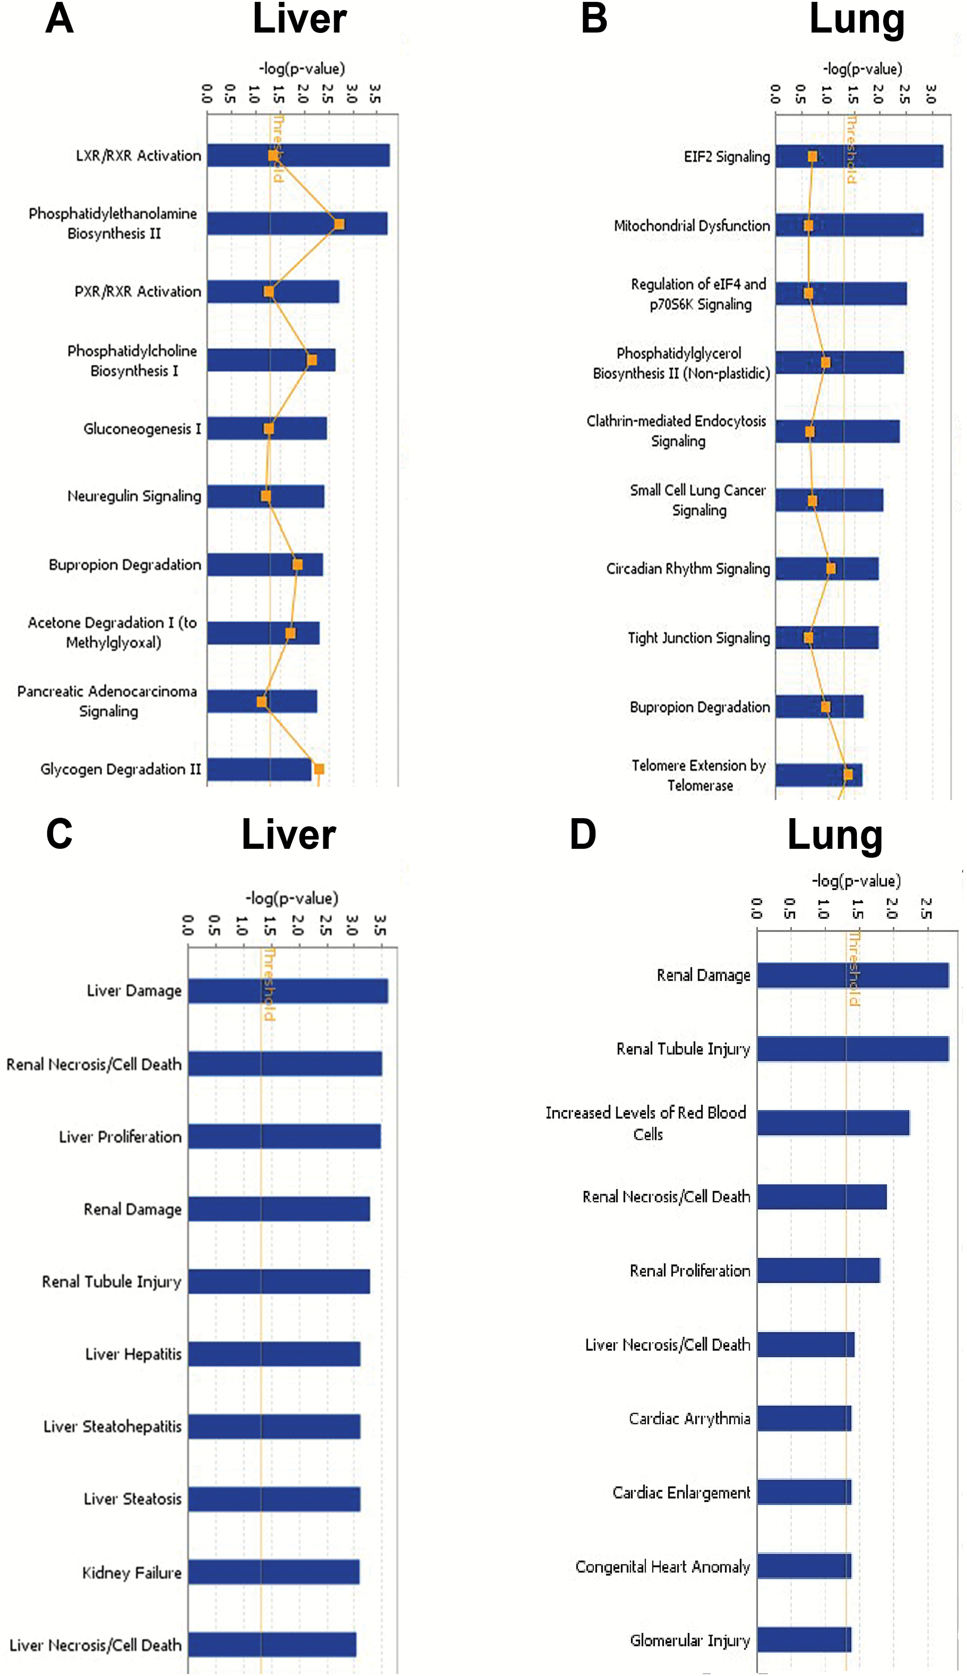
Figure 4. Significantly affected canonical pathways and toxicological functions identified by Ingenuity Pathway ...
Notes:
Figure 4. Significantly affected canonical pathways and toxicological functions identified by Ingenuity Pathway Analysis software (P < 0.05). The top 10 canonical pathways for liver (A) and lung (B), as well as top 10 toxicological functions for liver (C) and lung (D), are displayed. The threshold indicates the significantly changes of the pathways.
Unless provided in the caption above, the following copyright applies to the content of this slide: Published by Oxford University Press on behalf of The UK Environmental Mutagen Society 2016.

