Slide 1
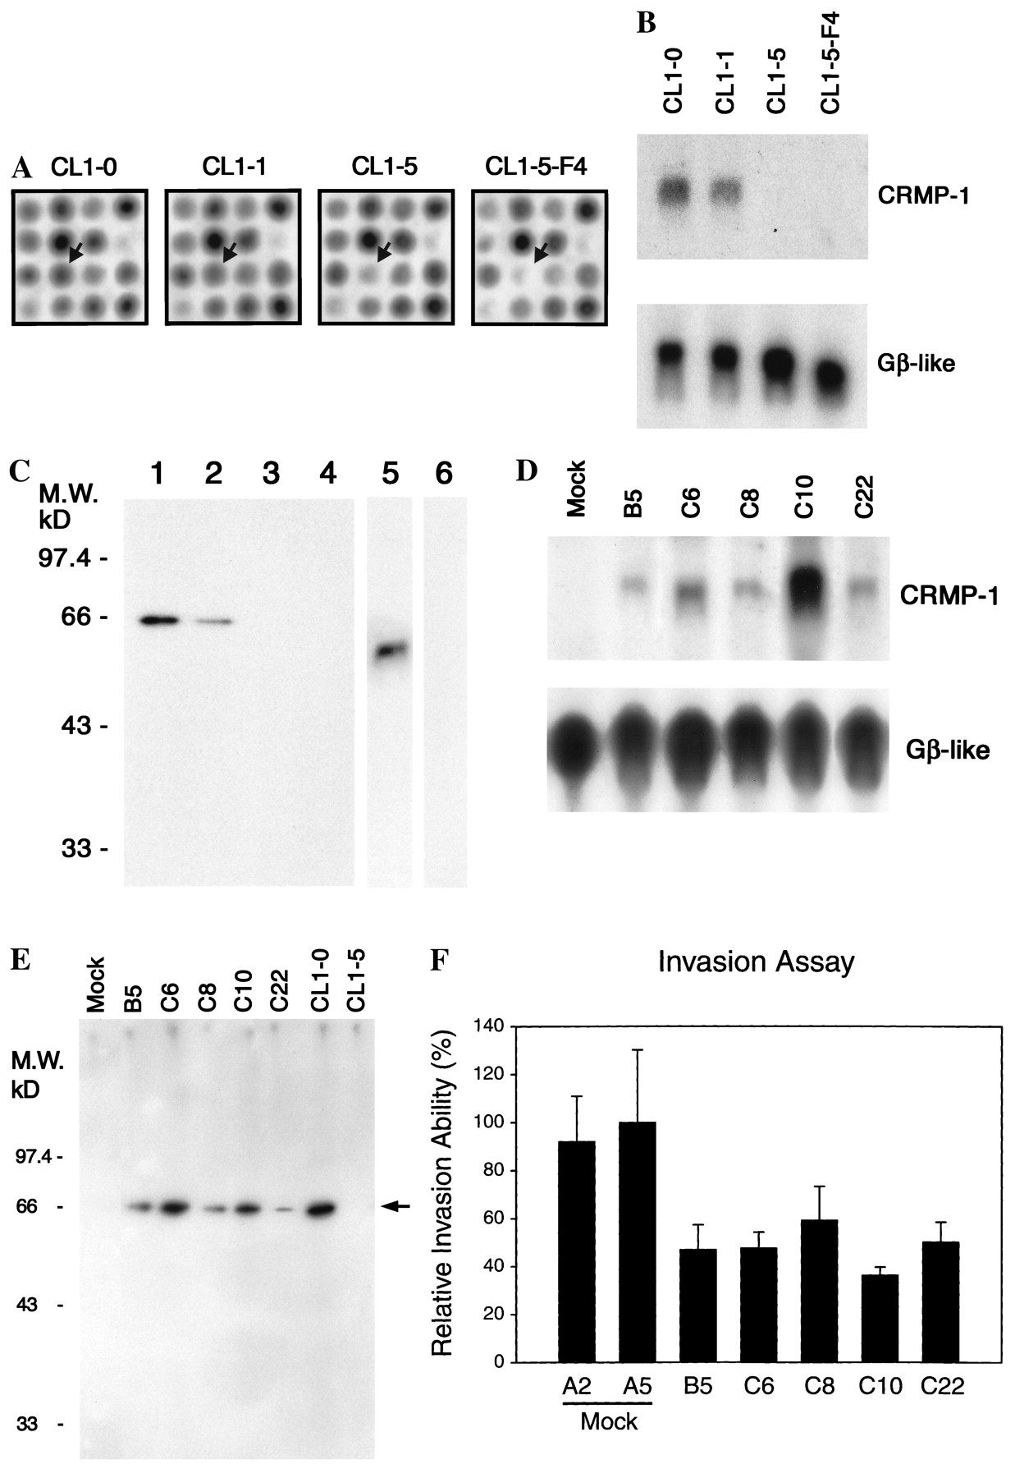
Fig. 1. Identification of differentially expressed collapsin response mediator protein-1 (CRMP-1) by complementary ...
Notes:
Fig. 1. Identification of differentially expressed collapsin response mediator protein-1 (CRMP-1) by complementary DNA (cDNA) microarray (panels A–C) and inhibition of invasion by overexpression of CRMP-1 (panels D–F). Panel A: Microarray images show higher expression of CRMP-1 in less invasive cell lines (cells lines in order of invasive activity are as follows: CL1–0 < CL1–1 < CL1–5 < CL1–5F4). Arrows = CRMP-1. Panel B: northern blot analysis of total RNA for CRMP-1. The 1.95-kilobase (kb) full-coding region of CRMP-1 cDNA was used as the probe. The 4.9-kb transcript of CRMP-1 is indicated. The guanine nucleotide-binding protein β-subunit-like (Gβ-like) probe was used as an internal control for RNA quantity. Panel C: western blot analysis of CRMP-1. We generated a specific monoclonal antibody, Y21, against CRMP-1 by use of the CRMP-1 fusion protein His-CRMP-(amino acids 76–572). Lanes 1–5 were probed with CRMP-1 monoclonal antibody Y21; lane 6 was probed with preimmune serum as the control. Lane 1 = CL1–0 cells; lane 2 = CL1–1 cells; lane 3 = CL1–5 cells; lane 4 = CL1–5-F4 cells; and lanes 5 and 6 = fusion protein His-CRMP (amino acids 76–572). Western blot analyses of three experiments produced the same results. M.W. = molecular weight; kD = kilodalton. Panel D: northern blot analysis of CRMP-1 expression in mock-transfected CL1–5 cells and CRMP-1-transfected CL1–5 cell clones (B5, C6, C8, C10, and C22). The 1.95-kb full-coding region of CRMP-1 cDNA was used as the probe. All five CRMP-1-transfected clones expressed CRMP-1 messenger RNA, but mock-transfected cells did not. The Gβ-like probe was used as an internal control for RNA quantity. Panel E: western blot analysis of CRMP-1 expression in mock-transfected CL1–5 cells and CRMP-1-transfected CL1–5 cell clones (B5, C6, C8, C10, and C22). CRMP-1 monoclonal antibody Y21 was used as the primary antibody. CRMP-1 protein was expressed in CRMP-1-transfected clones but not in mock-transfected cells. CL1–0 and CL1–5 cells were the positive and negative controls, respectively. M.W. = molecular weight; kD = kilodalton; arrow = 66-kD CRMP-1 proteins. Panel F: Expression of CRMP-1 suppressed the in vitro invasion activity of CL1–5 cells. To facilitate comparison of the relative invasiveness between mock-transfected clones (A2 and A5) and CRMP-1-transfected clones (B5, C6, C8, C10, and C22), values were normalized to the relative invasion activity of mock-transfected clone A5. Each clone was assayed in three experiments carried out in triplicate. CRMP-1-transfected clones (B5, C6, C8, C10, and C22), as a group, had statistically significantly reduced invasive activity (P<.001, by Student's t test; two-sided) compared with the mock-transfected clones (A2 and A5) as the other group. Error bars are 95% confidence intervals. All statistical tests were two-sided.
Unless provided in the caption above, the following copyright applies to the content of this slide: © Oxford University Press

Slide 2
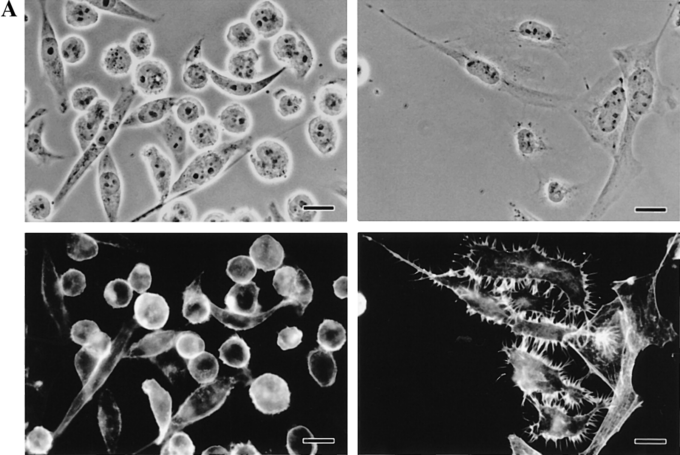
Fig. 2. Analysis of filamentous actin (F-actin) in collapsin response mediator protein-1 (CRMP-1)-transfected ...
Notes:
Fig. 2. Analysis of filamentous actin (F-actin) in collapsin response mediator protein-1 (CRMP-1)-transfected CL1–5 cells and mock-transfected CL1–5 cells (panel A) and subcellular localization of enhanced green fluorescent protein (EGFP)-tagged CRMP-1 in living CL1–0 cells in various phases of the cell cycle (panel B). Panel A, upper left: Phase-contrast micrography of clone C10, a representative CRMP-1-transfected clone, shows mostly rounded cells. Other CRMP-1-transfected clones (clones B5, C6, C8, and C22) also showed a similar morphology (data not shown). Upper right: Phase-contrast micrography of clone A2, a representative mock-transfected clone, shows elongated cells. Other mock-transfected clones also showed a similar morphology (data not shown). Lower left: Fluorescent staining of cells from clone C10. Actin filaments were detected with rhodamine-conjugated phalloidin, and cells seldom have filopodia (long, thin, needle-like projections protruding from the cell edge). Lower right: Fluorescent staining of F-actin in A2 cells shows numerous filopodia protruding from the cell surfaces. Scale bar = 10 μm. Panel B: CL1–0 cells were transiently transfected with the plasmid pEGFP-CRMP-1, carrying the fusion gene for EGFP-tagged CRMP-1, and the living cells were examined directly and photographed with a confocal microscope. Upper left: interphase cell with fluorescent CRMP-1 diffusely distributed in the cytoplasm. Upper middle: interphase cell with CRMP-1 localized in the nucleus and cytoplasm. Upper right: early prophase cell with CRMP-1 localized to the centrosomes. Lower left: metaphase cell with CRMP-1 associated with the mitotic spindle and centrosomes. Lower middle: anaphase cell with CRMP-1 associated with the mitotic spindle. Lower right: very late telophase cell with CRMP-1 localized at the midbody. Scale bar = 5 μm.
Unless provided in the caption above, the following copyright applies to the content of this slide: © Oxford University Press

Slide 3
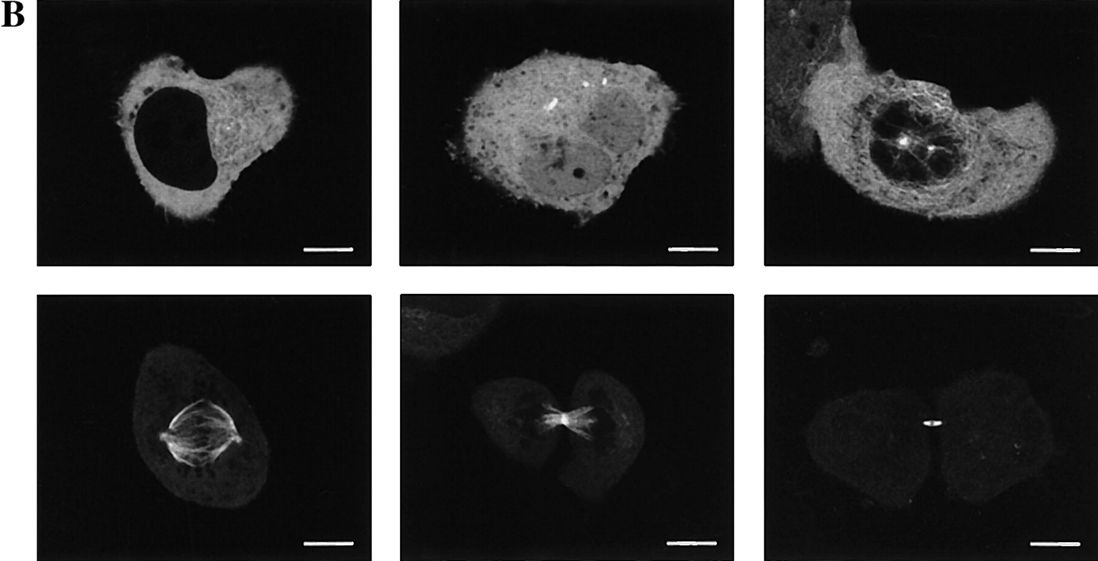
Fig. 2. Analysis of filamentous actin (F-actin) in collapsin response mediator protein-1 (CRMP-1)-transfected ...
Notes:
Fig. 2. Analysis of filamentous actin (F-actin) in collapsin response mediator protein-1 (CRMP-1)-transfected CL1–5 cells and mock-transfected CL1–5 cells (panel A) and subcellular localization of enhanced green fluorescent protein (EGFP)-tagged CRMP-1 in living CL1–0 cells in various phases of the cell cycle (panel B). Panel A, upper left: Phase-contrast micrography of clone C10, a representative CRMP-1-transfected clone, shows mostly rounded cells. Other CRMP-1-transfected clones (clones B5, C6, C8, and C22) also showed a similar morphology (data not shown). Upper right: Phase-contrast micrography of clone A2, a representative mock-transfected clone, shows elongated cells. Other mock-transfected clones also showed a similar morphology (data not shown). Lower left: Fluorescent staining of cells from clone C10. Actin filaments were detected with rhodamine-conjugated phalloidin, and cells seldom have filopodia (long, thin, needle-like projections protruding from the cell edge). Lower right: Fluorescent staining of F-actin in A2 cells shows numerous filopodia protruding from the cell surfaces. Scale bar = 10 μm. Panel B: CL1–0 cells were transiently transfected with the plasmid pEGFP-CRMP-1, carrying the fusion gene for EGFP-tagged CRMP-1, and the living cells were examined directly and photographed with a confocal microscope. Upper left: interphase cell with fluorescent CRMP-1 diffusely distributed in the cytoplasm. Upper middle: interphase cell with CRMP-1 localized in the nucleus and cytoplasm. Upper right: early prophase cell with CRMP-1 localized to the centrosomes. Lower left: metaphase cell with CRMP-1 associated with the mitotic spindle and centrosomes. Lower middle: anaphase cell with CRMP-1 associated with the mitotic spindle. Lower right: very late telophase cell with CRMP-1 localized at the midbody. Scale bar = 5 μm.
Unless provided in the caption above, the following copyright applies to the content of this slide: © Oxford University Press

Slide 4
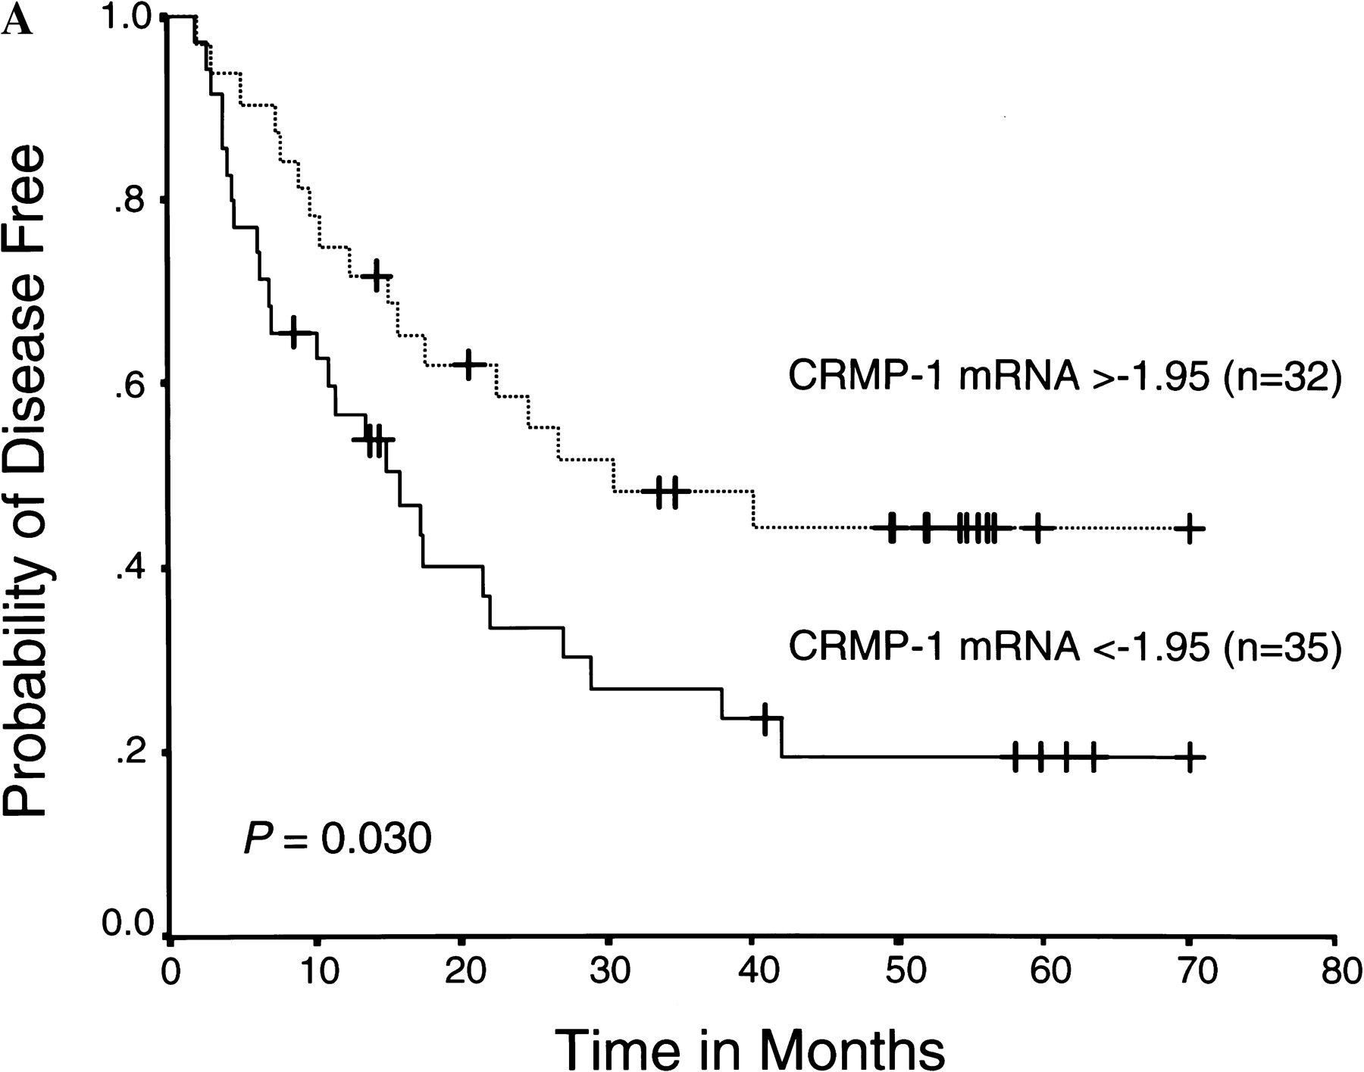
Fig. 3. Kaplan–Meier survival plots for patients with non-small-cell lung cancer, grouped according to collapsin ...
Notes:
Fig. 3. Kaplan–Meier survival plots for patients with non-small-cell lung cancer, grouped according to collapsin response mediator protein-1 (CRMP-1) messenger RNA (mRNA) expression. The relative amount of tissue CRMP-1 mRNA, standardized against the amount of TATA-box-binding protein mRNA, was expressed as –ΔCT = –[CT(CRMP–1) – CT(TBP)], where CT is the threshold cycle. Patients were included in the high-expression group when the – CT was –1.95 or greater (the median). Panel A: The difference in disease-free survival between the high- and low-expression patients is statistically significant (P = .030). All patients free of recurrence at their last follow-up are indicated by tick marks on the plot. At year 1, for high-expression patients, the 95% confidence interval (CI) is 0.60 to 0.90 for 24 patients at risk; for low-expression patients, the 95% CI is 0.40 to 0.73 for 19 patients at risk. At year 3, for high-expression patients, the 95% CI is 0.30 to 0.66 for 12 patients at risk; for low-expression patients, the 95% CI is 0.11 to 0.42 for eight patients at risk. Panel B: Difference in overall survival between the high- and low-expression patients is statistically significant (P = .016). All patients alive at their last follow-up are indicated by tick marks on the plot. At year 1, for high-expression patients, the 95% CI is 0.85 to 1.0 for 30 patients at risk; for low-expression patients, the 95% CI is 0.63 to 0.91 for 27 patients at risk. At year 3, for high-expression patients, the 95% CI is 0.46 to 0.79 for 19 patients at risk; for low-expression patients, the 95% CI is 0.28 to 0.61 for 15 patients at risk. All statistical tests were two-sided.
Unless provided in the caption above, the following copyright applies to the content of this slide: © Oxford University Press

Slide 5
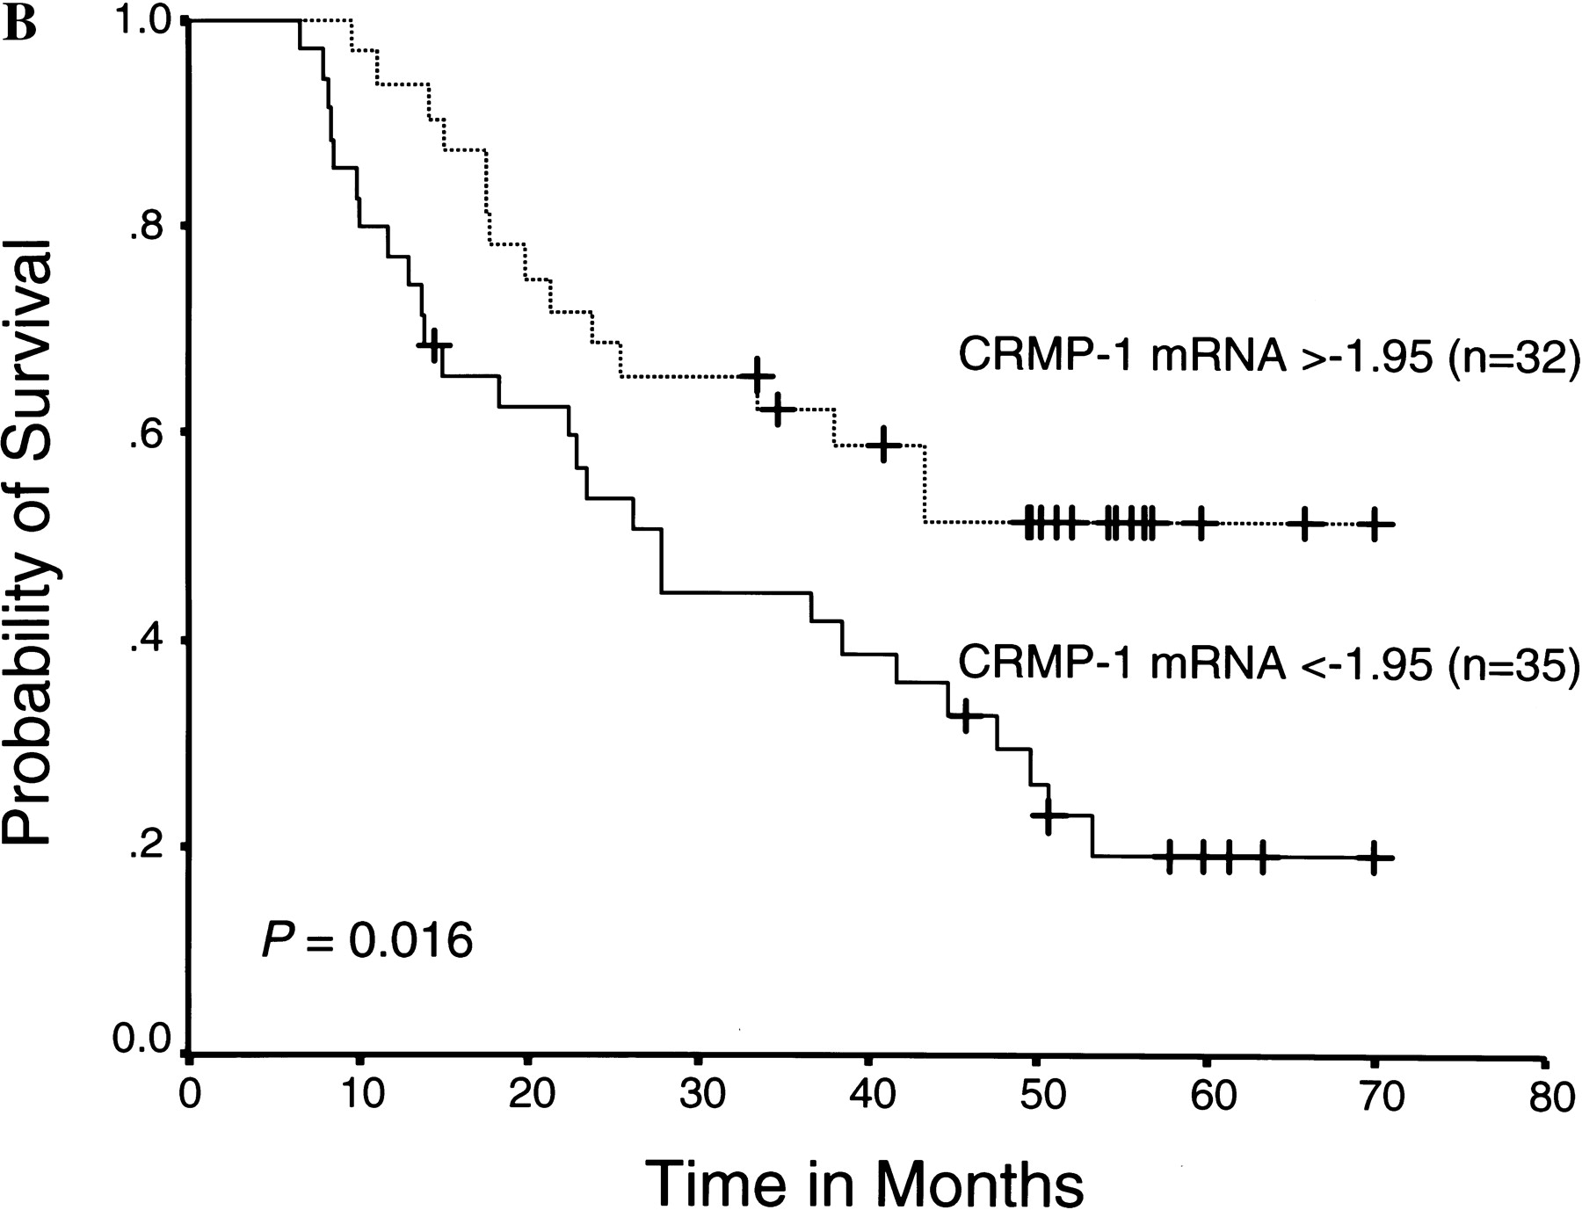
Fig. 3. Kaplan–Meier survival plots for patients with non-small-cell lung cancer, grouped according to collapsin ...
Notes:
Fig. 3. Kaplan–Meier survival plots for patients with non-small-cell lung cancer, grouped according to collapsin response mediator protein-1 (CRMP-1) messenger RNA (mRNA) expression. The relative amount of tissue CRMP-1 mRNA, standardized against the amount of TATA-box-binding protein mRNA, was expressed as –ΔCT = –[CT(CRMP–1) – CT(TBP)], where CT is the threshold cycle. Patients were included in the high-expression group when the – CT was –1.95 or greater (the median). Panel A: The difference in disease-free survival between the high- and low-expression patients is statistically significant (P = .030). All patients free of recurrence at their last follow-up are indicated by tick marks on the plot. At year 1, for high-expression patients, the 95% confidence interval (CI) is 0.60 to 0.90 for 24 patients at risk; for low-expression patients, the 95% CI is 0.40 to 0.73 for 19 patients at risk. At year 3, for high-expression patients, the 95% CI is 0.30 to 0.66 for 12 patients at risk; for low-expression patients, the 95% CI is 0.11 to 0.42 for eight patients at risk. Panel B: Difference in overall survival between the high- and low-expression patients is statistically significant (P = .016). All patients alive at their last follow-up are indicated by tick marks on the plot. At year 1, for high-expression patients, the 95% CI is 0.85 to 1.0 for 30 patients at risk; for low-expression patients, the 95% CI is 0.63 to 0.91 for 27 patients at risk. At year 3, for high-expression patients, the 95% CI is 0.46 to 0.79 for 19 patients at risk; for low-expression patients, the 95% CI is 0.28 to 0.61 for 15 patients at risk. All statistical tests were two-sided.
Unless provided in the caption above, the following copyright applies to the content of this slide: © Oxford University Press

