Slide 1
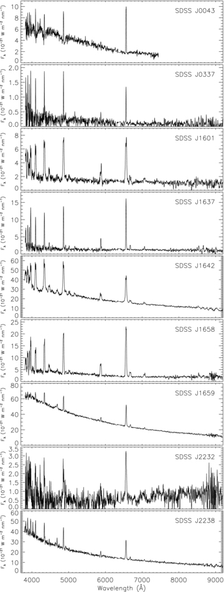
Figure 1 SDSS spectra of the CVs studied in this work. For this plot, the flux levels have been smoothed with 10-pixel ...
Notes:
Figure 1 SDSS spectra of the CVs studied in this work. For this plot, the flux levels have been smoothed with 10-pixel Savitsky–Golay filters. The units of the abscissae are 10−21W m−2nm−1, which correspond to 10−17erg s−1cm−2Å−1.
Unless provided in the caption above, the following copyright applies to the content of this slide: © 2008 The Authors. Journal compilation © 2008 RAS

Slide 2
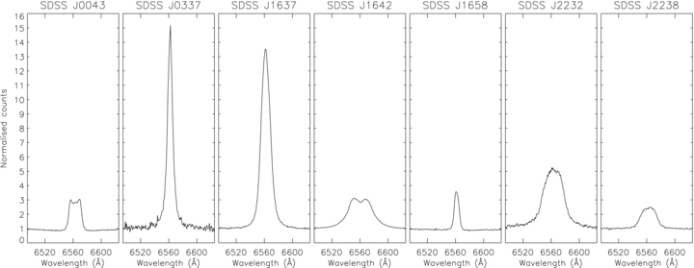
Figure 2 The averaged Hα emission-line profiles of the seven CVs for which we present spectroscopy. The spectra have ...
Notes:
Figure 2 The averaged Hα emission-line profiles of the seven CVs for which we present spectroscopy. The spectra have had their continuum level normalized to unity. The orbital motion was removed from the spectra of SDSS J1658 before its mean spectrum was constructed.
Unless provided in the caption above, the following copyright applies to the content of this slide: © 2008 The Authors. Journal compilation © 2008 RAS

Slide 3
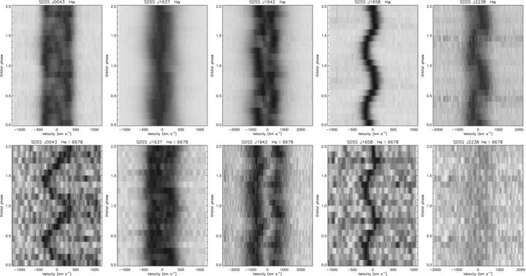
Figure 3 Grey-scale plots of the continuum-normalized and phase-binned trailed spectra of the five CVs for which we ...
Notes:
Figure 3 Grey-scale plots of the continuum-normalized and phase-binned trailed spectra of the five CVs for which we obtained orbital periods. Darker shading indicates stronger emission. The upper plots show the Hα lines. The lower plots show the He i 6678 Å lines, with the same velocity scale but different intensity scale. The He i spectra have been smoothed with a Savitsky–Golay filter for display purposes.
Unless provided in the caption above, the following copyright applies to the content of this slide: © 2008 The Authors. Journal compilation © 2008 RAS

Slide 4
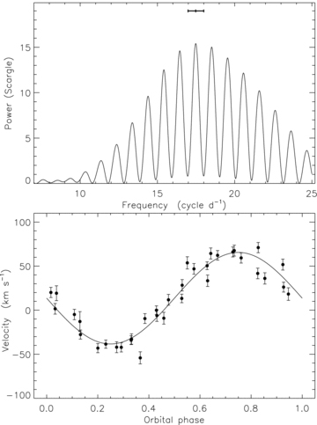
Figure 4 Upper panel: Scargle periodogram of the RVs of SDSS J0043 measured using a single Gaussian with width 1500 km ...
Notes:
Figure 4 Upper panel: Scargle periodogram of the RVs of SDSS J0043 measured using a single Gaussian with width 1500 km s−1. The measured period and uncertainty from the data of the first night only are indicated with an error bar at the top of the plot. Lower panel: measured RVs (filled circles) compared to the best-fitting spectroscopic orbit (solid line).
Unless provided in the caption above, the following copyright applies to the content of this slide: © 2008 The Authors. Journal compilation © 2008 RAS

Slide 5
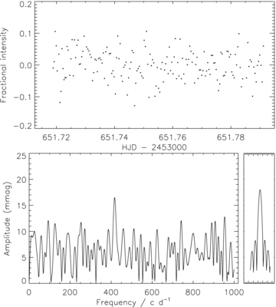
Figure 5 Upper panel: light curve of SDSS J0043 given as fractional change in intensity. Lower panels: amplitude ...
Notes:
Figure 5 Upper panel: light curve of SDSS J0043 given as fractional change in intensity. Lower panels: amplitude spectrum of the light curve (left-hand side) and the window function (right-hand side).
Unless provided in the caption above, the following copyright applies to the content of this slide: © 2008 The Authors. Journal compilation © 2008 RAS

Slide 6
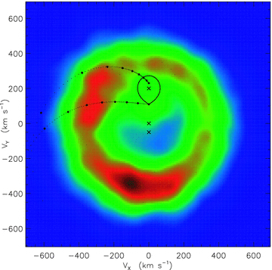
Figure 6 Doppler map of the Hα emission line from SDSS J0043. Strong emission is coloured red and weak to no emission ...
Notes:
Figure 6 Doppler map of the Hα emission line from SDSS J0043. Strong emission is coloured red and weak to no emission is blue. The Roche lobe of the mass donor is indicated by a solid curve, and the centre of mass of the system and individual stars are shown with crosses. The dots indicate the velocity of the accretion stream and the Keplerian velocity of the disc along the path of the stream. They are positioned at every 0.01RRL, decreasing from RRL= 1.0 at the mass donor, where RRL is the radius of the Roche lobe of the white dwarf.
Unless provided in the caption above, the following copyright applies to the content of this slide: © 2008 The Authors. Journal compilation © 2008 RAS

Slide 7
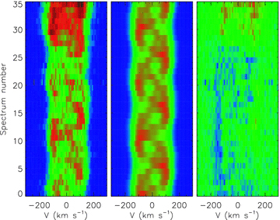
Figure 7 Comparison between the 35 observed spectra (left-hand panel) and the best-fitting representation for the ...
Notes:
Figure 7 Comparison between the 35 observed spectra (left-hand panel) and the best-fitting representation for the Doppler map (centre panel). The residuals (right-hand side) are shown in the right-hand panel.
Unless provided in the caption above, the following copyright applies to the content of this slide: © 2008 The Authors. Journal compilation © 2008 RAS

Slide 8
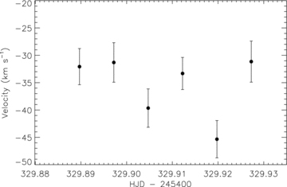
Figure 8 RVs measured for SDSS J0337 by cross-correlation against a single Gaussian function with FWHM 600 km ...
Notes:
Figure 8 RVs measured for SDSS J0337 by cross-correlation against a single Gaussian function with FWHM 600 km s−1.
Unless provided in the caption above, the following copyright applies to the content of this slide: © 2008 The Authors. Journal compilation © 2008 RAS

Slide 9
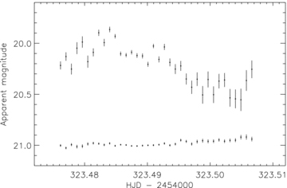
Figure 9 NTT unfiltered photometry of SDSS J1601. The magnitudes are differential with respect to a comparison star ...
Notes:
Figure 9 NTT unfiltered photometry of SDSS J1601. The magnitudes are differential with respect to a comparison star and have been offset by the r magnitude of the comparison star. Differential magnitudes for the comparison minus check stars are shown offset by +21.3 mag.
Unless provided in the caption above, the following copyright applies to the content of this slide: © 2008 The Authors. Journal compilation © 2008 RAS

Slide 10
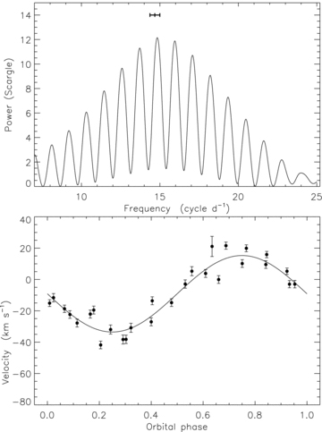
Figure 10 Upper panel: Scargle periodogram of the RVs of SDSS J1637 measured using a single Gaussian with width 500 km ...
Notes:
Figure 10 Upper panel: Scargle periodogram of the RVs of SDSS J1637 measured using a single Gaussian with width 500 km s−1. The measured period and uncertainty from data from the first night only are indicated with a thick line. Lower panel: measured RVs (filled circles) compared to the best-fitting spectroscopic orbit (solid line).
Unless provided in the caption above, the following copyright applies to the content of this slide: © 2008 The Authors. Journal compilation © 2008 RAS

Slide 11
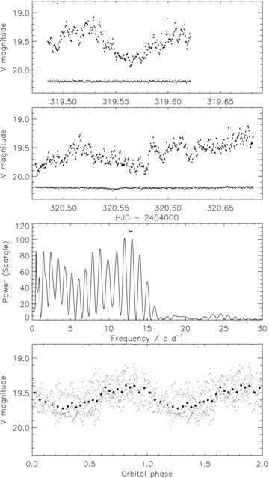
Figure 11 NTT V-filter photometry of SDSS J1642. The upper two panels show the light curves from the individual nights ...
Notes:
Figure 11 NTT V-filter photometry of SDSS J1642. The upper two panels show the light curves from the individual nights as well as differential photometry between the two comparison stars used (offset to appear in the plot). The third panel shows the Scargle periodogram of the combined data from the two nights, and the spectroscopic orbital period value is indicated at the top of the plot. The bottom panel shows the data phased with the photometric period of 110.6 min (grey dots) and combined into 25 phase bins (black filled circles). In most cases, the error bars are smaller than the points.
Unless provided in the caption above, the following copyright applies to the content of this slide: © 2008 The Authors. Journal compilation © 2008 RAS

Slide 12
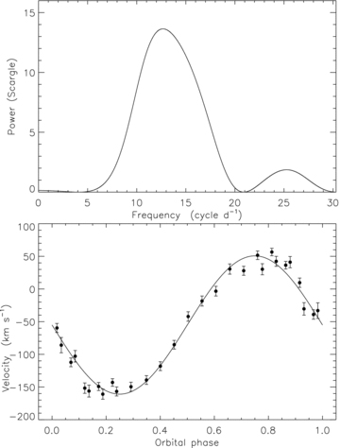
Figure 12 Upper panel: Scargle periodogram of the RV of SDSS J1642 measured using a double Gaussian with width 300 km ...
Notes:
Figure 12 Upper panel: Scargle periodogram of the RV of SDSS J1642 measured using a double Gaussian with width 300 km s−1 and separation 2100 km s−1. Lower panel: measured RVs (filled circles) compared to the best-fitting spectroscopic orbit (solid line).
Unless provided in the caption above, the following copyright applies to the content of this slide: © 2008 The Authors. Journal compilation © 2008 RAS

Slide 13
Figure 13 Doppler maps of the Hα (left-hand panel), He i 6678 Å (centre panel) and He i 7065 Å (right-hand panel) ...
Notes:
Figure 13 Doppler maps of the Hα (left-hand panel), He i 6678 Å (centre panel) and He i 7065 Å (right-hand panel) emission lines from SDSS J1642. The symbols are overplotted in the same way as for Fig. 6.
Unless provided in the caption above, the following copyright applies to the content of this slide: © 2008 The Authors. Journal compilation © 2008 RAS

Slide 14
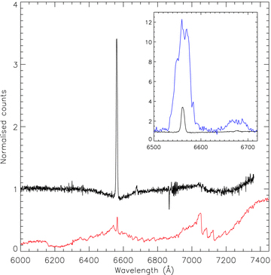
Figure 14 Main panel: the mean spectrum of SDSS J1658 from our VLT observations (black line), normalized unity using a ...
Notes:
Figure 14 Main panel: the mean spectrum of SDSS J1658 from our VLT observations (black line), normalized unity using a straight-line fit. A template M5 star is shown, with a red line, for comparison. Inset panel: a comparison between our mean VLT spectrum (black line) and the SDSS spectrum of SDSS J1658 (blue line) in the region of the Hα and He i 6678 Å lines.
Unless provided in the caption above, the following copyright applies to the content of this slide: © 2008 The Authors. Journal compilation © 2008 RAS

Slide 15
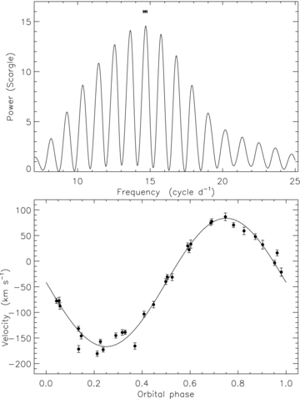
Figure 15 Upper panel: Scargle periodogram of the RVs of SDSS J1658 measured using a single Gaussian with width 400 km ...
Notes:
Figure 15 Upper panel: Scargle periodogram of the RVs of SDSS J1658 measured using a single Gaussian with width 400 km s−1. Lower panel: measured RVs (filled circles) compared to the best-fitting spectroscopic orbit (solid line).
Unless provided in the caption above, the following copyright applies to the content of this slide: © 2008 The Authors. Journal compilation © 2008 RAS

Slide 16
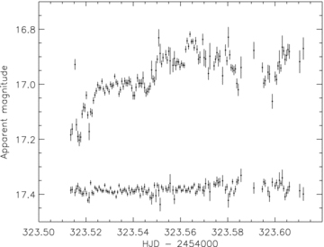
Figure 16 NTT V-filter photometry of SDSS J1659 obtained in cloudy conditions. Differential magnitudes for SDSS J1659 ...
Notes:
Figure 16 NTT V-filter photometry of SDSS J1659 obtained in cloudy conditions. Differential magnitudes for SDSS J1659 minus comparison star are shown as filled circles with error bars, offset by the V magnitude of the comparison. Differential magnitudes for the comparison minus the check star are shown offset at the bottom of the plot.
Unless provided in the caption above, the following copyright applies to the content of this slide: © 2008 The Authors. Journal compilation © 2008 RAS

Slide 17
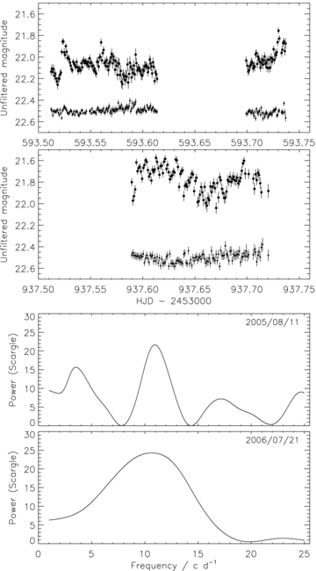
Figure 17 Upper panels: NOT unfiltered light curves of SDSS J2232. The comparison minus check magnitudes are shown in ...
Notes:
Figure 17 Upper panels: NOT unfiltered light curves of SDSS J2232. The comparison minus check magnitudes are shown in each panel offset to a magnitude of 20.4. Lower panels: Scargle periodograms of the two light curves.
Unless provided in the caption above, the following copyright applies to the content of this slide: © 2008 The Authors. Journal compilation © 2008 RAS

Slide 18
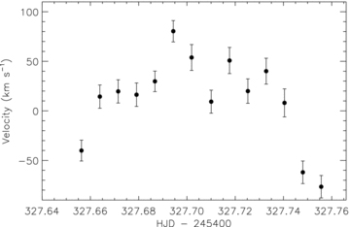
Figure 18 RVs measured for SDSS J2232 using a double Gaussian function with FWHMs 500 km s⁻¹ and separation ...
Notes:
Figure 18 RVs measured for SDSS J2232 using a double Gaussian function with FWHMs 500 km s−1 and separation 2000 km s−1.
Unless provided in the caption above, the following copyright applies to the content of this slide: © 2008 The Authors. Journal compilation © 2008 RAS

Slide 19
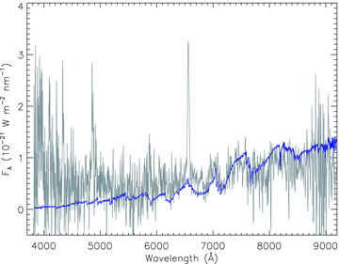
Figure 19 Compison between the SDSS spectrum of SDSS J2232 (grey line; the data have been smoothed) and a template SDSS ...
Notes:
Figure 19 Compison between the SDSS spectrum of SDSS J2232 (grey line; the data have been smoothed) and a template SDSS spectrum of an M4 dwarf (blue line).
Unless provided in the caption above, the following copyright applies to the content of this slide: © 2008 The Authors. Journal compilation © 2008 RAS

Slide 20
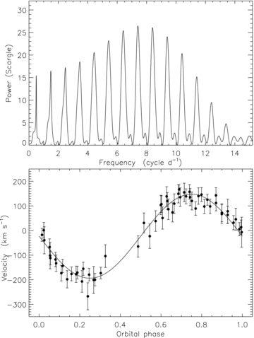
Figure 20 Upper panel: Scargle periodogram of the RVs of SDSS J2238 measured using a single Gaussian with FWHM 850 km ...
Notes:
Figure 20 Upper panel: Scargle periodogram of the RVs of SDSS J2238 measured using a single Gaussian with FWHM 850 km s−1. Lower panel: measured RVs (filled circles) compared to the best-fitting spectroscopic orbit (solid line).
Unless provided in the caption above, the following copyright applies to the content of this slide: © 2008 The Authors. Journal compilation © 2008 RAS

