Slide 1
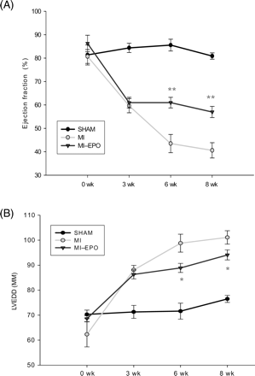
Figure 1 Effect of erythropoietin on myocardial remodelling after myocardial infarction. Changes in echocardiographic ...
Notes:
Figure 1 Effect of erythropoietin on myocardial remodelling after myocardial infarction. Changes in echocardiographic indices of left ventricular function and left ventricular end-diastolic diameter during 8-weeks follow-up after coronary artery ligation. *P < 0.05 vs. myocardial infarction, **P < 0.01 vs. myocardial infarction. LVEDD indicates left ventricular end-diastolic diameter.
Unless provided in the caption above, the following copyright applies to the content of this slide: © The European Society of Cardiology 2007. All rights reserved. For Permissions, please e-mail: journals.permissions@oxfordjournals.org

Slide 2
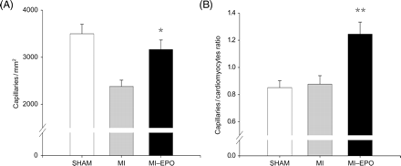
Figure 2 Effect of erythropoietin treatment on neovascularization. (A) Measurements of capillary density in number of ...
Notes:
Figure 2 Effect of erythropoietin treatment on neovascularization. (A) Measurements of capillary density in number of capillaries per millimetre2. (B) Bar graph representing the capillary-to-myocyte ratio in different groups. *P < 0.05 vs. myocardial infarction, **P < 0.01 vs. myocardial infarction.
Unless provided in the caption above, the following copyright applies to the content of this slide: © The European Society of Cardiology 2007. All rights reserved. For Permissions, please e-mail: journals.permissions@oxfordjournals.org

Slide 3
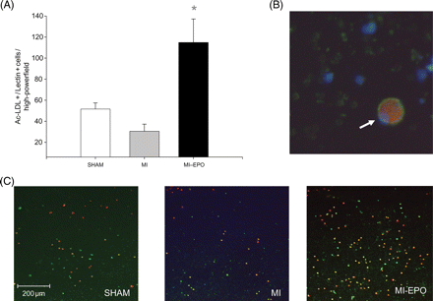
Figure 3 Effects of erythropoietin treatment on number of circulating endothelial progenitor cells. (A) Graphic ...
Notes:
Figure 3 Effects of erythropoietin treatment on number of circulating endothelial progenitor cells. (A) Graphic representation of number of endothelial progenitor cells. (B) Endothelial progenitor cell under high magnification (white arrow), positively stained for DiI AcLDL (red cytoplasm) and lectin (green cytoplasm), including DAPI nuclear staining (blue). (C) Representative microscopic fields from all experimental groups, with double stained (green + red) positive endothelial progenitor cells. *P < 0.01 vs. myocardial infarction.
Unless provided in the caption above, the following copyright applies to the content of this slide: © The European Society of Cardiology 2007. All rights reserved. For Permissions, please e-mail: journals.permissions@oxfordjournals.org

Slide 4
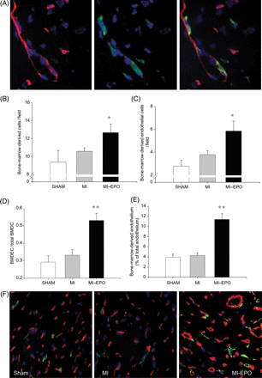
Figure 4 (A and B) Effect of erythropoietin treatment on incorporation of endothelial progenitor cells into the ...
Notes:
Figure 4 (A and B) Effect of erythropoietin treatment on incorporation of endothelial progenitor cells into the myocardial vasculature. (A) Bone-marrow-derived endothelial cells stained with hPAP (green), His 52 (endothelium, red), and DAPI (nucleus, blue) detected at 63% magnification. The three panels display the endothelium, bone-marrow-derived cells (green), and the fluorescent overlay of the same section, respectively, demonstrating endothelial cells that are bone-marrow-derived and appear yellow. (B) Bar graph representing the numbers of bone-marrow-derived cells (positive for hPAP) incorporated in the myocardium. (C) Bar graph representing the numbers of bone-marrow-derived endothelial cells (double positive for hPAP and His52) per high power field. (D) Bar graph representing the ratio between bone-marrow-derived endothelial cells to total bone-marrow-derived cells in the spared left ventricular free wall. (E) Bar graph representing the percentage of endothelium composed of bone-marrow-derived cells. (F) Representative fluorescent overlay of the treatment groups at 40 × magnification. Endothelial cells appear red, bone-marrow-derived cells appear green, bone-marrow-derived endothelial cells appear yellow. BMDC, bone-marrow-derived cells; BMDEC, bone-marrow-derived endothelial cells; hPAP, human placental alkaline phosphatase. *P < 0.05 vs. myocardial infarction, **P < 0.01 vs. myocardial infarction.
Unless provided in the caption above, the following copyright applies to the content of this slide: © The European Society of Cardiology 2007. All rights reserved. For Permissions, please e-mail: journals.permissions@oxfordjournals.org

Slide 5
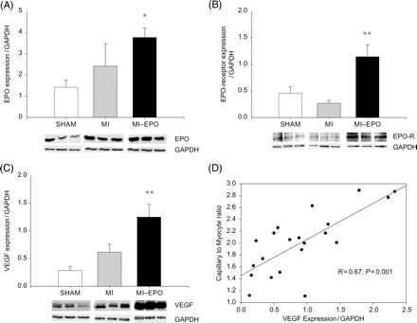
Figure 5 Expression of erythropoietin, erythropoietin-receptor, and vascular endothelial growth factor in the left ...
Notes:
Figure 5 Expression of erythropoietin, erythropoietin-receptor, and vascular endothelial growth factor in the left ventricular free wall. (A) Bar graph and representative bands showing the difference in the expression of erythropoietin in the left ventricular free wall. (B) Bar graph and representative bands showing the difference in the expression of erythropoietin-receptor in the left ventricular free wall. (C) Bar graph and representative bands showing the difference in the expression of VEGF in the left ventricular free wall. (D) Scatter plot delineating the relation between capillary-to-myocyte ratio and VEGF expression in the left ventricular free wall of all groups (sham, myocardial infarction, and myocardial-infarction–erythropoietin). EPOR, erythropoietin-receptor; VEGF; vascular endothelial growth factor. *P < 0.05 vs. myocardial infarction, **P < 0.01 vs. myocardial infarction.
Unless provided in the caption above, the following copyright applies to the content of this slide: © The European Society of Cardiology 2007. All rights reserved. For Permissions, please e-mail: journals.permissions@oxfordjournals.org

Slide 6
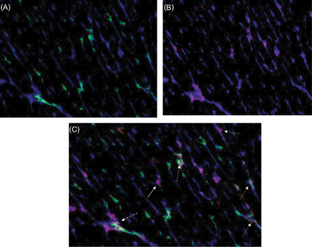
Figure 6 Expression of vascular endothelial growth factor by bone-marrow-derived and non-bone-marrow-derived ...
Notes:
Figure 6 Expression of vascular endothelial growth factor by bone-marrow-derived and non-bone-marrow-derived endothelial cells. (A) Representative fluorescent overlay showing bone-marrow-derived endothelium [endothelium (his 52, blue) bone-marrow-derived cells (hPAP, green)]. (B) Representative fluorescent overlay showing vascular endothelial growth factor expression in the endothelium [endothelium (his 52, blue) vascular endothelial growth factor (red)]. (C) Merged picture of (A) and (B) showing that vascular endothelial growth factor is expressed by bone-marrow-derived (dashed arrow) and non-bone-marrow-derived (solid arrow) endothelial cells.
Unless provided in the caption above, the following copyright applies to the content of this slide: © The European Society of Cardiology 2007. All rights reserved. For Permissions, please e-mail: journals.permissions@oxfordjournals.org

