Slide 1
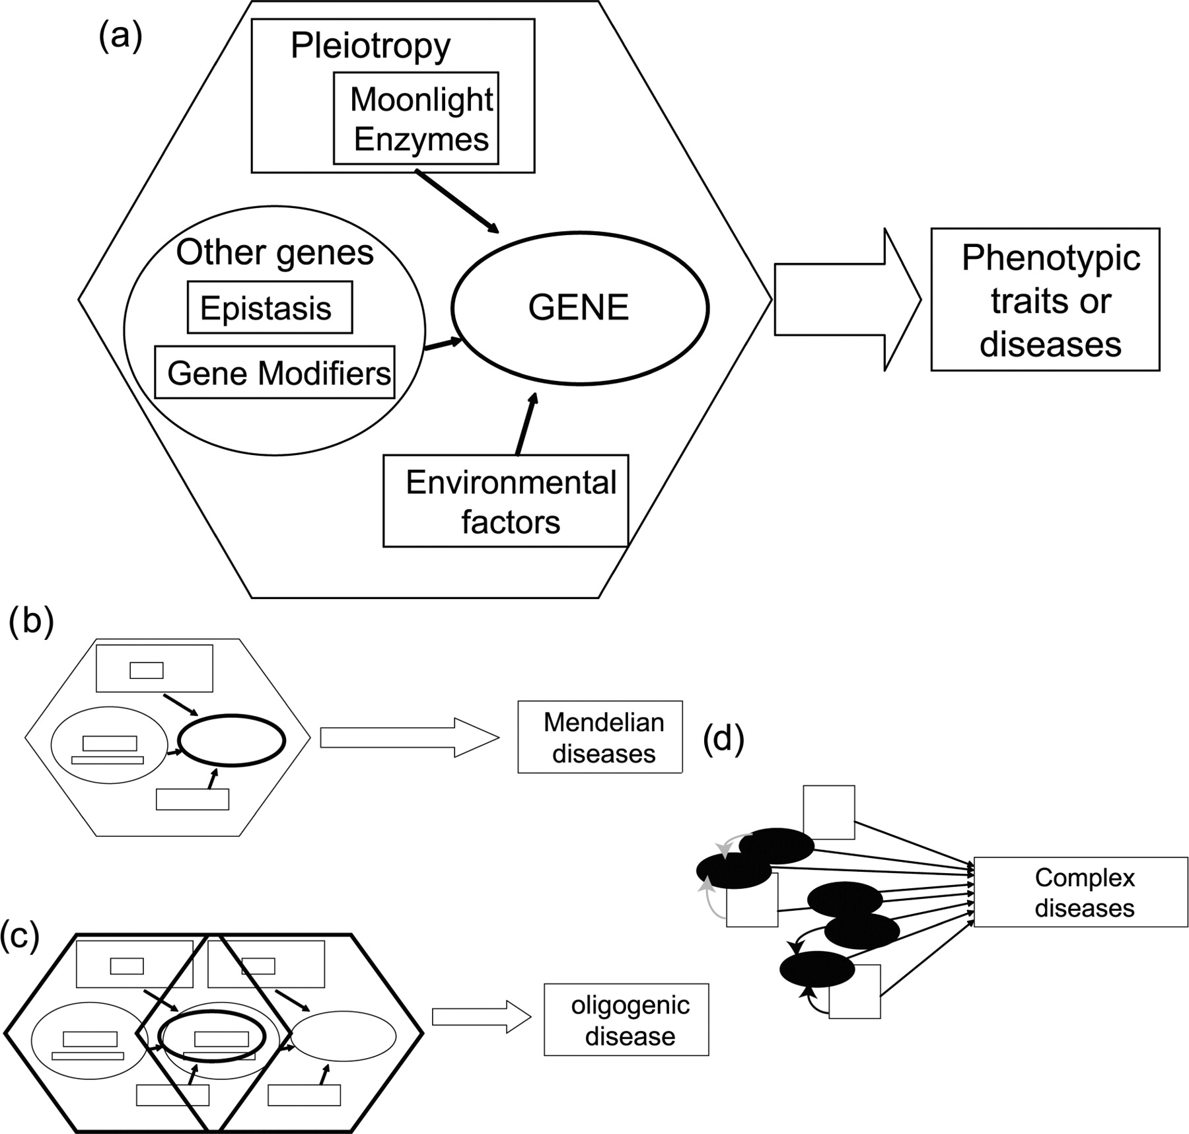
Figure 1: From Mendelian to complex diseases: (A) the mutation of a gene is the main cause for the phenotypic trait or ...
Notes:
Figure 1: From Mendelian to complex diseases: (A) the mutation of a gene is the main cause for the phenotypic trait or disease. Gene pleiotropy, gene modifiers, and environmental factors all influence the final phenotype (see glossary of terms in Table 3). (B) Most Mendelian or single gene diseases are determined by mutations at a single locus, mostly by those that produce mutations in the coding region of the protein. Other factors discussed in (A) also affect Mendelian diseases. (C) Oligogenic diseases require the interaction of a few genes and exhibit inheritance patterns somewhere between monogenic and polygenic. In the illustration, two genes and factors associated (represented by the hexagonal shapes) interact to produce a digenic disease. (D) Complex diseases or traits are affected by a multitude of genes (represented as black ovals) and several factors, such as environment (represented by white rectangles). Genes (and/or environmental factors) can affect other genes by enhancing (black arrows) or inhibiting (gray arrows) their action (to simplify arrows were drawn only for two genes).
Unless provided in the caption above, the following copyright applies to the content of this slide: Published by Oxford University Press 2007.

Slide 2
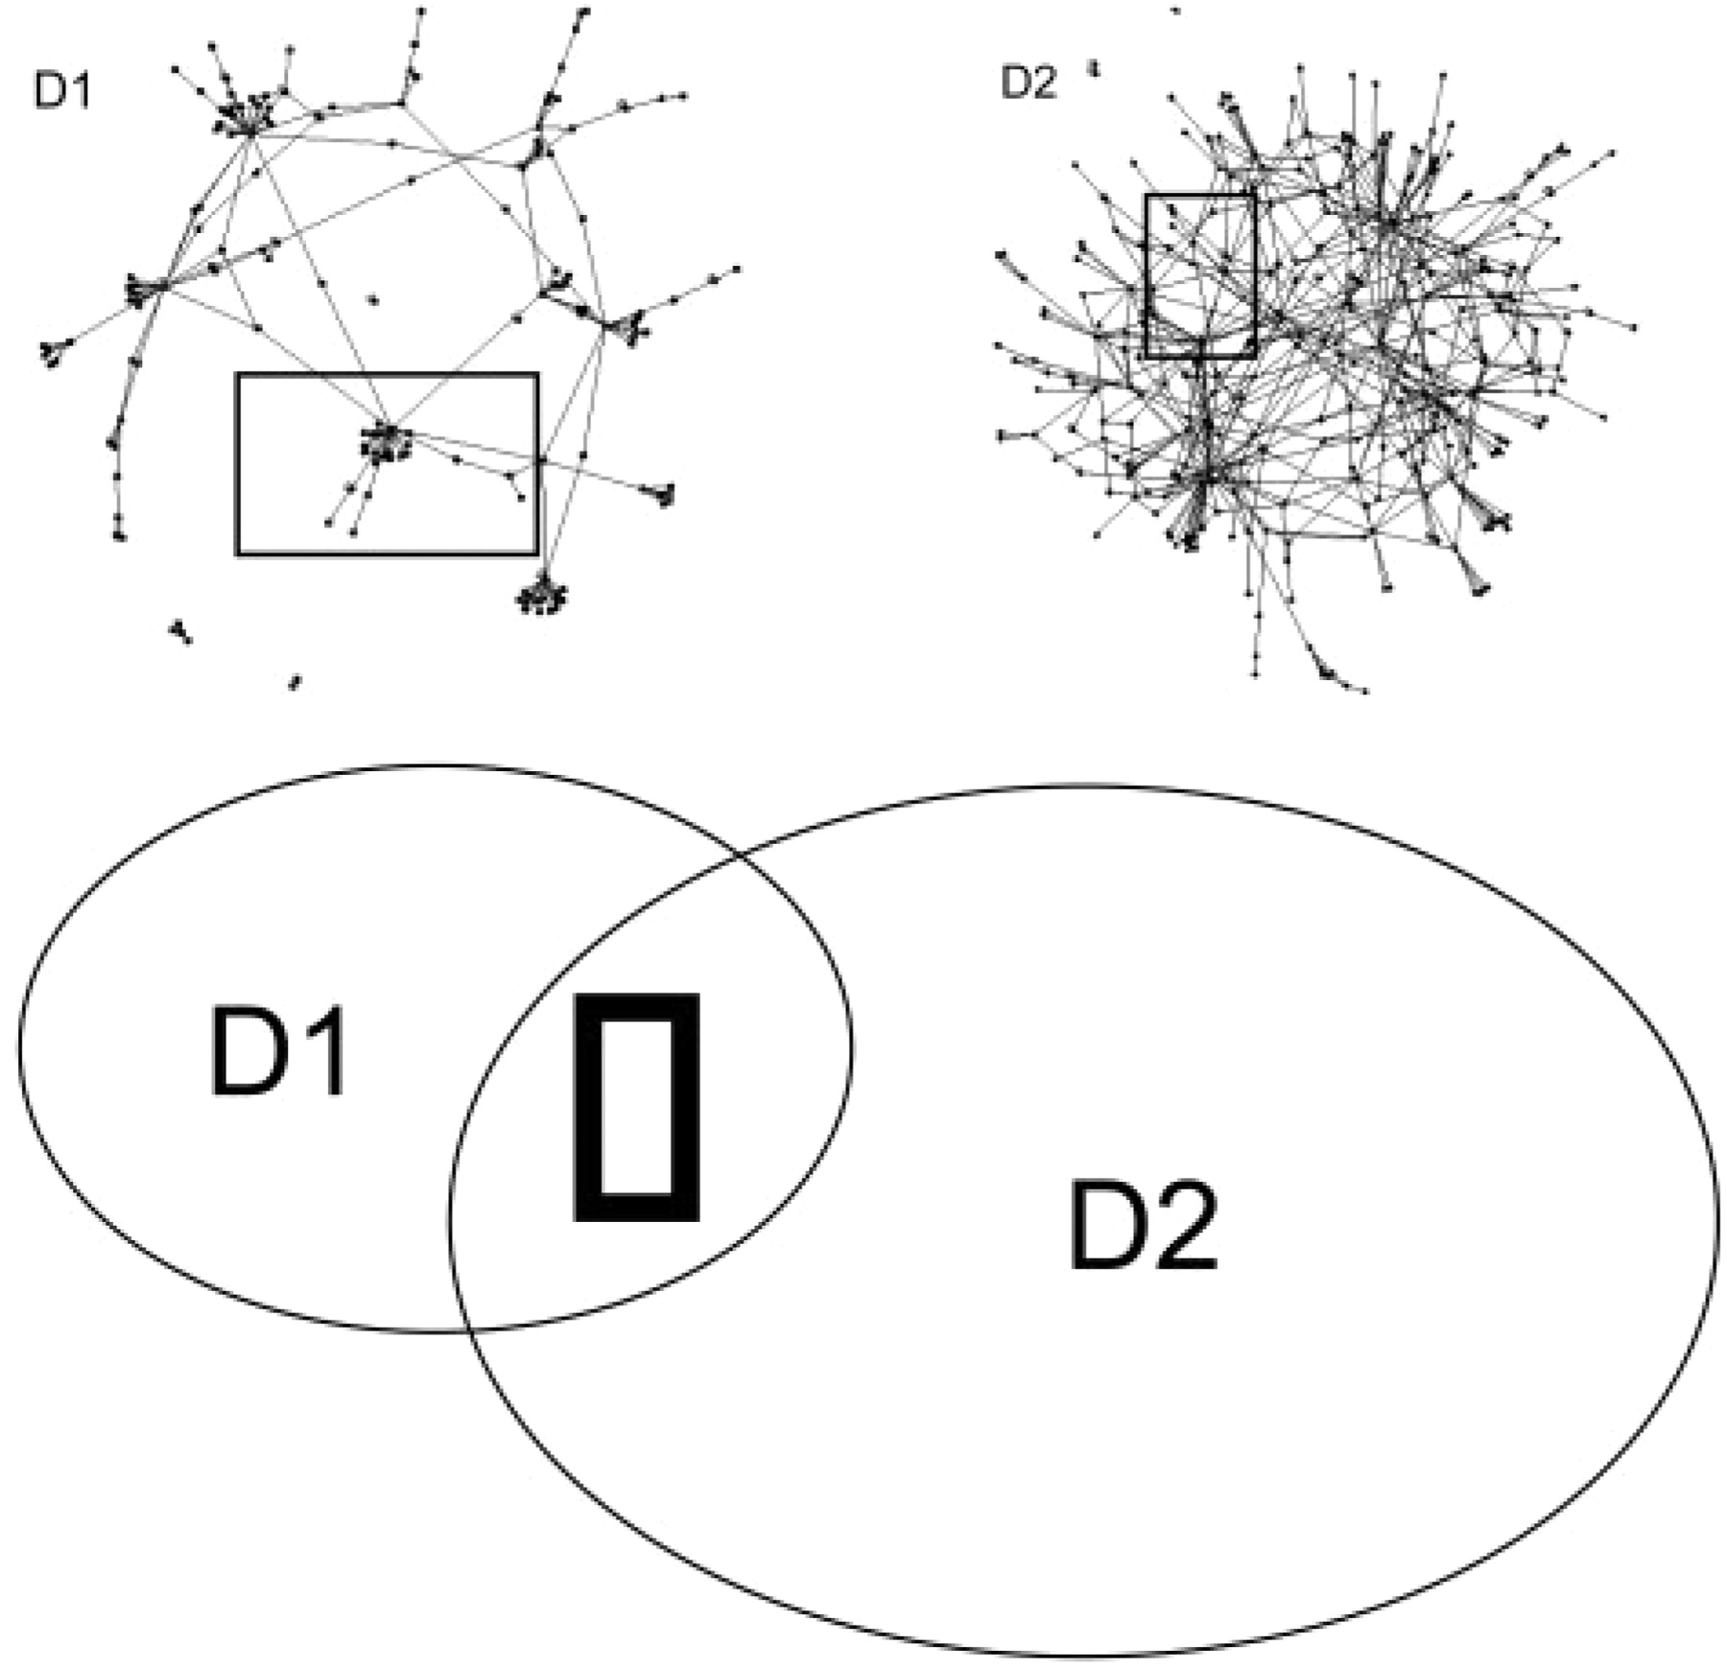
Figure 2: The interaction networks for two diseases are represented by two connected graphs (D1 and D2) and the ...
Notes:
Figure 2: The interaction networks for two diseases are represented by two connected graphs (D1 and D2) and the overlapping Venn diagrams. The diseases share a set of related proteins, namely a ‘disease module’ (enclosed by a rectangle). The two hypothetical diseases would likely share a set of phenotypic features. The networks depicted are from an arbitrary set of proteins and were obtained using Cytoscape [137].
Unless provided in the caption above, the following copyright applies to the content of this slide: Published by Oxford University Press 2007.

