Slide 1
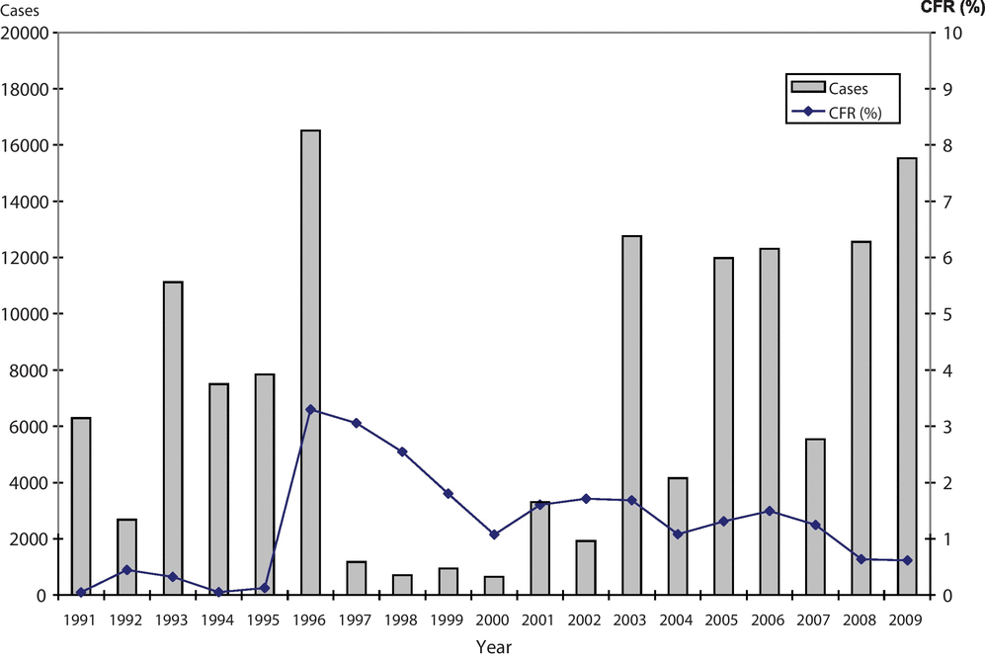
Figure 1 Annual numbers of dengue cases and case fatality rate (CFR) reported in India for 1991–2009. Compiled from ...
Notes:
Figure 1 Annual numbers of dengue cases and case fatality rate (CFR) reported in India for 1991–2009. Compiled from data published by South-East Asian Regional Office (1991–2005) and National Vector Borne Disease Control Program (NVBDCP) (2001–2009).14,15,23,24
Unless provided in the caption above, the following copyright applies to the content of this slide: © Royal Society of Tropical Medicine and Hygiene 2012

Slide 2
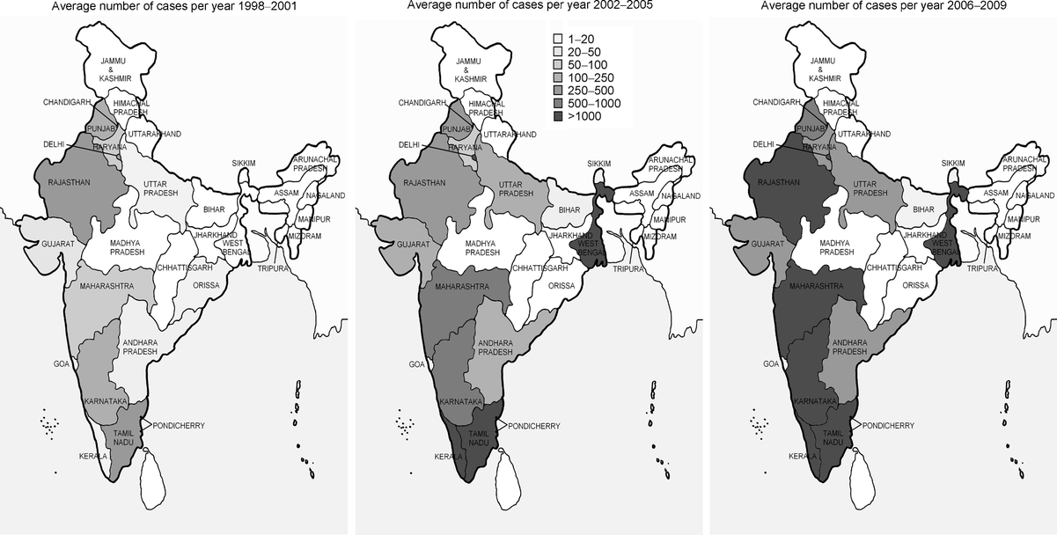
Figure 2 Average annual number of dengue cases in the states and Union Territories of India for 1998–2001, 2002–2005 ...
Notes:
Figure 2 Average annual number of dengue cases in the states and Union Territories of India for 1998–2001, 2002–2005 and 2006–2009. Compiled from data published by National Vector Borne Disease Control Program (NVBDCP).15,23,24
Unless provided in the caption above, the following copyright applies to the content of this slide: © Royal Society of Tropical Medicine and Hygiene 2012

Slide 3
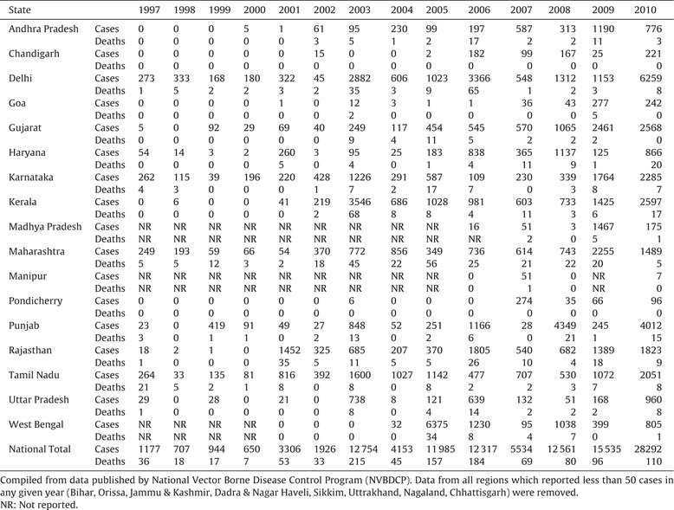
Table 1 National and selected state-wise data on the annual number of dengue cases and deaths for the period ...
Notes:
Table 1 National and selected state-wise data on the annual number of dengue cases and deaths for the period 1997–2010
Unless provided in the caption above, the following copyright applies to the content of this slide: © Royal Society of Tropical Medicine and Hygiene 2012

Slide 4
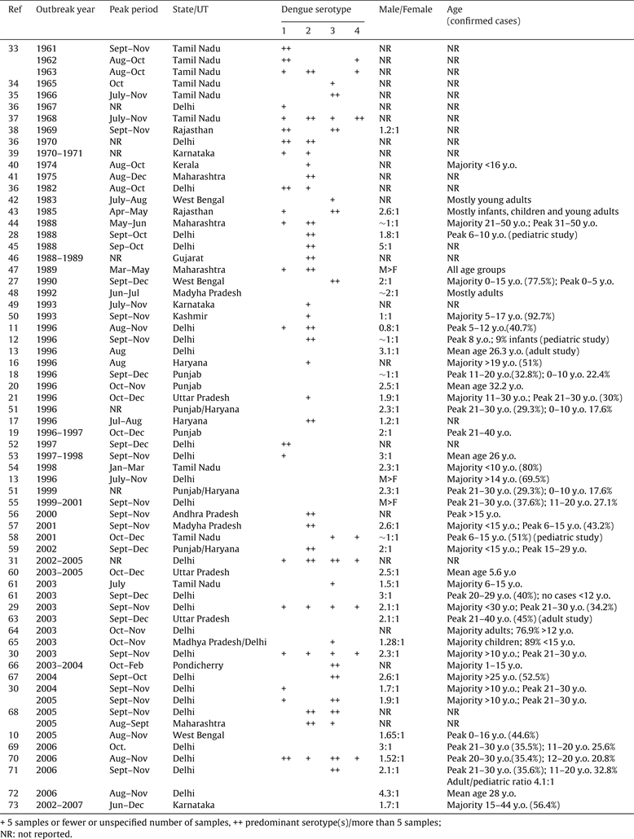
Table 2 Data on circulating serotypes, seasonality, sex ratio and age of cases from reports of dengue outbreaks in ...
Notes:
Table 2 Data on circulating serotypes, seasonality, sex ratio and age of cases from reports of dengue outbreaks in India
Unless provided in the caption above, the following copyright applies to the content of this slide: © Royal Society of Tropical Medicine and Hygiene 2012

