Slide 1
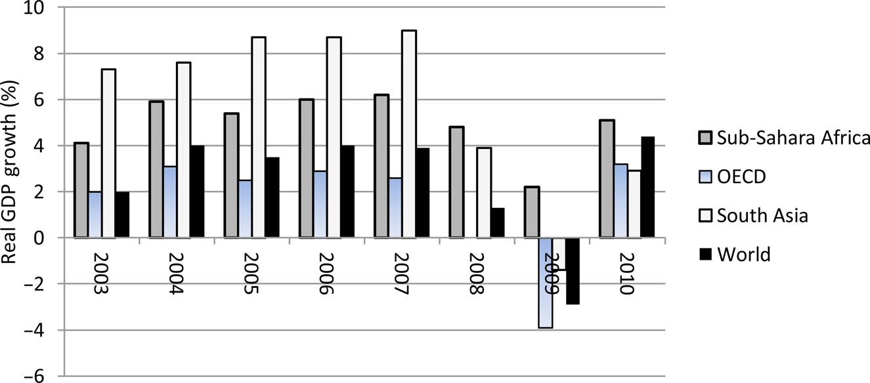
Figure 1: Real GDP Growth for Selected Regions, 2003–2010.
Notes:
Figure 1: Real GDP Growth for Selected Regions, 2003–2010. Source: Data from World Bank (2012).
Unless provided in the caption above, the following copyright applies to the content of this slide: © The author 2014. Published by Oxford University Press on behalf of the Centre for the Study of African Economies. All rights reserved. For permissions, please email: journals.permissions@oup.com

Slide 2
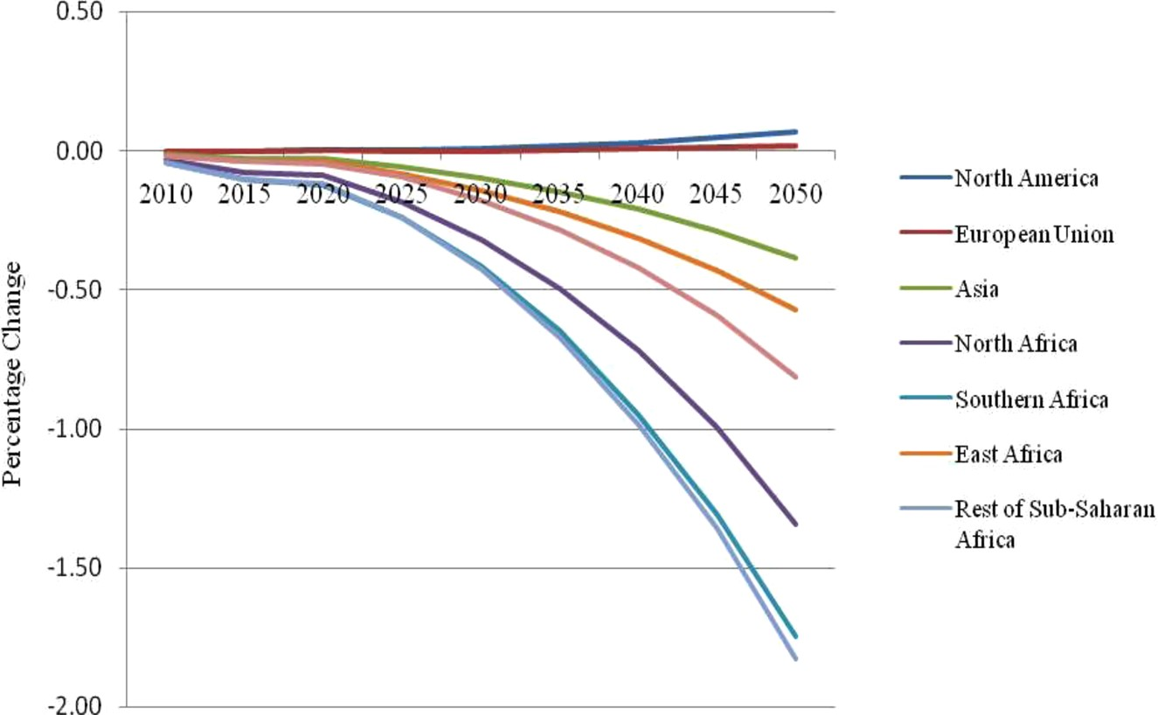
Figure 2: Impacts of the Decline in Agricultural Productivity on GDP Growth.
Notes:
Figure 2: Impacts of the Decline in Agricultural Productivity on GDP Growth. Source: Author's estimates from model simulation.
Unless provided in the caption above, the following copyright applies to the content of this slide: © The author 2014. Published by Oxford University Press on behalf of the Centre for the Study of African Economies. All rights reserved. For permissions, please email: journals.permissions@oup.com

Slide 3
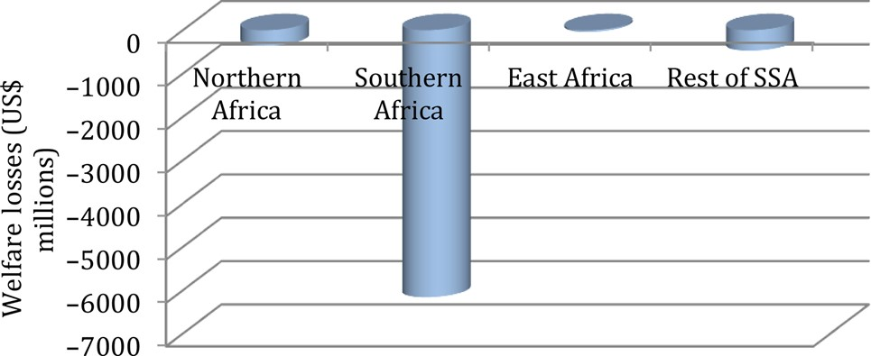
Figure 3: Impacts of the Decline in Agricultural Productivity on Welfare (Equivalent Variation) in Africa by the ...
Notes:
Figure 3: Impacts of the Decline in Agricultural Productivity on Welfare (Equivalent Variation) in Africa by the 2050s. Source: Author's estimates from model simulation.
Unless provided in the caption above, the following copyright applies to the content of this slide: © The author 2014. Published by Oxford University Press on behalf of the Centre for the Study of African Economies. All rights reserved. For permissions, please email: journals.permissions@oup.com

Slide 4
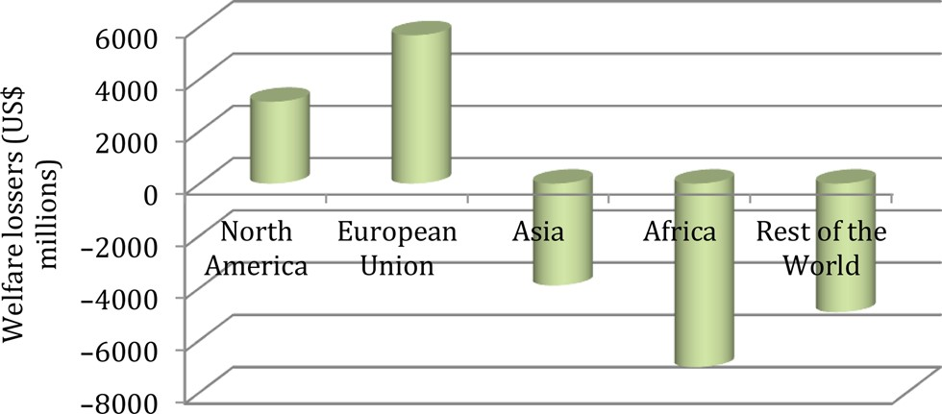
Figure 4: Impacts of the Decline in Agricultural Productivity on Welfare (Equivalent Variation) Globally by the 2050s.
Notes:
Figure 4: Impacts of the Decline in Agricultural Productivity on Welfare (Equivalent Variation) Globally by the 2050s. Source: Author's estimates from model simulation.
Unless provided in the caption above, the following copyright applies to the content of this slide: © The author 2014. Published by Oxford University Press on behalf of the Centre for the Study of African Economies. All rights reserved. For permissions, please email: journals.permissions@oup.com

Slide 5
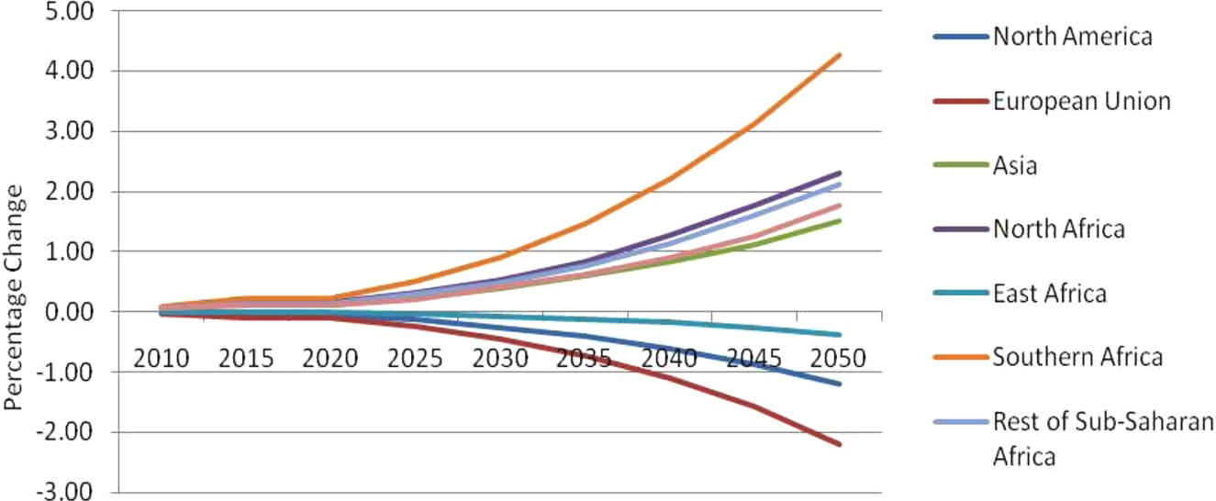
Figure 5: Ratio of Domestic to Imported Prices for Agricultural Products (Per cent).
Notes:
Figure 5: Ratio of Domestic to Imported Prices for Agricultural Products (Per cent). Source: Author's estimates from model simulation.
Unless provided in the caption above, the following copyright applies to the content of this slide: © The author 2014. Published by Oxford University Press on behalf of the Centre for the Study of African Economies. All rights reserved. For permissions, please email: journals.permissions@oup.com

