Slide 1
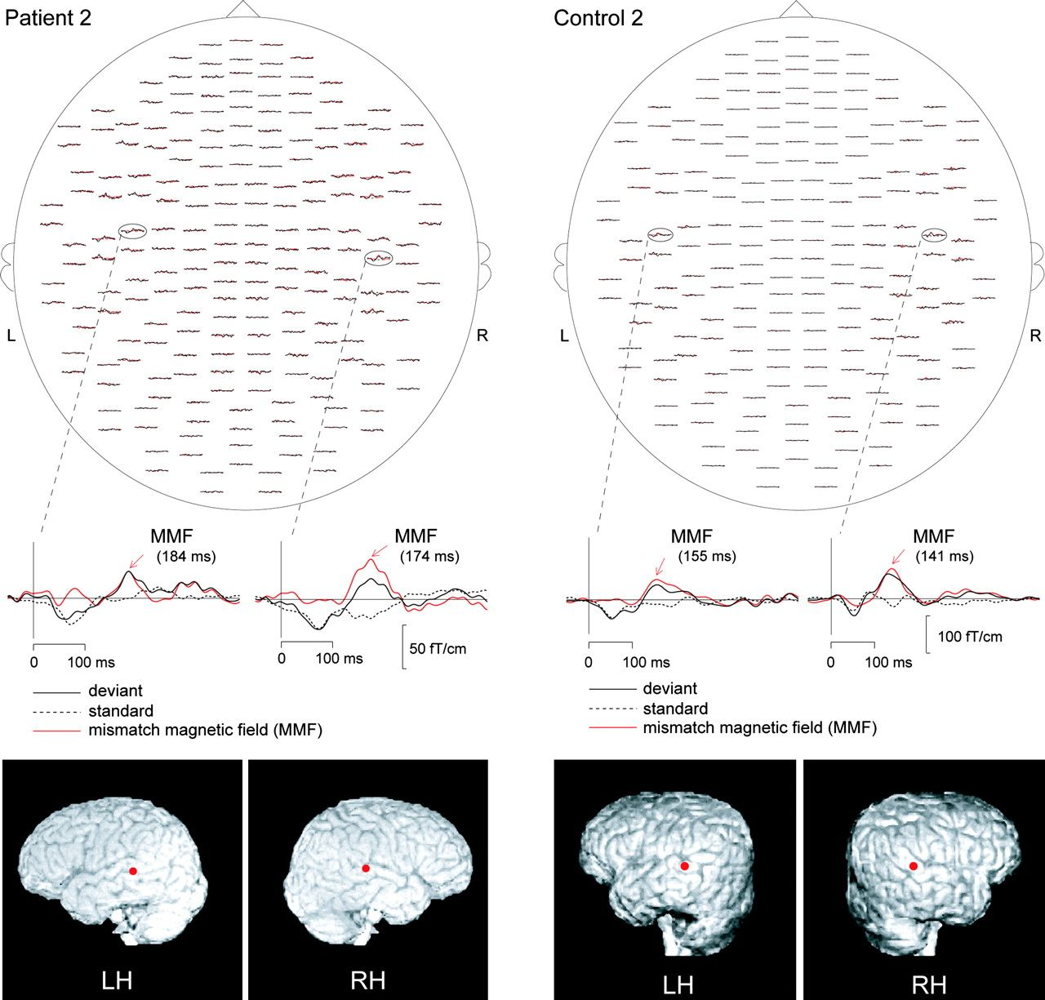
Figure 1. (Top) Spatial distribution of auditory-evoked fields of patient 2 (left panel) and control subject 2 (right ...
Notes:
Figure 1. (Top) Spatial distribution of auditory-evoked fields of patient 2 (left panel) and control subject 2 (right panel) to standard (1000 Hz, 100 ms) and deviant tone stimuli (1000 Hz, 50 ms). The signals from the MEG channels are projected onto a plane; the head is viewed from the top and the nose pointed upwards. Each response pair illustrates signals recorded by the 2 orthogonal gradiometers of a signal sensor unit. The MMNm was obtained by subtracting the standard-elicited waveform from the deviants-elicited waveform. (Bottom) The ECD location (circled dots) of the MMNm in each hemisphere was superimposed on the surface rendition of the brain MR images. L, left; R, right; LH, left hemisphere; RH, right hemisphere.
Unless provided in the caption above, the following copyright applies to the content of this slide: © The Author 2007. Published by Oxford University Press. All rights reserved. For permissions, please e-mail: journals.permissions@oxfordjournals.org

Slide 2
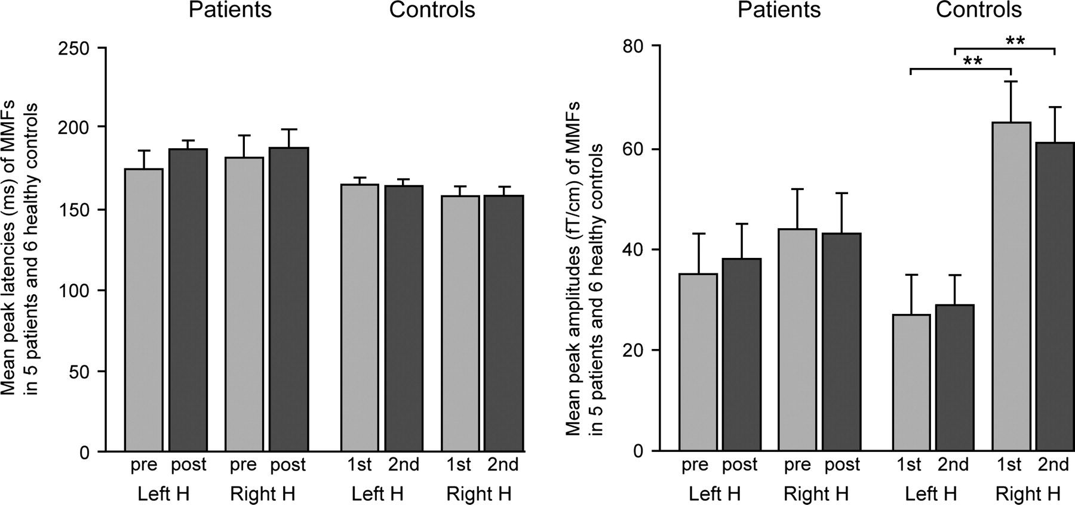
Figure 2. Mean latencies and amplitudes (+SEM) of the MMNm in 5 patients and 6 healthy controls. Pre- (pre) and ...
Notes:
Figure 2. Mean latencies and amplitudes (+SEM) of the MMNm in 5 patients and 6 healthy controls. Pre- (pre) and postoperative (post) data were presented separately for the patient group, whereas data obtained in the first (1st) and second measurement (2nd; about 3–8 months after the first one) were shown for the control group. **P < 0.005.
Unless provided in the caption above, the following copyright applies to the content of this slide: © The Author 2007. Published by Oxford University Press. All rights reserved. For permissions, please e-mail: journals.permissions@oxfordjournals.org

Slide 3
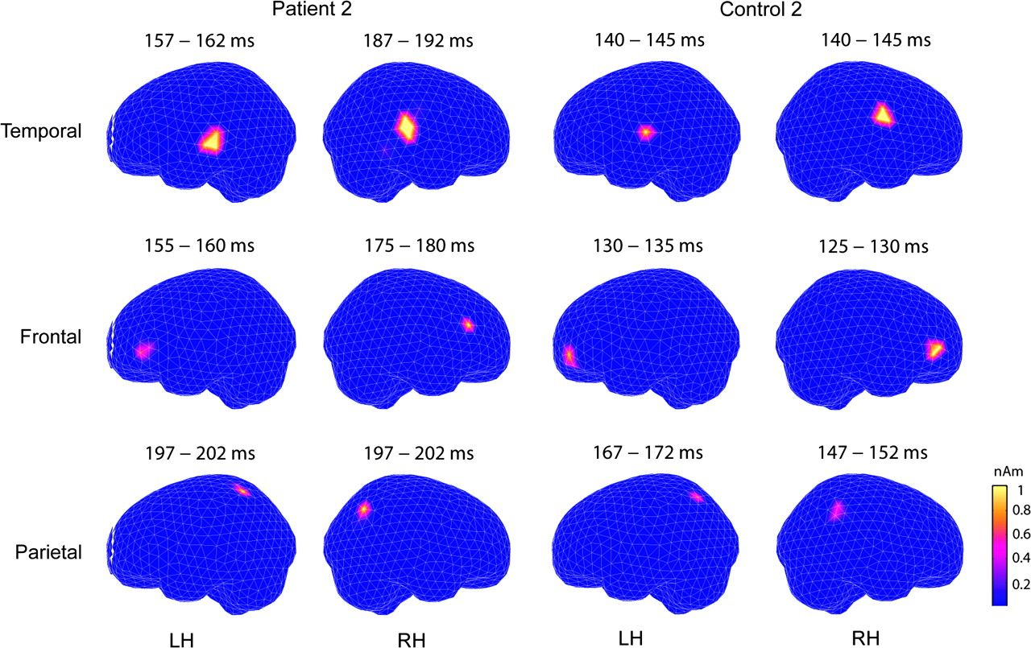
Figure 3. Minimum-current estimates of the cerebral sources of mismatch magnetic fields in one healthy subject (control ...
Notes:
Figure 3. Minimum-current estimates of the cerebral sources of mismatch magnetic fields in one healthy subject (control 2) and in one TLE patient (patient 2). LH, left hemisphere; RH, right hemisphere.
Unless provided in the caption above, the following copyright applies to the content of this slide: © The Author 2007. Published by Oxford University Press. All rights reserved. For permissions, please e-mail: journals.permissions@oxfordjournals.org

Slide 4
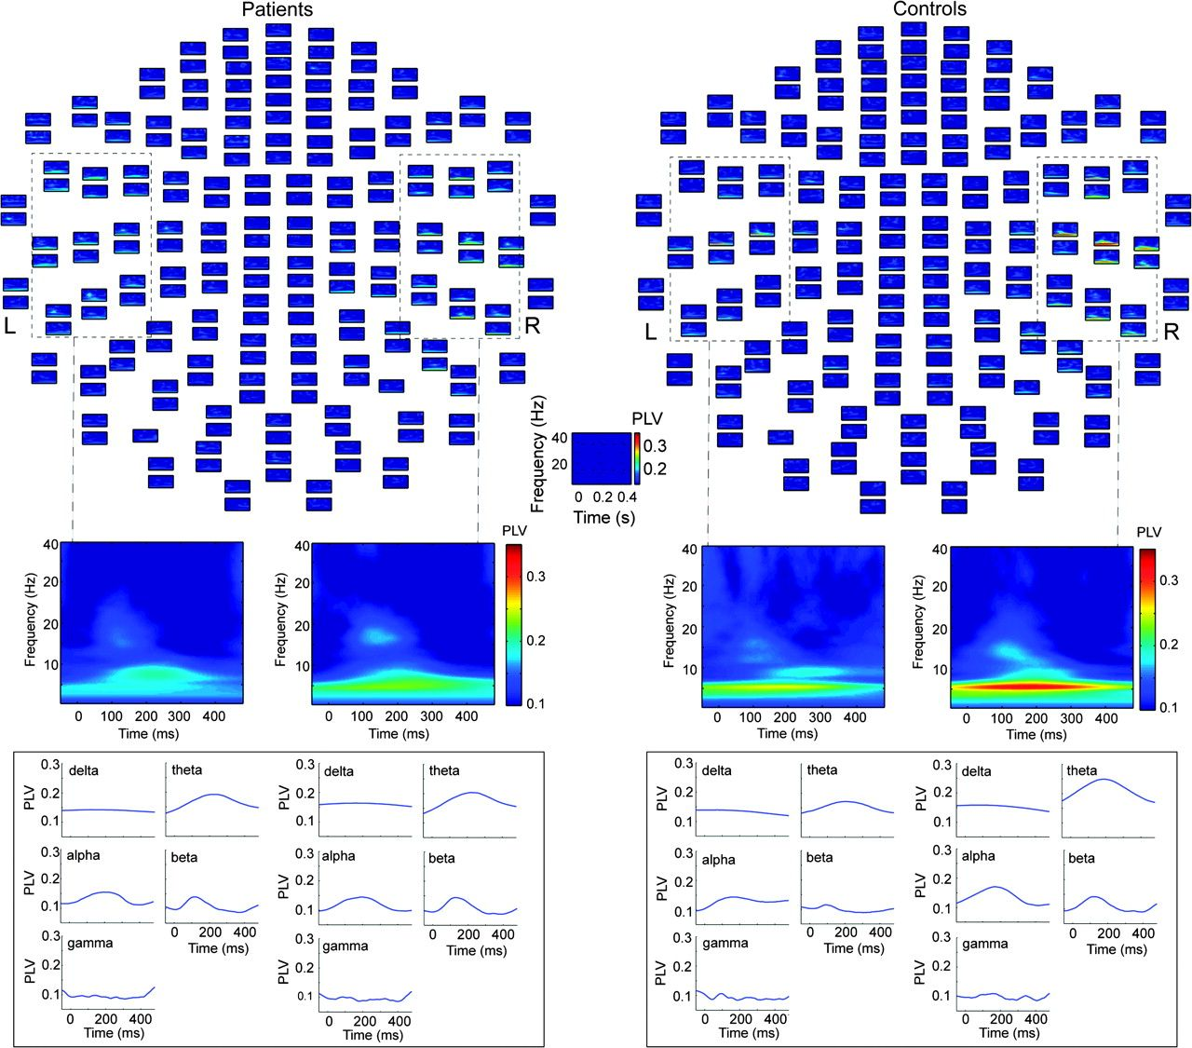
Figure 4. PLF across trials of cerebral responses to deviant sound stimuli in 5 right-TLE patients and 6 controls. Left ...
Notes:
Figure 4. PLF across trials of cerebral responses to deviant sound stimuli in 5 right-TLE patients and 6 controls. Left upper: The grand-averaged time–frequency representations of PLFs for preoperative 0.5- to 40-Hz responses to deviant stimuli in TLE patients. The head is flattened and viewed from above. Each insert shows the average plot of 18 gradiometer channels in the individual hemispheres. The PLFs are color coded: Small values are indicated with blue, and large, with red. PLF > 0.18 indicates P < 0.05. Left bottom: The grand-averaged PLFs for individual oscillatory bands over time with respect to the stimulus onset (time 0). Right upper: The grand-averaged time–frequency representations of PLFs for 0.5–40 Hz responses to deviant stimuli in the control subjects in the first measurement. Right bottom: The grand-averaged PLFs for individual oscillatory bands over time with respect to the stimulus onset (time 0).
Unless provided in the caption above, the following copyright applies to the content of this slide: © The Author 2007. Published by Oxford University Press. All rights reserved. For permissions, please e-mail: journals.permissions@oxfordjournals.org

Slide 5
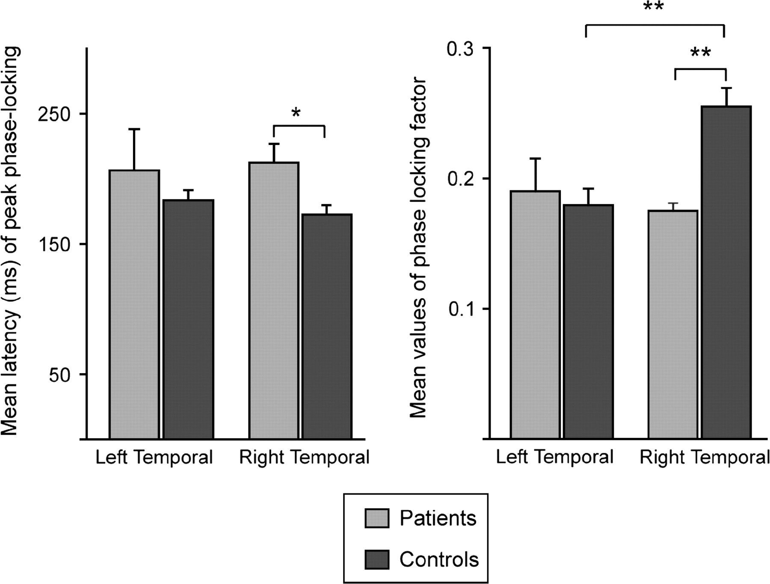
Figure 5. The mean peak PLFs and latencies after deviant sound stimulation in 5 patients and 6 healthy controls. *P < ...
Notes:
Figure 5. The mean peak PLFs and latencies after deviant sound stimulation in 5 patients and 6 healthy controls. *P < 0.05; **P < 0.005.
Unless provided in the caption above, the following copyright applies to the content of this slide: © The Author 2007. Published by Oxford University Press. All rights reserved. For permissions, please e-mail: journals.permissions@oxfordjournals.org

Slide 6
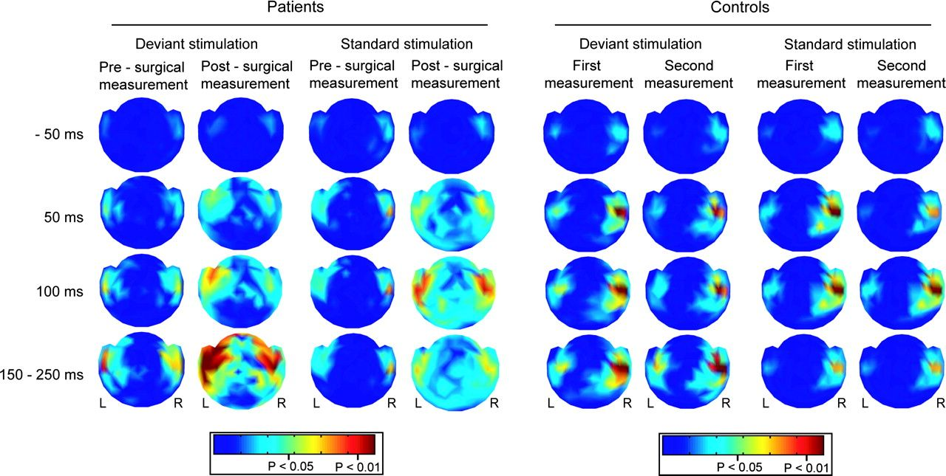
Figure 6. Left panel: The topographic plots of PLFs for 4- to 14-Hz signals with respect to the onset of standard or ...
Notes:
Figure 6. Left panel: The topographic plots of PLFs for 4- to 14-Hz signals with respect to the onset of standard or deviant stimulation in TLE patients before and after epileptic surgery. The MEG helmet covering the entire scalp is projected onto a plane, with the nose pointing upward. Right panel: The topographic plots of phase locking for 4- to 14-Hz cerebral signals with respect to the onset of standard or deviant stimulation in 2 separate measurements of control subjects. Strong phase locking is indicated with red, and weak, with blue. L, left; R, right.
Unless provided in the caption above, the following copyright applies to the content of this slide: © The Author 2007. Published by Oxford University Press. All rights reserved. For permissions, please e-mail: journals.permissions@oxfordjournals.org

