Slide 1
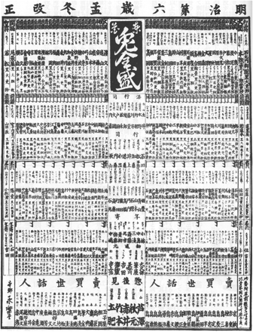
1 Tōka usagi zensei [The Pride of Tokyo's Rabbits], 1873. Reprinted in Fūzoku gahō [Manners and Customs in ...
Notes:
1 Tōka usagi zensei [The Pride of Tokyo's Rabbits], 1873. Reprinted in Fūzoku gahō [Manners and Customs in Pictures], no. 326 (Oct. 1905).
Unless provided in the caption above, the following copyright applies to the content of this slide: © The Past and Present Society, Oxford, 2011

Slide 2
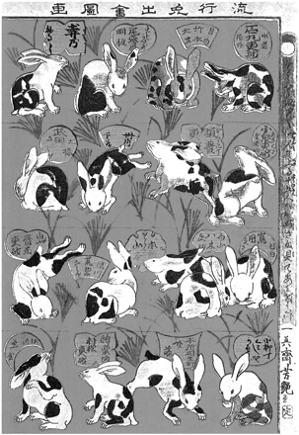
2 Utagawa Yoshitsuya II, Ryūkō usagi deai zuga [Popular Rabbits Illustrated], 1873. Reproduced with permission ...
Notes:
2 Utagawa Yoshitsuya II, Ryūkō usagi deai zuga [Popular Rabbits Illustrated], 1873. Reproduced with permission from the Meiji Shinbun Zasshi Bunko, Faculty of Law, Tokyo University.
Unless provided in the caption above, the following copyright applies to the content of this slide: © The Past and Present Society, Oxford, 2011

Slide 3
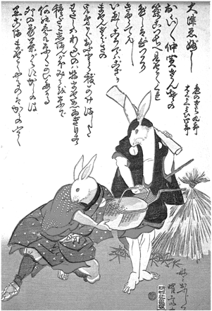
3 Yōsai Kuniteru, Ōtsu-e bushi [Ōtsu-e Song], 1873. Reproduced with permission from the Meiji Shinbun Zasshi ...
Notes:
3 Yōsai Kuniteru, Ōtsu-e bushi [Ōtsu-e Song], 1873. Reproduced with permission from the Meiji Shinbun Zasshi Bunko, Faculty of Law, Tokyo University.
Unless provided in the caption above, the following copyright applies to the content of this slide: © The Past and Present Society, Oxford, 2011

