Slide 1
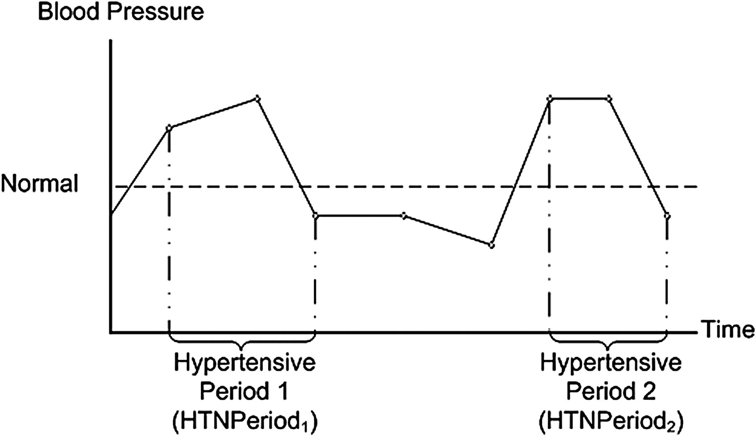
Figure 1 Periods of Continuously Elevated Blood Pressure. Circles represent individual physician–patient encounters.
Notes:
Figure 1 Periods of Continuously Elevated Blood Pressure. Circles represent individual physician–patient encounters.
Unless provided in the caption above, the following copyright applies to the content of this slide: American Medical Informatics Association

Slide 2
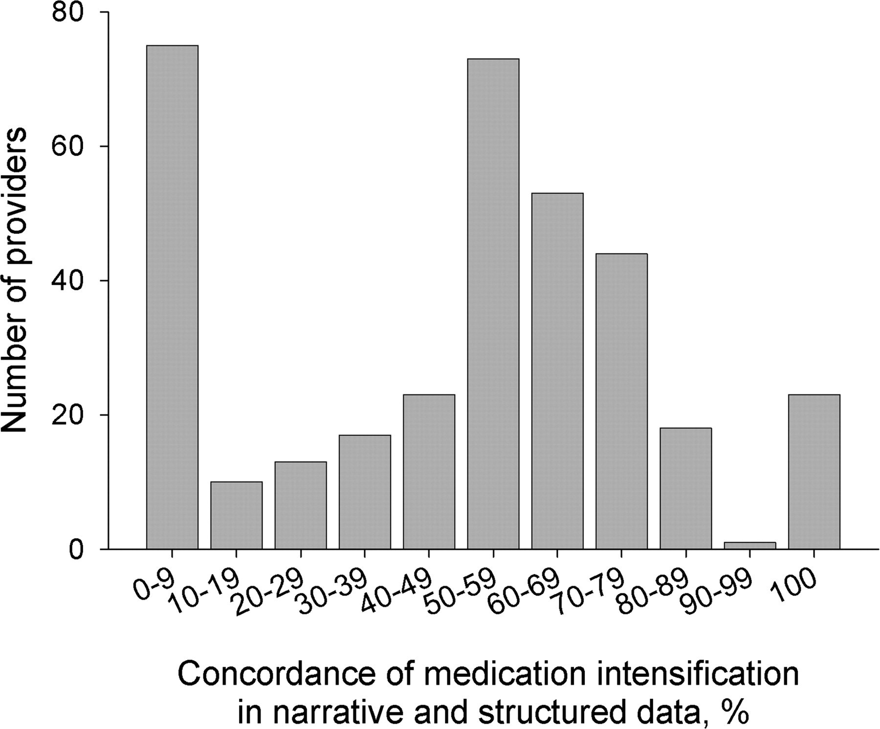
Figure 2 Distribution of Concordance between Medication Intensification Documentation in Narrative and Structured Data ...
Notes:
Figure 2 Distribution of Concordance between Medication Intensification Documentation in Narrative and Structured Data among Providers. For each provider who has had an encounter with at least one study patient, the average concordance of medication intensification was calculated as the fraction of anti-hypertensive medication intensifications documented in the notes that had medication intensifications documented in structured EMR records for the same encounter. Intervals of concordance of medication intensification were plotted against the number of providers whose average concordance fell into these intervals.
Unless provided in the caption above, the following copyright applies to the content of this slide: American Medical Informatics Association

Slide 3
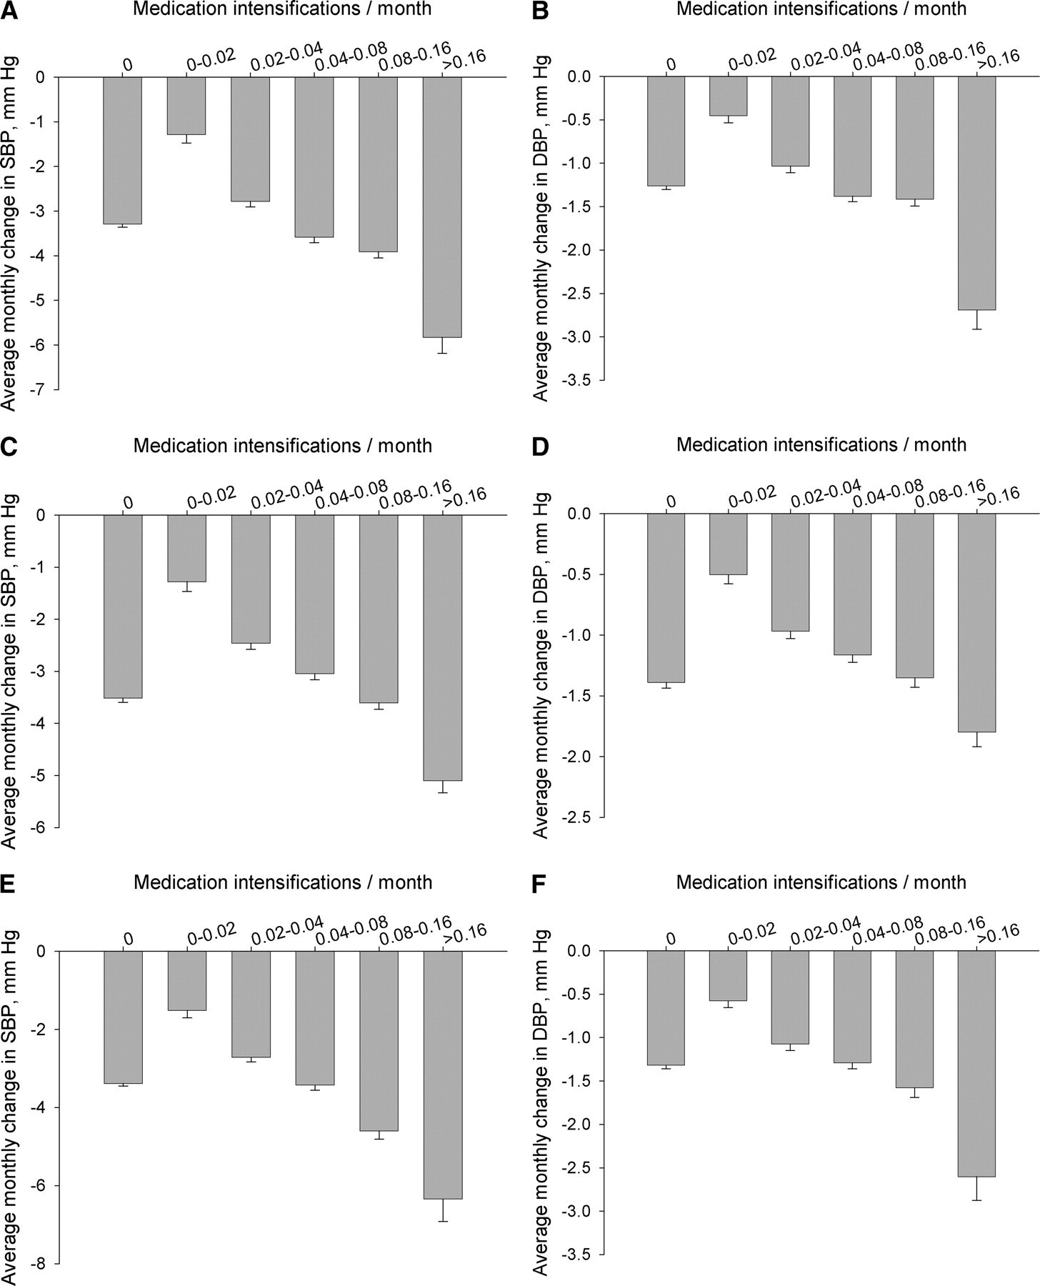
Figure 3 A. Average Monthly Change in Systolic Blood Pressure (SBP) by Frequency of Treatment Intensification ...
Notes:
Figure 3 A. Average Monthly Change in Systolic Blood Pressure (SBP) by Frequency of Treatment Intensification Documented Both in the Notes and Structured Records.The average number of anti-hypertensive medication intensifications per month of continuously elevated blood pressure was plotted against the average change in blood pressure, mm Hg/mo. B. Average Monthly Change in Diastolic Blood Pressure (DBP) by Frequency of Treatment Intensification Documented Both in the Notes and Structured Records. C. Average Monthly Change in Systolic Blood Pressure by Frequency of Treatment Intensification Documented in the Structured Records but Not in the Notes. D. Average Monthly Change in Diastolic Blood Pressure by Frequency of Treatment Intensification Documented in the Structured Records but Not in the Notes. E. Average Monthly Change in Systolic Blood Pressure by Frequency of Treatment Intensification Documented in the Notes, but Not in the Structured Records. F. Average Monthly Change in Diastolic Blood Pressure by Frequency of Treatment Intensification Documented in the Notes, but Not in the Structured Records.
Unless provided in the caption above, the following copyright applies to the content of this slide: American Medical Informatics Association

