Slide 1
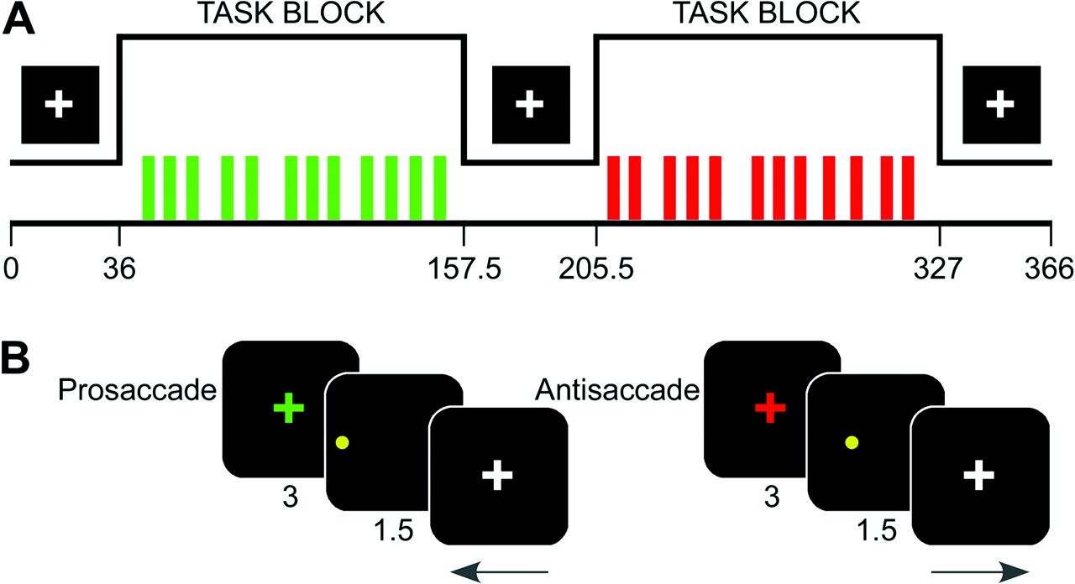
Figure 1. Schematic depictions of run (A) and task trial (B) structures.
Notes:
Figure 1. Schematic depictions of run (A) and task trial (B) structures.
Unless provided in the caption above, the following copyright applies to the content of this slide: © The Author 2008. Published by Oxford University Press. All rights reserved. For permissions, please e-mail: journals.permissions@oxfordjournals.org

Slide 2
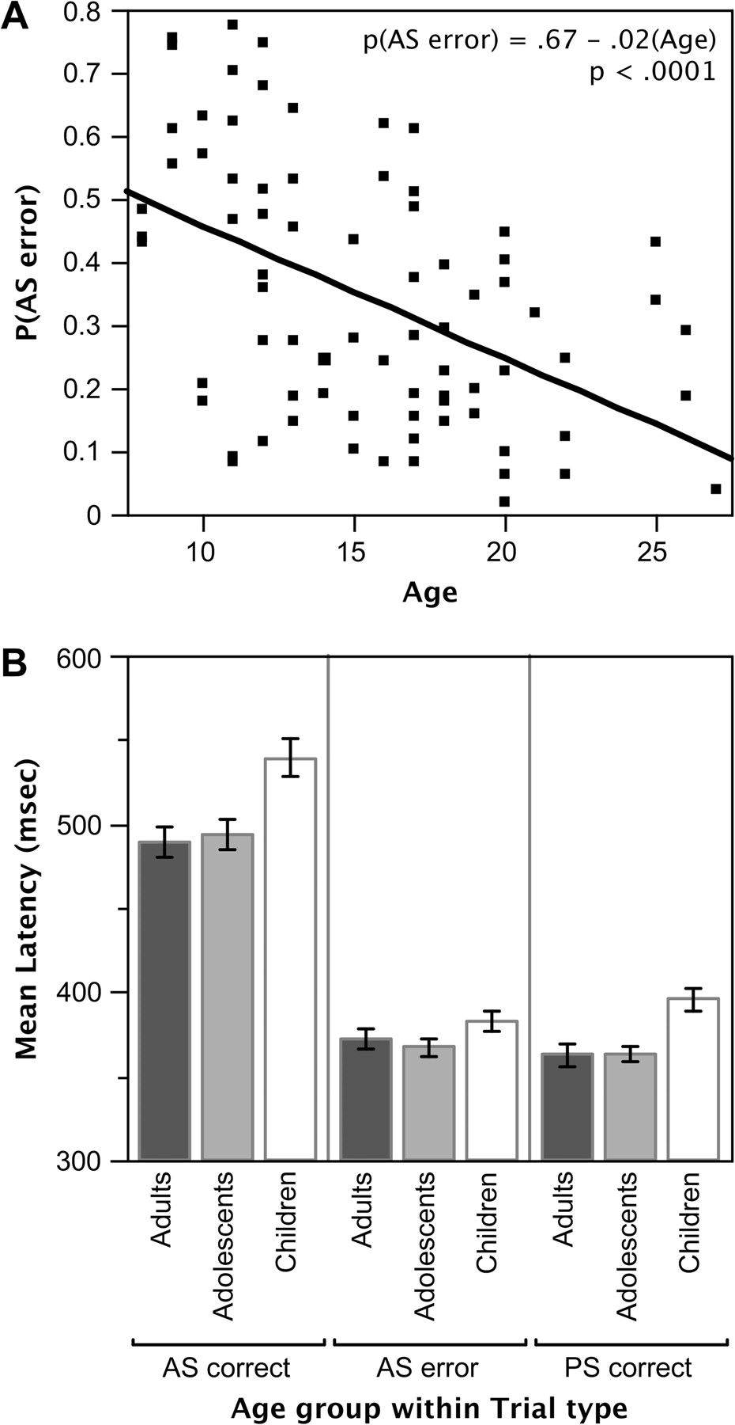
Figure 2. (A) Bivariate plot showing AS error rates as a function of age. (B) Mean initial saccade latencies for ...
Notes:
Figure 2. (A) Bivariate plot showing AS error rates as a function of age. (B) Mean initial saccade latencies for correctly and incorrectly performed AS trials and for correctly performed PS trials as a function of age group.
Unless provided in the caption above, the following copyright applies to the content of this slide: © The Author 2008. Published by Oxford University Press. All rights reserved. For permissions, please e-mail: journals.permissions@oxfordjournals.org

Slide 3
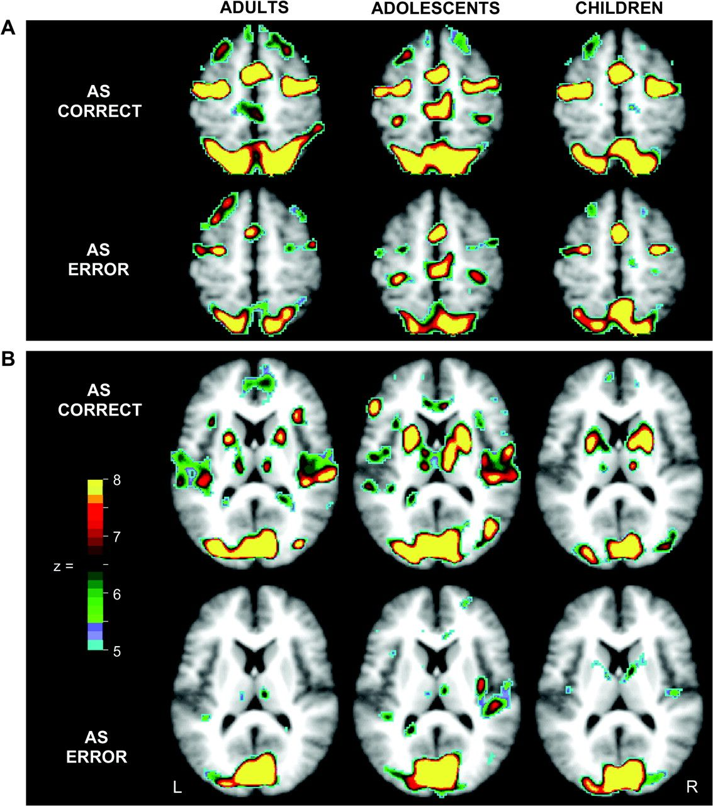
Figure 3. Voxels showing significant statistical activity change for correctly and incorrectly performed AS trials ...
Notes:
Figure 3. Voxels showing significant statistical activity change for correctly and incorrectly performed AS trials (i.e., correct and error trials) in adults, adolescents and children. All statistical images were corrected for multiple comparisons and sphericity (see Methods) and were then additionally thresholded at z = 5, P < 0.000001. (A) Horizontal sections at z = 54 show differing activity for correct and error trials, though similar distributions and levels of activity across age groups in SMA/preSMA, FEF, and PPC. (B) Horizontal sections at z = 12 show increased activity in putamen for correct trials relative to error trials in all age groups. Note that because maps are based on ANOVA, the direction of effects is not represented.
Unless provided in the caption above, the following copyright applies to the content of this slide: © The Author 2008. Published by Oxford University Press. All rights reserved. For permissions, please e-mail: journals.permissions@oxfordjournals.org

Slide 4
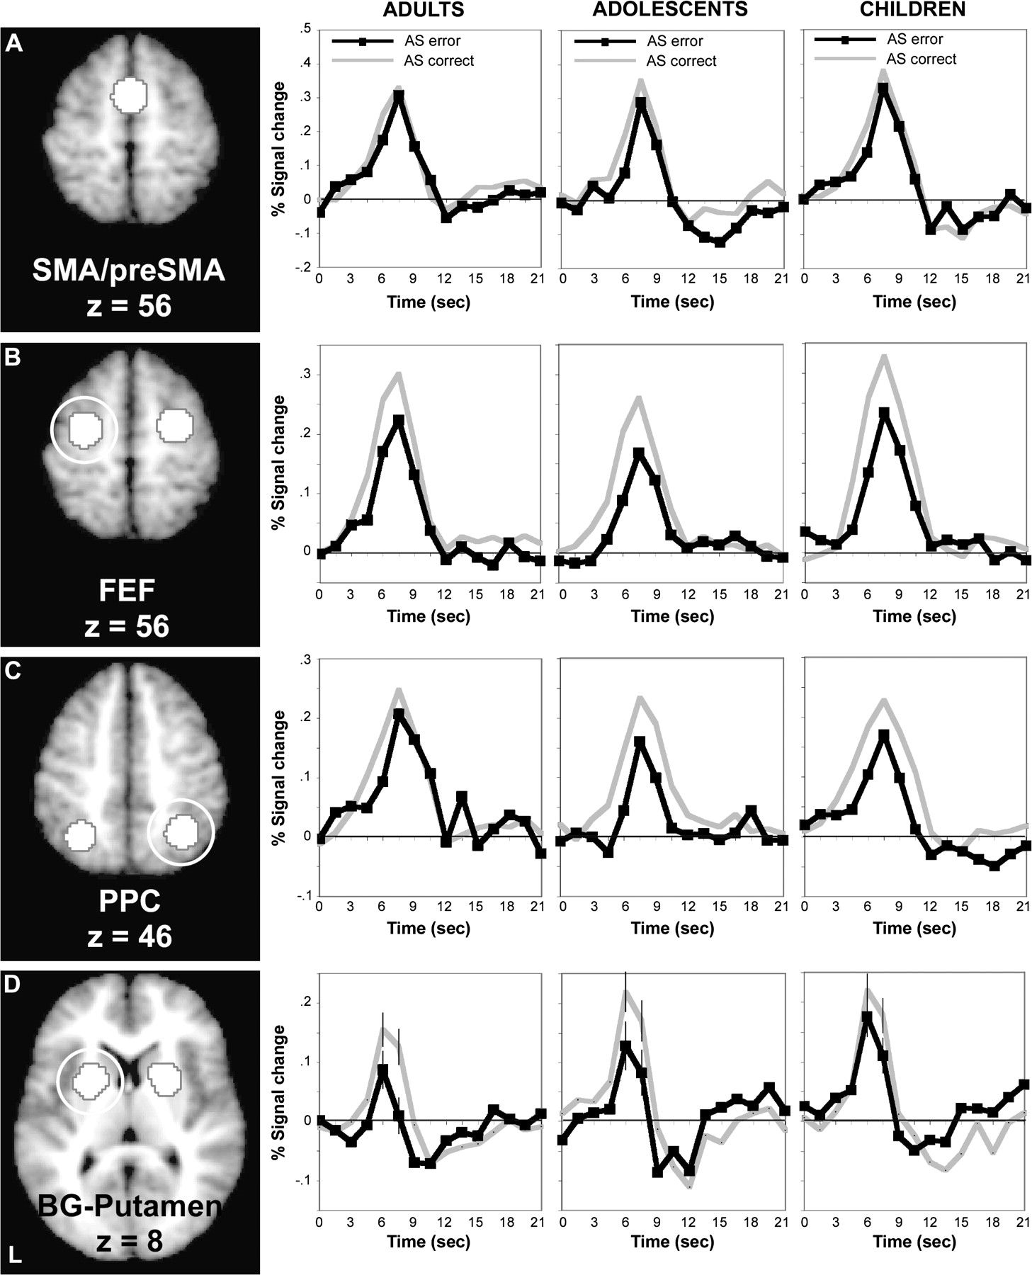
Figure 4. Canonical eye-movement regions consistently showed increased activity for correct versus error trials in the ...
Notes:
Figure 4. Canonical eye-movement regions consistently showed increased activity for correct versus error trials in the absence of age-group effects. (A) A horizontal section shows the SMA/preSMA region from which time courses for adults, adolescents, and children were obtained for correct and error trials (depicted immediately to the right). (B–D) Regions in FEF, PPC, and putamen. Time courses are arranged similarly to those for (A). For (B), (C), and (D), depicted time courses are derived from circled regions, but do not differ in their (uncircled) contralateral homologues. Standard error bars are included at peaks for time courses in putamen (D) to emphasize the similarity of effects across age groups.
Unless provided in the caption above, the following copyright applies to the content of this slide: © The Author 2008. Published by Oxford University Press. All rights reserved. For permissions, please e-mail: journals.permissions@oxfordjournals.org

Slide 5
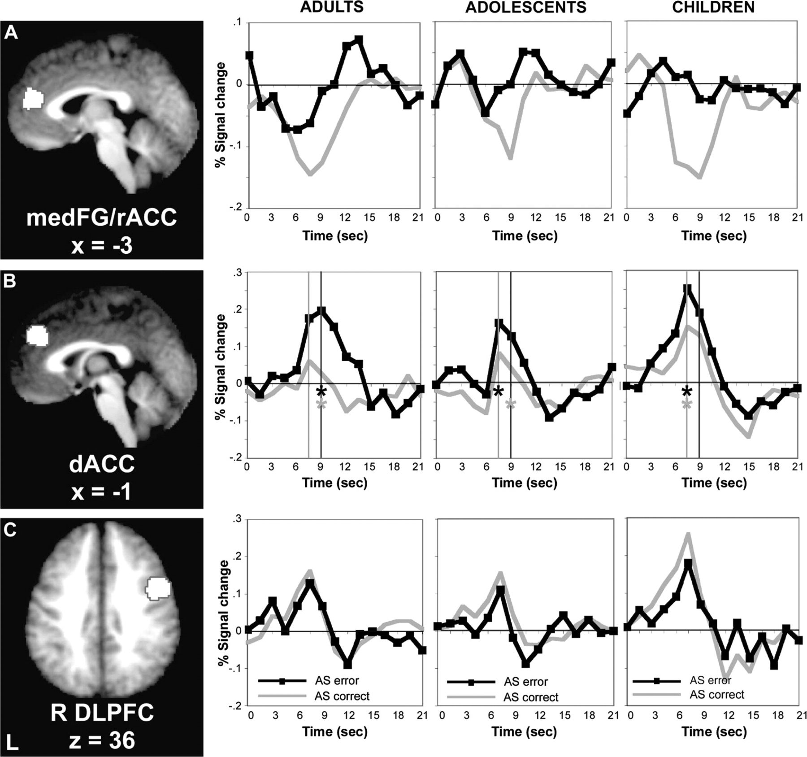
Figure 5. Activity in ACC and dlPFC. (A and B) medFG/rACC and dACC showed dissociable patterns of activity. (A) A ...
Notes:
Figure 5. Activity in ACC and dlPFC. (A and B) medFG/rACC and dACC showed dissociable patterns of activity. (A) A transverse section shows the medFG/rACC regions from which time courses for each age group were derived. Whereas time courses for error trials did not differ significantly from baseline, correct trials were associated with significant deactivations in all age groups. (B) A transverse section showing the dACC region. dACC showed significantly greater modulation during error versus correct trials, with adults showing greater differential activity than adolescents or children. Time points 6 (at 7.5 s following trial onset) and 7 (at 9 s following trial onset) are marked with vertical lines to distinguish early from late time points. For each age group, black asterisks mark the time point showing mean maximal peak activity for error trials. Gray asterisks mark the time point showing mean maximal differences in activity between error and correct trials. (C) Children showed increased activity in right dlPFC relative to adolescents and adults. Across age groups, correctly performed AS trials were associated with increased activity relative to AS errors. Panel layout parallels (A) and (B).
Unless provided in the caption above, the following copyright applies to the content of this slide: © The Author 2008. Published by Oxford University Press. All rights reserved. For permissions, please e-mail: journals.permissions@oxfordjournals.org

Slide 6
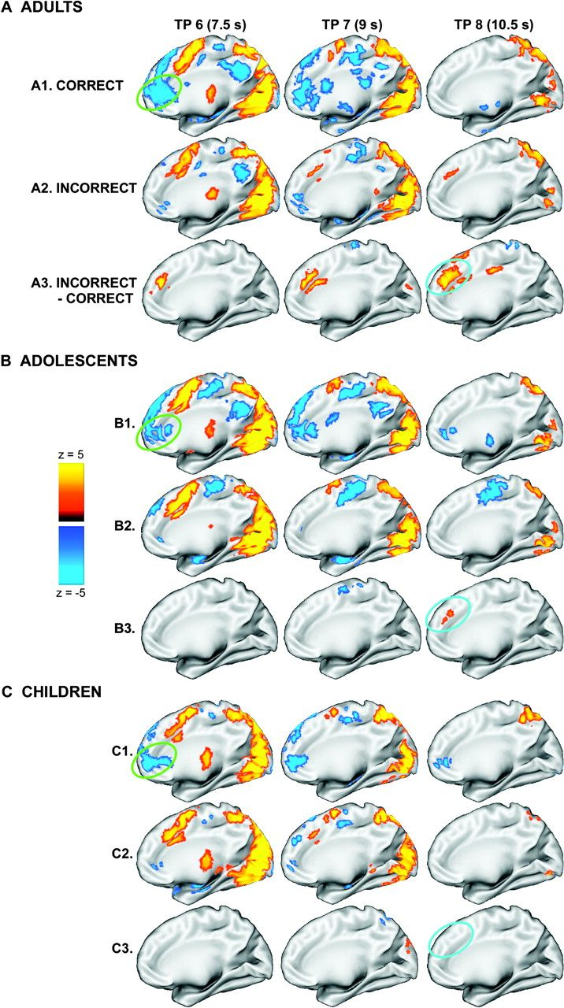
Figure 6. Findings of dissociable medFG/rACC and dACC activity across time for correct and error AS trials in each age ...
Notes:
Figure 6. Findings of dissociable medFG/rACC and dACC activity across time for correct and error AS trials in each age group. (A) Statistical activation maps displayed on the partially inflated medial cortical surface of the right hemisphere for correctly performed AS trials (A1), AS errors (A2), and for AS errors—AS correct trials (A3) for adults at time points 6, 7, and 8. (B and C) Similarly arranged for adolescents and children. The approximate location of medFG/rACC is circled in green and dACC in blue. We note that effects in the left hemisphere paralleled those depicted in the right.
Unless provided in the caption above, the following copyright applies to the content of this slide: © The Author 2008. Published by Oxford University Press. All rights reserved. For permissions, please e-mail: journals.permissions@oxfordjournals.org

Slide 7
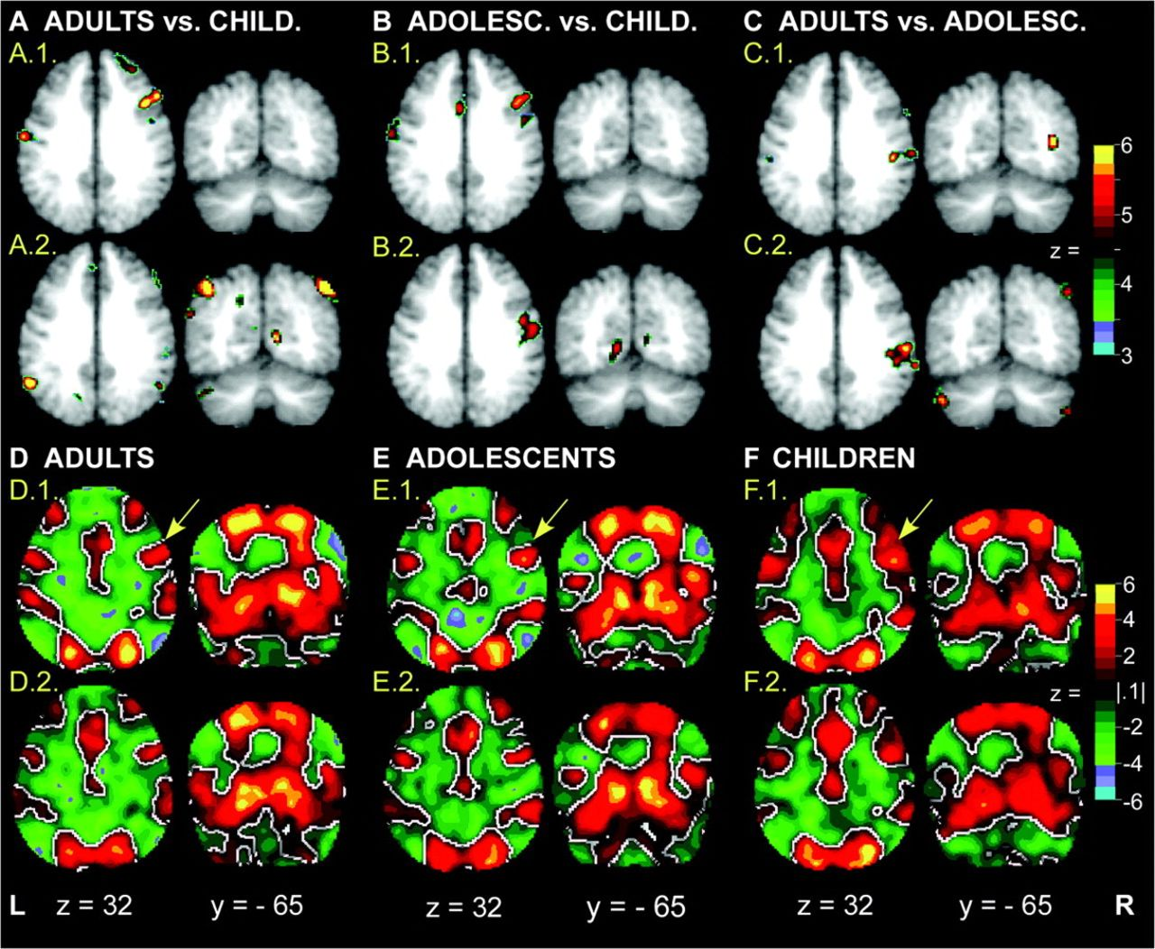
Figure 7. Exploratory statistical images showing voxels that were differentially activated across age groups. (A1, B1, ...
Notes:
Figure 7. Exploratory statistical images showing voxels that were differentially activated across age groups. (A1, B1, and C1) Voxels where time courses of activity for correctly performed AS trials differed for adults versus children, adolescents versus children, and adults versus adolescents, respectively. (A2, B2, and C2) Voxels where, across paired age groups, time courses differed for AS errors. Because these maps are based on ANOVA (i.e., are (F)z-statistical images), the direction of effects is not indicated. (D–F) (t)z-statistical images assessing the extent to which the estimated level of activity at time point 6 (at 7.5 s following trial onset) for correct and error trials, for each age group, differed from the baseline constant term. Time point 6 was selected as the most representative point of peak activity across the whole brain. No corrections were applied. The minimal threshold was arbitrarily set to z = ±0.1 to allow visualization of a relatively “complete” data set showing the direction of effects. (D1, E1, and F1) Effects for correct AS trials for adults, adolescents and children, respectively. (D2, E2, and F2) Effects for AS error trials. Arrows highlight activity in dlPFC.
Unless provided in the caption above, the following copyright applies to the content of this slide: © The Author 2008. Published by Oxford University Press. All rights reserved. For permissions, please e-mail: journals.permissions@oxfordjournals.org

