Slide 1
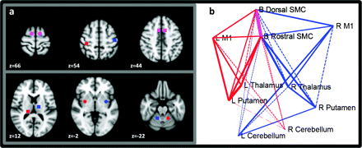
Figure 1. Motor circuit seed regions. (a) LH seed regions in red and RH seed regions in blue, bilateral SMC seeds are ...
Notes:
Figure 1. Motor circuit seed regions. (a) LH seed regions in red and RH seed regions in blue, bilateral SMC seeds are shown in pink. (b) Graph theoretic depiction of the motor circuit. LH connections are displayed in red and RH connections are displayed in blue. The pink edge between dorsal and rostral SMC is common to both hemispheres. Line widths correspond to connection strength. Solid lines represent significant connections after multiple comparisons corrections (for 29 connection pairs). Dashed lines represent subthreshold connections.
Unless provided in the caption above, the following copyright applies to the content of this slide: © The Author 2011. Published by Oxford University Press. All rights reserved. For permissions, please e-mail: journals.permissions@oup.com

Slide 2
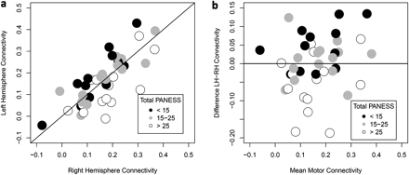
Figure 2. Relationship between total PANESS and mean hemispheric connectivity. (a) LH and RH connectivity. (b) ...
Notes:
Figure 2. Relationship between total PANESS and mean hemispheric connectivity. (a) LH and RH connectivity. (b) Difference LH–RH connectivity and mean connectivity.
Unless provided in the caption above, the following copyright applies to the content of this slide: © The Author 2011. Published by Oxford University Press. All rights reserved. For permissions, please e-mail: journals.permissions@oup.com

Slide 3
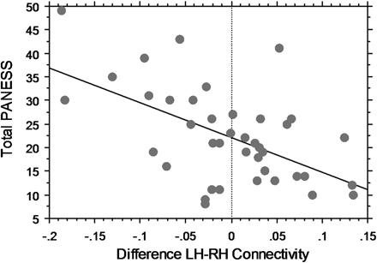
Figure 3. Relationship between lateralized (LH–RH) motor connectivity and Total PANESS scores.
Notes:
Figure 3. Relationship between lateralized (LH–RH) motor connectivity and Total PANESS scores.
Unless provided in the caption above, the following copyright applies to the content of this slide: © The Author 2011. Published by Oxford University Press. All rights reserved. For permissions, please e-mail: journals.permissions@oup.com

Slide 4
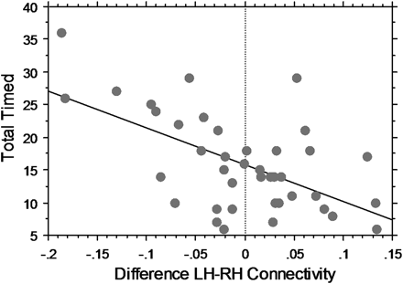
Figure 4. Relationship between lateralized (LH–RH) motor connectivity and Total Timed scores.
Notes:
Figure 4. Relationship between lateralized (LH–RH) motor connectivity and Total Timed scores.
Unless provided in the caption above, the following copyright applies to the content of this slide: © The Author 2011. Published by Oxford University Press. All rights reserved. For permissions, please e-mail: journals.permissions@oup.com

Slide 5
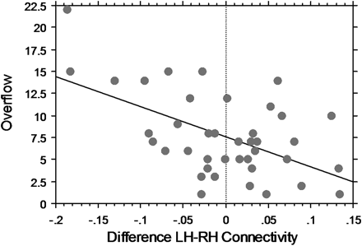
Figure 5. Relationship between lateralized (LH–RH) motor connectivity and Overflow scores.
Notes:
Figure 5. Relationship between lateralized (LH–RH) motor connectivity and Overflow scores.
Unless provided in the caption above, the following copyright applies to the content of this slide: © The Author 2011. Published by Oxford University Press. All rights reserved. For permissions, please e-mail: journals.permissions@oup.com

Slide 6
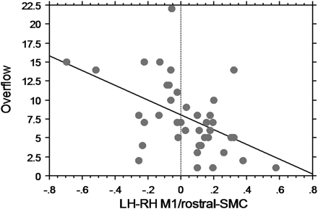
Figure 6. Relationship between lateralized (LH–RH) connectivity in the M1/rostral-SMC region pair and Overflow scores.
Notes:
Figure 6. Relationship between lateralized (LH–RH) connectivity in the M1/rostral-SMC region pair and Overflow scores.
Unless provided in the caption above, the following copyright applies to the content of this slide: © The Author 2011. Published by Oxford University Press. All rights reserved. For permissions, please e-mail: journals.permissions@oup.com

