Slide 1
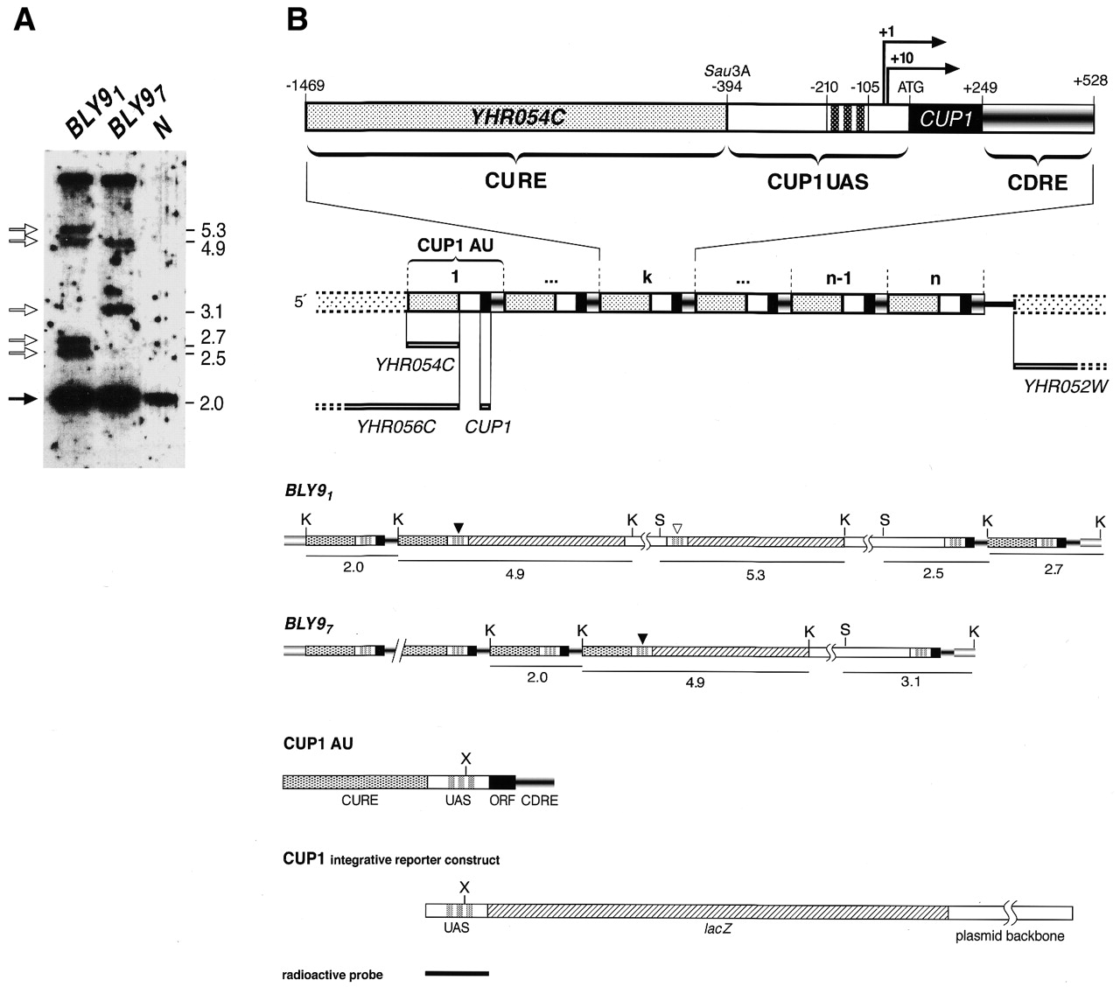
Figure 3. Organization of the CUP1 locus in the reporter strains BLY9₁ and BLY9₇. (A) ...
Notes:
Figure 3. Organization of the CUP1 locus in the reporter strains BLY91 and BLY97. (A) Southern blot analysis; empty arrows indicate the bands originating from KpnI/ScaI double digested CUP1 repeat units which contain the CUP1 UAS::lacZ reporter in strains BLY91 and BLY97. The radiolabeled probe used for detection of the digestion products corresponds to the CUP1 UAS region [see (B)]. The filled arrow marks the 2.0 kb KpnI–KpnI band, which roughly corresponds to the CUP1 amplification unit, as shown by the digestion of genomic DNA from the JPY8 strain prior to integration of the CUP1 UAS::lacZ reporter (lane N). The size of the fragments is in kb. (B) Schematic representation of the multimerized CUP1 genomic locus and of the integrated CUP1 UAS::lacZ reporter constructs in BLY91 and BLY97. n represents the number of tandemly repeated units per haploid genome, with an extimated value of 15 for most laboratory strains (12). In the detailed structure of the generic (k) CUP1amplification unit (CUP1 AU), dashed lines between positions –210 and –105 mark the positions of the binding sites for Ace1 within the CUP1 UAS. Positions between –1469 and –394 delimit the CURE, while the CUP1downstream repeated element (CDRE) lies between positions +249 and +528. Numbers in bold indicate the two start sites. K, KpnI; S, ScaI; X, XbaI. Fragments which were detected in the Southern analysis in (A) are underlined and their length (in kb) is indicated below. In both BLY91 and BLY97 black arrowheads indicate the copies of the CUP1 UAS which are flanked by their natural CURE. In BLY91 an empty arrowhead marks the CUP1 UAS that is not linked to a CURE.
Unless provided in the caption above, the following copyright applies to the content of this slide:

Slide 2
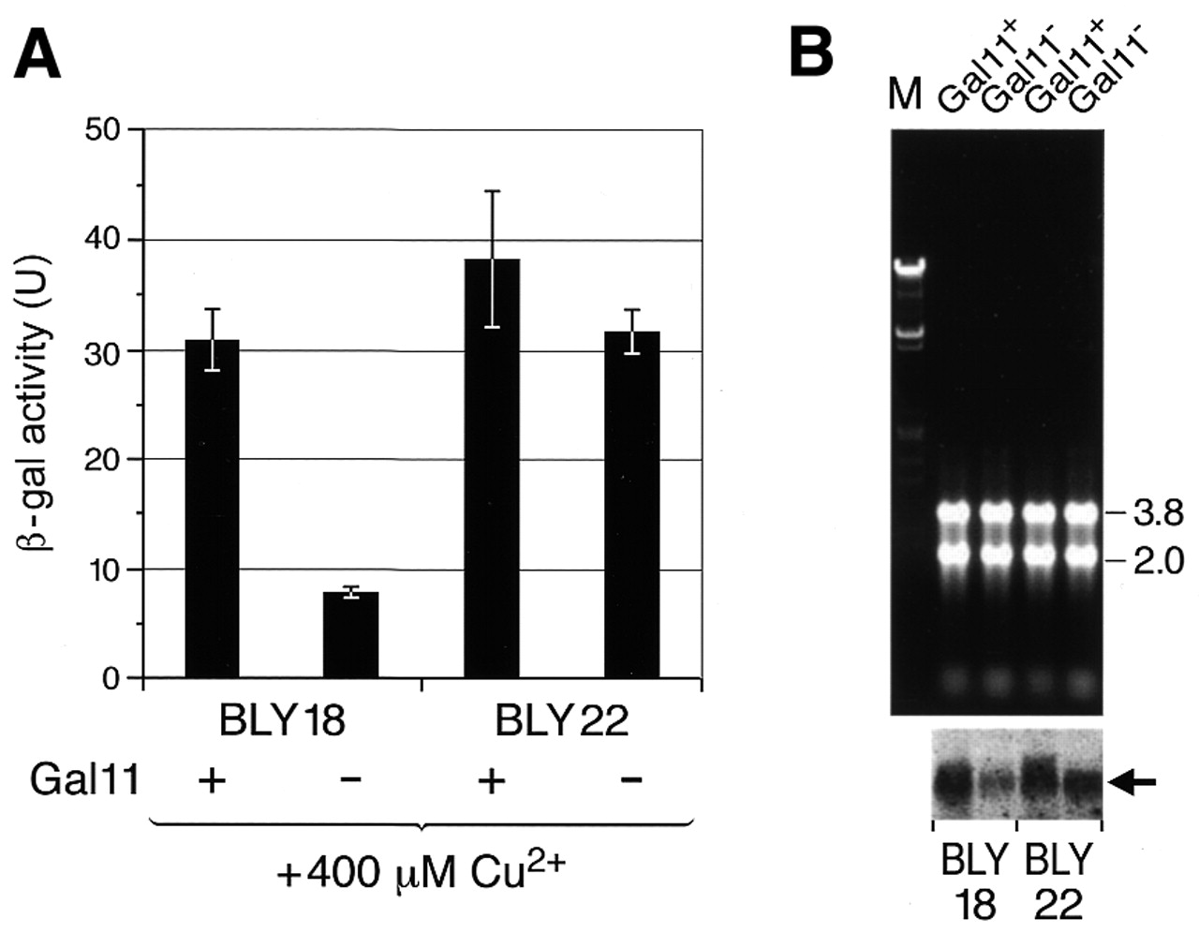
Figure 4. Insertion of the CURE 5′ of the CUP1 UAS::lacZ reporter confers insensitivity to gal11Δ. (A) ...
Notes:
Figure 4. Insertion of the CURE 5′ of the CUP1 UAS::lacZ reporter confers insensitivity to gal11Δ. (A) β-Galactosidase assay to assess the level of Cu2+-induced lacZ expression in BLY18 and BLY22 either containing Gal11 (Gal11+) or not (Gal11–). The experiment was performed in triplicate and error bars indicate the standard deviation obtained for each set of samples. (B) Northern blot analysis; the arrow indicates the radioactive signal corresponding to the lacZ transcripts. The intensities of the 3.8 and 2.0 kb rRNAs are shown as a measure of the amount of total RNA considered in the northern blot analysis.
Unless provided in the caption above, the following copyright applies to the content of this slide:

Slide 3
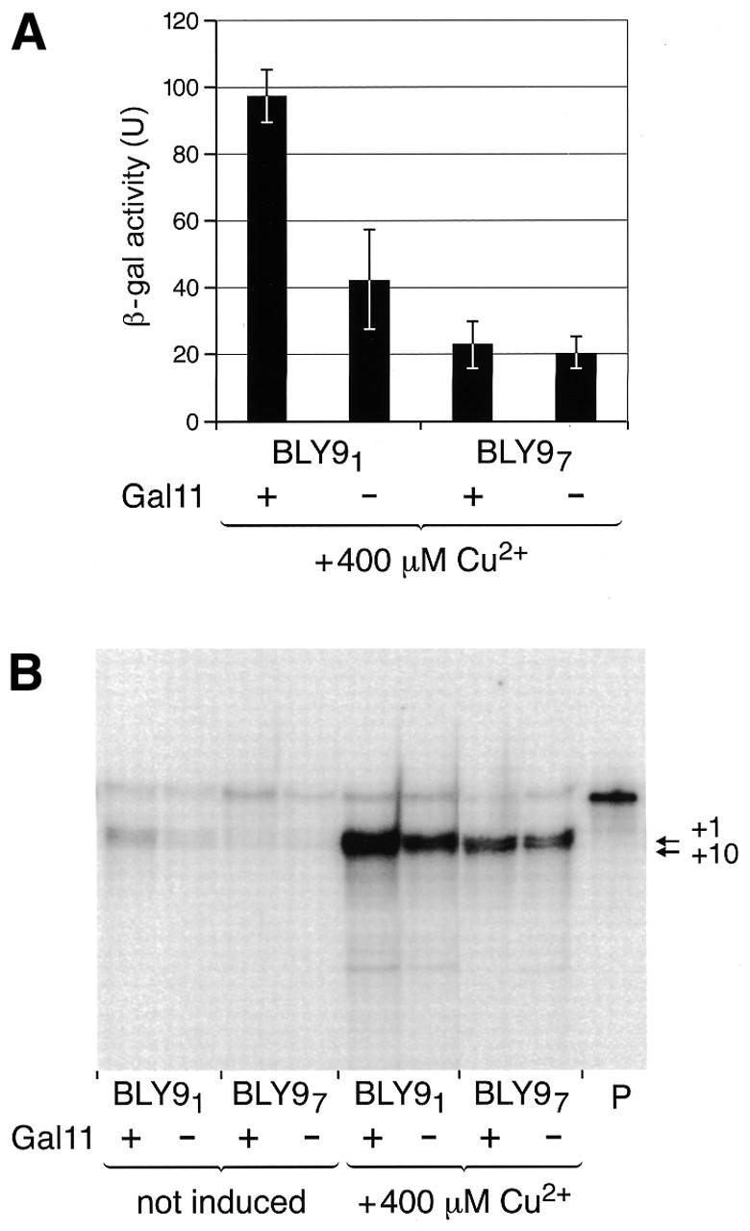
Figure 2. The effect of gal11Δ on activation of the CUP1 promoter is dependent on the chromosomal context of ...
Notes:
Figure 2. The effect of gal11Δ on activation of the CUP1 promoter is dependent on the chromosomal context of the integrated CUP1 UAS::lacZ reporter. (A) β-Galactosidase assay to measure lacZ expression in strains BLY91 and BLY97, either containing Gal11 (Gal11+) or not (Gal11–). The experiment was performed in triplicate and error bars indicate the standard deviation obtained for each set of samples. (B) S1 mapping of the lacZ transcripts under both non-inducing and inducing conditions (400 µM Cu2+). The free probe used in the protection assay is indicated by the letter P. Arrows indicate the position of the protected lacZ mRNA initiated at the two CUP1 start sites (+1 and +10). Note that the absolute levels of lacZ transcript are higher in BLY91 than in BLY97, reflecting the higher number of copies of the reporter gene integrated at the CUP1 locus, as shown in Figure 3.
Unless provided in the caption above, the following copyright applies to the content of this slide:

Slide 4
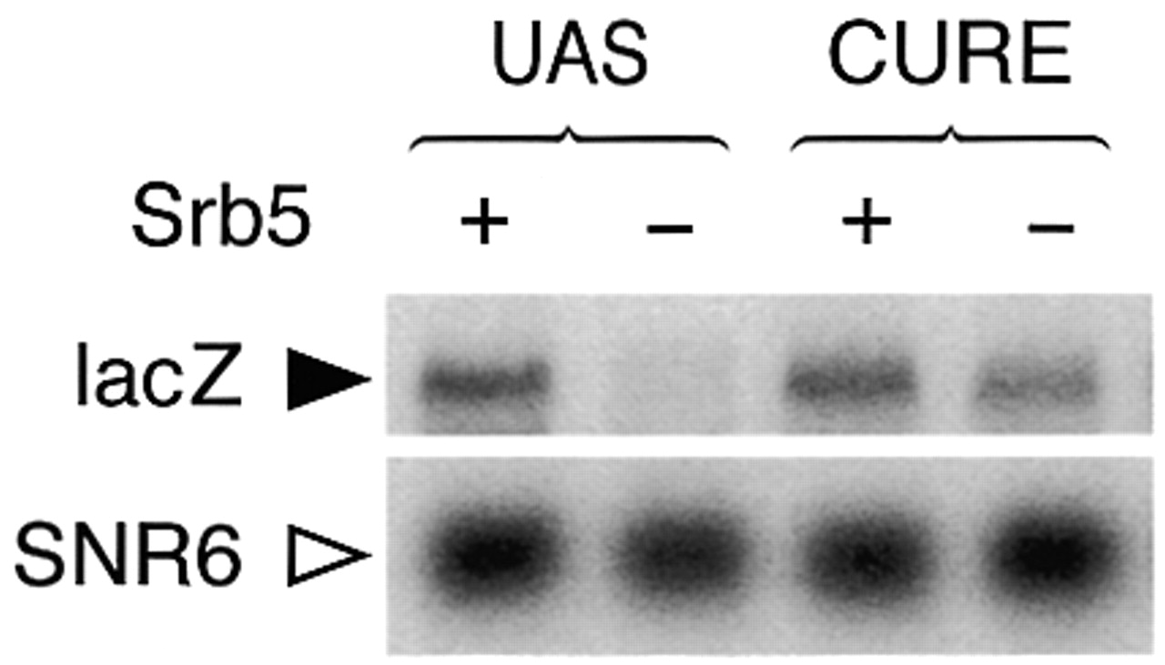
Figure 5. Low levels of CUP1 UAS activation in srb5Δ are rescued by addition of the CURE 5′ of the CUP1 ...
Notes:
Figure 5. Low levels of CUP1 UAS activation in srb5Δ are rescued by addition of the CURE 5′ of the CUP1 UAS::lacZ reporter. Northern blot analysis showing the radioactive signals corresponding to lacZ and SNR6 transcripts detected for the reporter strains BLY30 (CUP1 UAS::lacZ) and BLY32 (CURE::lacZ), either expressing Srb5 (+) on not (–).
Unless provided in the caption above, the following copyright applies to the content of this slide:

Slide 5
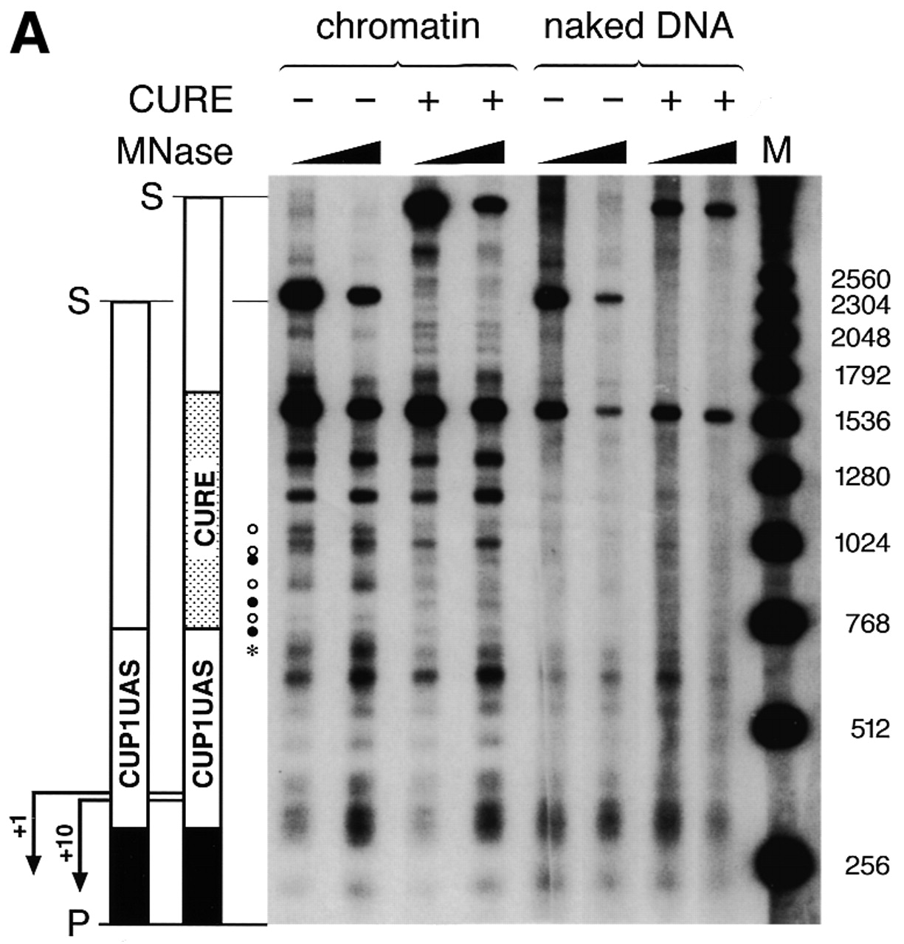
Figure 6. Alterations in local DNA accessibility within the CUP1 regulatory regions. (A) MNase analysis. A ...
Notes:
Figure 6. Alterations in local DNA accessibility within the CUP1 regulatory regions. (A) MNase analysis. A schematic representation of the ScaI (S)–PvuII (P) genomic regions considered for analysis is shown beside the autoradiogram. Lanes in which the ScaI–PvuII fragments contain or not the complete CURE sequence upstream of the CUP1 UAS are indicated by + and –, respectively. Open circle, bands detected primarily in the absence of CURE; closed circle, bands detected primarily in the presence of CURE; asterisk, band which is weaker relative to the lower band in the presence of CURE. The region in black corresponds to the lacZ reporter gene. The bent arrows mark the two transcription start sites. (B) Restriction endonuclease analysis before Cu2+ induction. The tested restriction enzymes that cut within the CUP1 UAS are indicated in the scheme at the top. The thick black line below this scheme indicates the probe used for Southern blotting. (C) Restriction endonuclease analysis after Cu2+ induction. In the graph below the autoradiograms, bars indicate accessibility of the CUP1 UAS in the absence (white bars) and presence (black bars) of the CURE upstream of the CUP1 UAS. Accessibility is expressed as a percentage of the signal from the band derived from digestion inside the CUP1 UAS (region indicated by the thick black arrow), relative to the total amount of ScaI–PvuII fragment considered for the analysis (R+) and (R).
Unless provided in the caption above, the following copyright applies to the content of this slide:

Slide 6
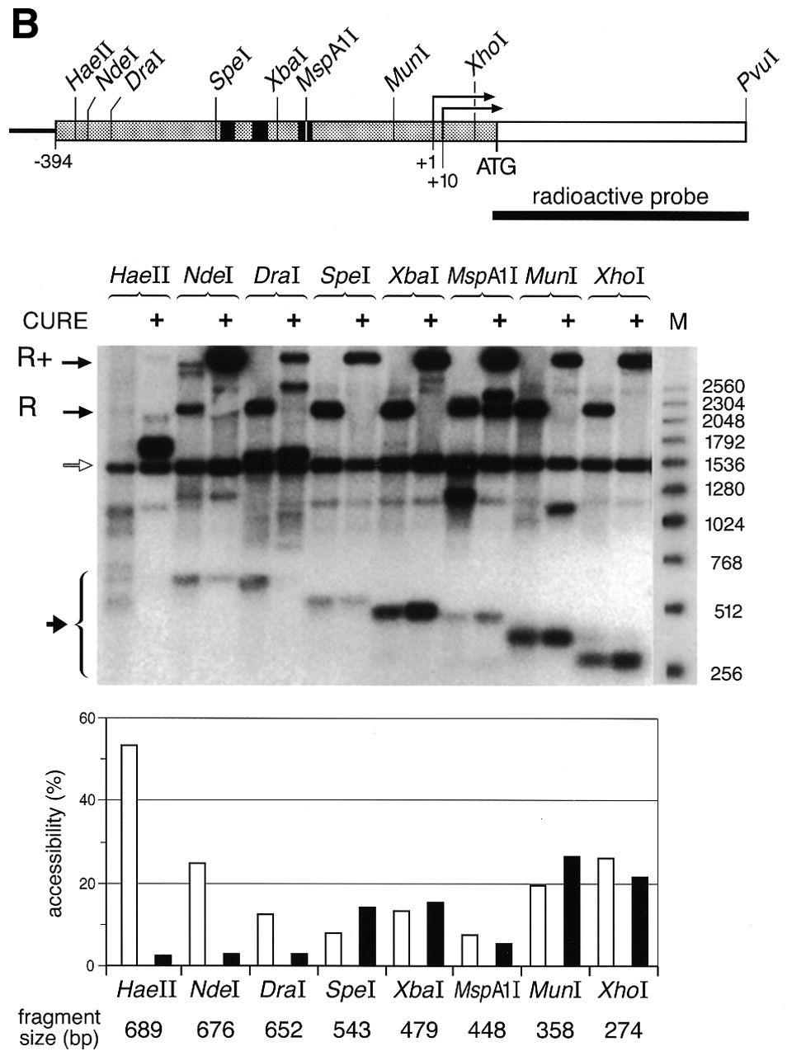
Figure 6. Alterations in local DNA accessibility within the CUP1 regulatory regions. (A) MNase analysis. A ...
Notes:
Figure 6. Alterations in local DNA accessibility within the CUP1 regulatory regions. (A) MNase analysis. A schematic representation of the ScaI (S)–PvuII (P) genomic regions considered for analysis is shown beside the autoradiogram. Lanes in which the ScaI–PvuII fragments contain or not the complete CURE sequence upstream of the CUP1 UAS are indicated by + and –, respectively. Open circle, bands detected primarily in the absence of CURE; closed circle, bands detected primarily in the presence of CURE; asterisk, band which is weaker relative to the lower band in the presence of CURE. The region in black corresponds to the lacZ reporter gene. The bent arrows mark the two transcription start sites. (B) Restriction endonuclease analysis before Cu2+ induction. The tested restriction enzymes that cut within the CUP1 UAS are indicated in the scheme at the top. The thick black line below this scheme indicates the probe used for Southern blotting. (C) Restriction endonuclease analysis after Cu2+ induction. In the graph below the autoradiograms, bars indicate accessibility of the CUP1 UAS in the absence (white bars) and presence (black bars) of the CURE upstream of the CUP1 UAS. Accessibility is expressed as a percentage of the signal from the band derived from digestion inside the CUP1 UAS (region indicated by the thick black arrow), relative to the total amount of ScaI–PvuII fragment considered for the analysis (R+) and (R).
Unless provided in the caption above, the following copyright applies to the content of this slide:

Slide 7
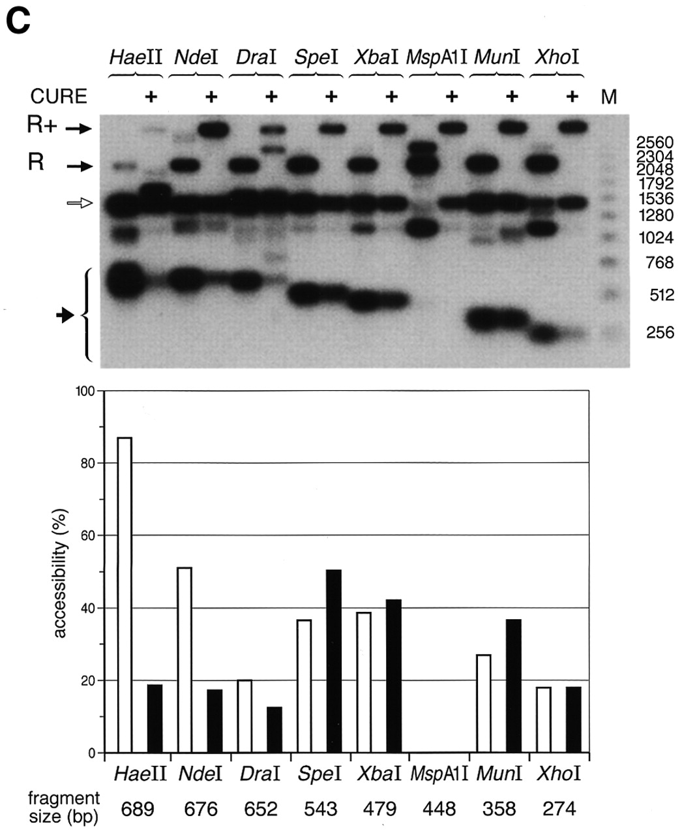
Figure 6. Alterations in local DNA accessibility within the CUP1 regulatory regions. (A) MNase analysis. A ...
Notes:
Figure 6. Alterations in local DNA accessibility within the CUP1 regulatory regions. (A) MNase analysis. A schematic representation of the ScaI (S)–PvuII (P) genomic regions considered for analysis is shown beside the autoradiogram. Lanes in which the ScaI–PvuII fragments contain or not the complete CURE sequence upstream of the CUP1 UAS are indicated by + and –, respectively. Open circle, bands detected primarily in the absence of CURE; closed circle, bands detected primarily in the presence of CURE; asterisk, band which is weaker relative to the lower band in the presence of CURE. The region in black corresponds to the lacZ reporter gene. The bent arrows mark the two transcription start sites. (B) Restriction endonuclease analysis before Cu2+ induction. The tested restriction enzymes that cut within the CUP1 UAS are indicated in the scheme at the top. The thick black line below this scheme indicates the probe used for Southern blotting. (C) Restriction endonuclease analysis after Cu2+ induction. In the graph below the autoradiograms, bars indicate accessibility of the CUP1 UAS in the absence (white bars) and presence (black bars) of the CURE upstream of the CUP1 UAS. Accessibility is expressed as a percentage of the signal from the band derived from digestion inside the CUP1 UAS (region indicated by the thick black arrow), relative to the total amount of ScaI–PvuII fragment considered for the analysis (R+) and (R).
Unless provided in the caption above, the following copyright applies to the content of this slide:

Slide 8
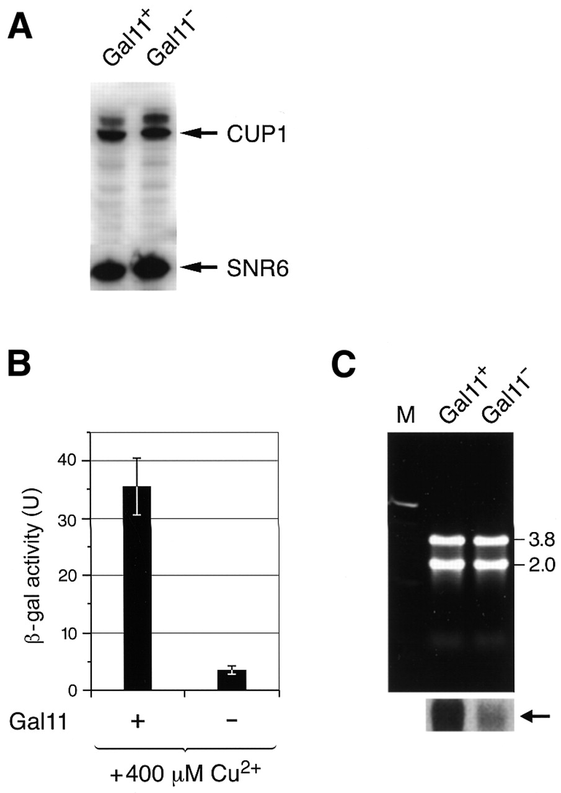
Figure 1. Lack of Gal11 significantly affects Cu²⁺-induced expression of an episomal CUP1 ...
Notes:
Figure 1. Lack of Gal11 significantly affects Cu2+-induced expression of an episomal CUP1 UAS::lacZ reporter gene but not that of the endogenous CUP1 genes. (A) Northern blot analysis of the relative levels of CUP1 and SNR6 transcripts isolated from JPY8 (gal11Δ) cells either expressing (Gal11+) or not (Gal11–) gal11 protein. SNR6 is transcribed by RNA pol III and is not affected by the lack of Gal11. (B) β-Galactosidase assay to measure the Cu2+-induced lacZ expression in JPY8 (gal11Δ) either containing Gal11 (+) or not (–). The experiment was performed in triplicate and the error bars indicate the standard deviation obtained for each set of samples. (C) Northern blot analysis of the same transformants; the arrow indicates the radioactive signal corresponding to the lacZ transcripts. The intensities of the 3.8 and 2.0 kb rRNA are shown as a measure of the constant amount of total RNA used in the northern blot assay.
Unless provided in the caption above, the following copyright applies to the content of this slide:

