Slide 1
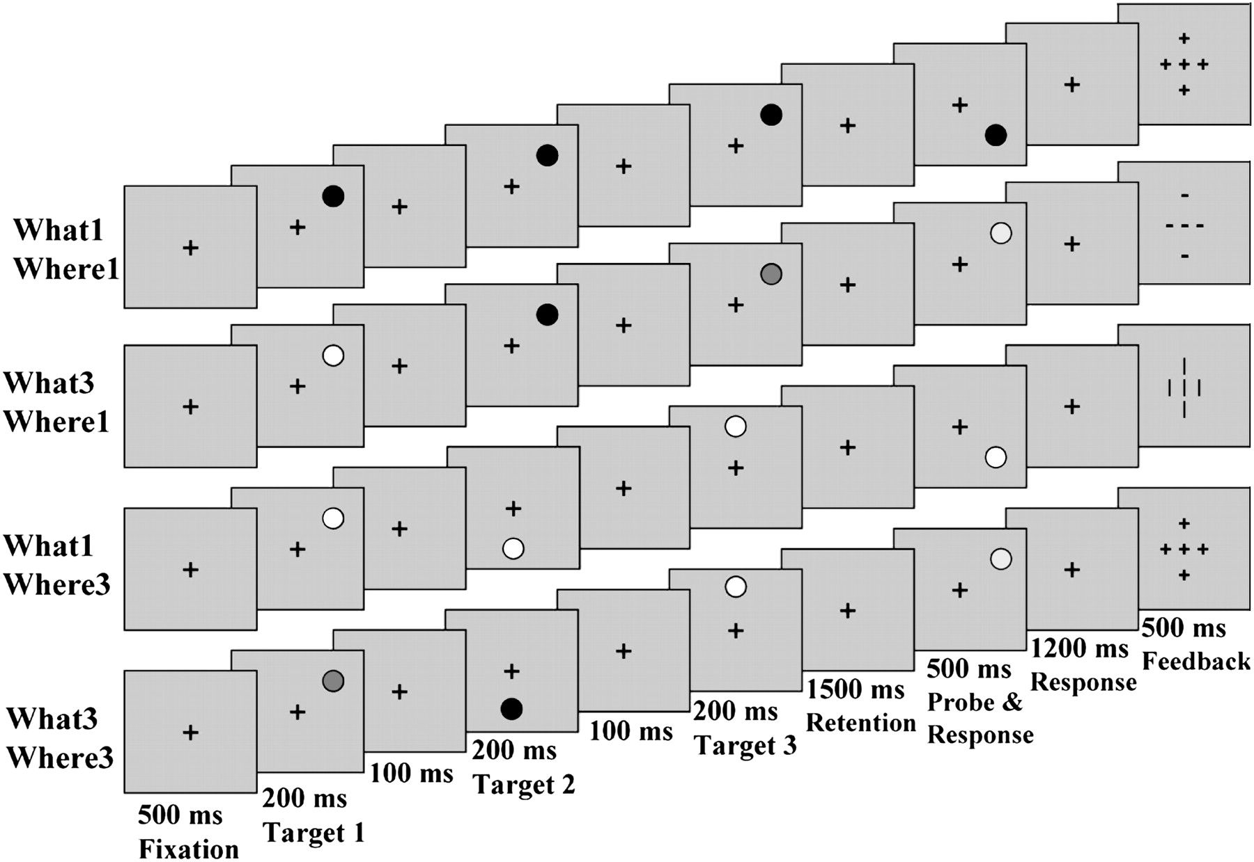
Figure 1. Task 2—What–Where conditions and trial structure. Different shades of grayscale represent different colors, ...
Notes:
Figure 1. Task 2—What–Where conditions and trial structure. Different shades of grayscale represent different colors, with the exception of the background.
Unless provided in the caption above, the following copyright applies to the content of this slide: © The Author 2010. Published by Oxford University Press. All rights reserved. For permissions, please e-mail: journals.permissions@oxfordjournals.org

Slide 2
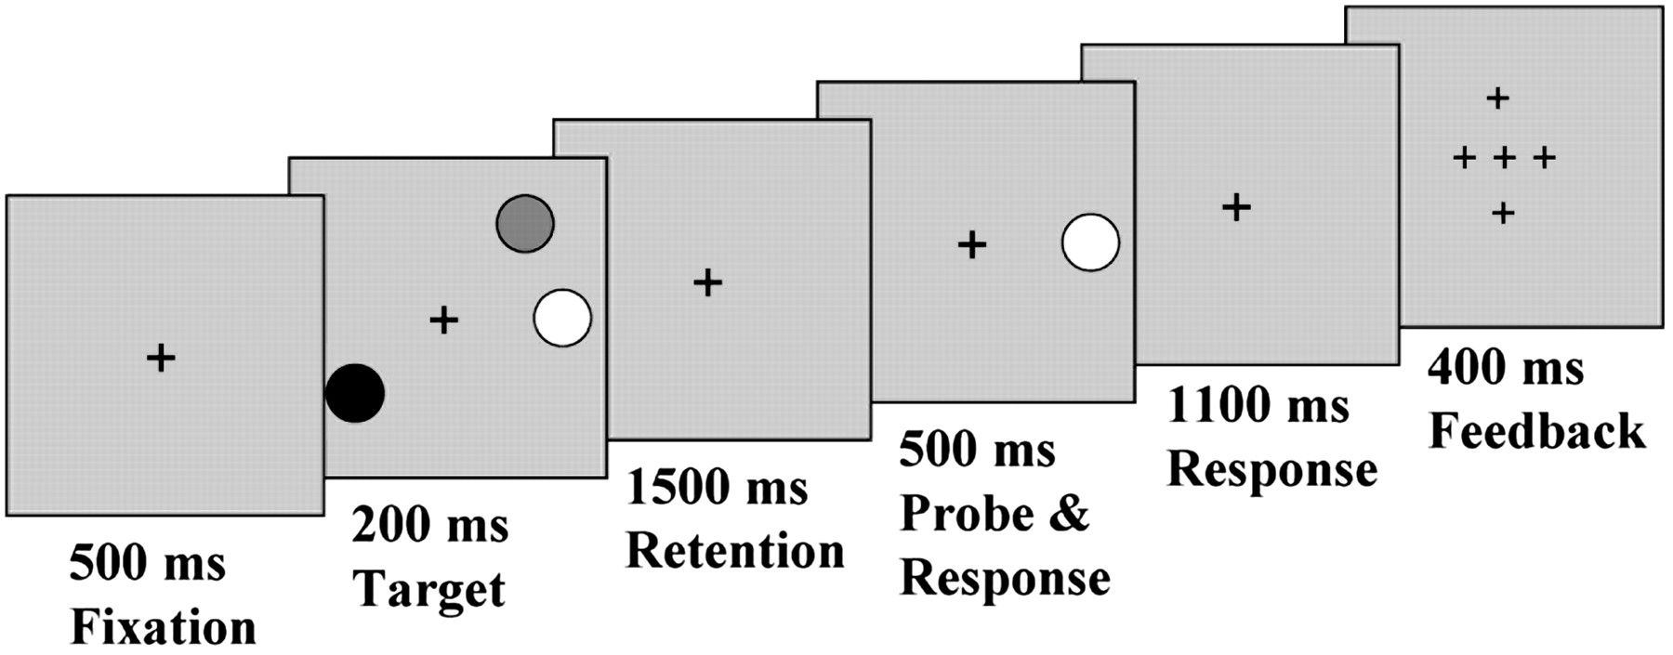
Figure 2. Task 1—localizer task structure. Target display contained 1, 2, 3, or 5 colored disks.
Notes:
Figure 2. Task 1—localizer task structure. Target display contained 1, 2, 3, or 5 colored disks.
Unless provided in the caption above, the following copyright applies to the content of this slide: © The Author 2010. Published by Oxford University Press. All rights reserved. For permissions, please e-mail: journals.permissions@oxfordjournals.org

Slide 3
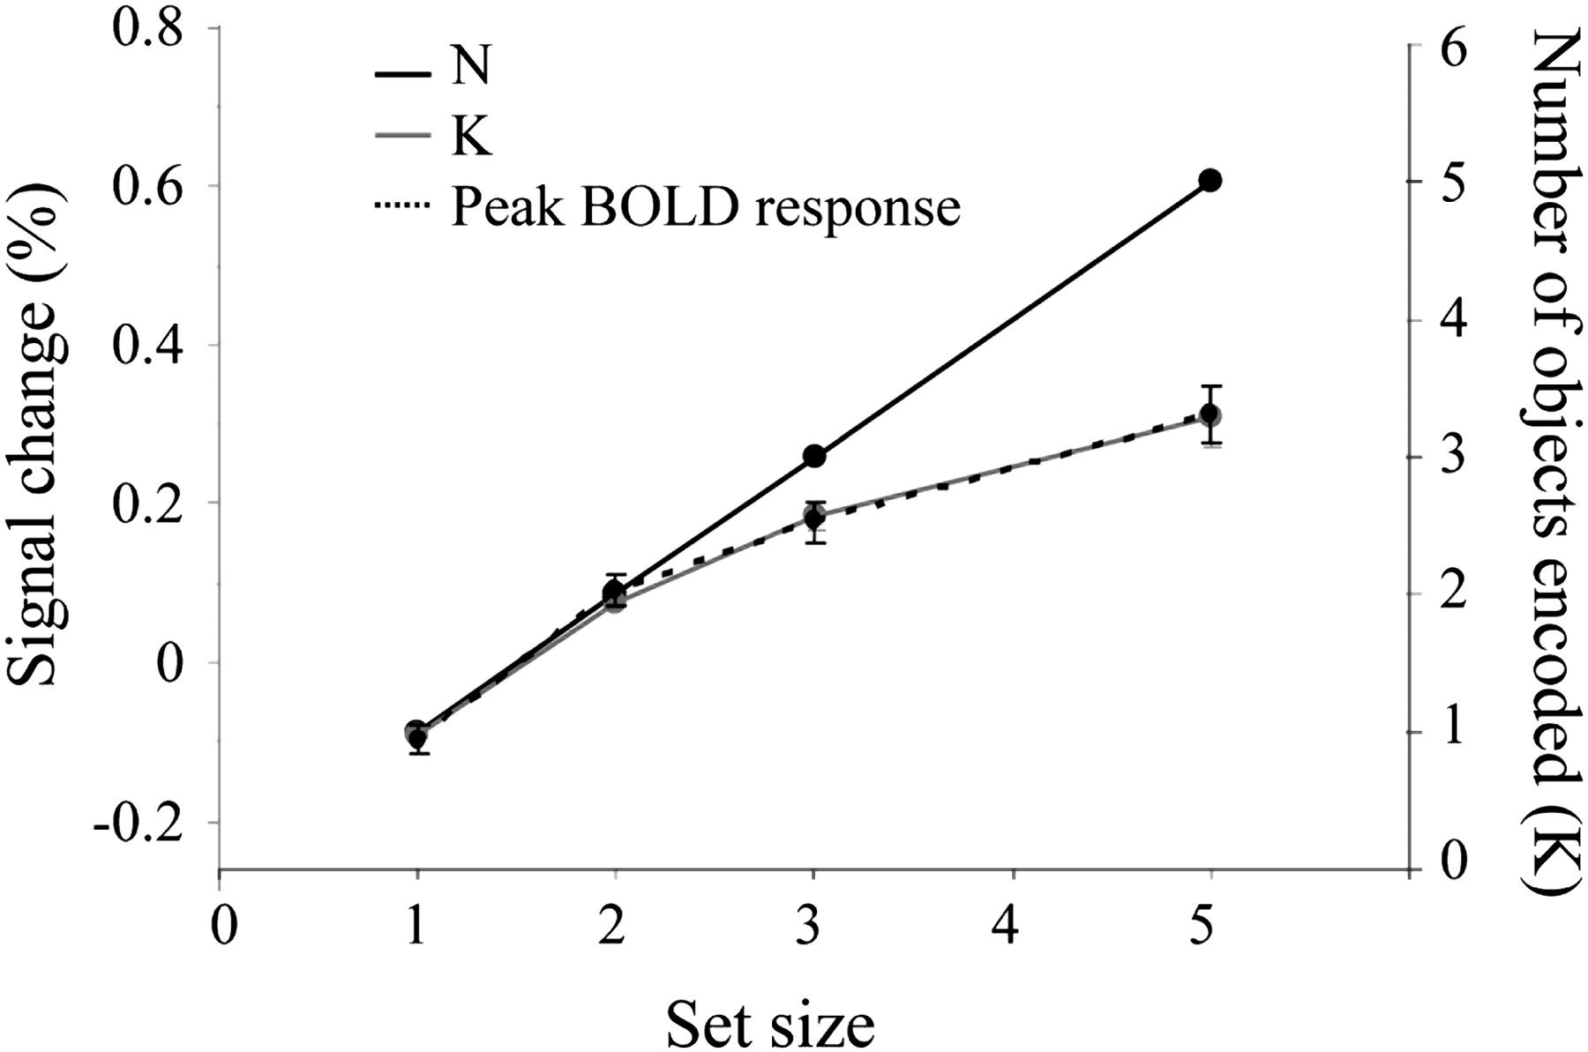
Figure 3. Average K function and peak BOLD response averaged across individual IPS/IOS VOIs plotted against 1-to-1 ...
Notes:
Figure 3. Average K function and peak BOLD response averaged across individual IPS/IOS VOIs plotted against 1-to-1 stimulus encoding function (N). Percent signal change is computed relative to the 2 volumes preceding the onset of each trial. Error bars represent standard error of the mean.
Unless provided in the caption above, the following copyright applies to the content of this slide: © The Author 2010. Published by Oxford University Press. All rights reserved. For permissions, please e-mail: journals.permissions@oxfordjournals.org

Slide 4
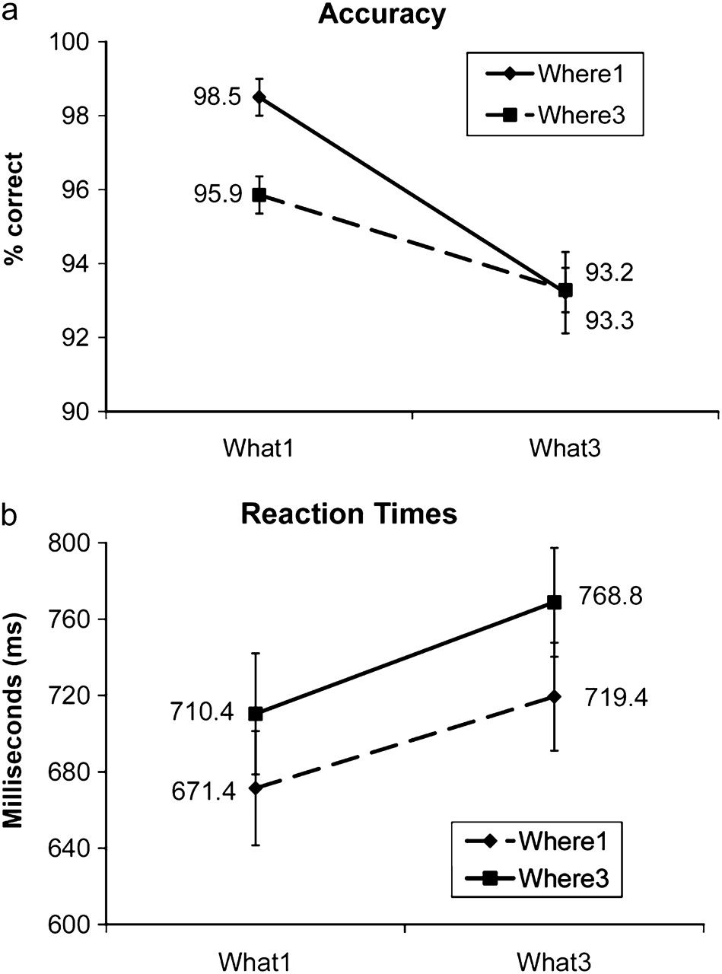
Figure 4. a) Accuracy in the What–Where task. Accuracy scores show significant main effects of What and Where and a ...
Notes:
Figure 4. a) Accuracy in the What–Where task. Accuracy scores show significant main effects of What and Where and a significant interaction. (b) Reaction times in the What–Where task. Reaction times show both main effects but no interaction.
Unless provided in the caption above, the following copyright applies to the content of this slide: © The Author 2010. Published by Oxford University Press. All rights reserved. For permissions, please e-mail: journals.permissions@oxfordjournals.org

Slide 5
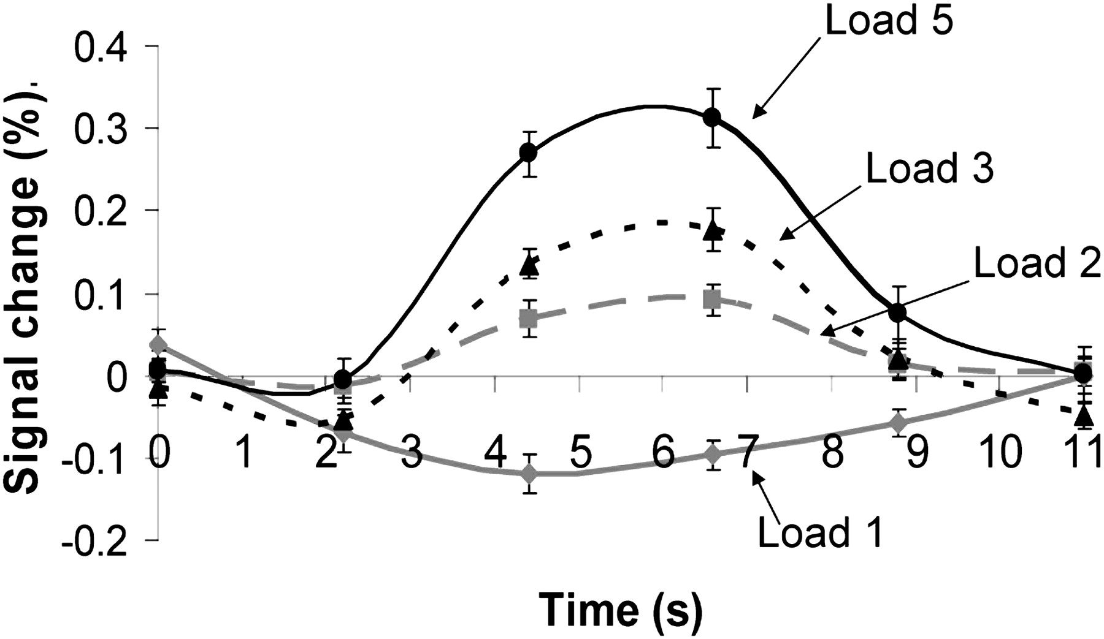
Figure 5. Average time course for the localizer task, computed across individually localized IPS/IOS VOIs.
Notes:
Figure 5. Average time course for the localizer task, computed across individually localized IPS/IOS VOIs.
Unless provided in the caption above, the following copyright applies to the content of this slide: © The Author 2010. Published by Oxford University Press. All rights reserved. For permissions, please e-mail: journals.permissions@oxfordjournals.org

Slide 6
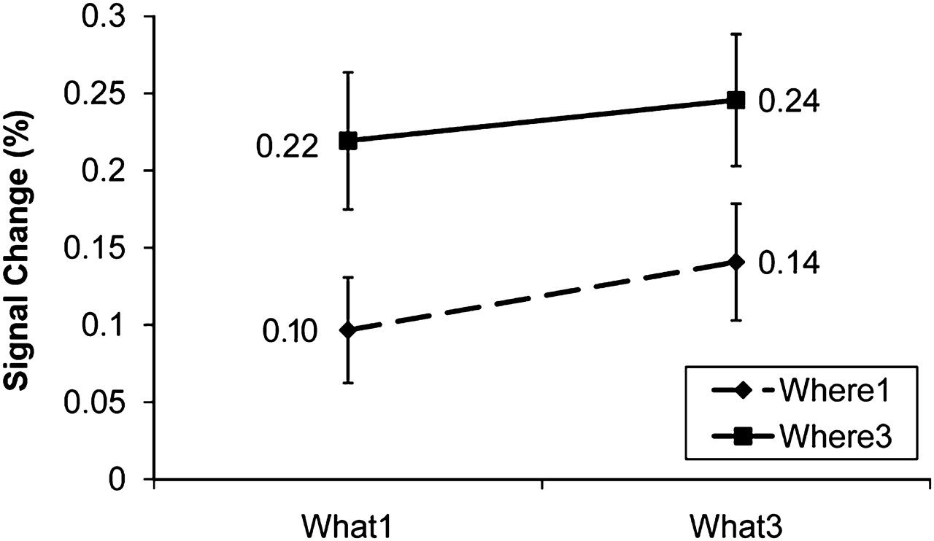
Figure 6. Average activation levels in the What–Where task. Error bars represent standard error of the mean.
Notes:
Figure 6. Average activation levels in the What–Where task. Error bars represent standard error of the mean.
Unless provided in the caption above, the following copyright applies to the content of this slide: © The Author 2010. Published by Oxford University Press. All rights reserved. For permissions, please e-mail: journals.permissions@oxfordjournals.org

Slide 7
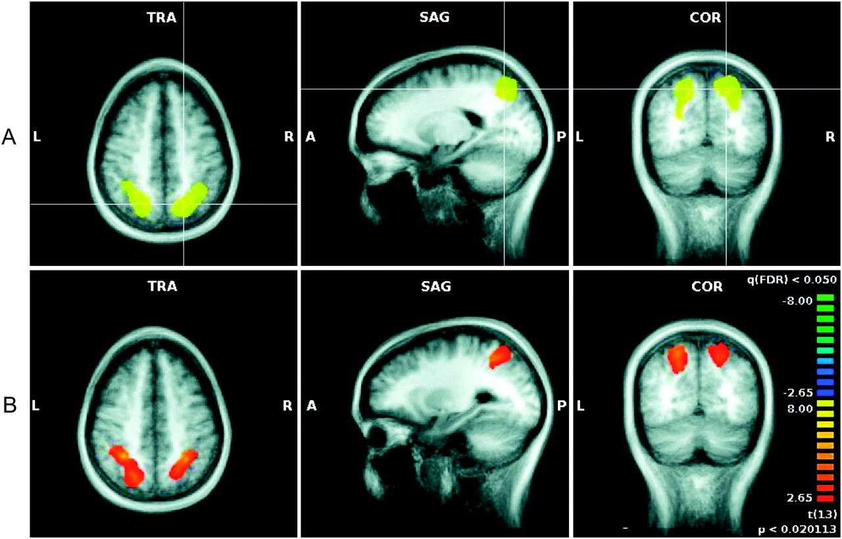
Figure 7. A) Group average IPS/IOS VOI, overlaid on an average of the 14 subjects’ anatomical scans. (B) Voxels showing ...
Notes:
Figure 7. A) Group average IPS/IOS VOI, overlaid on an average of the 14 subjects’ anatomical scans. (B) Voxels showing a main effect of Where within the masked group average IPS/IOS region.
Unless provided in the caption above, the following copyright applies to the content of this slide: © The Author 2010. Published by Oxford University Press. All rights reserved. For permissions, please e-mail: journals.permissions@oxfordjournals.org

