Slide 1
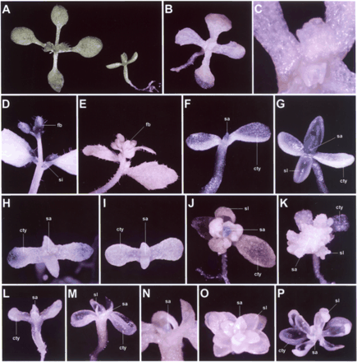
Fig. 1 GUS activity in emf1-1AP1::GUS and various emf late-flowering AP1::GUS double mutant plants. (A) ...
Notes:
Fig. 1 GUS activity in emf1-1AP1::GUS and various emf late-flowering AP1::GUS double mutant plants. (A) 10-day-old AP1::GUS transgenic wild type plant (left) and emf1-1AP1::GUS single mutant plants (right). During this stage, only rosette leaves were produced in wild-type plant and sessile leaves were produced in emf1-1 single mutant plants. (B) A 10-day-old AP1::GUS transgenic wild-type plant without detectable GUS activity. Only vegetative leaves were produced in this stage. (C) Close up of the shoot apical meristem region from (B). (D) Strong GUS activity was detected in the young floral buds (fb) in main inflorescence as well as in the shoot apical meristem (contained the floral buds in very early stage of flower development) of a secondary inflorescence (si) from an AP1::GUS transgenic wild-type plant. (E) No GUS activity can be detected in the young floral buds (fb) in either main or secondary inflorescence of a non-transgenic control plant. (F) A 5-day-old emf1-1AP1::GUS seedling showing GUS activity in shoot apex (sa). No GUS activity was detected in cotyledons (cty). (G) Strong GUS activity was specifically detected in the shoot apex (sa) of a 10-day-old emf1-1AP1::GUS seedling. GUS was not detected in cotyledons (cty) and expanded sessile leaves (sl). (H) GUS was not detected in shoot apex (sa) of a 10-day-old emf1-1 fwa-1AP1::GUS seedling. The tips of the cotyledons (cty) were, however, stained GUS positive. (I) GUS was stained negatively in either shoot apex (sa) or cotyledons (cty) of a 10-day-old emf1-1 ft-1AP1::GUS seedling. (J) GUS was weakly stained in shoot apex (sa) of a 20-day-old emf1-1 fwa-1AP1::GUS seedling. GUS was stained negatively in cotyledons (cty) and expanded sessile leaves (sl). (K) GUS was stained negatively in either shoot apex (sa), sessile leaves (sl), or cotyledons (cty) of a 20-day-old emf1-1 ft-1AP1::GUS seedling. (L) GUS was stained negatively in shoot apex (sa) and cotyledons (cty) of a 10-day-old emf2-1 fwa-1AP1::GUS seedling. (M) GUS was weakly stained in shoot apex (sa) of a 20-day-old emf2-1 fwa-1AP1::GUS seedling. GUS was stained negatively in cotyledons (cty) and expanded sessile leaves (sl). (N) Close up of the shoot apical meristem region (sa) from (M). (O) GUS was stained negatively in whole seedling of a 20-day-old emf2-3 fwa-1AP1::GUS plant. sa, shoot apex; sl, sessile leaves. (P) GUS was stained negatively in whole seedling of a 20-day-old emf2-3 ft-1AP1::GUS plant. cty, cotyledons; sa, shoot apex; sl, sessile leaves.
Unless provided in the caption above, the following copyright applies to the content of this slide:

Slide 2
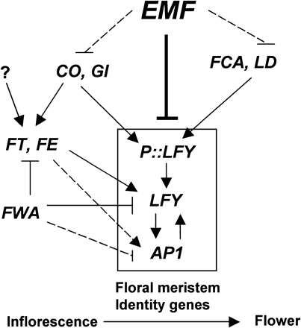
Fig. 4 Possible interactions between EMF and different late-flowering genes in regulating floral initiation ...
Notes:
Fig. 4 Possible interactions between EMF and different late-flowering genes in regulating floral initiation in wild-type Arabidopsis. EMF genes function to prohibit (—│) the expression of floral meristem identity genes such as LFY and AP1 through distinct pathway from most late-flowering genes. EMF also possibly act as upstream genes to negatively (- -│) regulate late-flowering genes in controlling LFY and AP1 activity. Although mutation in any one of the late-flowering genes caused the similar reduction of LFY activity, they may regulate LFY differently. Based on ours and other reports (Simon et al. 1996, Nilsson et al. 1998, Page et al. 1999, Aukerman et al. 1999, Blázquez 2000, Reeves and Coupland 2000), genes such as FCA, LD, CO and GI activated (→) LFY mainly by transcriptional regulation whereas FT and FE are involved in regulation of LFY through positive (→) response to LFY activity. Mutation in fwa caused the expression of wild-type FWA gene (Soppe et al. 2000) which acts as a repressor (—│) for LFY transcripts. FT, FE and FWA are also possible regulating LFY through activation (- ->) or suppression (- -│) of AP1 (Blázquez 2000). CO and GI have been thought to work in the same pathway (Fowler et al. 1999) and possible interacted with an unidentified pathway (?) to activate (→) FT in regulating AP1 and LFY activity (Kardailsky et al. 1999, Kobayashi et al. 1999, Onouchi et al. 2000). FWA has also been thought to suppress AP1 by negatively (—│) regulating of FT (Onouchi et al. 2000, Blázquez 2000). In emf single mutants, LFY and AP1 expressed early due to the release of the suppression by EMF genes. In emf late-flowering double mutants, the expression of AP1 and LFY was delayed or reduced due to the loss of the promotion or maintenance by late-flowering genes. The incomplete loss of AP1 and LFY expression supported that at least two pathways existed among these late-flowering genes in regulating flower initiation. P::LFY indicates the transcriptional unit for LFY gene, P, LFY promoter.
Unless provided in the caption above, the following copyright applies to the content of this slide:

Slide 3
Fig. 3 The detection of AP1 and LFY expression in emf2-1 single and emf2-1 late-flowering double mutant ...
Notes:
Fig. 3 The detection of AP1 and LFY expression in emf2-1 single and emf2-1 late-flowering double mutant plants. (A) mRNA accumulation for AP1 and LFY was determined by RT-PCR and Southern analysis. Total RNA isolated from 10-day-old wild-type Columbia and single or double mutants seedlings were used as template. 28S rRNA in an EtBr-staining gel was used to demonstrate that equal amount RNA was used for each RT-PCR reactions. A fragment of UBQ5 gene was amplified as an internal control. Each experiment was repeated twice with similar results. The results indicated that the level of expression for both AP1 and LFY was lower in all the emf2-1 late-flowering double mutants than in emf2-1 single mutants. The strength of the signals in (A) was measured with a PhosphorImager as in Fig. 2. The values of the hybridization signal obtained for AP1 (B) and LFY (C) were normalized to the values obtained for the UBQ5 control probe for each sample. The normalized value for emf2-1 single mutant was set equal to 100%, and the resulting relative values for each double mutants and wild-type Columbia plants were measured as the percentage of the value for emf2-1. Data are the means of two independent experiments that showed similar results.
Unless provided in the caption above, the following copyright applies to the content of this slide:

Slide 4
Fig. 2 The detection of AP1 and LFY expression in emf1-1 single and emf1-1 late-flowering double mutant ...
Notes:
Fig. 2 The detection of AP1 and LFY expression in emf1-1 single and emf1-1 late-flowering double mutant plants. (A) mRNA accumulation for AP1 and LFY was determined by RT-PCR and Southern analysis. Total RNA isolated from 10-day-old wild-type Columbia and single or double mutants seedlings were used as template. 28S rRNA in an EtBr-staining gel was used to demonstrate that equal amount RNA was used for each RT-PCR reactions. A fragment of UBQ5 gene was amplified as an internal control. Each experiment was repeated twice with similar results. The results indicated that the level of expression for both AP1 and LFY was lower in all the emf1-1 late-flowering double mutants than in emf1-1 single mutants. The strength of the signals in (A) was measured with a PhosphorImager (Fuji Photo Film Co., Tokyo, Japan). The values of the hybridization signal obtained for AP1 (B) and LFY (C) were normalized to the values obtained for the UBQ5 control probe for each sample. The normalized value for emf1-1 single mutant was set equal to 100%, and the resulting relative values for each double mutants and wild-type Columbia plants were measured as the percentage of the value for emf1-1. Data are the means of two independent experiments that showed similar results.
Unless provided in the caption above, the following copyright applies to the content of this slide:

