Slide 1
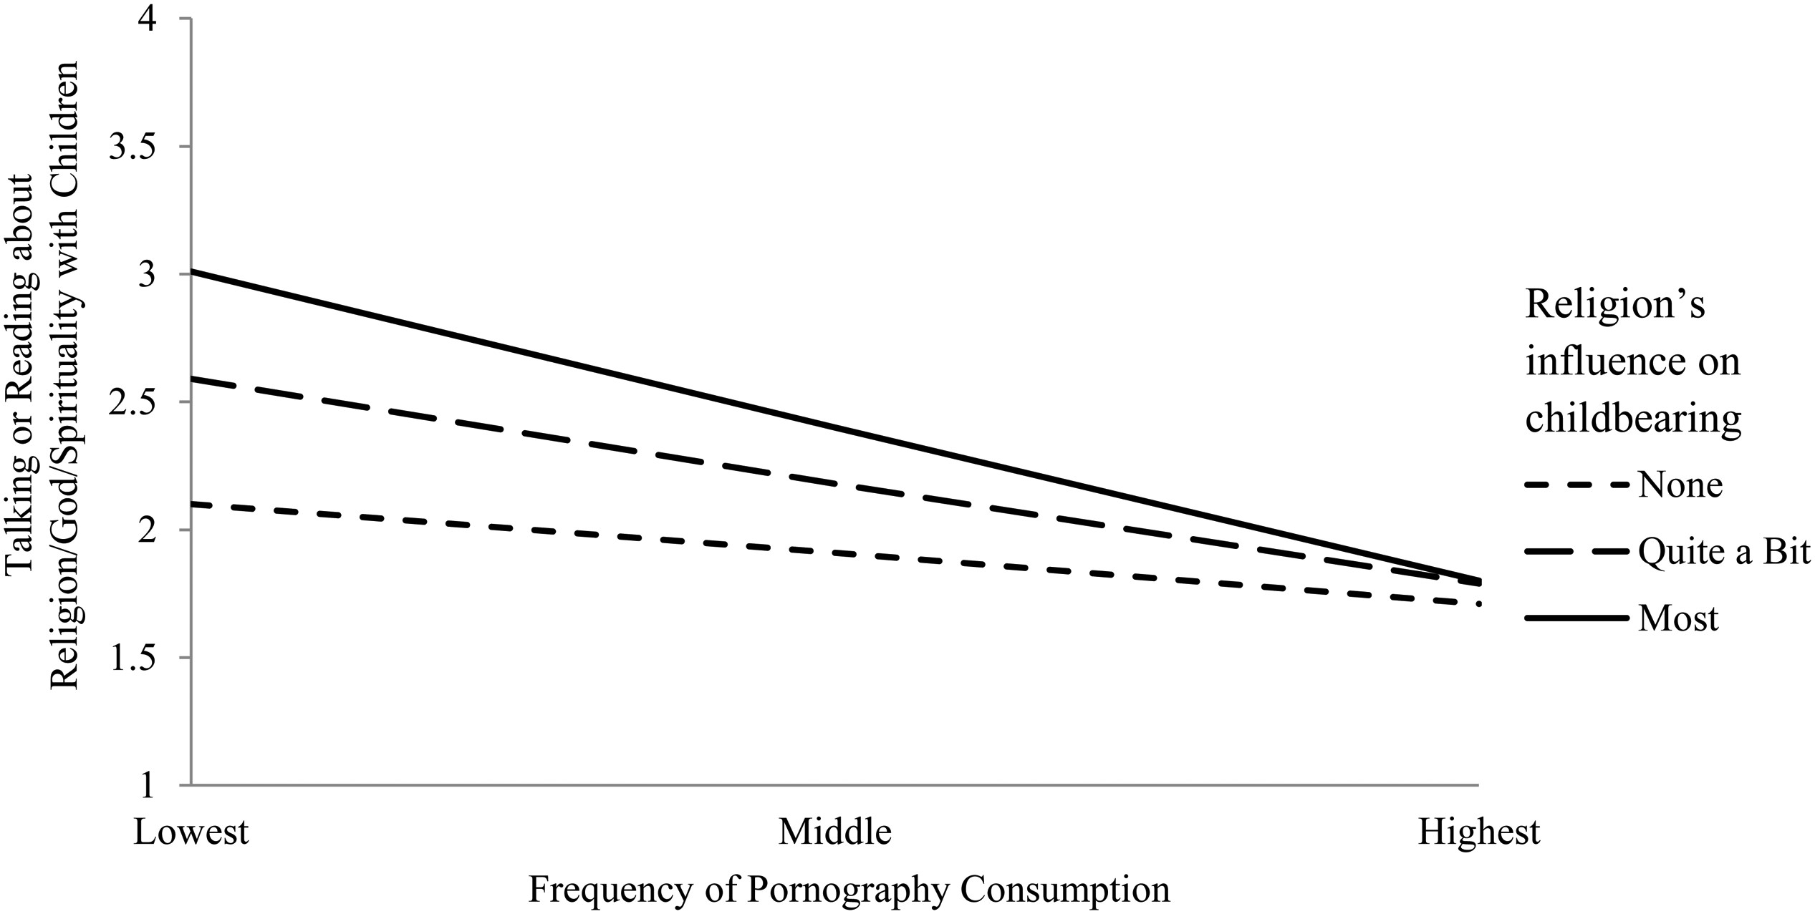
FIGURE 1 Predicted Values of Talking or Reading about Religion/God/Spirituality with Children on Pornography ...
Notes:
FIGURE 1 Predicted Values of Talking or Reading about Religion/God/Spirituality with Children on Pornography Consumption and Religion's Influence on Childbearing (Males Only).
Unless provided in the caption above, the following copyright applies to the content of this slide: © The Author 2015. Published by Oxford University Press on behalf of the Association for the Sociology of Religion. All rights reserved. For permissions, please e-mail: journals.permissions@oup.com

