Slide 1
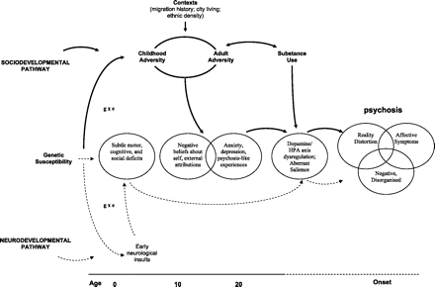
Fig. 1. Hypothesized Sociodevelopmental and Neurodevelopmental Pathways to Psychosis. (Adapted from Murray et al98; ...
Notes:
Fig. 1. Hypothesized Sociodevelopmental and Neurodevelopmental Pathways to Psychosis. (Adapted from Murray et al98; figure 1, p. s130.)
Unless provided in the caption above, the following copyright applies to the content of this slide: © The Author 2010. Published by Oxford University Press on behalf of the Maryland Psychiatric Research Center. All rights reserved. For permissions, please email: journals.permissions@oxfordjournals.org.

