Slide 1
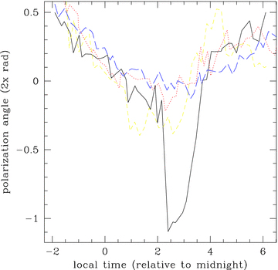
Figure 1 Apparent pulsar polarization angle. The solid, dotted, dashed, long dashed are the mornings of the 18th, ...
Notes:
Figure 1 Apparent pulsar polarization angle. The solid, dotted, dashed, long dashed are the mornings of the 18th, 17th, 9th and 16th, respectively. The vertical axis is twice the polarization position angle, i.e. tan−1(U/Q). The long-term change seen in the data (the dip towards the centre of the plot) is likely due to change in airmass and geomagnetic field angle, while the variation between each point and those immediately following is consistent with pulsar angle variations at the source. The night of the 18th showed a 2 hour period in which the polarization angle departed from the slowly changing behaviour characteristic of the rest of the data set. This is likely an ionospheric anomaly. For this plot, angles are arithmetically averaged over 1 min intervals, then the median angle for each 9 min interval is plotted.
Unless provided in the caption above, the following copyright applies to the content of this slide: © 2009 ASIAA. Journal compilation © 2009 RAS

Slide 2
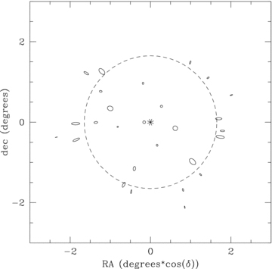
Figure 2 Polarized point-source map at the Faraday depth φ= 0 rad m⁻². The radius (mean of semimajor and ...
Notes:
Figure 2 Polarized point-source map at the Faraday depth φ= 0 rad m−2. The radius (mean of semimajor and semiminor axes) of each ellipse is proportionate to apparent flux. Ellipticity is proportionate to polarization. Map is averaged over 16 MHz. The asterisk in the centre is the pulsar. 5C 7.245 has been omitted for clarity. The ellipticity is plotted eight times larger than the apparent polarization. The global polarization angle was rotated to align the pattern radially. The feed support structures could lead to such a polarization pattern (see the text). The dashed ring is the half power point of the primary beam. Sources outside that radius appear more strongly polarized.
Unless provided in the caption above, the following copyright applies to the content of this slide: © 2009 ASIAA. Journal compilation © 2009 RAS

Slide 3
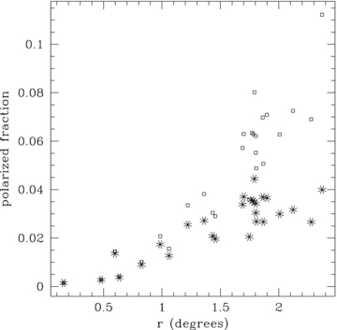
Figure 3 Apparent polarization of sources at the Faraday depth φ= 0 rad m⁻². The small squares are the ...
Notes:
Figure 3 Apparent polarization of sources at the Faraday depth φ= 0 rad m−2. The small squares are the apparent polarizations. The asterisks are multiplied by the primary beam, which is an estimate of their impact to the total polarization in the image. We see that most of the apparent polarized flux contribution is from the periphery of the beam.
Unless provided in the caption above, the following copyright applies to the content of this slide: © 2009 ASIAA. Journal compilation © 2009 RAS

Slide 4
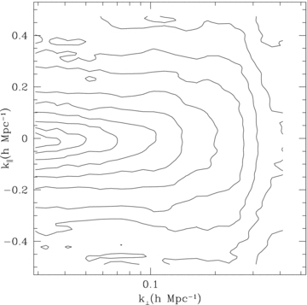
Figure 6 The 3D polarization power spectra based on our observed visibilities. These are estimated from the power of ...
Notes:
Figure 6 The 3D polarization power spectra based on our observed visibilities. These are estimated from the power of maps at fixed rotation measures. The transverse scale has been converted from angular to comoving units at z= 8.5. The parallel scale is converted from φ according to equation (A38). The contours are of Δ2P (see the text), and start at 0.0069 K2 in the left middle near k∼ 0, increasing logarithmically by 10 per contour level. On large scales, k⊥ < 0.3 h Mpc−1 our observations set an upper limit equivalent to a few kelvins per ln k in 3D space.
Unless provided in the caption above, the following copyright applies to the content of this slide: © 2009 ASIAA. Journal compilation © 2009 RAS

Slide 5
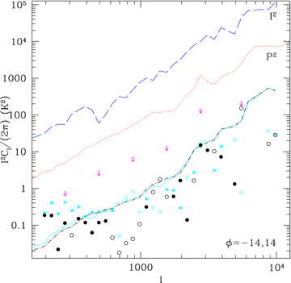
Figure 4 Power spectrum of unpolarized (I², long dash) and total polarized emission (P², dotted) ...
Notes:
Figure 4 Power spectrum of unpolarized (I2, long dash) and total polarized emission (P2, dotted) over the central square degree, after subtracting the 31 brightest sources in the primary beam. This polarized signal includes leakage and thermal noise. The upper bound symbols are a 2σ estimate of polarization bound using baseline cross-correlation. They are averages of the polarization power in 1 MHz bands. The lower solid and dot–dashed lines are the total power polarization measured at φ=−14 and 14 over a width Δφ= 3.5, as determined from the map power. Using the cross-correlation technique described in the text, we plot a less conservative estimate with circles for φ=−14 and squares for φ=+14. Open symbols denote negative power, and filled are positive values. For details on the unit conversions, see the appendix.
Unless provided in the caption above, the following copyright applies to the content of this slide: © 2009 ASIAA. Journal compilation © 2009 RAS

Slide 6
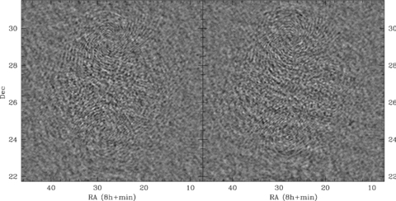
Figure 5 Polarized sky image at φ= 3 rad m⁻². Left-hand panel is the Stokes Q intensity, while right-hand ...
Notes:
Figure 5 Polarized sky image at φ= 3 rad m−2. Left-hand panel is the Stokes Q intensity, while right-hand panel is the Stokes U. All baselines with |w| < 200 are included. The field of view is 78, which is three primary beams. Real polarized sky structure as well as leakage I into Q,U will have higher contrast within the main beam region. Sources that generally have the same contrast inside and outside the main beam area include RFI and the aggregate extended image artefacts of multiple bright sources far outside the main beam. These images do show a weak enhancement of contrast in the main beam region, but the enhancement is too weak to allow confidence in detection of sky structure. For this reason, we interpret the measured power spectra from these images as upper limits to the polarized sky structure. Artefacts from one known bright source 3C 200 are faintly visible as concentric rings centred on the source location. 3C 200 is in the upper centre of the image just outside the main beam.
Unless provided in the caption above, the following copyright applies to the content of this slide: © 2009 ASIAA. Journal compilation © 2009 RAS

