Slide 1
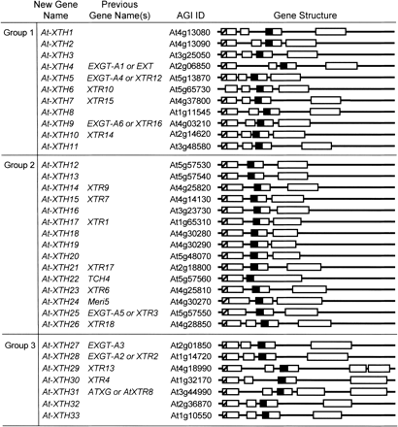
Fig. 1 Systematic nomenclature and gene structure of the ArabidopsisXTH gene family. The family of 33 ...
Notes:
Fig. 1 Systematic nomenclature and gene structure of the ArabidopsisXTH gene family. The family of 33 Arabidopsis XTH genes is shown divided into three major groups (see also Fig. 2). Each gene has the new systematic XTH nomenclature, the previously used common names, the designated identification number assigned by the Arabidopsis Genome Initiative (AGI ID; Arabidopsis Genome Initiative 2000) and a schematic diagram of the corresponding gene structure. Exons are shown as open boxes and introns as lines. The crosshatched boxes indicate a putative signal peptide directing secretion of the polypeptide into the cell wall and the filled boxes represent the DEIDFEFLG motif that is thought to correspond to the XTH catalytic site.
Unless provided in the caption above, the following copyright applies to the content of this slide:

Slide 2
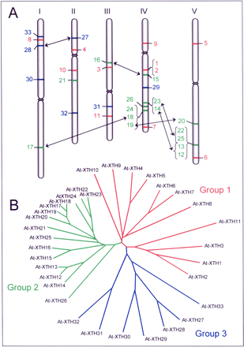
Fig. 2 Genomic structure and phylogenetic relationship between the members of the Arabidopsis XTH gene ...
Notes:
Fig. 2 Genomic structure and phylogenetic relationship between the members of the Arabidopsis XTH gene family. (A) Physical map showing the distribution of the Arabidopsis XTH genes (see also Fig. 1) among the five chromosomes with arrows indicating duplicated genes. (B) Dendrogram generated using CLUSTALW (http://spiral.genes.nig.ac.jp/homology) and TreeViewPPC software, based on the predicted amino acid sequences of all 33 Arabidopsis XTH genes. For both parts A and B of the figure, genes from groups 1, 2 and 3 are shown in red, green and blue, respectively. The physical map and dendrogram are revised from versions published in Yokoyama and Nishitani (2001b).
Unless provided in the caption above, the following copyright applies to the content of this slide:

Slide 3
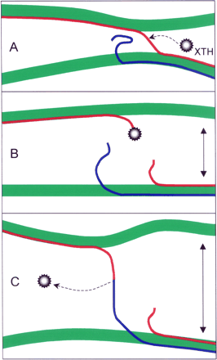
Fig. 3 Polysaccharide-to-polysaccharide (P→P) transglucosylation of xyloglucan in the cell wall showing ...
Notes:
Fig. 3 Polysaccharide-to-polysaccharide (P→P) transglucosylation of xyloglucan in the cell wall showing restructuring-type transglucosylation. (Step 1; panels A to B) XTH cleaves a xyloglucan chain (red line), which is acting as a tether between two neighboring microfibrils. This xyloglucan chain is broken and a xyloglucan–XTH complex is formed. If the cell is turgid, the microfibrils can now move further apart, as indicated by the unbroken arrows. (Step 2; panels B to C) The xyloglucan–XTH complex is now out of reach of the new non-reducing terminus but within reach of the non-reducing terminus of an adjacent xyloglucan chain (blue line). The latter acts as an acceptor substrate and a tether is thereby re-formed between the two microfibrils. The reducing ends of the xyloglucan chains are to the right. Revised from Thompson and Fry (2001).
Unless provided in the caption above, the following copyright applies to the content of this slide:

Slide 4
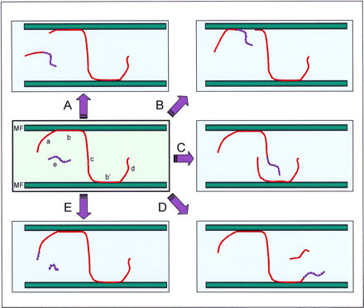
Fig. 4 Polysaccharide-to-polysaccharide (P→P) transglucosylation of xyloglucan in the cell wall showing ...
Notes:
Fig. 4 Polysaccharide-to-polysaccharide (P→P) transglucosylation of xyloglucan in the cell wall showing integrational transglucosylation. There are five possible modes of integrational endotransglucosylation between a newly secreted xyloglucan (blue line) and a previously wall-bound xyloglucan chain (red line). The reducing terminus is the right-hand end of each chain. In the initial state (green shaded left center panel), four different segments of the wall-bound chain are distinguished: (a) a non-reducing loose end, (b, b′) regions anchored to cellulose microfibrils (MF) by hydrogen bonding, (c) a tether between the microfibrils, (d) a reducing loose end. Arrows (A⇒ to D⇒) indicate what happens when XTH cleaves the wall-bound chain at sites a to d, respectively, and the newly secreted chain acts as acceptor. Arrow E⇒ shows what happens if the XTH attacks the newly secreted chain at site e and the previously wall-bound chain acts as acceptor. Revised from Thompson and Fry (2001).
Unless provided in the caption above, the following copyright applies to the content of this slide:

Slide 5
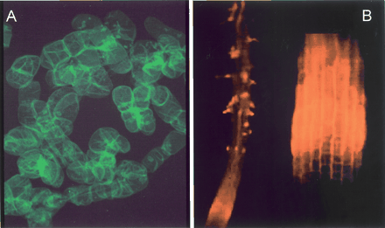
Fig. 5 Distribution of the action of endogenous XTHs exhibiting xyloglucan endotransglucosylase activity with ...
Notes:
Fig. 5 Distribution of the action of endogenous XTHs exhibiting xyloglucan endotransglucosylase activity with endogenous donor substrates. Fluorescently labeled plant tissues, following infiltration of XGO–fluorophore conjugates, which act as acceptor substrates for XTHs, while endogenous xyloglucan acts as the donor substrate. After removal of unreacted XGO–fluorophore conjugates by washing, any remaining fluorescence in the cell wall is due to xyloglucan–fluorophore conjugates formed by transglucosylation. (A) Fluorescent labeling of tobacco BY-2 cells over-expressing an XTH, after incubation with a fluoresceinyl xyloglucan heptasaccharide (see also Ito and Nishitani 1999). The photograph was taken at a magnification of ×400. (B) Arabidopsis roots exhibiting a characteristic distribution pattern of XET action on the donor substrate: high transglucosylase activity is limited to the root cell elongation zone and to the initiating root hairs. Left image: low-power view of an Arabidopsis root, showing xyloglucan endotransglucosylation in the zone of elongation and in young root hairs (K. Vissenberg, J.-P. Verbelen and S.C. Fry, unpublished). Right image: close-up of elongation zone — note that the cell size increases along the length of the fluorescent zone, confirming that it is the zone of elongation (Vissenberg et al. 2000). In both images, the root tip is pointing downwards and the root diameters in the zone of elongation are ∼100 µm.
Unless provided in the caption above, the following copyright applies to the content of this slide:

