Slide 1
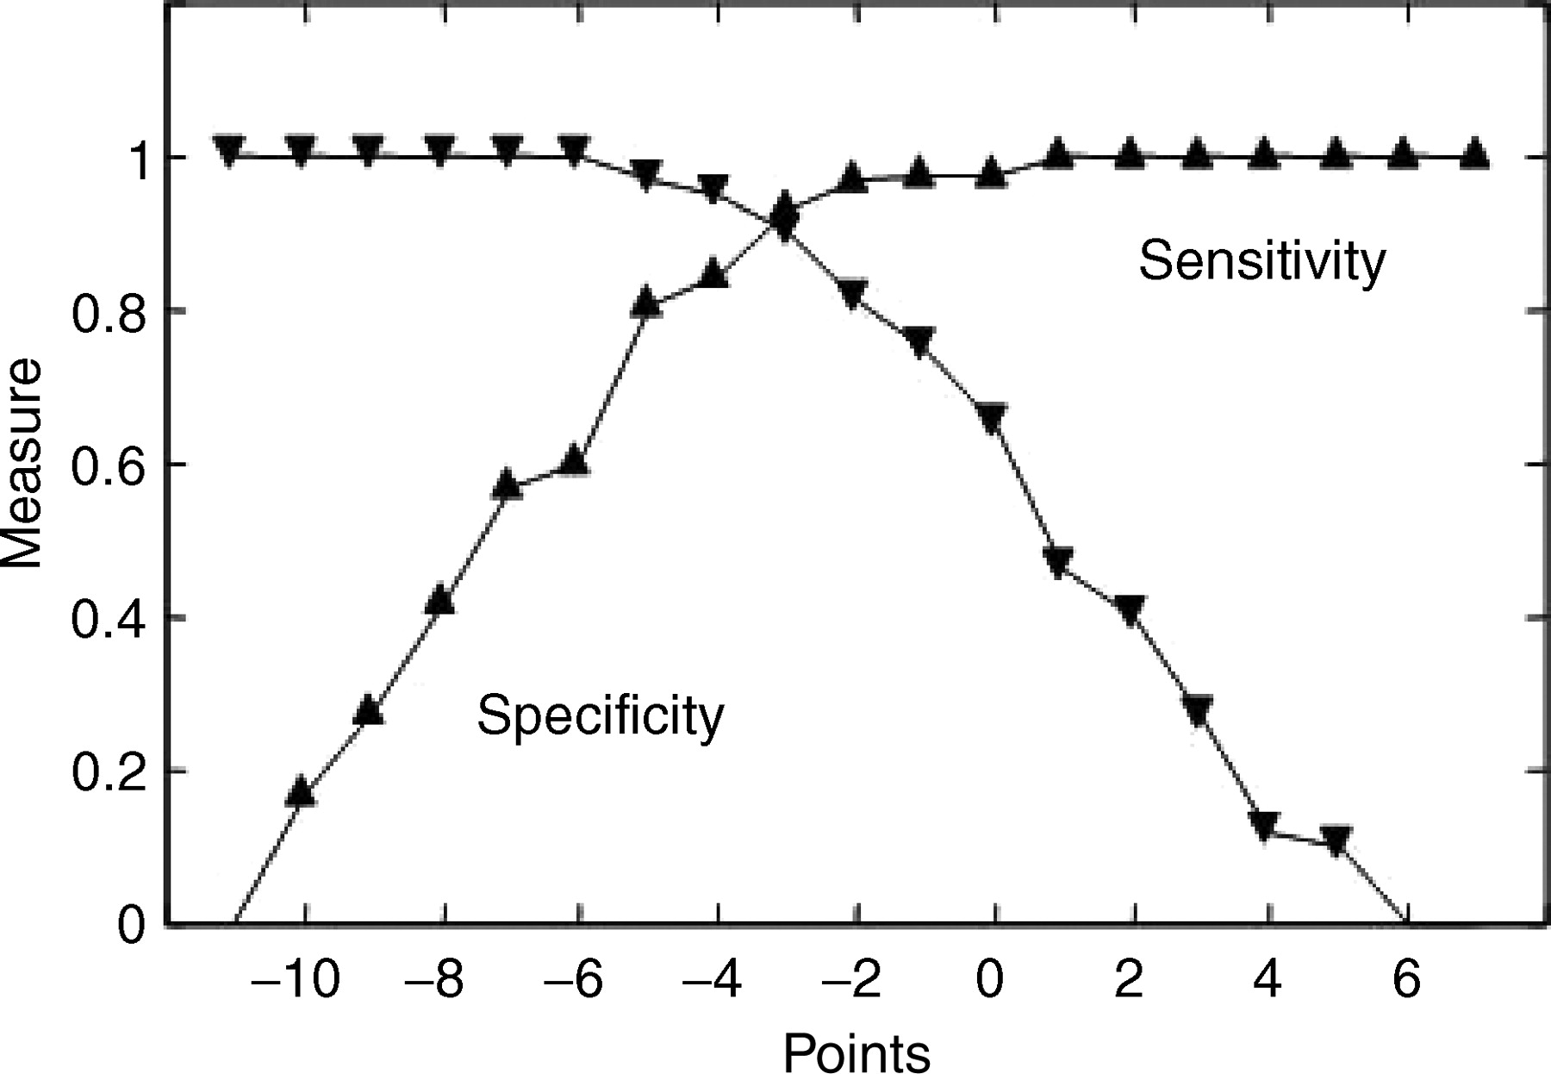
Figure 1 Sensitivity and specificity for the diagnosis of tilt-positive primary syncope compared with ...
Notes:
Figure 1 Sensitivity and specificity for the diagnosis of tilt-positive primary syncope compared with secondary syncope using the point scores reported in Table 2.
Unless provided in the caption above, the following copyright applies to the content of this slide: © The European Society of Cardiology 2005. All rights reserved. For Permissions, please e-mail: journals.permissions@oxfordjournals.org

Slide 2
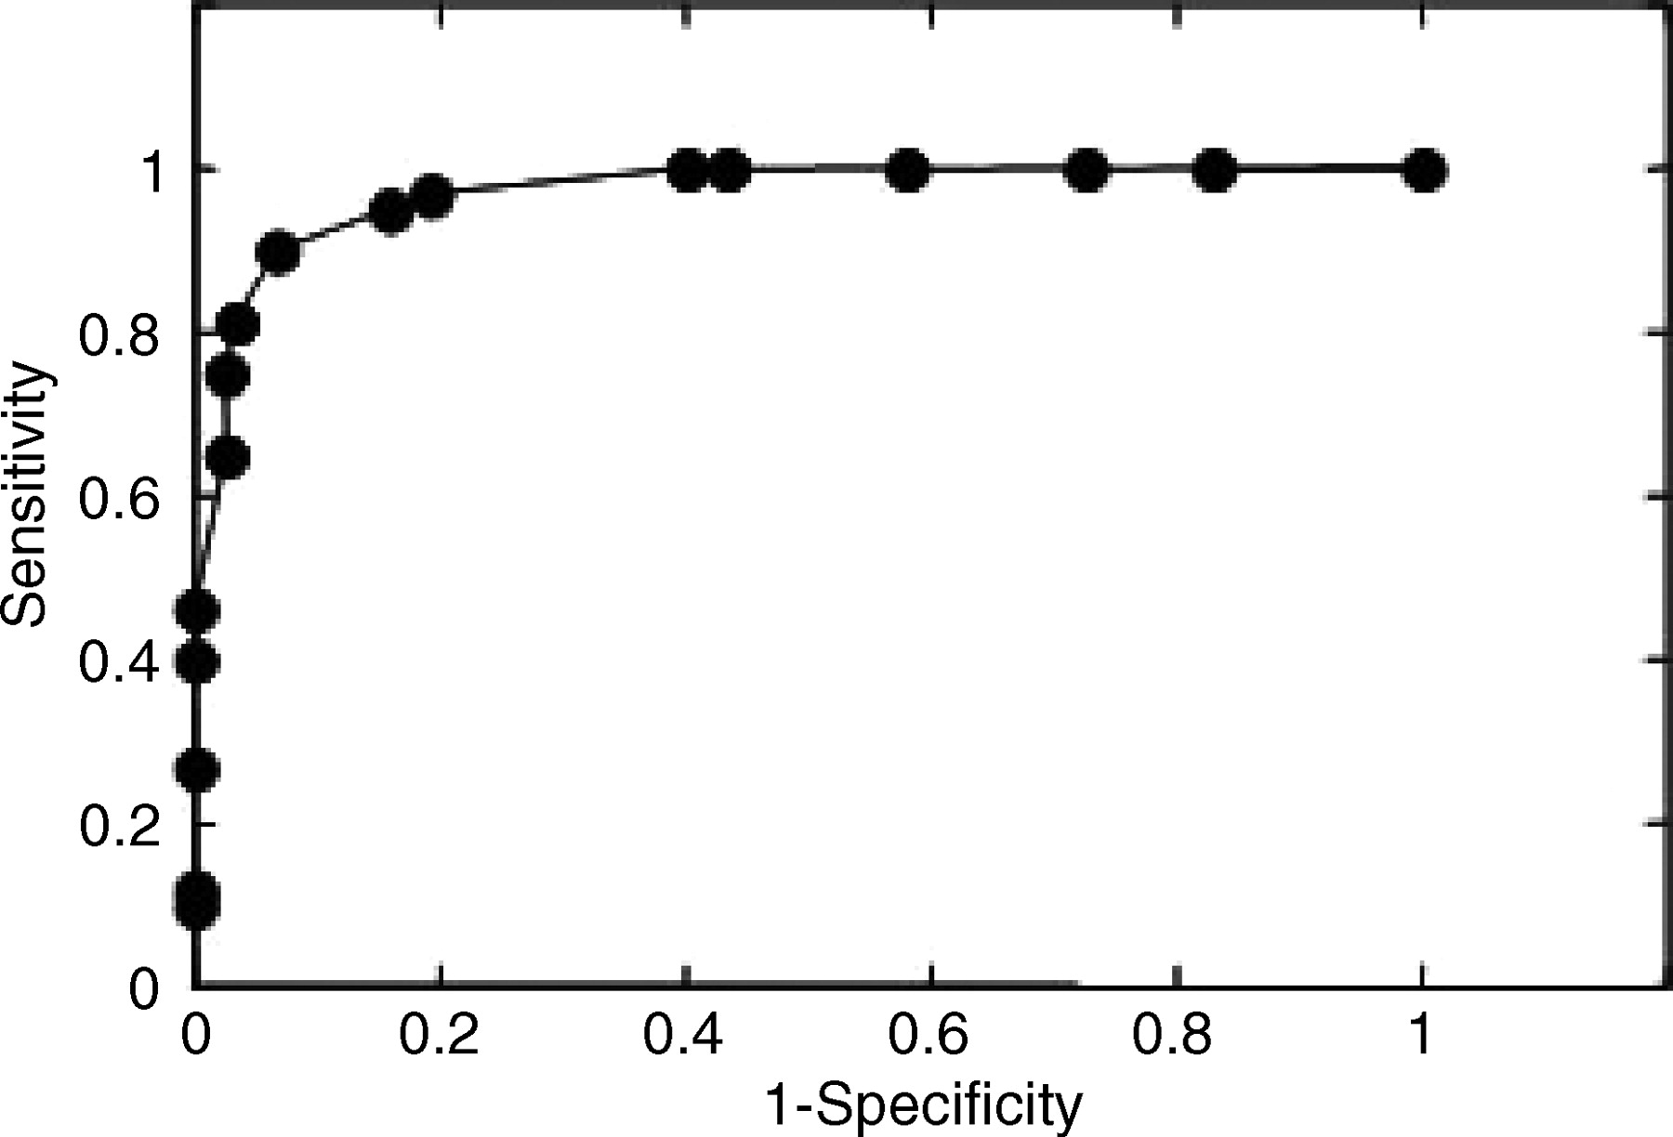
Figure 2 Receiver operator characteristic analysis of the diagnostic score developed in Table 2. The ...
Notes:
Figure 2 Receiver operator characteristic analysis of the diagnostic score developed in Table 2. The populations are those of patients with primary tilt-positive syncope and patients with secondary syncope.
Unless provided in the caption above, the following copyright applies to the content of this slide: © The European Society of Cardiology 2005. All rights reserved. For Permissions, please e-mail: journals.permissions@oxfordjournals.org

Slide 3
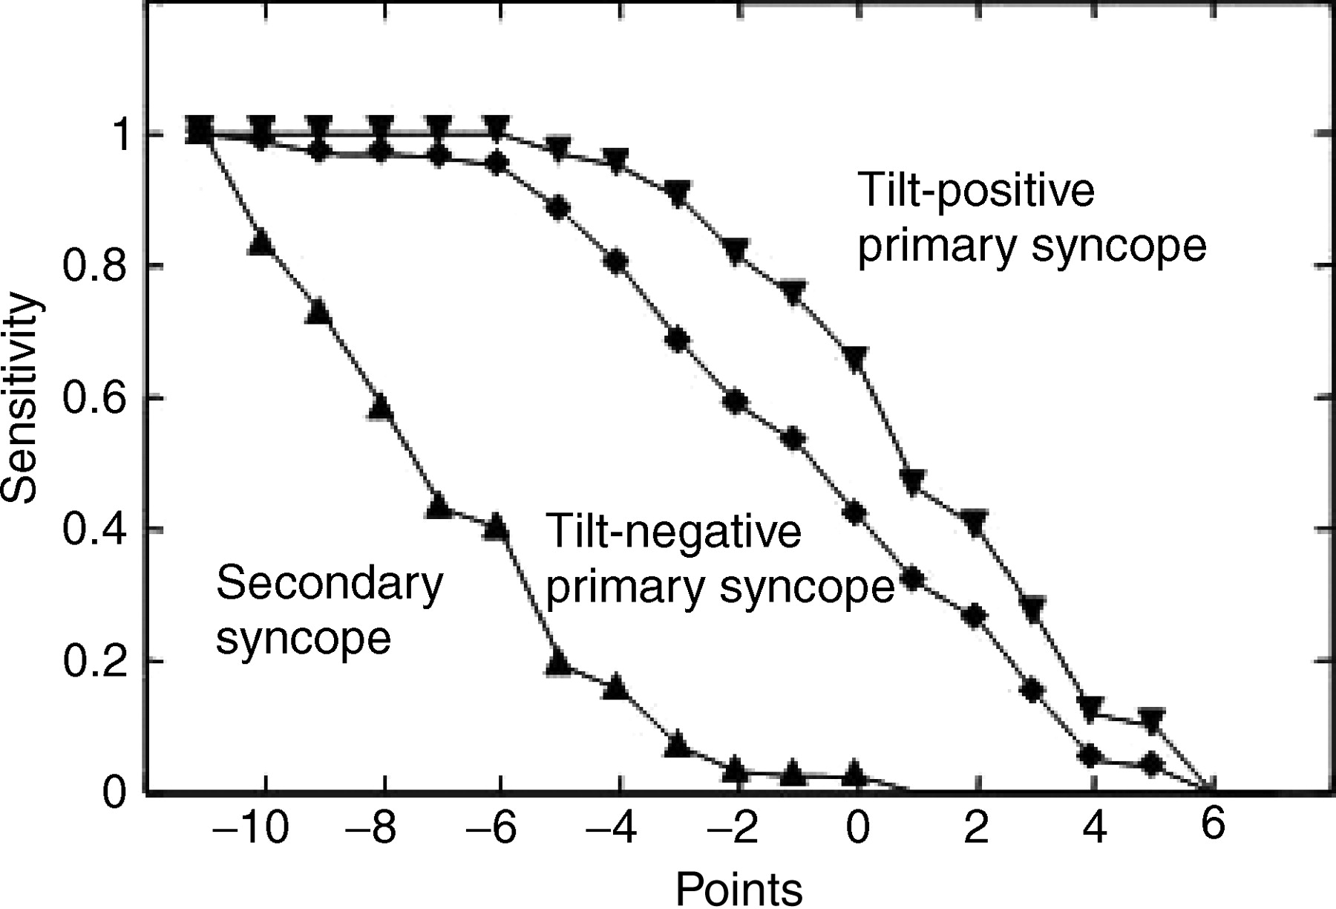
Figure 3 A comparison of point score distributions for populations of tilt-positive and tilt-negative primary ...
Notes:
Figure 3 A comparison of point score distributions for populations of tilt-positive and tilt-negative primary syncope patients.
Unless provided in the caption above, the following copyright applies to the content of this slide: © The European Society of Cardiology 2005. All rights reserved. For Permissions, please e-mail: journals.permissions@oxfordjournals.org

