Slide 1
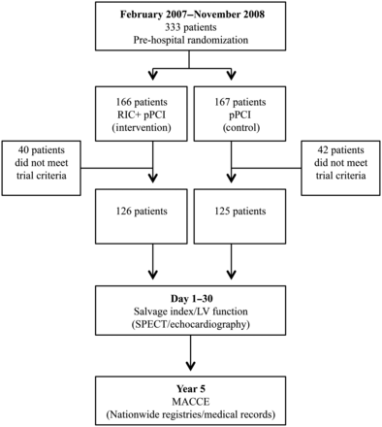
Figure 1 Trial flowchart. RIC, remote ischaemic conditioning; pPCI, primary percutaneous coronary intervention; LV, ...
Notes:
Figure 1 Trial flowchart. RIC, remote ischaemic conditioning; pPCI, primary percutaneous coronary intervention; LV, left ventricular; SPECT, single photon emission computed tomography; MACCE, major adverse cardiac and cerebrovascular events.
Unless provided in the caption above, the following copyright applies to the content of this slide: Published on behalf of the European Society of Cardiology. All rights reserved. © The Author 2013. For permissions please email: journals.permissions@oup.com

Slide 2
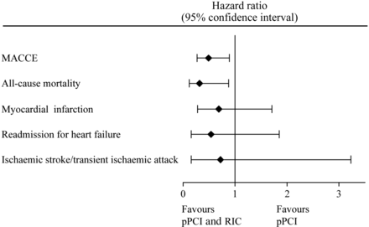
Figure 2 Hazard ratio for the primary composite endpoint (major adverse cardiac and cerebrovascular events) and for ...
Notes:
Figure 2 Hazard ratio for the primary composite endpoint (major adverse cardiac and cerebrovascular events) and for the secondary endpoints (all-cause mortality, myocardial infarction, readmission for heart failure, and ischaemic stroke/transient ischaemic attack) in the follow-up period (per-protocol analysis).
Unless provided in the caption above, the following copyright applies to the content of this slide: Published on behalf of the European Society of Cardiology. All rights reserved. © The Author 2013. For permissions please email: journals.permissions@oup.com

Slide 3
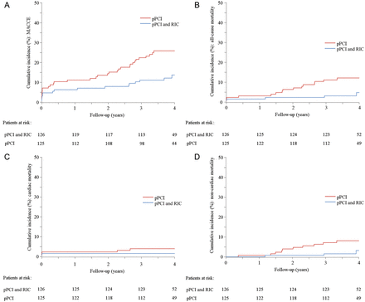
Figure 3 (A) Cumulative incidence (%) of major adverse cardiac and cerebrovascular events (MACCE) by year since ...
Notes:
Figure 3 (A) Cumulative incidence (%) of major adverse cardiac and cerebrovascular events (MACCE) by year since randomization (per-protocol analysis). P = 0.010. (B) Cumulative incidence (%) of all-cause mortality by year since randomization (per-protocol analysis). P = 0.019. (C) Cumulative incidence of cardiac mortality (%) by year since randomization (per-protocol analysis). P = 0.248. (D) Cumulative incidence of non-cardiac mortality (%) by year since randomization (per-protocol analysis). P = 0.045.
Unless provided in the caption above, the following copyright applies to the content of this slide: Published on behalf of the European Society of Cardiology. All rights reserved. © The Author 2013. For permissions please email: journals.permissions@oup.com

