Slide 1
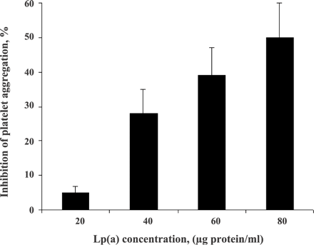
Fig. 2 Effect of Lp(a) on ADP-induced platelet aggregation in PRP. Platelets in PRP were incubated with various ...
Notes:
Fig. 2 Effect of Lp(a) on ADP-induced platelet aggregation in PRP. Platelets in PRP were incubated with various concentrations of Lp(a) in 37 °C for 1 min under stirring and then platelet aggregation was initiated with the addition of 5 μM ADP. Values represent the mean±S.D. from four different platelet and Lp(a) preparations.
Unless provided in the caption above, the following copyright applies to the content of this slide: Copyright © 2004, European Society of Cardiology

Slide 2
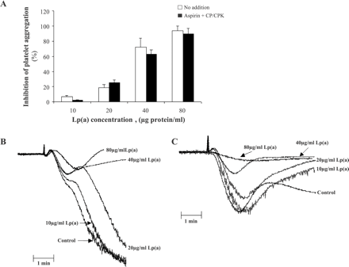
Fig. 1 Effect of Lp(a) on PAF-induced platelet aggregation in PRP. (A) Bar-graph showing the % inhibition of ...
Notes:
Fig. 1 Effect of Lp(a) on PAF-induced platelet aggregation in PRP. (A) Bar-graph showing the % inhibition of platelet aggregation in the absence (open bars) or in the presence of aspirin and CP/CPK (closed bars). Values represent the mean±S.D., from four different platelet and Lp(a) preparations. (B) Representative aggregation curves illustrating the dose-dependent inhibitory effect of Lp(a) on platelet aggregation induced by 25 nM PAF. (C) Representative aggregation curves illustrating the dose-dependent inhibitory effect of Lp(a) on platelet aggregation induced by 25 nM PAF, in the presence of aspirin and CP/CPK.
Unless provided in the caption above, the following copyright applies to the content of this slide: Copyright © 2004, European Society of Cardiology

Slide 3
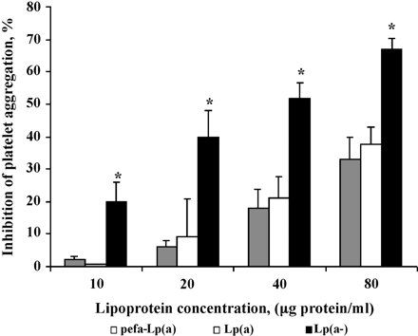
Fig. 3 Role of endogenous PAF-AH and apo(a) on Lp(a)-mediated inhibition of PAF-induced platelet aggregation. Washed ...
Notes:
Fig. 3 Role of endogenous PAF-AH and apo(a) on Lp(a)-mediated inhibition of PAF-induced platelet aggregation. Washed platelets (2.5×108/ml) were incubated with Lp(a) (expressing PAF-AH activity of 13±5 nmol/mg protein/min) (open bars) or pefa-Lp(a) (inactive PAF-AH) (gray bars) or Lp(a-) (closed bars) at 37 °C for 1 min under stirring. Fibrinogen, 0.5 mg/ml was added 30 s prior to aggregation with 10 nM PAF. Values represent the mean±S.D. from three different experiments. *p<0.03 compared to either Lp(a) or pefa-Lp(a).
Unless provided in the caption above, the following copyright applies to the content of this slide: Copyright © 2004, European Society of Cardiology

Slide 4
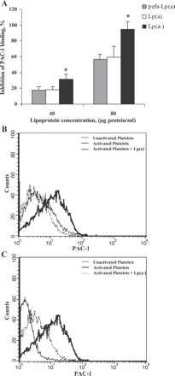
Fig. 4 Role of endogenous PAF-AH and apo(a) on Lp(a)-mediated inhibition of PAF-induced activation of ...
Notes:
Fig. 4 Role of endogenous PAF-AH and apo(a) on Lp(a)-mediated inhibition of PAF-induced activation of αIIbβ3. (A) Bar-graph showing the %inhibition of PAC-1 binding in the presence of Lp(a) (expressing PAF-AH activity of 13±5 nmol/mg protein/min) (open bars) or pefa-Lp(a) (inactive PAF-AH) (gray bars) or Lp(a-) (closed bars). Values represent the mean±S.D. from three different experiments. *p<0.04 compared to either Lp(a) or pefa-Lp(a). (B, C) Representative histograms, obtained by FACS analysis, illustrating the effect of 80 μg protein/ml of either Lp(a) (B) or Lp(a-) (C) on PAC-1 binding on activated platelets.
Unless provided in the caption above, the following copyright applies to the content of this slide: Copyright © 2004, European Society of Cardiology

Slide 5
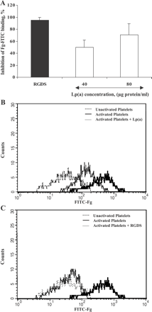
Fig. 5 Lp(a) mediated inhibition of PAF-induced FITC-Fg binding. (A) Bar-graph showing the %inhibition of FITC-Fg ...
Notes:
Fig. 5 Lp(a) mediated inhibition of PAF-induced FITC-Fg binding. (A) Bar-graph showing the %inhibition of FITC-Fg binding in the presence of Lp(a) (open bars or 1 mM RGDS (black bars)). Values represent the mean±S.D. from three different experiments. (B, C) Representative histograms, obtained by FACS analysis, illustrating the effect of Lp(a) (40 μg protein/ml) (B), or RGDS (C) on FITC-Fg binding to platelets activated with 80 nM PAF.
Unless provided in the caption above, the following copyright applies to the content of this slide: Copyright © 2004, European Society of Cardiology

