Slide 1
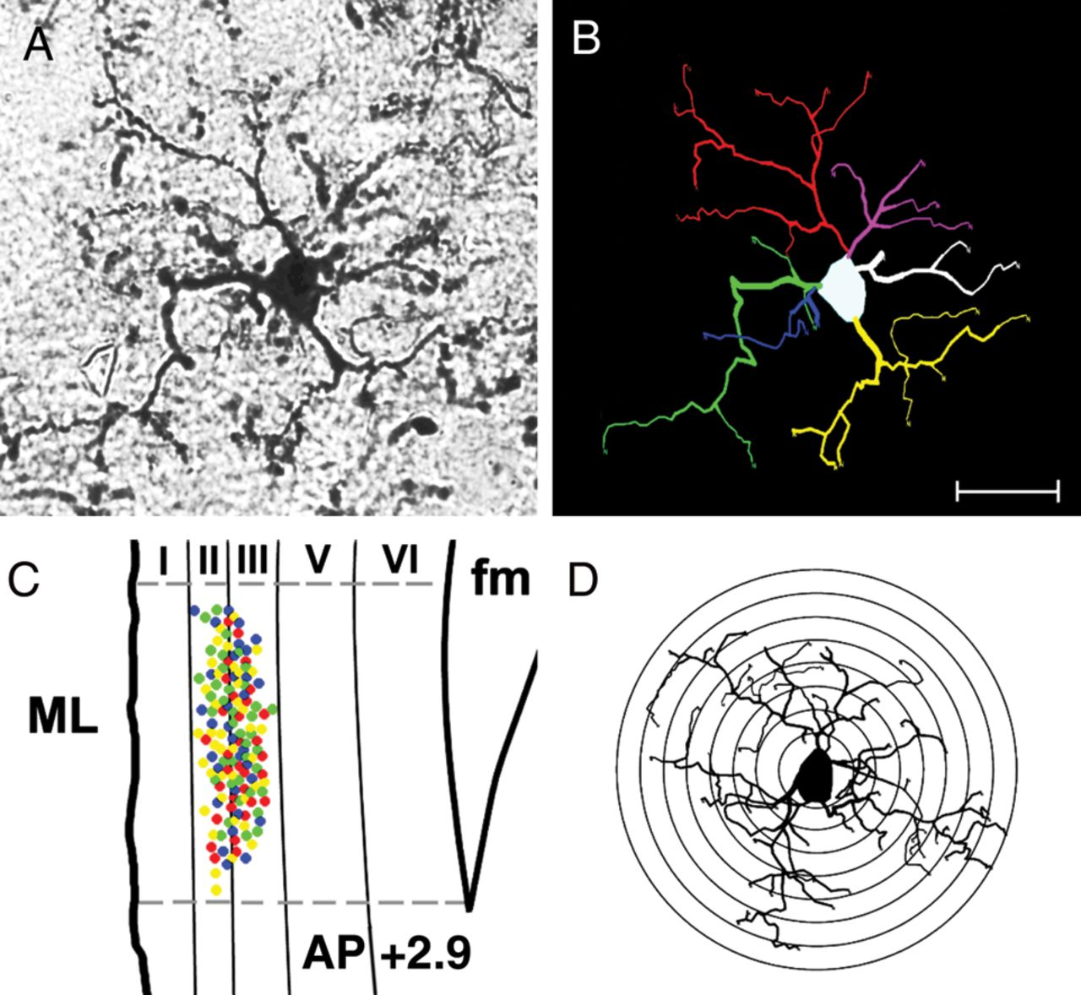
Figure 1. (A) Photomicrograph taken at ×100 and (B) the corresponding 2D trace. At high magnification, much of the 3D ...
Notes:
Figure 1. (A) Photomicrograph taken at ×100 and (B) the corresponding 2D trace. At high magnification, much of the 3D structure of the cell is lost from the plane of focus. The Neurolucida tracings demonstrate the entire appearance of individual cells in a 2D image. (C) Anatomical localization of microglial cells used for analysis in the infralimbic mPFC. The location for each cell is represented by a colored point, CON, green, STR, yellow, CON + M, blue, and STR + M, red. (D) Image depicting concentric circles imposed upon cells at 5 μm intervals for the Sholl analysis. ML, midline. Scale bar = 20 μm.
Unless provided in the caption above, the following copyright applies to the content of this slide: © The Author 2012. Published by Oxford University Press. All rights reserved. For Permissions, please e-mail: journals.permissions@oup.com

Slide 2
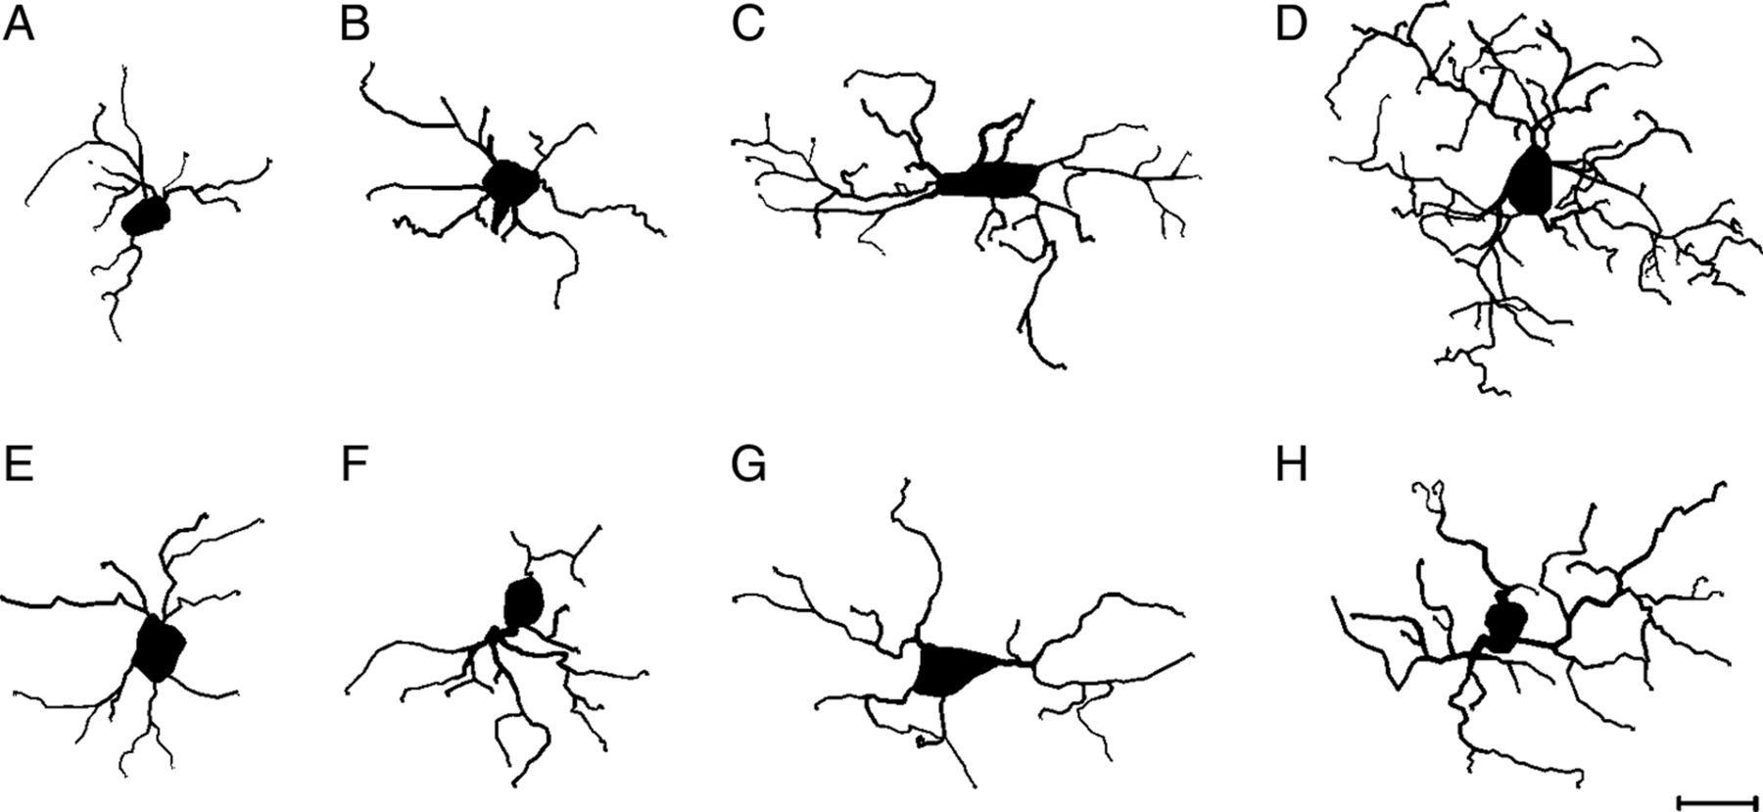
Figure 2. Representative Neurolucida tracings rendered from (A) small CON cell; (B) small STR cell; (C) large CON cell; ...
Notes:
Figure 2. Representative Neurolucida tracings rendered from (A) small CON cell; (B) small STR cell; (C) large CON cell; (D) large STR cell; (E) small CON + M cell; (F) small STR + M cell; (G) large CON + M cell; and (H) large STR + M cell. Note the hyper-ramified appearance of the large STR cell (D). Scale bar = 20 μm.
Unless provided in the caption above, the following copyright applies to the content of this slide: © The Author 2012. Published by Oxford University Press. All rights reserved. For Permissions, please e-mail: journals.permissions@oup.com

Slide 3
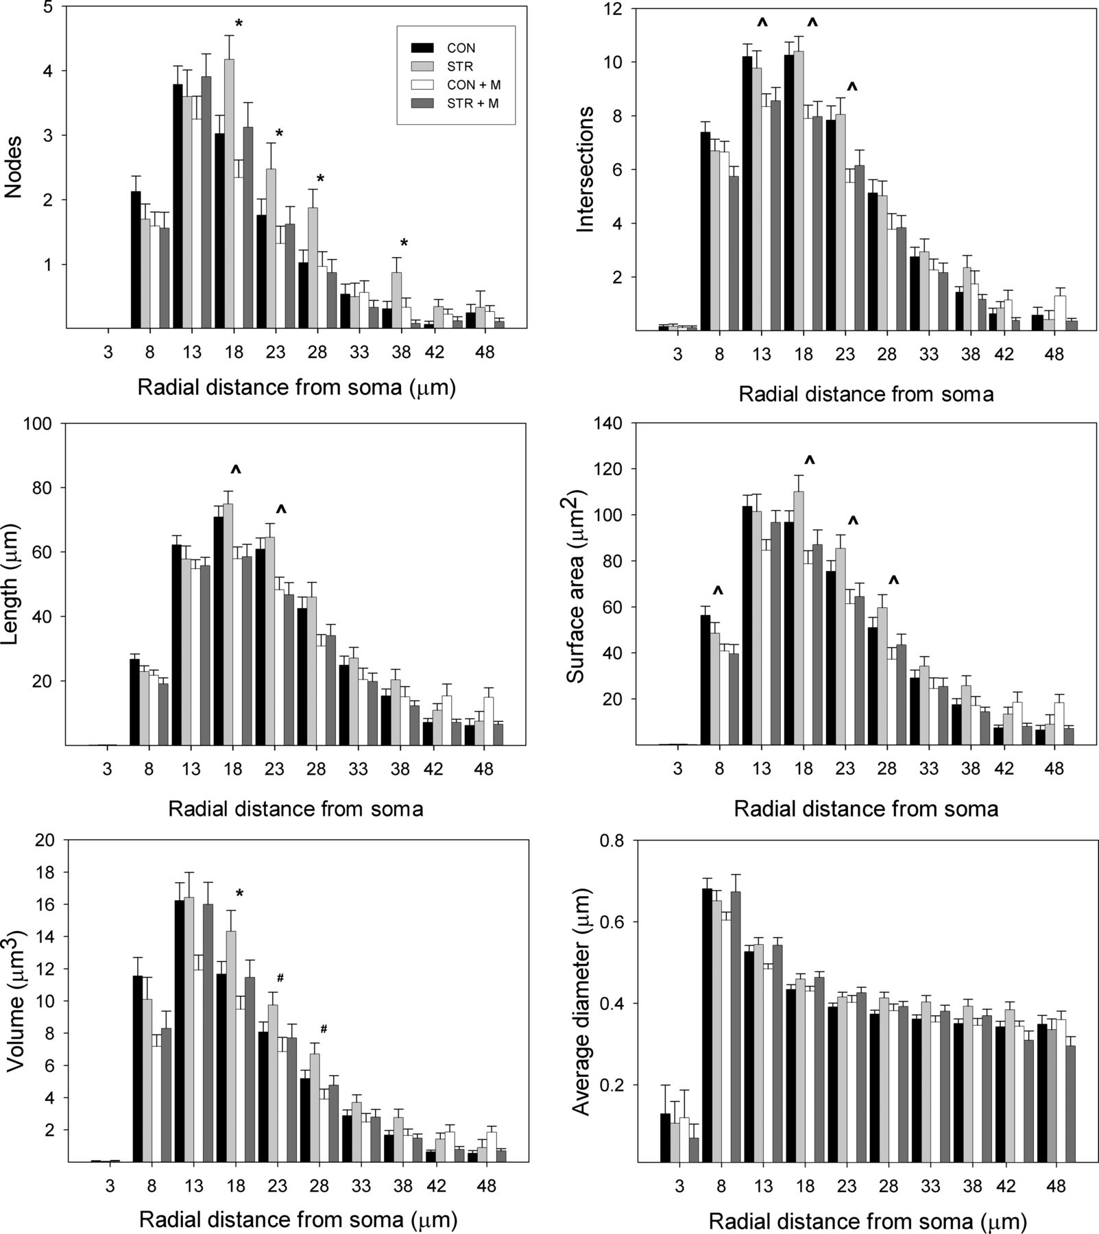
Figure 3. Bar graphs depicting results from the Sholl analysis of total sample as a function of radius. Animals exposed ...
Notes:
Figure 3. Bar graphs depicting results from the Sholl analysis of total sample as a function of radius. Animals exposed to chronic stress exhibit a greater number of branch points than all other experimental groups at 18, 23, and 28 μm from the soma. Error bars represent SEM. *STR > all other groups (CON, CON + M, and STR + M). ^STR and CON > STR + M and CON + M. #STR > STR + M and CON + M (P < 0.05).
Unless provided in the caption above, the following copyright applies to the content of this slide: © The Author 2012. Published by Oxford University Press. All rights reserved. For Permissions, please e-mail: journals.permissions@oup.com

Slide 4
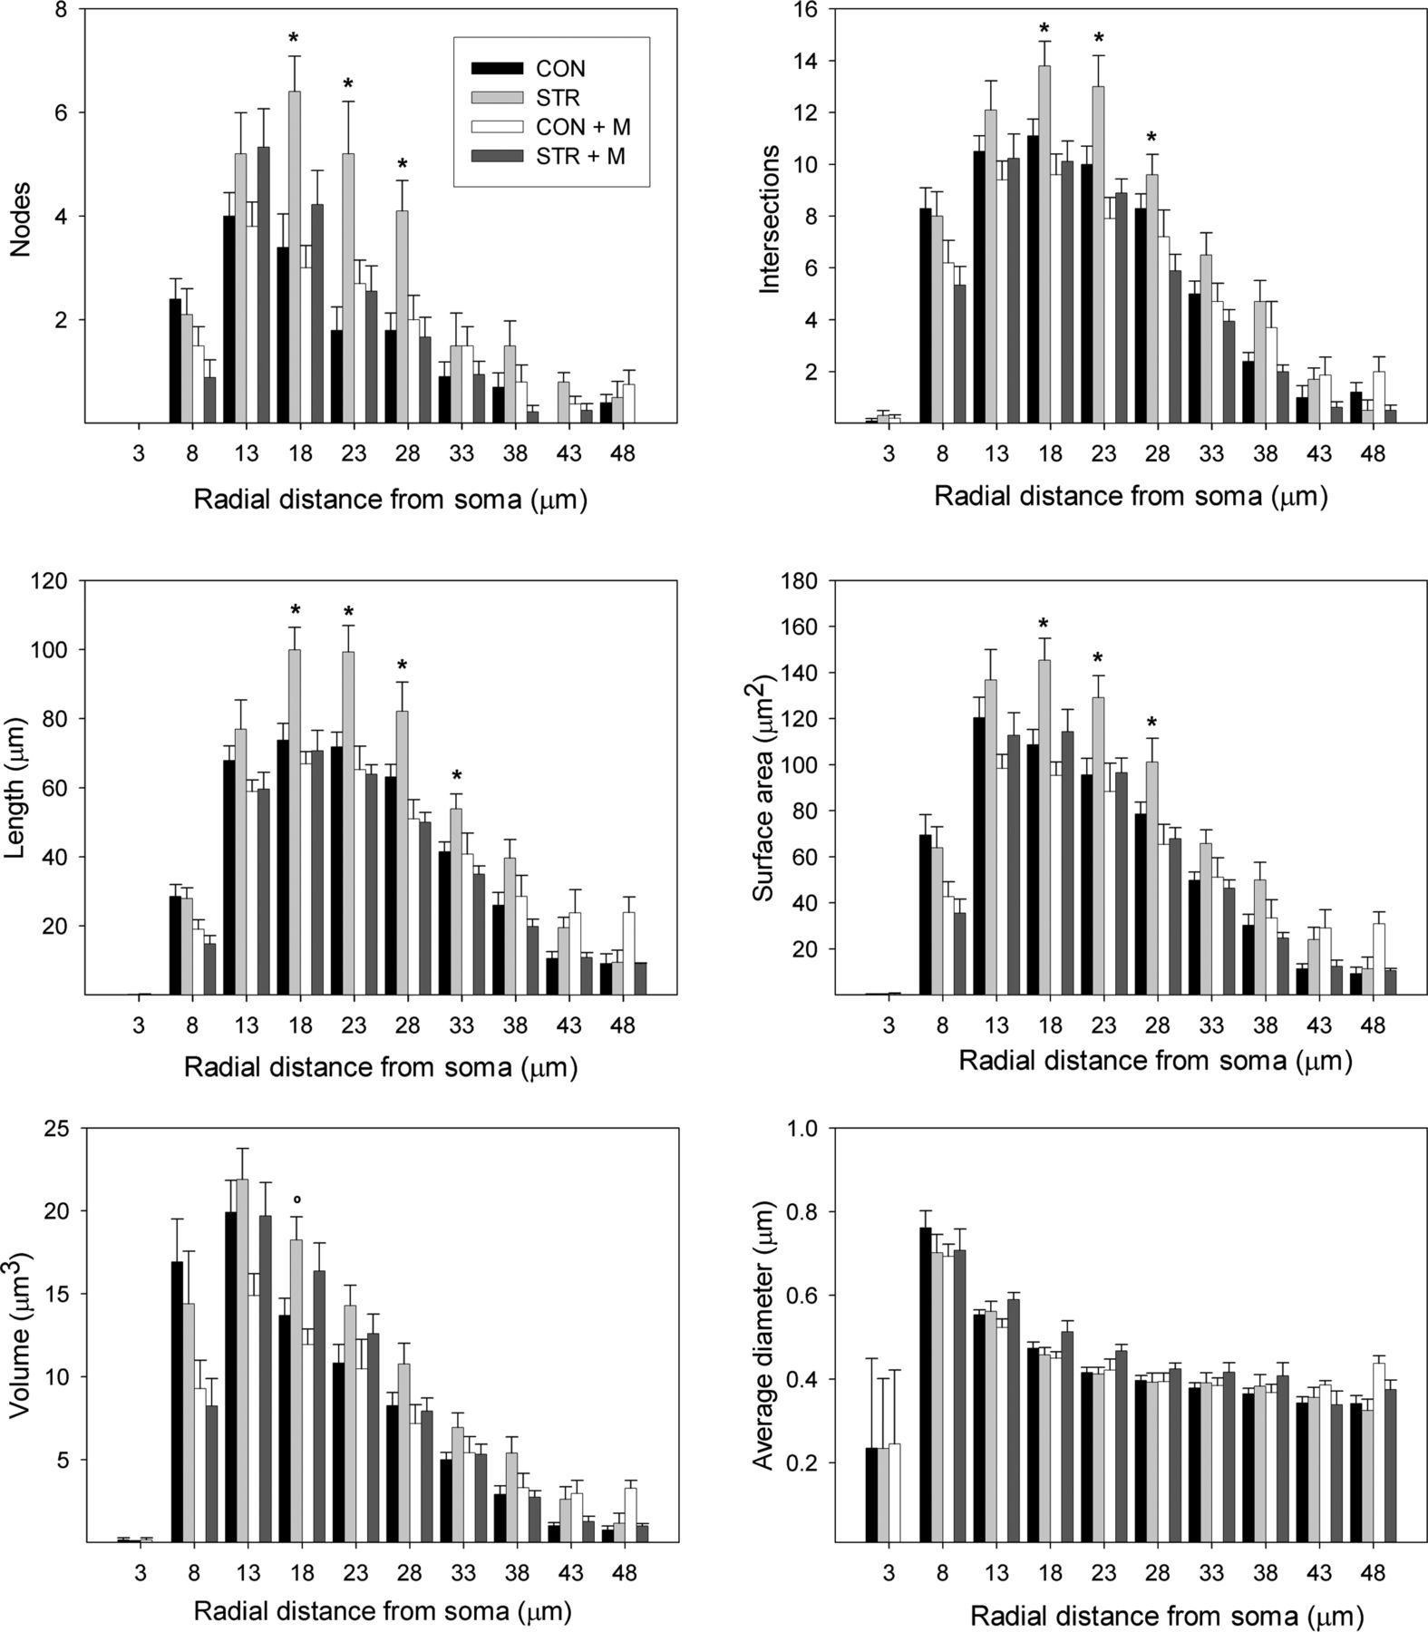
Figure 4. Bar graphs depicting results from the Sholl analysis of large cells (top 75th percentile of sample) as a ...
Notes:
Figure 4. Bar graphs depicting results from the Sholl analysis of large cells (top 75th percentile of sample) as a function of radius. Animals exposed to chronic stress exhibited greater numbers than other experimental groups of branch points, intersections, and process length, all indicators of secondary branching. Error bars represent SEM. *STR > CON, CON + M, STR + M. ○STR > CON and CON + M (P < 0.05).
Unless provided in the caption above, the following copyright applies to the content of this slide: © The Author 2012. Published by Oxford University Press. All rights reserved. For Permissions, please e-mail: journals.permissions@oup.com

Slide 5
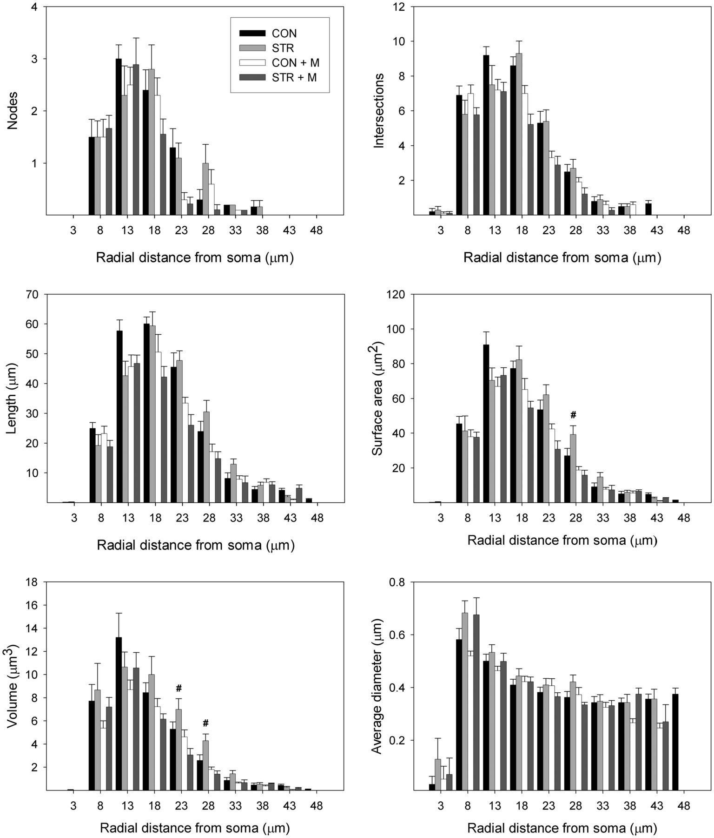
Figure 5. Bar graphs depicting results from the Sholl analysis of small cells (lower 25th percentile of sample) as a ...
Notes:
Figure 5. Bar graphs depicting results from the Sholl analysis of small cells (lower 25th percentile of sample) as a function of radius. There was no effect of stress on any measure in this group of cells. Error bars represent SEM. #STR > CON + M and STR + M (P < 0.05).
Unless provided in the caption above, the following copyright applies to the content of this slide: © The Author 2012. Published by Oxford University Press. All rights reserved. For Permissions, please e-mail: journals.permissions@oup.com

Slide 6
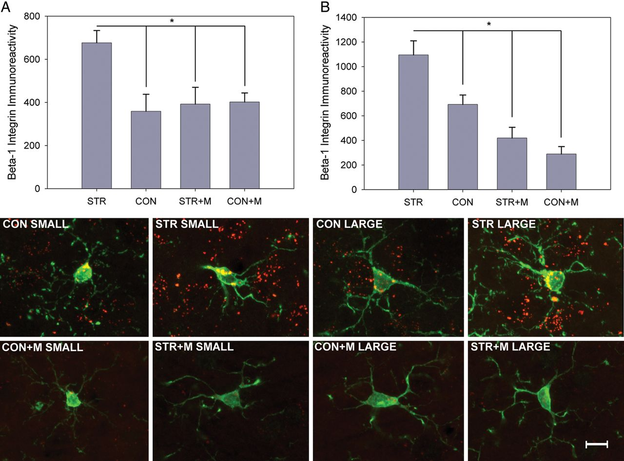
Figure 6. Stress increases levels of β1-integrin immunoreactivity specific to microglia. (A). Levels of β1-integrin ...
Notes:
Figure 6. Stress increases levels of β1-integrin immunoreactivity specific to microglia. (A). Levels of β1-integrin immunoreactivity in small microglia. (B). Levels of β1-integrin immunoreactivity in large microglia. In both groups of cells, stress significantly increases levels of β1-integrin relative to control, and minocycline reverses this effect. The effect of minocycline is more significant in large cells. The panel of images below depicts representative photomicrographs of double-labeled cells (Iba-1, green; and β1-integrin, red) from small and large cells of each experimental group. *P < 0.05. Scale bar = 10 µm.
Unless provided in the caption above, the following copyright applies to the content of this slide: © The Author 2012. Published by Oxford University Press. All rights reserved. For Permissions, please e-mail: journals.permissions@oup.com

